Slide 1
CareMap: AI-Driven Healthcare Equity in Kitchener–Waterloo–Cambridge
Group 1

Slide 2
Introduction
Strategy
Leverage AI insights, geospatial mapping & chat interfaces to uncover and close healthcare gaps in KWC
Purpose
Empower residents and planners with real-time tools to locate services and highlight underserved areas

Slide 3
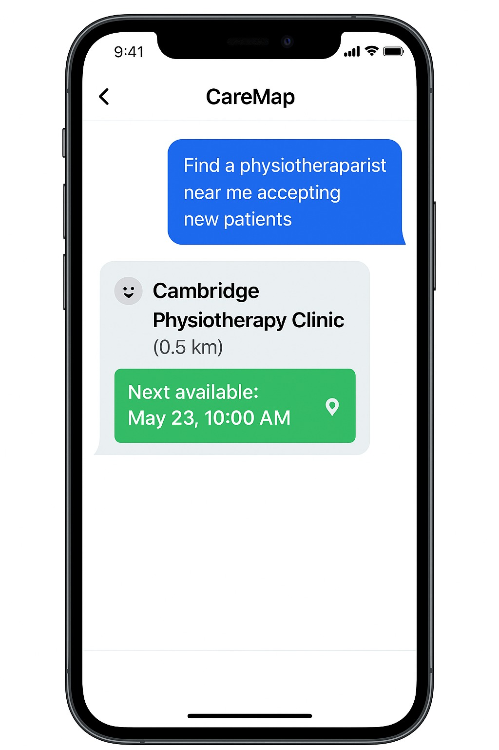
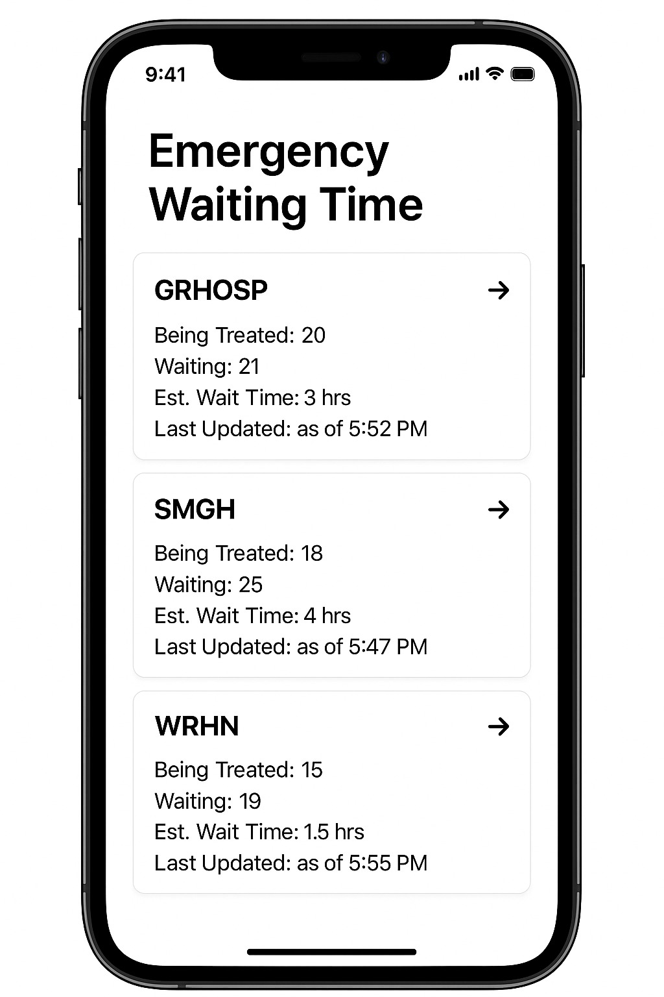
Concepts
Vision
A connected healthcare ecosystem where every KWC resident can access timely, appropriate care
Mission
Build a map-based dashboard + RAG-powered chatbot for service discovery, disparity analysis, and data-driven policy support

Slide 4
Key Use Cases
01
02
Public Access Chatbot
Find a physiotherapist near me accepting new patients(instant, accurate guidance)
Underserved-Area Identification
Classification model flags neighbourhood “service deserts” for targeted outreach
Demand Forecasting for Clinics
03
Time-series forecasts help clinics in student-dense zones staff up for
seasonal surges

Slide 5
Datasource/Dataset:
Source / Category | Data | Purpose
ED Wait Times | WRHN, SMGH, GRHOSP | Real-time “Being Treated”, “Waiting”, ETA
Provider Directory | Securian Canada | Dentists, physiotherapists, allied-health listings
Lab Services | LifeLabs | Lab locations & turnaround/wait times
Geo & Walk-in Clinics | web-scraped clinic data | Geocoding, routing, directions & walk-in clinic locations
Population & Capacity | StatsCan, CIHI, Ontario Open Data | Demographics, facility capacity, spatial mapping

Slide 6
Technologies and resources
Phase | Technology
Retrieval | FAISS / Chroma DB / postgresDB
Embeddings | OpenAI Embeddings API / Hugging Face SentenceTransformers
Orchestration | LangChain
Generation | LLaMA 3.2 (3 B or 7 B parameters)
UI & Deployment | Streamlit dashboard & chat, Docker, AWS (EKS/EC2)

Slide 7
Literature review and references
Identifying Underserved Areas
Pong, R. W., et al. (2006). "Rural health research in Canada: Capacity and prospects." Canadian Journal of Rural Medicine.
CIHI. (2023). Physician Resource Report – Demonstrates the spatial inequity in access to primary care.
Demand Forecasting
Rojas, E., et al. (2019). "Healthcare demand prediction using time series methods." Journal of Biomedical Informatics.
Taylor, S. J., & Letham, B. (2018). "Forecasting at scale." PeerJ Preprints – Describes the Prophet model used in public service forecasting.
AI Chatbot for Navigation
Pereira, J., & Díaz, Ó. (2019). "A survey on chatbots for healthcare." Journal of Medical Systems.
LangChain Documentation (2024). FAISS-based retrieval for accurate healthcare query responses.

Slide 8
Thank You

