Slide 1
Identifying Personal Attacks in Wikipedia Comments
Danielle Mallare-Dani
December 9th, 2021

Slide 2
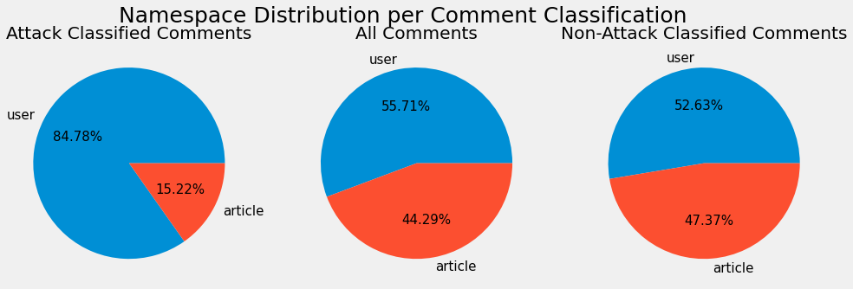
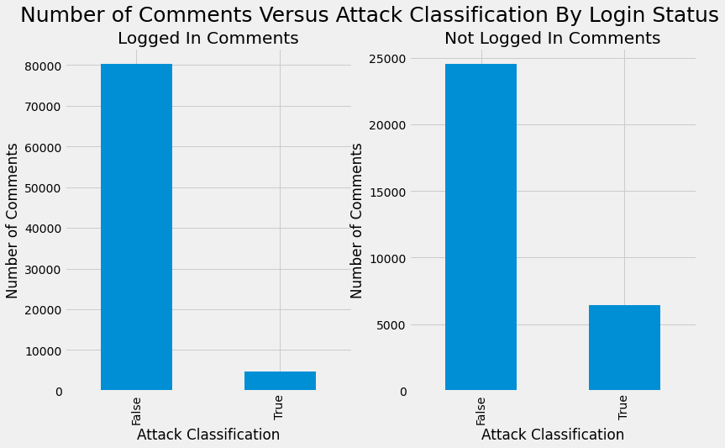
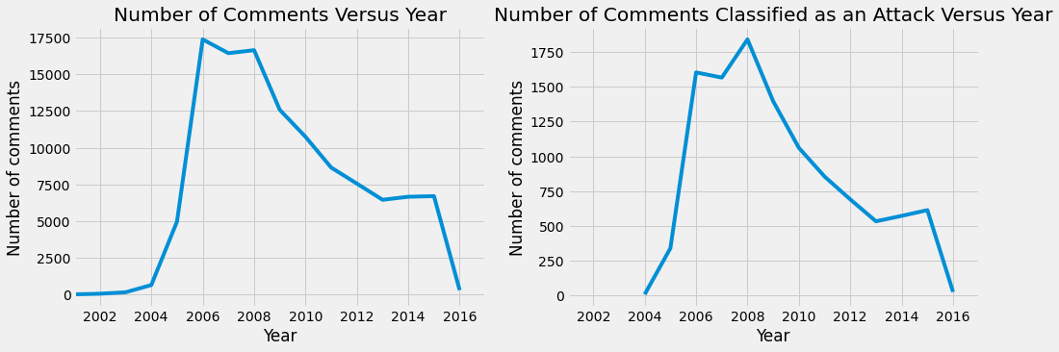
Data Visualization
To get a feel for the data and to understand how the features in the dataset impacted a comment’s classification, I did an in-depth exploration of each feature in the dataset.
The pie charts show that most comments that get classified as an attack are on a user.
The bar charts illustrate the differences in comment distributions among users who are logged in or not.
The year charts show that the distribution of all comments and attack labeled comments are very similar.

Slide 3
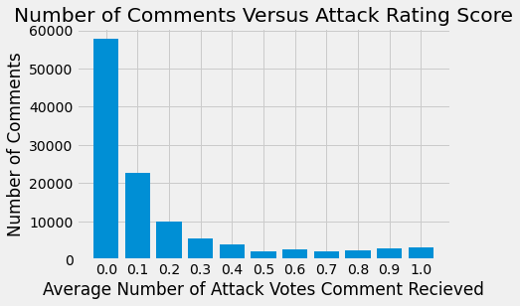
Comment Cleaning & Feature Extraction
The attack information from different annotators was examined (see the bar chart).
The final decision was to label a comment as an attack if the comment had an average number of ratings greater than 0.6. That is, at least 7 of the 10 annotators rated it as a personal attack.
To determine how to clean the comment text, I did an initial simple clean of the text, generated a bag-of-words representation, and analyzed the representation. This led to a final clean that included:
Removal of all numbers
Removal of all punctuation
Removal of some of the HTML style elements. For example, “cellpadding”
The following features were considered for use:
Login status, was used to train the models
Namespace, was used to train the models
Various combinations of character and word n-gram tf-idf vectorizers were experimented with
Year was also considered, but not utilized to train the models

Slide 4
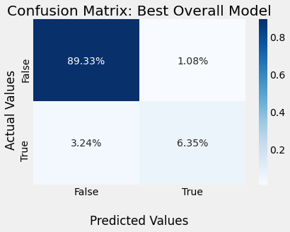
Modeling the Data
Evaluating model performance:
Average macro precision, recall, and f1-score
Precision: Proportion of comments classified as attacks that were correct
Recall: Proportion of offensive comments that were identified correctly
Confusion matrix converted to percentages and displayed as a heat map
Understand how well the model does with labeling both types of comments
K-Fold cross-validation was used with k = 4.
Generally led to an approximately one percent increase in recall
Generally led to a half percent increase in precision
Best results obtained from each model (without hyperparameter tuning)
Model | Precision | Recall | F1-Score
Linear SVC | 0.9130 | 0.8293 | 0.8650
Logistic Regression | 0.9157 | 0.7937 | 0.8414
Random Forest | 0.9223 | 0.6465 | 0.7015

Slide 5
Hyperparameter Tuning
The following hyperparameter tuning was conducted for each model. The best parameters are highlighted in bold.
Tuning yielded between a 0.5-0.75% increase in average macro f1-score.
I also examined the following parameters associated with the word n-gram tf-idf vectorizer:
max_df
max_features
Usage of stop words
Model | Parameter 1 | Parameter 2 | Parameter 3
Linear SVC | C [0.1, 1, 10,100] | Class Weight [‘balanced’, None] | N/A
Logistic Regression | C [0.1, 1, 10, 100] | Class Weight [‘balanced’, None] | N/A
Random Forest | Number of Estimators [10, 50, 100] | Max Depth [2, 5, 10, None] | Criterion [‘entropy’, ‘gini’]

Slide 6
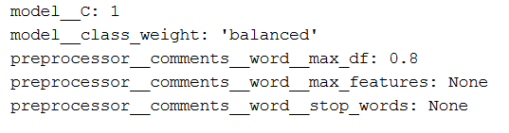
Conclusion
Best overall model: Linear SVC
Features: Login status, namespace, and tf-idf unigram and bigram word and character vectorizers
Parameters set:
Performance of the best overall model versus strawman:
Optimizations to my code included:
Creation of custom functions to allow me to systematically train, test, and conduct hyperparameter tuning and generate results in a consistent format.
Use of RandomizedSearchCV instead of exhaustive GridSearchCV with large search spaces
Model | Precision | Recall | F1-Score
Best Linear SVC | 0.88 | 0.87 | 0.87
Strawman | 0.80 | 0.79 | 0.80

