Slide 1



Nescafé
Concentrated Coffee Pods
Product Launch Analysis
Group 12:
Minghao Du
Jiaman Li
Haohua Lu
Fengyuan Tian
Xiangping Zhou
December 10th, 2021

Slide 2
CONTENTS
01
Introduction
02
Research Problem
03
Research Plan
04
Analytical Plan
05
Key Findings from the Simulation

Slide 3
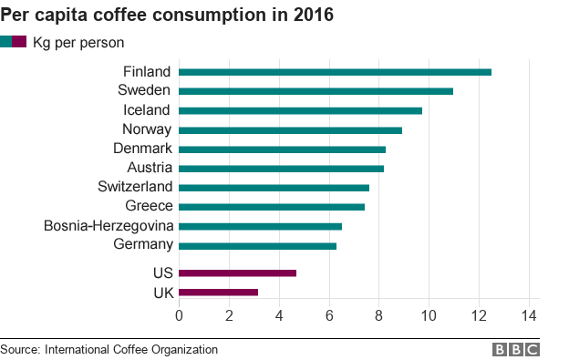
01
Introduction: Global Coffee Market
Coffee is one of the most popular beverages in the world
According to Mordor Intelligence, The global coffee market was valued at USD 102.02 billion in 2020. (Coffee Market, 2021)
Source: International Coffee Organization
Coffee market: 2021 - 26: Industry share, size, growth - mordor intelligence. Coffee Market | 2021 - 26 | Industry Share, Size, Growth - Mordor Intelligence. (n.d.). Retrieved December 10, 2021, from https://www.mordorintelligence.com/industry-reports/coffee-market.

Slide 4

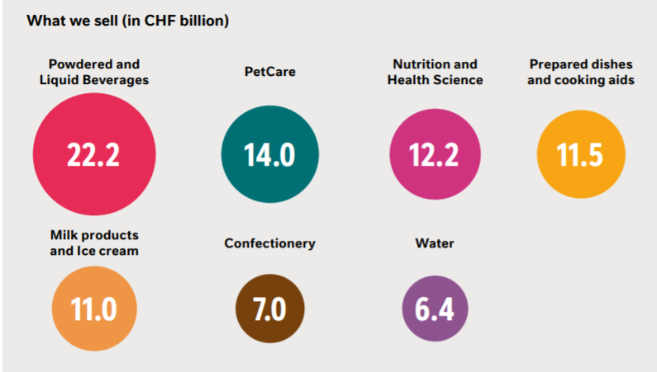
01
Introduction: Top Manufacturer - Nestle
Nestle is the largest multinational food and drink manufacturer measured by revenue (Spector, 2021)
“Powdered and Liquid Beverages” is the most profitable sector in Nestle
Nescafe is the signature
Spector, N. (2021, May 27). The 10 food and beverage companies making the most money. GOBankingRates. Retrieved December 8, 2021, from https://www.gobankingrates.com/money/business/10-food-beverage-companies-making-most-money/.
Source: Nestle Annual Report 2020

Slide 5
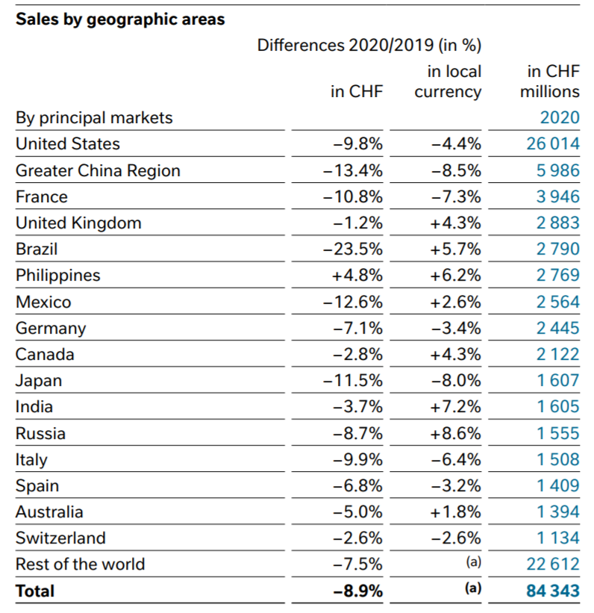
01
Introduction: Nescafe Sales Declined
According to the Nestle Annual Report in 2020, the Greater China Region is the second largest market of Nestle
The sales declined 13.4% compared to 2019
Source: Nestle Annual Report 2020

Slide 6

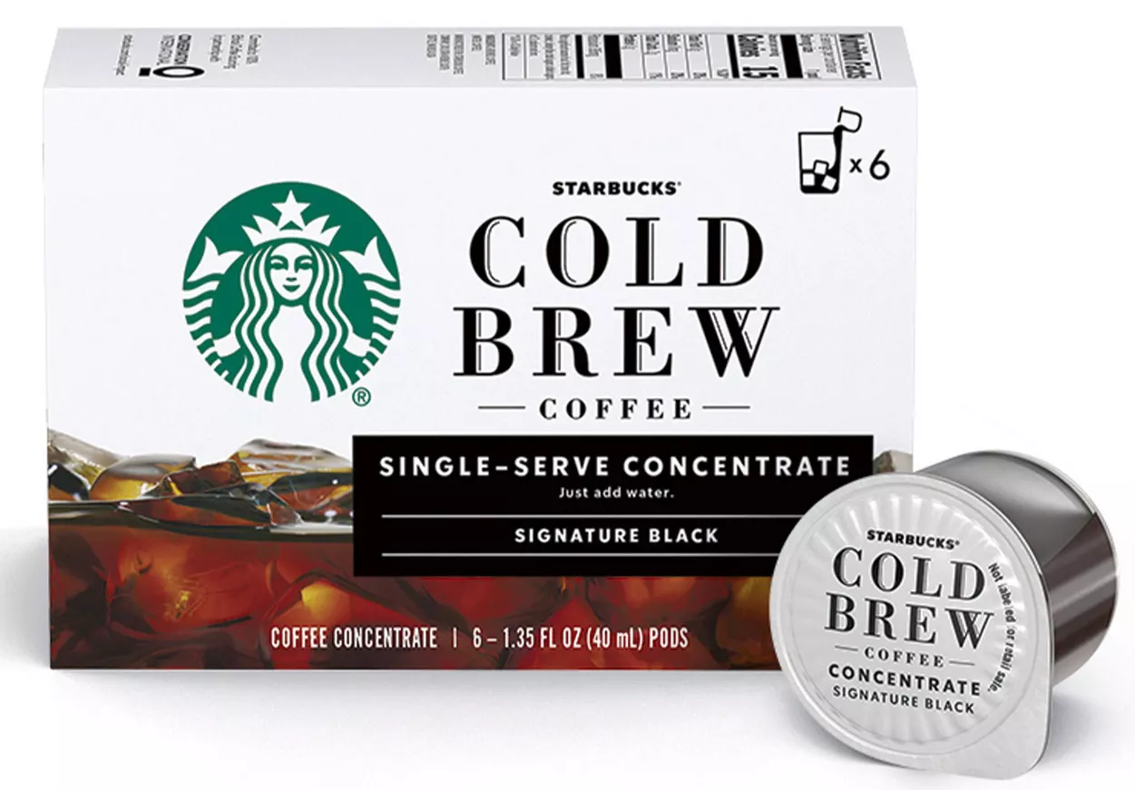
01
Introduction: New Types of Instant Coffee
The most recent trending instant coffee in the Chinese market is the concentrated coffee pod.
Syrup-like product
Extracted from coffee beans
Vacuum-frozen at extremely cold temperatures.
They are tiny and portable
You only need a cup of water or milk to dilute the concentrated pods.
Concentrated Coffee Pods made by Starbucks
Concentrated Coffee Pods made by Yongpu

Slide 7
02
Research Problem: Statement
As a group of analysts, we are helping Nescafe to investigate the necessity of launching its concentrated coffee pods to recap its sales and compete with these new emerging forces in the Chinese Market.
The research question: “Will the launch of Nescafe concentrated coffee pods increase Nescafe’s sales in the Chinese market?”

Slide 8
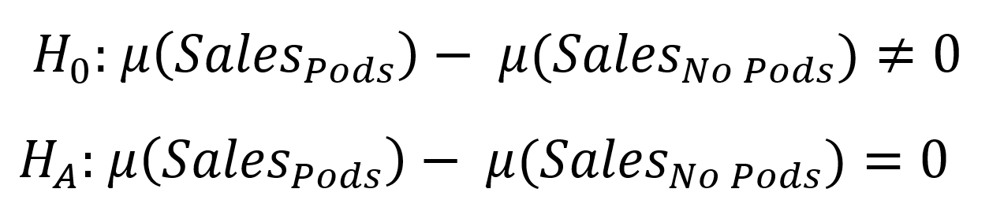
02
Research Problem: Hypotheses
Null hypothesis: the launch of Nescafe concentrated coffee pods will not increase Nescafe’s sales in the Chinese market.
Alternative hypothesis: the launch of Nescafe concentrated coffee pods will increase Nescafe’s sales in the Chinese market.

Slide 9
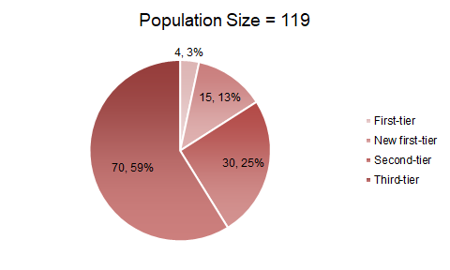
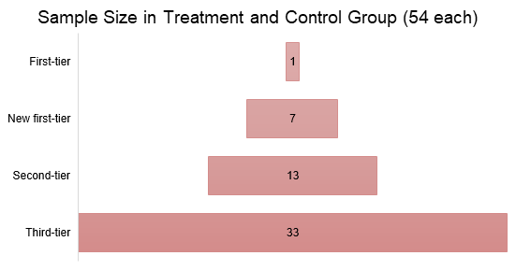
03
Research Plan: Sample Selection
Population of Interest: Consumers in 119 targeted cities.
- Existing consumers of Nestlé brand and coffee products
- Consumers who buy coffee products but not the Nestlé brand
Sample Size Generator:
- Margin of error = 5%
- Confidence level = 95%
Treatment Group: 54 cities
Control Group: 54 cities

Slide 10



03
Research Plan: Variables
Independent Variable (X):
- The launch of Nestlé concentrated coffee pods (Yes=1, No=0)
Dependent Variable (Y):
- Total sales of Nescafé (Nestlé SA) in a fiscal period.
Two Sample t-test

Slide 11
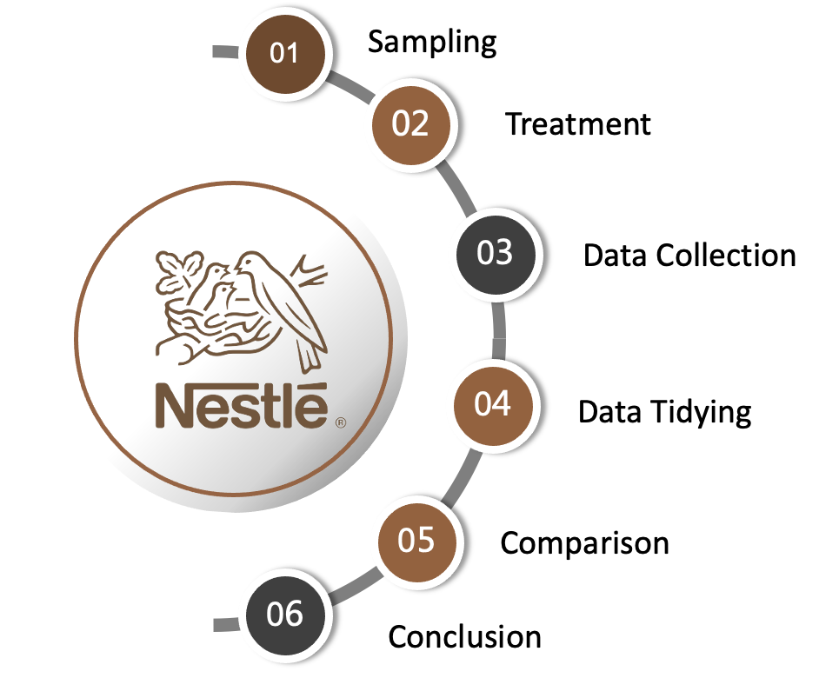
03
Research Plan: Operational Procedure

Slide 12
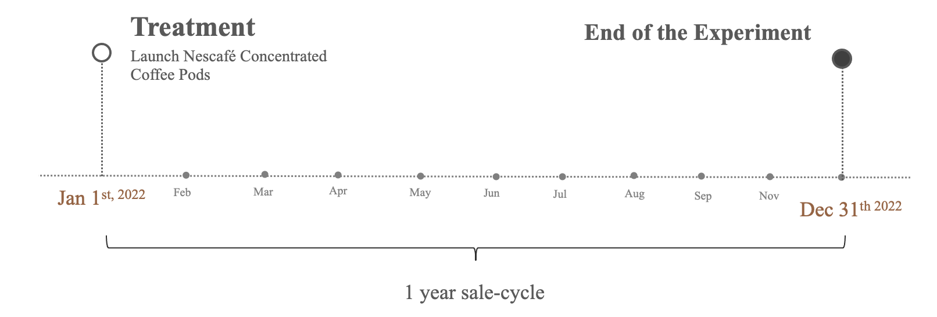
03
Research Plan: Timeline

Slide 13


03
Research Plan: Data Collection & Security
Sales in control & treatment group
Collect monthly
54 cities each group
108 cities in total
Confounding variables
Sales volume
No sensitive information included

Slide 14
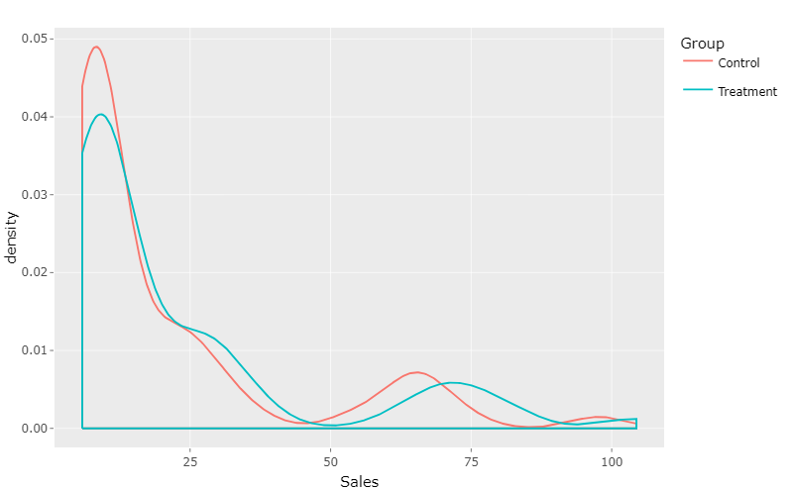
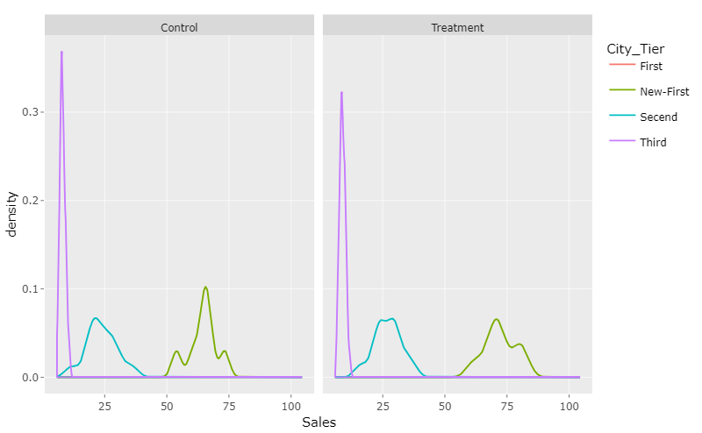
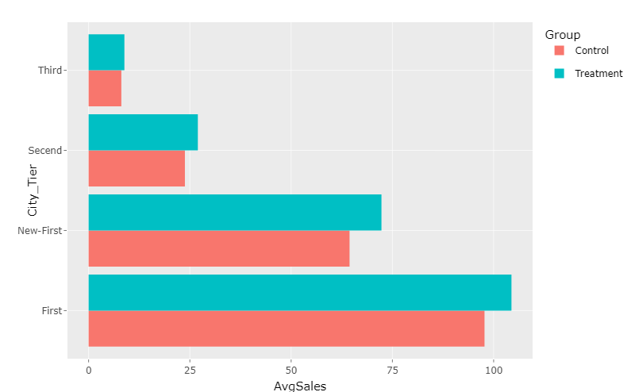
04
Statistical Analysis Plan
Data Simulation
Baseline Sales Mean: 100
Standard Deviation: 10
Simulation Rounds: 1000 rounds
Exploratory Analysis
Inspect data
Generate plots
Statistical properties of the simulated data calculation
Quantitative Analysis
Power
P-value
Effective Size

Slide 15
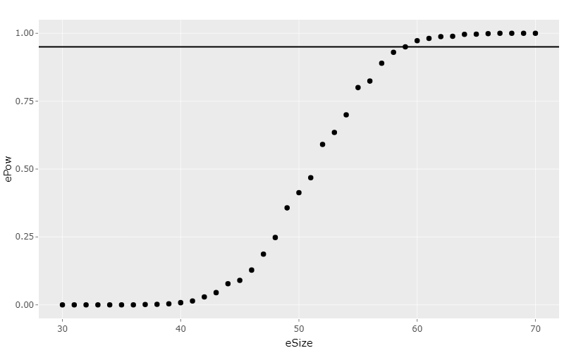
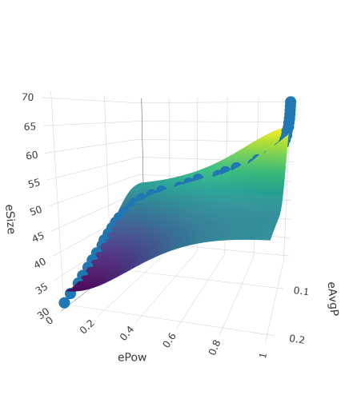
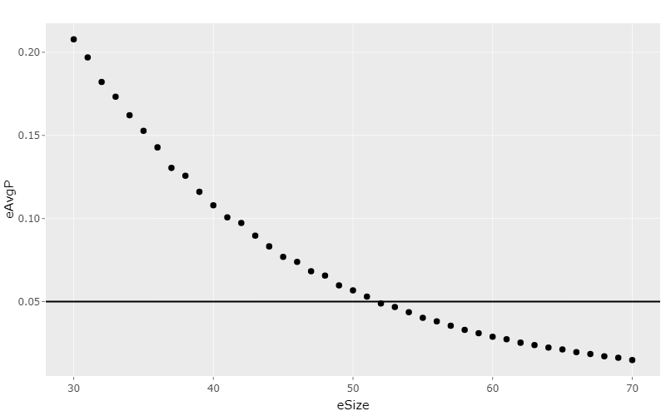
05
Key Findings from the Simulation
Research question: Will the launch of Nescafe concentrated coffee pods increase Nescafe’s sales in the Chinese market?
Effective size vs Power
Exploration
Power > 0.95
Effective size >= 60
P-Value < 0.05
Effective size >= 52
Effective size vs Power vs Avg. P-value
Analysis
Effective size vs Avg. P-value
Scenario 1: No Effect
Effective size = 40
Power = 0.009
P-value = 0.1086
Scenario 2: Has Effect
Effective size = 60
Power = 0.961
P-value = 0.0292
Notes:
In this section We are trying to find the answer to our research question: Will the launch of Nescafe concentrated coffee pods increase Nescafe’s sales in the Chinese market?
First we did some explorations on effective size, as the top left graph shown, as the effective size increases the corresponding power also increases, eventually exceed 0.95 at around 60
The bottom left graph shows the relationship between the effective size and the average p-value. Having an alpha of 0.05 we start to reject the null hypothesis when the effective size is greater than 52.
The graph in the middle shows the relationship between the three, as well as a plane fitted to these data points.
Finally, to answer the research question, we have conducted analysis on two scenarios.
In scenario 1 we set the effective size to 40, this gives us a power of 0.009 and a p-value of 0.1086. It shows no statistical significant difference in sales means between treatment and control group.
In scenario 2 we set the effective size to 60, this gives us a power of 0.961 and a p-value of 0.0292. It shows statistical significant difference in sales means between treatment and control group.

Slide 16
THANKS
谢谢观看

