Slide 1
Basic plots
Mingjun Yang
Guided by Professor Robert F. Boruch

Slide 2
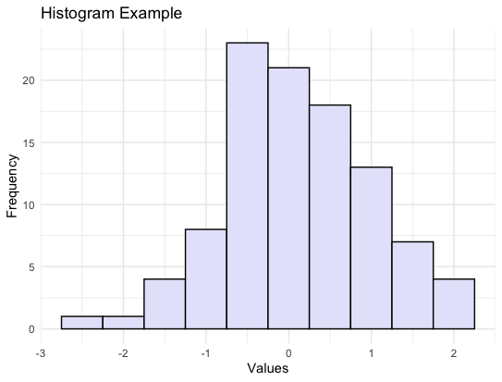
Histogram
A Histogram is a commonly used data visualization chart used to display the distribution of continuous data. It divides the data into several adjacent intervals (also called "bins" or "bars") and counts the frequency or frequency density of the data in each interval.
Histograms are commonly used to display and compare the distribution of numerical data, helping to identify patterns, outliers, symmetry, and skewness

Slide 3
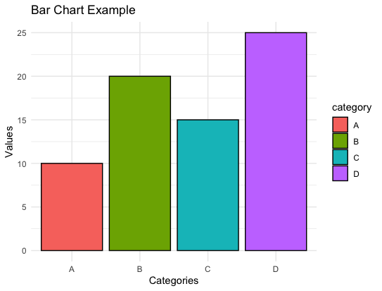
Bar chart
A Bar Chart uses rectangular bars to represent data values. The length or height of each bar is proportional to the value it represents. Bar charts can be either vertical (with bars extending upwards) or horizontal (with bars extending sideways).
Bar charts are commonly used to compare and display the values of different categories or groups of data.

Slide 4
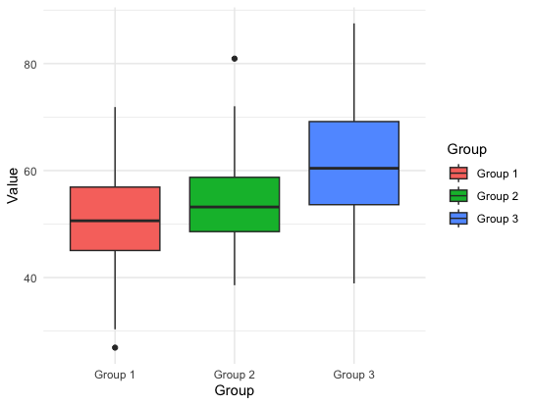
Boxplot
A Box Plot displays the distribution and summary of a set of data. It provides a visual summary of the minimum, first quartile, median, third quartile, and maximum of a dataset, showcasing the spread and skewness of the data.
Box plots are commonly used to analyze the distribution, variability, and skewness of data, especially in comparing multiple datasets. Useful for identifying outliers and understanding the central tendency of the data.

Slide 5
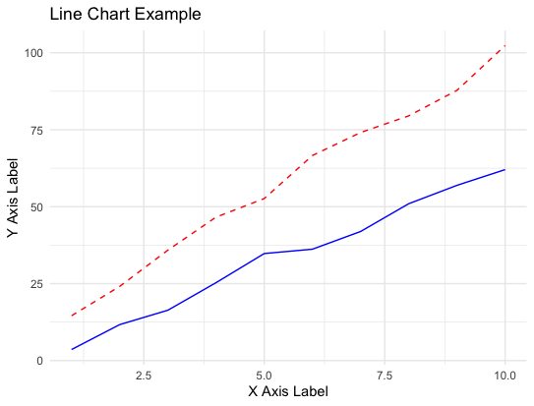
Line chart
A Line Chart displays data points as a series of markers connected by straight lines. It is particularly useful for showing trends, patterns, or changes in data over time or any continuous sequence.

Slide 6
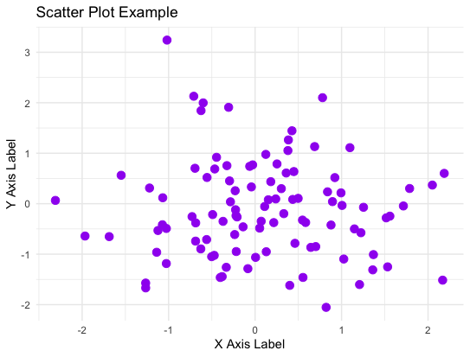
Scatter plot

Slide 7
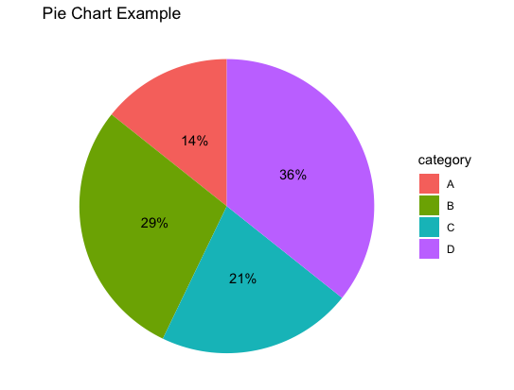
Pie chart
A Pie Chart is a circular chart divided into sectors, each representing a portion or percentage of a whole. The size of each sector is proportional to the quantity it represents relative to the whole.
Ideal for displaying relative proportions, percentages, or fractions of a total in a visually appealing and easy-to-understand manner.

Slide 8
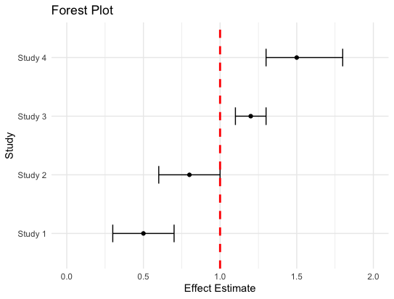
Forest plot
A Forest Plot is a graphical representation used in meta-analysis or systematic reviews. It displays the results of multiple studies or trials on a specific topic or research question. The plot typically shows the effect sizes and confidence intervals for each study, as well as an overall summary estimate.
Forest plots are widely used in medical research, social sciences, and other fields where a meta-analysis of multiple studies is conducted to synthesize evidence on a particular topic.

