Slide 1
Web Development –Diploma Computer Science

Slide 2
HTML & CSS

Slide 3
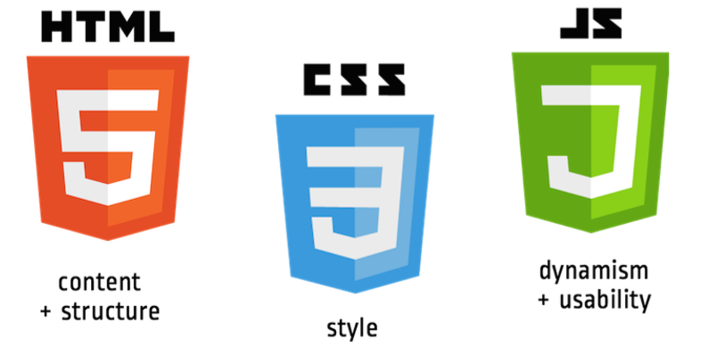
Front-end languages
The languages your browser speaks

Slide 4
HTML Basics

Slide 5
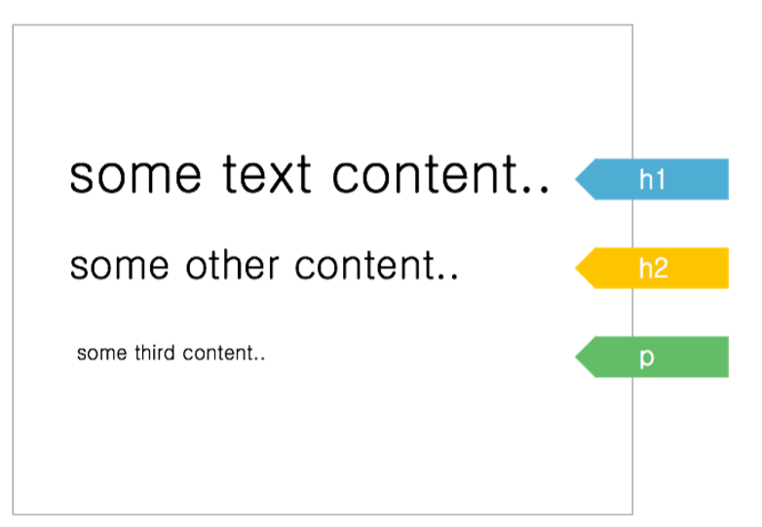
HTML
It's a markup language (== structure)
HTML tags help you identify content, and browser default styles will apply

Slide 6
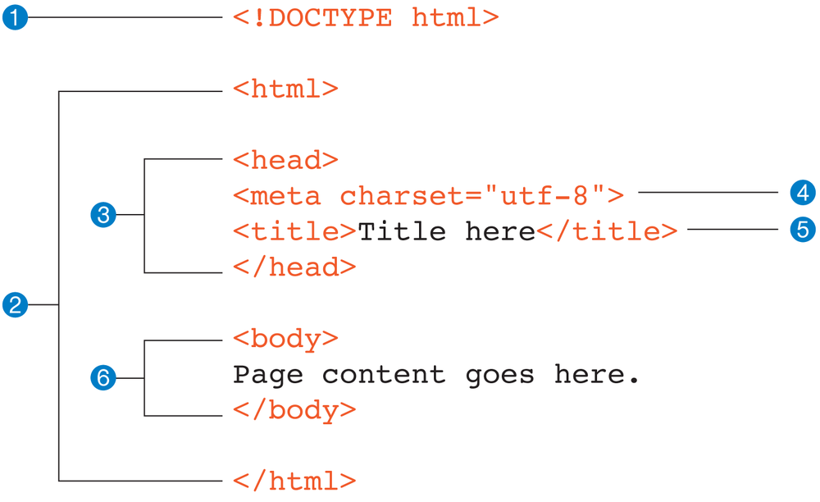
Page Structure
Document type declaration, tells the browser that you are using HTML5
Contains the entire web page.The html element is also called the root element
The head contains descriptive information about the document, such as the title, the style sheets, scripts, and other “meta” information
A meta element can be used to provide all sorts of information
Contents of the title element appear in the browser title bar
The body element contains everything that we want to show up in the browser window.

Slide 7
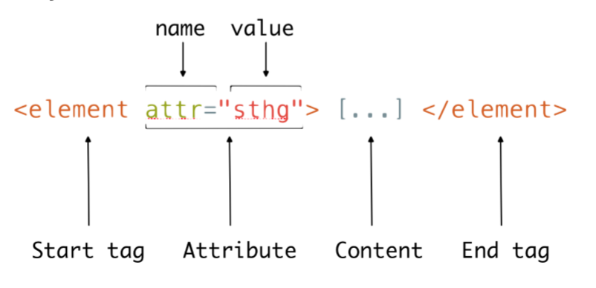
Basic Syntax

Slide 8
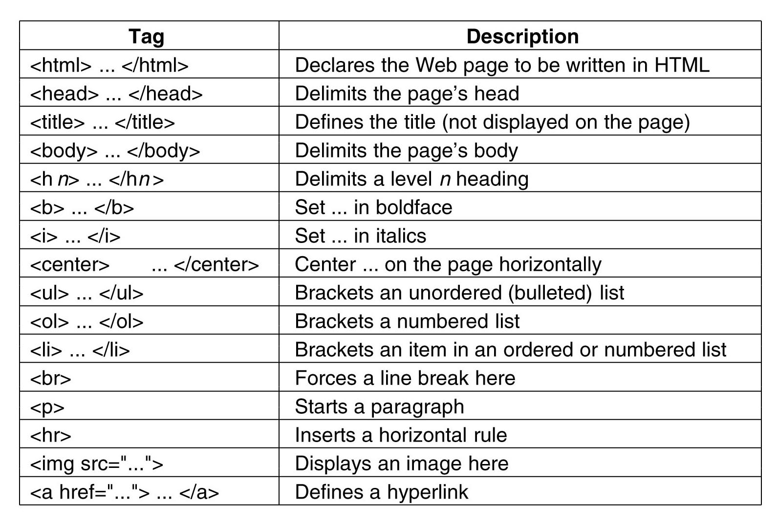
Basic Tags List

Slide 9
HTML - Quizz
<a href="http://innovationvillage.co.ug/" target="_blank">
Innovation Village
</a>
What is the name of the tag?
What is the content?
What are the 2 attributes (name and value)?

Slide 10
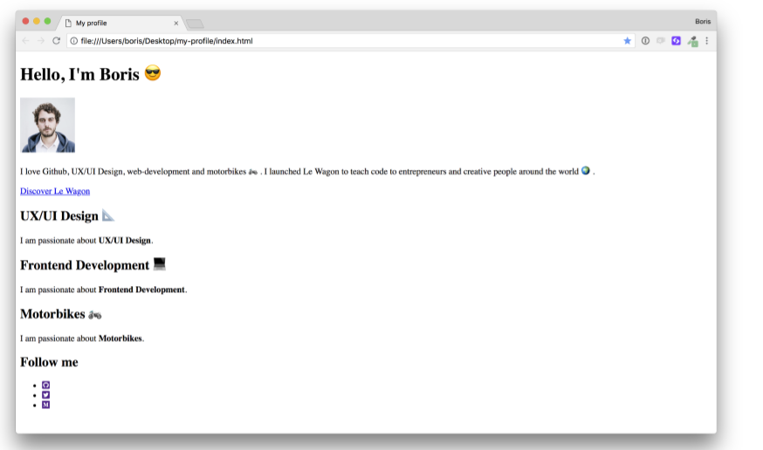
Live Code: Profile Page
Let’s make a profile page!

Slide 11
Exercise
Research different HTML tags and complete the following tasks
Create HTML table with names and email addresses of your friends. The table should have column headings
Create an HTML form where users can register with their first name, last name, email address and password
Create two pages;
A page listing your friends by name
Clicking any name should link to the person’s profile page
Find a list of 5 websites with beginner friendly content on HTML
Find out how to upload your work to Github
Notes:
Minimum is 2

