Slide 1
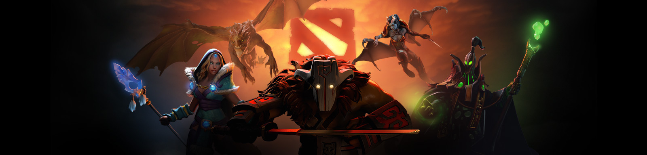

Investigation into Defense of the Ancients 2 game
A Capstone project by Louis Montagu-Smith
Notes:
Welcome to my talk about my study into a detailed Dota 2 dataset

Slide 2
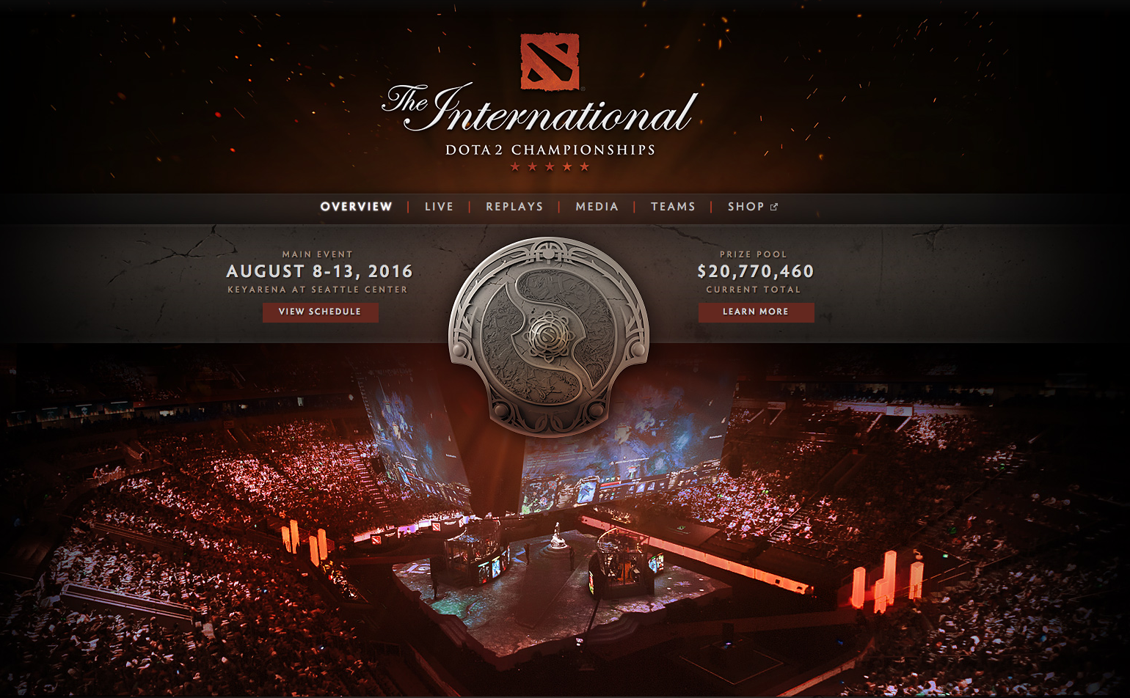
Why Dota 2?
source: http://www.dota2.com/international/overview/
Dota 2 is free-to-play with massive fan based able to produce international tournaments with lucrative prize pools
Initially looks very complex and can be daunting to new players
This study explores important variables to gold with linear regression models and winning with logistic regression models with the aim of providing simple strategies to improve new player progression
Notes:
Dota 2 is a popular free-to-play game which has international tournaments with lucrative prize money incentives
When first starting out in Dota 2 new players can become overwhelmed
This study has attempted to identify some basic strategies that will benefit new players and quickly improve their understanding of the game to be successful.

Slide 3
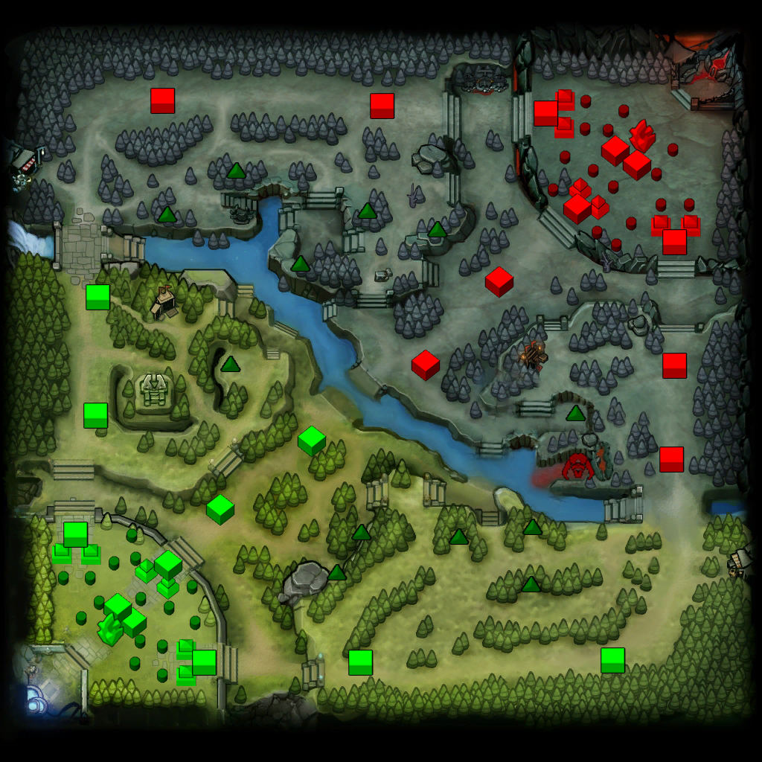
What is Dota 2?
Dota 2 is a popular multiplayer online battle arena (MOBA) game
2 teams of 5 heroes playing for the Radiants (green) and the Dires (red)
Defense towers guard routes to each base called ‘upper, middle and lower’ lanes
Barracks in each base spawn AI-controlled units called ‘creep’
Players control heroes to fight enemy heroes, towers and AI-controlled creep
Objective to access enemies base and destroy their Ancient structure
Dota 2 mini-map at start of a match
cubes (11/side) represent tower positions
smaller double-cubes (6/side)represent barracks location
non-cube (1/side) represents ‘Ancient’ location
Notes:
Dota 2 is a game that sets 2 teams of 5 against each other
each base has a structure called an ‘Ancient’. The opponent’s ‘Ancient’ destruction is the objective for each team.
each base is connected by lanes that have defensive towers along each lane
remove the towers to gain access to the enemy base to be able to destroy their ‘Ancient’

Slide 4
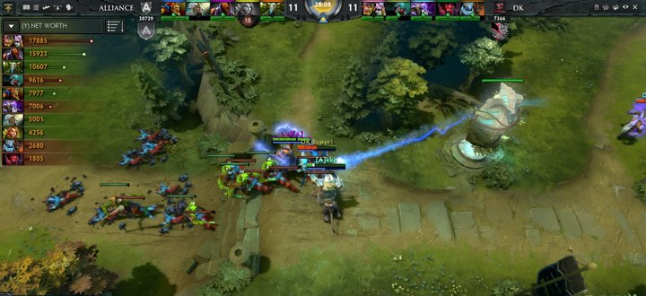
How does a Dota 2 match play out?
Heroes escort the packs of friendly creep along lanes towards enemy towers
Towers do lots of damage to Heroes so they must wait until friendly creep engage enemy towers to be able to take them down
Removing enemy towers clears the lanes for better access to enemy bases and their Ancient structure
Heroes get experience (xp) and gold from killing enemy heroes, creep and towers
Notes:
waves of ‘creep’ travel along their lanes and auto attack enemy units and structures
Heroes must escort their creep to enemy towers to be able to engage and destroy them, soloing towers is very difficult

Slide 5
The Dataset
A dataset with 50,000 matches was published to Kaggle by Devin, which can be found here:
https://www.kaggle.com/devinanzelmo/dota-2-matches
Here several csv files can be found covering a wide range of data on all players in each match leading to 500,000 observations
Two interesting files were identified:
- match.csv (match data) – 50,000 rows
- players.csv (player data) – 500,000 rows
One support file was identified:
- hero_names.csv (hero information) – 112 heroes
Notes:
dataset formed into a ‘CombinedDF’ dataset containing 500,000 observations over 53 different variables

Slide 6
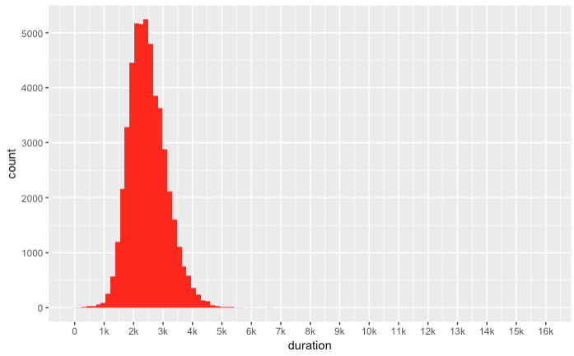
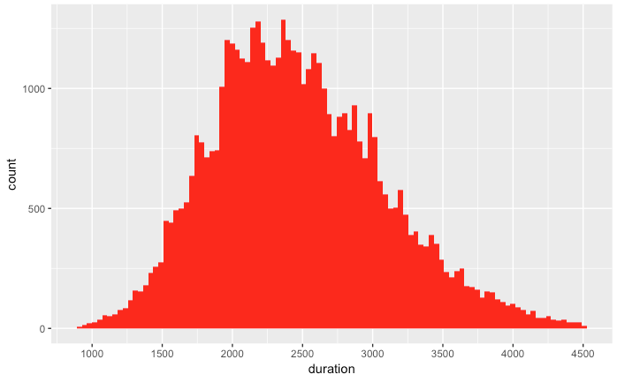
Data Wrangling
During the data wrangling process the dataset was narrowed down from 500,000 observation to 420,510 observations using various filters
Duration
histogram of ‘duration’ for all matches
histogram of ‘duration’ for matches between 15 – 75 minutes
Very short and very long matches were considered to be ‘uncompetitive’
Research suggests Dota 2 matches commonly last between 20 – 60 minutes
Dataset limited to matches lasting between 15 – 75 minutes
Notes:
Filtering ‘duration’ variable was key to weeding out most of the ‘uncompetitive’ matches which are expected to provide spurious data

Slide 7
Data Wrangling
Hero_id
All matches have a unique number for hero_id for all players
No one hero can be selected more than once per match
Some matches had hero_id of zero (hero not selected)
Most matches with hero_id of zero already filtered out by ‘duration’
Lever_status
integer between 0 and 4
0 represents players who did not leave
1-4 represent players who left mid-match under various conditions
The filter applied to ‘duration’ had already removed a significant portion of these matches
Hero_Names.csv
The original csv file posted by Devin was taken and modified to add:
hero class classification (1 per hero); Strength (STR), Agility (AGI) or Intellect (INT)
hero role classifications (often more than 1 per hero):
Carry, Disabler, Initiator, Jungler, Support, Durable, Nuker, Pusher, Escape
Notes:
Hero_id and lever_status filters supported the ‘duration’ filter as these matches needed to be culled by their criteria most had already been removed

Slide 8
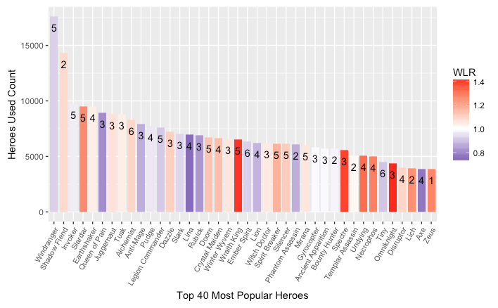
Modeling Process – Early Stages
When first starting out the modeling process it quickly became clear the data had a large amount of variance present
Best to start by looking at a single hero first in attempt to reduce this noise
WLR = Win:Loss Ratio, red indicates > 1, blue indicates < 1
number per bar refers to number of categorized roles per hero
Notes:
Windranger selected based upon it being most popular by quite a margin, has 5 of 9 roles associated and has WLR close to 1 (just below 1)

Slide 9
Linear Regression Modeling of ‘gold’
for Windranger
Winning matches has a very strong positive relationship to the amount of gold a player will finish with.
Spending gold has a slight negative relationship with the amount of gold a player finishes with.
Acquiring experience quickly (xp_per_min) is important to leveling up heroes fast. The higher the level a hero is the more impact they have and the more gold they can accumulate.
Avoiding deaths in a match is important to keeping gold. Gold is lost every time a hero dies. The amount of gold a hero loses is tied to the level they at the time of a death.

Slide 10
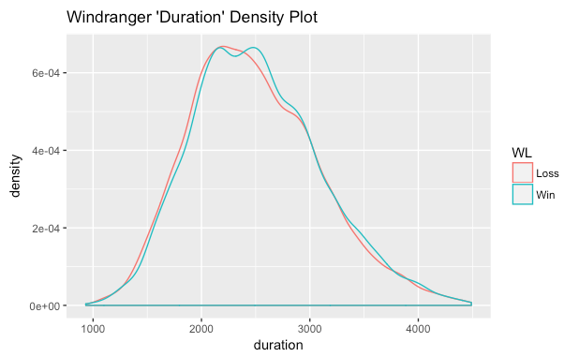
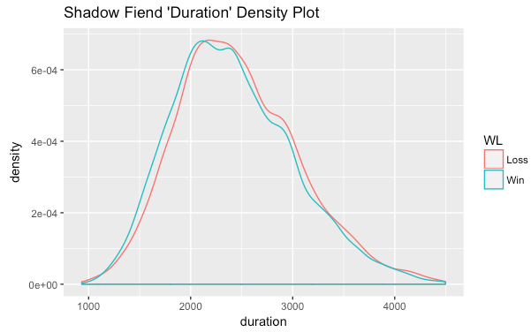
Logistic Regression Modeling of ‘win’
to win matches it is important to enter combat and assist in the killing of enemy heroes
it is not necessarily important to score the killing blows
Avoiding death is very important as the time penalties incurred for dying puts the team on the back foot until that hero can re-join the fight
the length a match goes on for can impact different heroes
Windranger may benefit from longer matches
Shadow Fiend may benefit from shorter matches

Slide 11
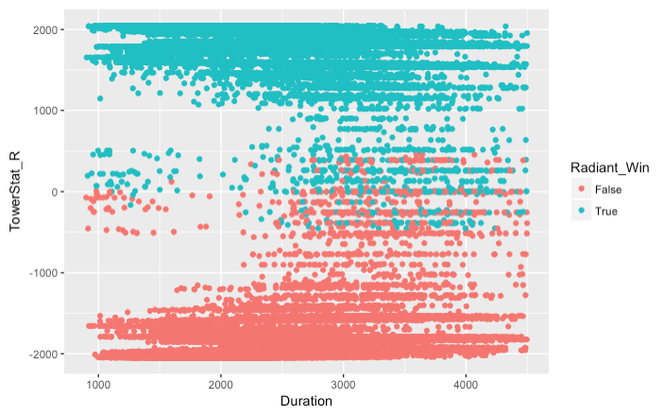
Looking Forward to Future Work
Explore the models for each hero and characterize them
Team compositions and what strategies these teams should deploy
Item purchases at the shop, which items are better for which heroes
Deeper look at the 33 column dedicated to ‘unit_order_’ in the original dataset
Investigate ‘dominant wins’ vs ‘close wins’ defined by tower health differences

Slide 12
HUGE Thanks!
Devin, Competitions Master on Kaggle.com
https://www.kaggle.com/devinanzelmo
Dr Guy Maskall, mentor from Springboard.com

Slide 13
Any Questions?
Thanks for listening!

Slide 14
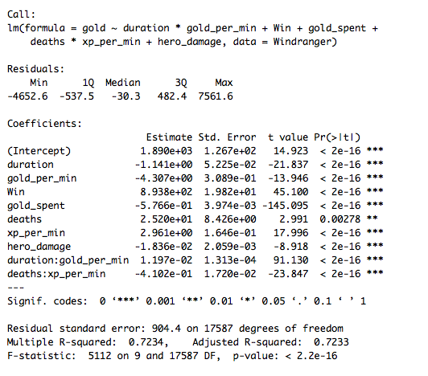
Appendix 1 – linear regression model for ‘gold’

Slide 15
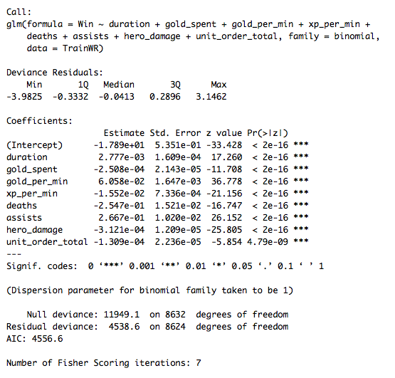

Appendix 2 – logistic regression model for ‘win’

