Slide 1
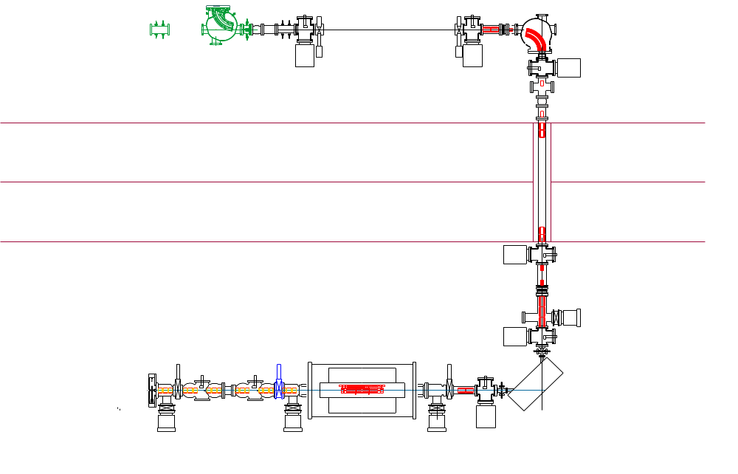
Steuerungen in Sektion TR5
TR5KX1,
TR5KY1
TR5KX2,
TR5KY2
TR5KX3,
TR5KY3
TR5KX5,
TR5KY5
TR5KX6
TR5KY6
TR5ME1
TR5ME2
TR5ME3
TR5ME5
TR5ME6
TR5DF1,
TR5DC1
TR5DF2,
TR5DC2
TR5ME4
TR5VV1
TR5KX4,
TR5KY4
TR5VV2
TR5VP1T
TR5VP2I
TR5VP3I
TR5VP4T

Slide 2
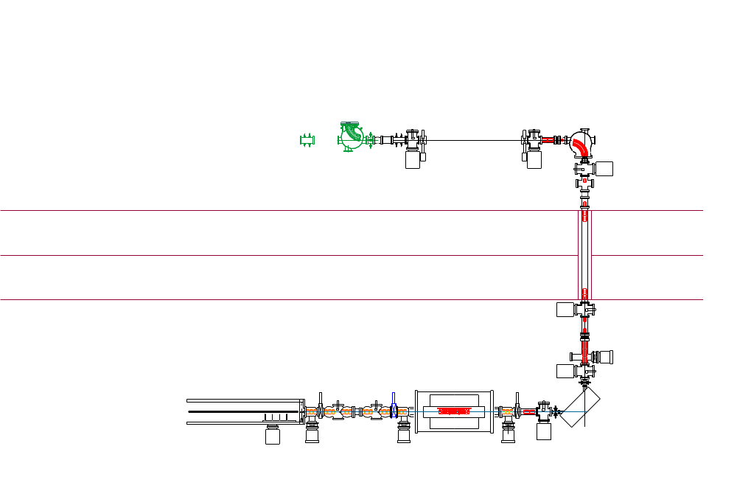
Steuerungen Kühlerfalle (Separate Sektion)
B-field
Kühlerfalle
TR6BT1
Elektrode 1-25
Temperature control

Slide 3
Steuerung Sektion TR6 innerhalb Re-Injektionskanal
TR6QD2 2
TR6DF2,
TR6DC2
TR6QD2 1
TR6KX3
TR6KY3
TR6VP4I
TR6KX2
TR6KY2
TR6QT1 3
TR6QT1 2
TR6QT1 1
TR6KX1
TR6KY1
TR6VP3I
TR6DF2,
TR6DC2
TR6ME1
TR6QD1 1
TR6VV1
TR6DS2
TR6QD1 2
TR6MU1
TR6DS1
TR6DF1,
TR6DC1
TR6EG1,
(electron gun)
TR6VP1T
TR6VP2I

Slide 4
Steuerung Sektion TR6 oberhalb Re-Injektionskanal
TR6MK1
TR6VV2
TR6EU1
TR6DF5
TR6DC5
TR6QD4 1
TR6QD4 2
TR6VP5I
TR6VP6I
TR6KX5,
TR6KY5
TR6DF4
TR6DC4
TR6KX4,
TR6KY4
TR6QD3 2
TR6QD3 1

