Slide 1
CS++ - The successor of the CS Framework
Live-Demonstration eines Aktor-basierten Powersupplies
Dr. Holger Brand, GSI Helmholtzzentrum für Schwerionenforschung GmbH

Slide 2
Content
CS Framework
Innovation CS → CS++
NI Actor Framework
CS++
Base Classes & Factory
CS++Base & CS++Reference; CS++BaseActor
Configuration
CS++StartActor
CS++DeviceActor
CS++DMM, CS++DCPwr
CS++GUIActor
CS++DeviceGUIActor; CS++DCPwrGui
Build Specification

Slide 3
CS Framework I
CS is a framework that can be used by many experiments.
CS is a
multi-threaded,
event driven,
object oriented and
distributed framework with
SCADA functionality.
An experiment control system can be developed by combining the CS framework with experiment specific add-ons.
CS is supported on MS-Windows and Linux
LabVIEW RT on Pharlab
Lasers
Ion Traps
Nuclear Physics Experiments

Slide 4
CS Framework II
Development was started with LabVIEW 6
On top of ObjectVIEW, Vogel Automatisierungstechnik (ObjectVIEW was removed with CS 2.0)
Artificial object-oriented approach
Inspired by C++
by reference
multiple inheritance
DIM as core for the network communication (CS 3.0)
Publisher-Subscriber-Pattern (one to many)
Command-Pattern (many to one)
Many things rely on design recommendations and can not be enforced.

Slide 5
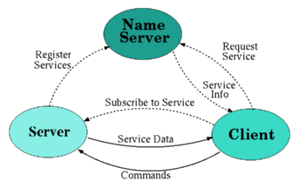
CS Framework III
Base classes
CSObj -> Object reference & Attributes
CAEObj -> Capabilities for active threads and events (DIM)
BaseGUI -> Graphical User Interface, adds an active thread
BaseSM -> State Machine, adds an active thread
BaseProcess -> Adds threads for concrete event-handling and periodic actions

Slide 6
CS Framework IV
SuperProcess
Watchdog functionality & Process maintenance
Can automatically launch more processes during startup.
DSCIntProc
Provides connectivity to the Data Logging & Supervisory Control Module (DIM <-> Tags, Shared Variables)
Alarming, Trending
IO-Server like OPC, EPICS etc.
Configuration Database
Object configuration data
Watchdog timeouts
VISA Resource etc.
Mass configuration

Slide 7
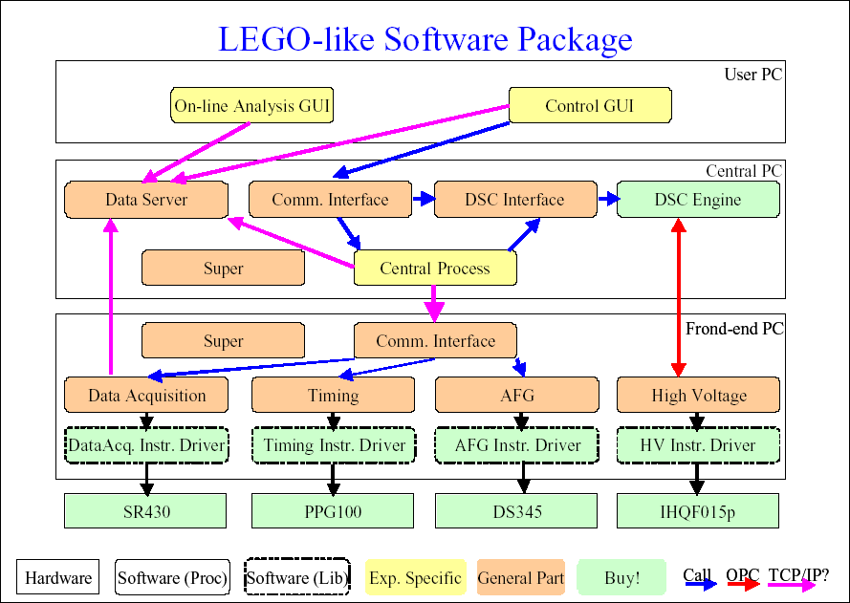
CS Framework V

Slide 8

Innovation: CS → CS++
LVOOP, Native object-oriented support by LabVIEW
Feasibility study: Mobile Agents was successful.
CS++ respecting dataflow
Similar requirements as CS Framework
Less complexity
Enable short-term students to join
Enforce recommendations by LVOOP properties.
Based on NI Actor Framework
Part of LabVIEW since 2012
Long term support by NI
Profit from the community
Driving project is the test facility for the superconducting SIS-100 Dipole Magnets at FAIR.

Slide 9
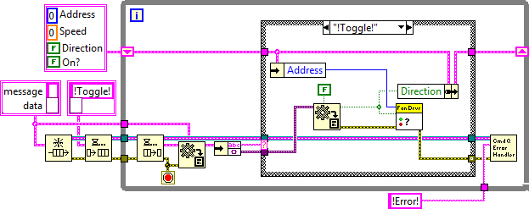
NI Actor Framework I Stephen R. Mercer et al. @ NI Week 2011
Standard approach
Queued State Machine
Modular & Event-driven
But, scaling is a problem!

Slide 10
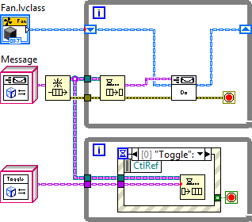
NI Actor Framework II Stephen R. Mercer et al. @ NI Week 2011
Three Sources of Code Replication
Override the handling of one message
Extend the set of handled messages
Decorate the machine with additional behavior
LVOOP
Cluster & Node -> Class & Methode
Message & Case Structure -> Class & Dynamic Dispatch
Extend
Override
Decorate

Slide 11
CS++ Base Classes
Classes representing passive data are derived from LabVIEWObject, the ultimate LabVIEW ancestor class.
CS++Base.lvclass inherits from LabVIEWObject
To be used as ancestor class for objects to be treated as entity.
Can be referenced using the CS++Reference.lvclass (LV-Reference Pattern is assumed to be well known.)
CS++BaseActor.lvclass inherits from Actor
To be used as ancestor class for actors part of CS++.
It provides common features that all CS++Actors should have.
Dynamic dispatch VIs: Initialize Attributes.vi, After Launch Init.vi
CS++Factory inherits from LabVIEWObject
To be used to dynamically create initialized objects
CS++Base & CS++BaseActor.
Configuration data is read from ini-file by default and
provided to the object as Variant for attribute initialization.
Derived factories can read from database etc.

Slide 12
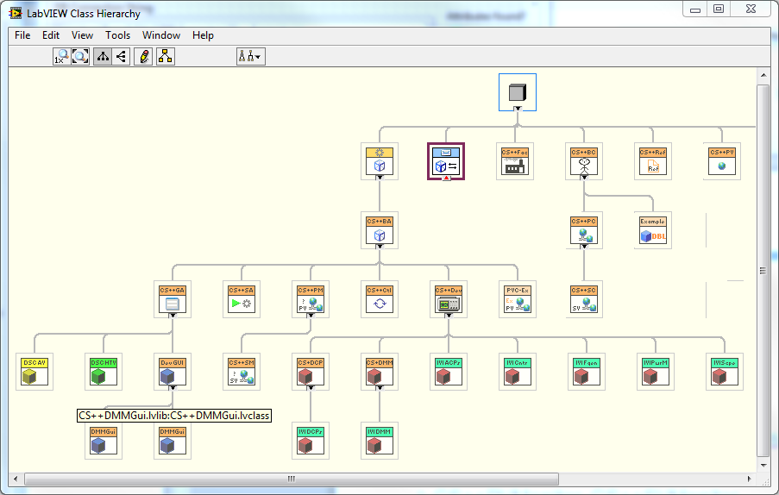
CS++ Class Hierarchie

Slide 13
Example Configuration
[CS++StartActor]
LVClassPath="C:\...\CSPP\Core\Actors\CS++StartActor\CS++StartActor.lvclass"
LVLibPath="C:\...\CSPP\Core\Actors\CS++StartActor\CS++StartActor.lvlib"
CS++StartActor:CS++StartActor.MessageLogger="Syslog"
CS++StartActor:CS++StartActor.Open_ActorCore=True
[Syslog]
// Can be loaded from the LabVIEW Tools Network
IP="140.181.78.202"
Port=514
Debug=True
[CS++StartActor.StartActors]
#Actor Object to start with option to open its Actor Core.vi.
mySVClient=True
myDSCTrending=True
myDSCAlarmViewer=True
myCS++DeviceActor=False
myDMM=False
myDCPwr=False

Slide 14
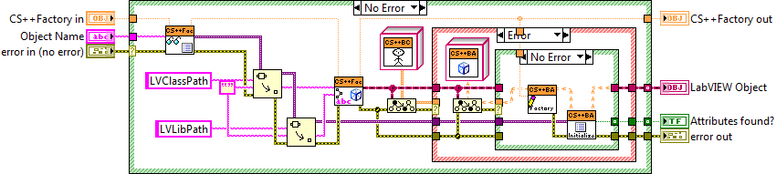
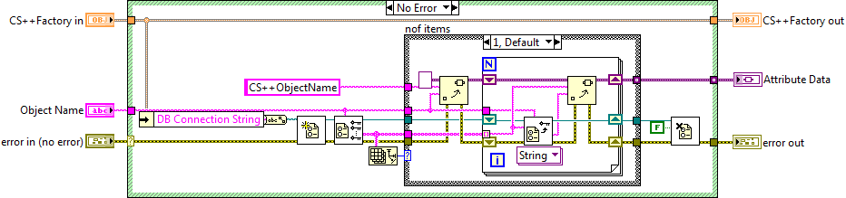
CS++Factory.CreateObject
dynamic dispatch
next transparency

Slide 15
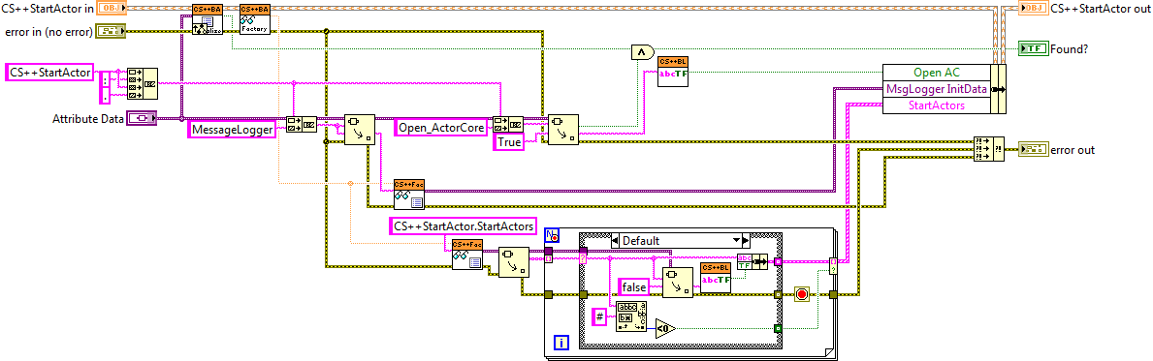
CS++StartActor.Initialize Attributes
Call parent method.
Read initialization data from Variant.
Specify default values
Save to object attribute data.
Check if data was found.

Slide 16
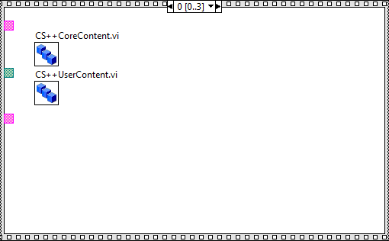
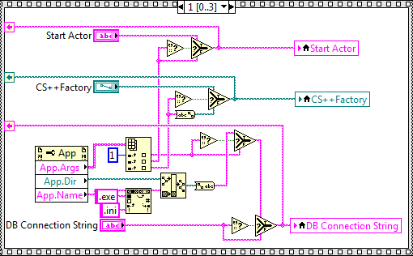
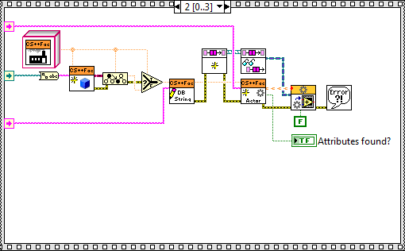
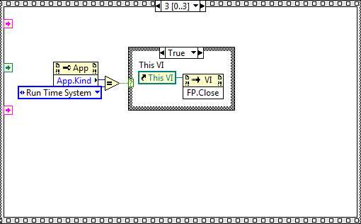
Launch CS++StartActor
Parse command line parameters
Load class constants,
include dependencies
for building application
Launch Start-Actor
→ dispatch Actor Core.vi
→ Message Handling
Close launching VI

Slide 17
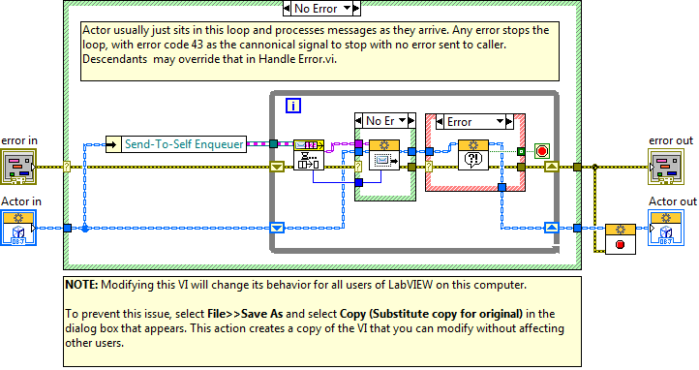
Actor.lvclass:Actor Core.vi

Slide 18
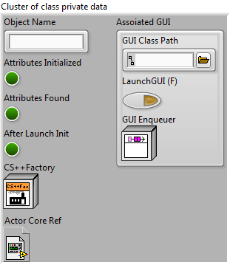


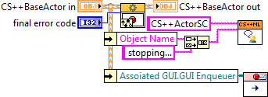

CS++BaseActor: Attributes and Methods
Initialize Attributes.vi
Pre Launch Init.vi e.g. check conditions that may hinders activating the actor.
Stop Core.vi
Release allocated resources.
Actor Core.vi: send After Launch Init.vi
Resources should be allocated after activation.

Slide 19
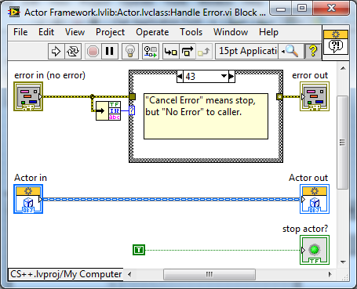
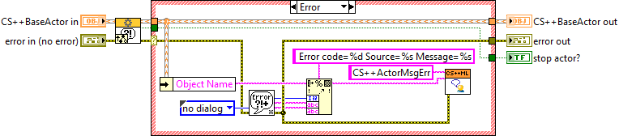
CS++BaseActor:Handle Error.vi
Actor Core will stop execution by default in case of error as result of message handling.
CS++BaseActor will send the error info to the message logger.
Derived classes need to override this method if stopping is not an adequate reaction!

Slide 20
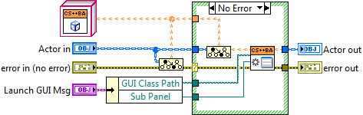
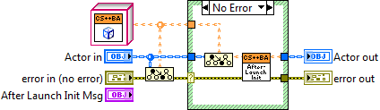
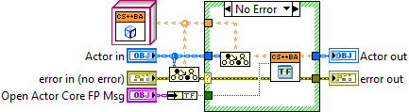
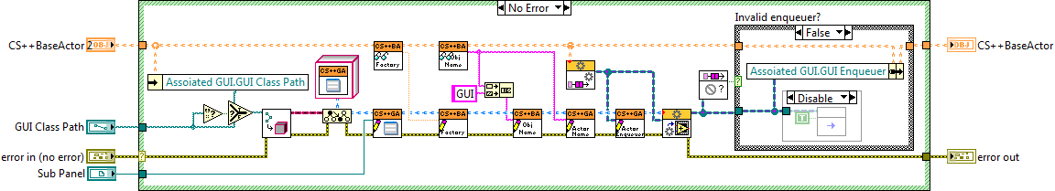
CS++BaseActor:Messages
After Launch Init Msg.lvclass
Dynamich dispatch After Launch Init.vi: Allocate resources here.
Open Core FP Msg.lvclass
Open or close the frontpanel of the Actor Core.vi.
Launch GUI Msg.lvclass
Trigger an actor to launch an associated GUI actor.

Slide 21
3-Tier Architecture
Shared Variable Engine
GUI Layer
Control Layer
Device Layer
Network
Message¹
¹Linked Network Actor

Slide 22
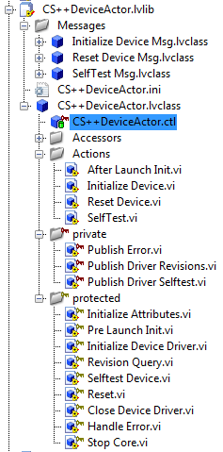
CS++DeviceActor.lvclass & Configuration
[myDeviceActor]
LVClassPath="C:\...\CSPP\Core\Actors\CS++DeviceActor\CS++DeviceActor.lvclass"
LVLibPath="C:\...\CSPP\Core\Actors\CS++DeviceActor\CS++DeviceActor.lvlib"
CS++DeviceActors:CS++DeviceActor.ResourceName="COM1"
CS++DeviceActors:CS++DeviceActor.Reset=False
CS++DeviceActors:CS++DeviceActor.Selftest=True
CS++DeviceActors:CS++DeviceActor.OptionString=""
CS++DeviceActors:CS++DeviceActor.ResetWithDefaults=False
CS++DeviceActors:CS++DeviceActor.PollingInterval_s=10.
CS++BaseActor:CS++BaseActor.DefaultGUI=“C:\...\CS++DeviceGUIActor.lvclass"
CS++BaseActor:CS++BaseActor.LaunchDefaultGUI=True
PV-URL are defined in a separate section, so it can be used by other objects, too, e.g. the corresponding GUI.
[myDeviceActor.URLs]
ResourceName="ni.var.psp://localhost/myProcess/myDeviceActor_ResourceName"
DriverRevision="ni.var.psp://localhost/myProcess/myDeviceActor_DriverRevision"
FirmwareRevision="ni.var.psp://localhost/myProcess/myDeviceActor_FirmwareRevision"
SelftestResultCode="ni.var.psp://localhost/myProcess/myDeviceActor_SelftestResultCode"
SelftestResultMessage="ni.var.psp://localhost/myProcess/myDeviceActor_SelftestResultMessage"
ErrorCode="ni.var.psp://localhost/myProcess/myDeviceActor_ErrorCode"
ErrorMessage="ni.var.psp://localhost/myProcess/myDeviceActor_ErrorMessage"

Slide 23
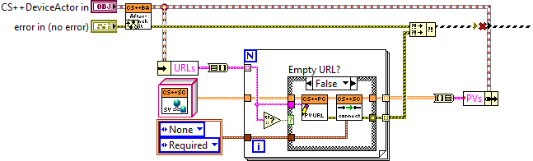
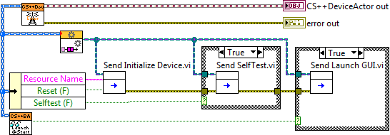
CS++DeviceActor.After Launch Init.vi

Slide 24
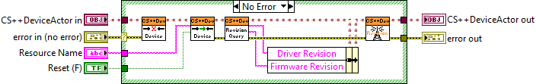


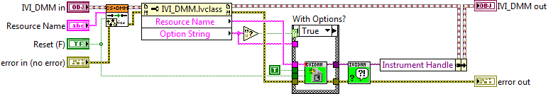
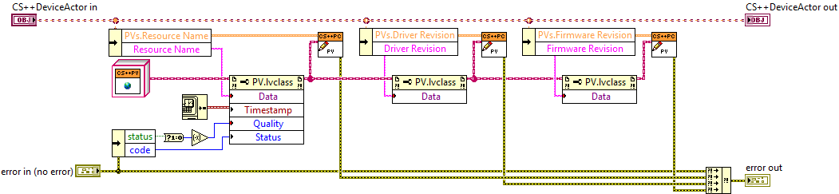
CS++DeviceActor.Initialize Device.vi

Slide 25
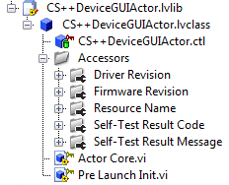
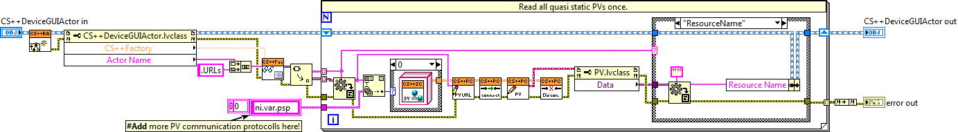
CS++DeviceGUIActor.lvclass
Pre Launch Init.vi
Read URLs from configuration file
For URLs corresponding to static PVs
Open PV Connection
Read PV once and store in object attibutes
Close PV Connection
Actor Core.vi
For URLs corresponding to dynamic PVs
Register PVs with Update-Message to PVMonitor-Actor
Register corresponding dynamic GUI events.

Slide 26
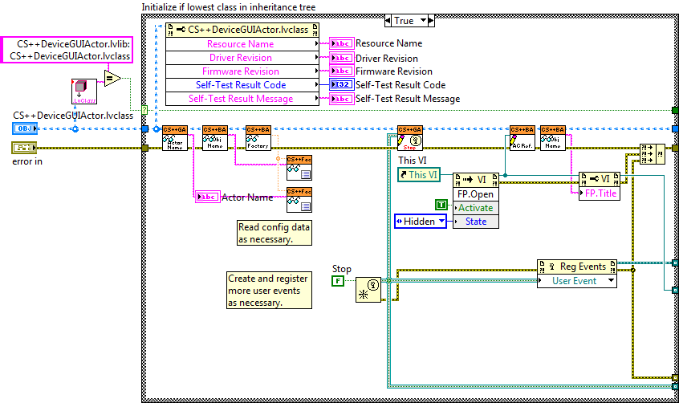
CS++DeviceGUIActor.Actor Core.vi I

Slide 27
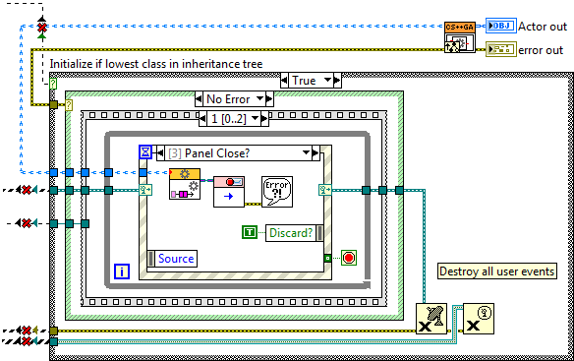
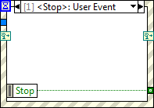
CS++DeviceGUIActor.Actor Core.vi II

Slide 28
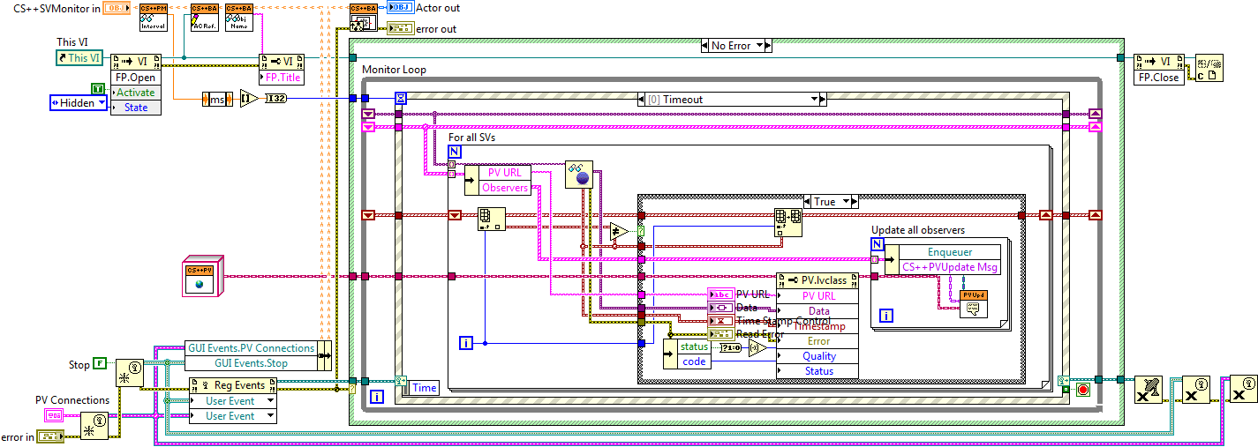
CS++PVMonitor
Implementation for Shared Variable
Periodic reading of shared variable values
Send registered Update-Messages to observers

Slide 29
Live Demonstration
Demo of existing classes
Live implementation of a DC Power Supply actor class
derived from CS++DCPwr.lvclass

Slide 30
References
CS Framework, http://wiki.gsi.de/cgi-bin/view/CSframework/WebHome
DIM, http://dim.web.cern.ch/dim
LVOOP
The Decisions Behind the Design, http://zone.ni.com/devzone/cda/tut/p/id/3574
FAQ, http://zone.ni.com/devzone/cda/tut/p/id/3573
Common OO Design Patterns for LabVIEW, http://decibel.ni.com/content/docs/DOC-2875
Mobile Agent System, http://wiki.gsi.de/cgi-bin/view/NIUser/LVMobileAgentSystem
Diploma Thesis of Frederik Berck, http://wiki.gsi.de/pub/NIUser/LVMobileAgentSystem/DiplomarbeitFrederikBerck.pdf
NI Actor Framework
Community@NI, https://decibel.ni.com/content/groups/actor-framework-2011?view=overview
READ THIS FIRST to get started with Actor Framework, https://decibel.ni.com/content/docs/DOC-17193
Actor Framework.pptx at NI Week 2011, https://decibel.ni.com/content/docs/DOC-17109
CS++
Published on GitHub, https://github.com/HB-GSI/CSPP, License: EUPL v1.1

Slide 31
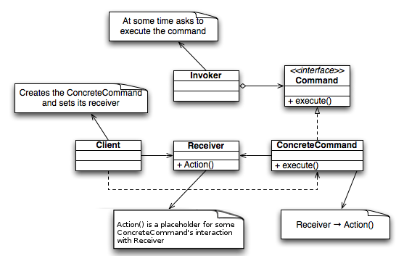
Command Pattern
http://en.wikipedia.org/wiki/Command_Pattern

