Slide 1

PORTFOLIOS WITH
PURPOSE
Optimizing Portfolio Construction with ESG Considerations
Niharika Dalsania (nd322)
Joel Dsouza (jnd74)

Slide 2
AGENDA
Background
Data
ESG Portfolio Construction
Results and Analysis
ESG as a factor
Conclusion

Slide 3
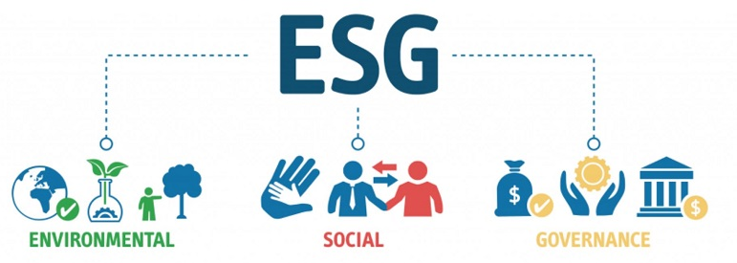
WHAT IS ESG?

Slide 4

HOW TO INCLUDE ESG IN INVESTING?
Environmental
Climate change, Greenhouse gas emissions, pollution, water waste, impact on biodiversity, etc.
Social
Customer relations, labour, human rights, occupational health safety, supply chains, etc.
Governance
Board management practices, succession planning, compensation, compliance, data security, etc

Slide 5
IT’S ALL ABOUT DATA
Point in time data used get rid of survivorship bias
Price data: Historical price of S&P 100 constituents
ESG data: RepRisk ESG Risk Scores and ESG Trend Scores
Factor data: Historical Book to Market (value factor) and Market Capitalisation (size factor) of S&P 100 constituents
 | Low Risk | Medium Risk | High Risk | Extreme Risk
Letter grade | AAA, AA, A | BBB, BB, B | CCC, CC, C | D
ESG Risk Score | 0 to 25 | 26 to 49 | 50 to 74 | 75 to 100

Slide 6
WHERE DOES ESG FIT IN THE PORTFOLIO?
 | No ESG | Semi ESG | Low risk | Full ESG
 |  | ESG Top | ESG Bottom | ESG in objective | ESG as constraint | ESG for scaling
Stock selection | No | Yes | Yes | No | No | No
Weight allocation | No | No | No | Yes | Yes | Yes
Methodology | Markowitz | Markowitz on top 25 stocks | Markowitz on bottom 25 stock | Modified Markowitz with objective of minimizing ESG Risk score and constraint on min returns or max risk | Markowitz with extra constraint on maximum ESG Risk score | Markowitz weights are scaled up or down based on ESG Risk score or ESG Trend score

Slide 7
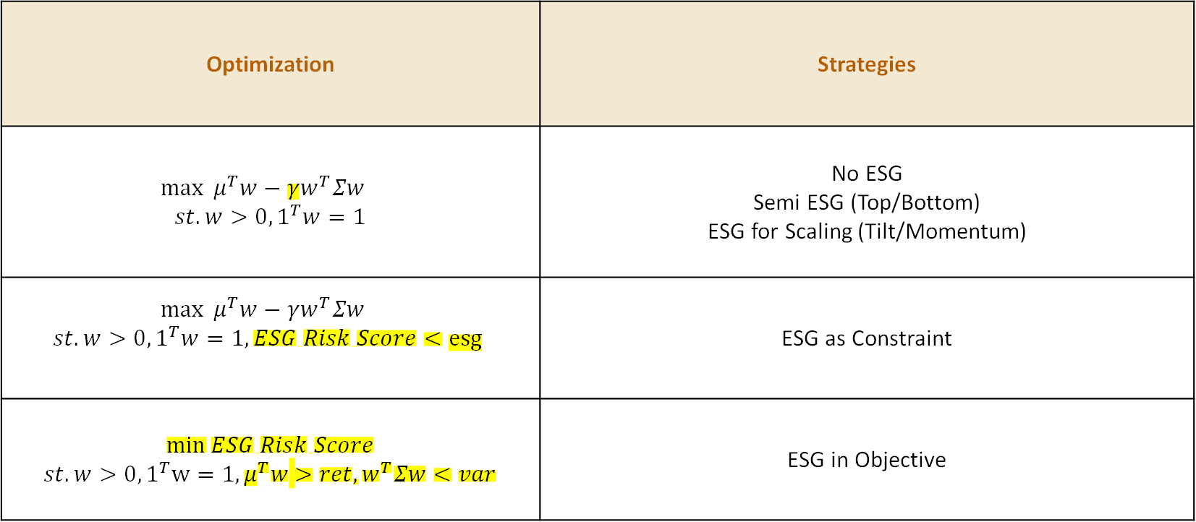
CLASSICAL MARKOWITZ OPTMIZATION
Optimization | Strategies
$$\max{ μ^{T}w−γw^{T}Σw}$$ $st. w>0, 1^{T}w=1$ | No ESG Semi ESG (Top/Bottom) ESG for Scaling (Tilt/Momentum)
$$\max{ μ^{T}w−γw^{T}Σw}$$ $st. w>0, 1^{T}w=1,ESG Risk Score<esg$ | ESG as Constraint
$$\min{ESG Risk Score}$$ $st. w>0, 1^{T}w=1,μ^{T}w$ $>ret, w^{T}Σw<var$ | ESG in Objective

Slide 8
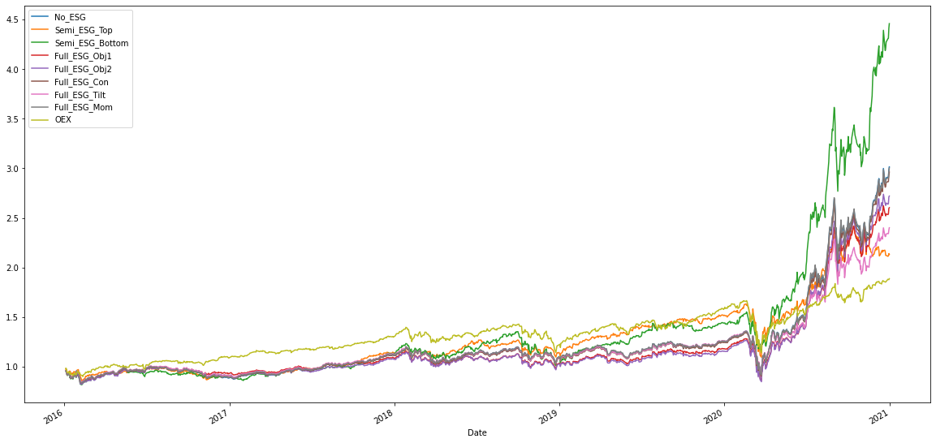
WHICH STRATEGY WINS?
S&P 100 index outperforms all ESG based strategies pre Covid crisis
A major boom observed in ESG based strategies post Covid crisis
The Semi ESG Bottom strategy gives the best cumulative returns

Slide 9
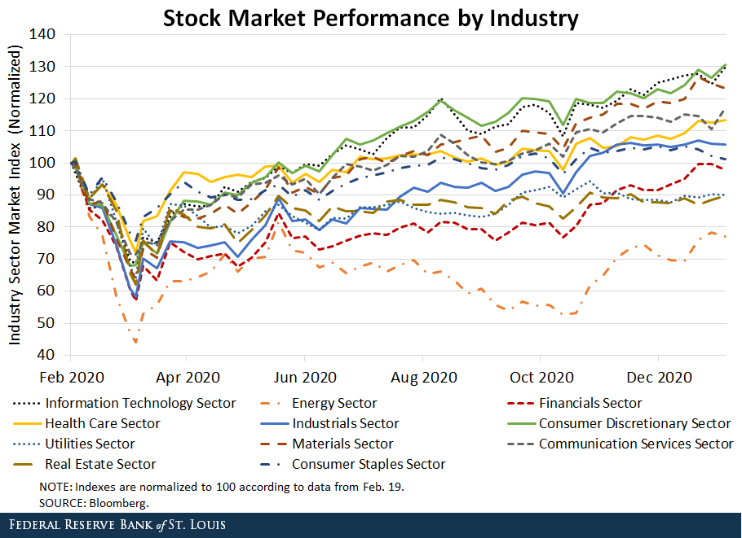
SECTOR ANALYSIS
Sectors mainly chosen by the bottom 25 companies portfolio posit covid crisis:
Healthcare - governance increased ESG risk
Technology - social/governance increased ESG risk
Financials - social/governance increased ESG risk
Consumer Discretionary - in general high ESG risk

Slide 10
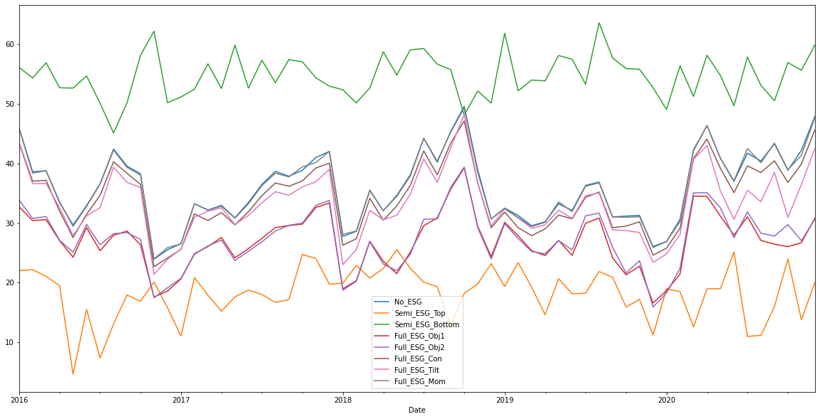
WHICH STRATEGY REDUCES ESG RISK?
The Semi ESG Top strategy has the Lowest ESG Risk score
The Semi ESG Bottom strategy has the Highest ESG Risk Score
All other ESG favouring strategies have Medium ESG Risk score on average – lower than ESG Risk score of No ESG

Slide 11
PERFORMANCE SUMMARY
 | No ESG | Semi ESG | Low risk | Full ESG
 |  | ESG Top | ESG Bottom | ESG in objective |  | ESG as constraint | ESG for scaling
 |  |  |  | Obj1 | Obj2 |  | Tilt | Mom.
Returns (%) | 24.69 | 16.34 | 34.84 | 21.08 | 22.16 | 24.25 | 19.14 | 24.60
Volatility (%) | 25.74 | 23.15 | 27.48 | 24.96 | 25.90 | 25.55 | 23.86 | 25.81
Sharpe Ratio | 0.98 | 0.77 | 1.22 | 0.89 | 0.90 | 0.97 | 0.85 | 0.98
Maximum Drawdown (%) | 32.39 | 32.90 | 25.36 | 33.02 | 32.97 | 32.57 | 32.44 | 32.48
ESG Risk score | 35.97 | 18.25 | 54.68 | 26.99 | 27.31 | 34.25 | 33.24 | 35.90
Volatility similar for all portfolios with ESG considerations but returns vary
ESG in objective portfolios look like an attractive choice

Slide 12
LOSE SOMETHING TO GAIN SOMETHING
 | No ESG | Allow 5% less returns | Allow 10% less returns | Allow 15% less returns | Allow 5% more risk | Allow 10% more risk | Allow 15% more risk
Returns (%) | 24.69 | 21.08 | 18.45 | 16.18 | 22.16 | 20.97 | 20.21
Volatility (%) | 25.74 | 24.96 | 24.63 | 24.30 | 25.90 | 26.45 | 27.02
Sharpe Ratio | 0.98 | 0.89 | 0.81 | 0.73 | 0.90 | 0.85 | 0.81
ESG Risk score | 35.97 | 26.99 | 23.53 | 20.96 | 27.31 | 24.59 | 22.98
Better ESG Rating with risk/returns trade-off
Attractive for investors seeking portfolios with better ESG Risk rating

Slide 13
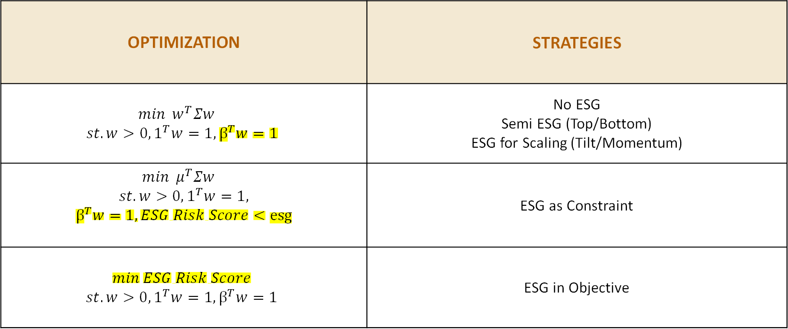
INDEX TRACKING MARKOWITZ
OPTIMIZATION | STRATEGIES
$$\min{ w^{T}Σw}$$ $$st. w>0, 1^{T}w=1,β^{T}w=1$$ | No ESG Semi ESG (Top/Bottom) ESG for Scaling (Tilt/Momentum)
$$\min{ μ^{T}Σw}$$ $$st. w>0, 1^{T}w=1,$$ $$β^{T}w=1,ESG Risk Score<esg$$ | ESG as Constraint
$$\min{ESG Risk Score}$$ $$st. w>0, 1^{T}w=1,β^{T}w=1$$ | ESG in Objective

Slide 14
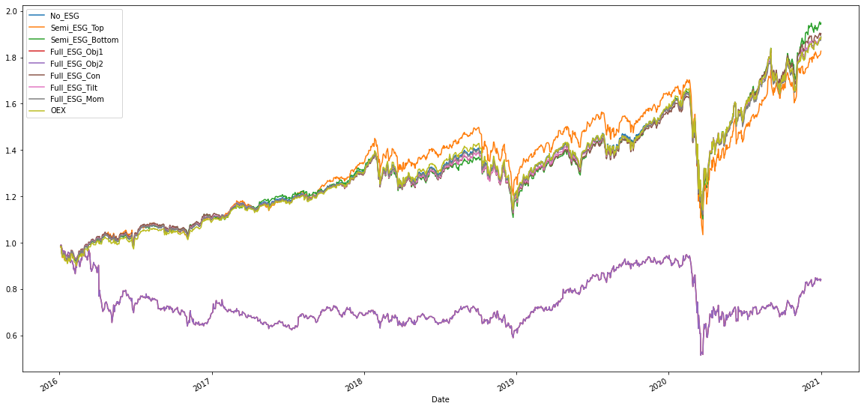
WHICH STRATEGY WINS?
The ESG Objective strategy underperforms all the strategies
The Semi ESG Top performs better than benchmark pre Covid crisis but underperforms post Covid crisis

Slide 15
PERFORMANCE SUMMARY
 | No ESG | Semi ESG | Low risk | Full ESG
 |  | ESG Top | ESG Bottom | ESG in objective | ESG as constraint | ESG for scaling
 |  |  |  | Obj1 |  | Tilt | Mom.
Returns (%) | 13.56 | 12.80 | 14.26 | 3.39 | 14.20 | 13.57 | 13.52
Volatility (%) | 18.71 | 20.09 | 18.99 | 28.49 | 18.70 | 18.72 | 18.71
Sharpe Ratio | 0.77 | 0.70 | 0.79 | 0.02 | 0.80 | 0.77 | 0.77
Maximum Drawdown (%) | 31.85 | 39.25 | 33.42 | 48.01 | 31.65 | 31.73 | 31.89
ESG Risk score | 32.88 | 17.87 | 53.92 | 3.68 | 28.52 | 29.75 | 32.70
ESG Top improves the ESG risk score dramatically along with tracking the index
ESG as constraint gives higher returns with lower ESG score

Slide 16
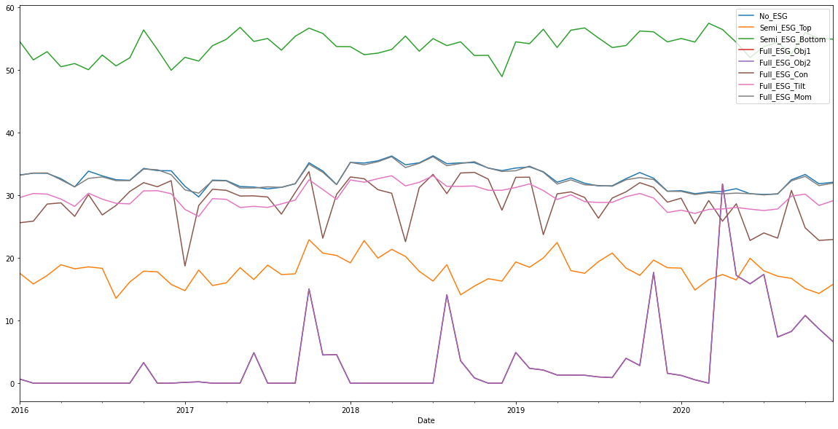
WHICH STRATEGY REDUCES ESG RISK?
The ESG Objective strategy has the Lowest ESG Risk score
The Semi ESG Bottom strategy has the Highest ESG Risk Score
All other ESG favouring strategies have Lower Medium ESG Risk score on average – lower than ESG Risk score of No ESG

Slide 17
E, S, G - WHICH IS THE BEST?
 | No ESG | E in objective | E as constraint | S in objective | S as constraint | G in objective | G as constraint
Returns (%) | 24.69 | 25.50 | 23.86 | 23.94 | 24.45 | 19.61 | 24.63
Volatility (%) | 25.74 | 25.12 | 25.46 | 25.01 | 25.42 | 24.47 | 25.71
Sharpe Ratio | 0.98 | 1.03 | 0.96 | 0.96 | 0.98 | 0.84 | 0.98
Maximum Drawdown (%) | 32.39 | 32.88 | 32.42 | 32.38 | 32.43 | 33.02 | 32.58
E/S/G Risk score | 32.97 | 2.10 | 4.86 | 9.33 | 14.34 | 10.01 | 15.00
Existence of correlation amongst E, S, G
High cosine similarity of weight vectors (70% in objective, 99% in constraint)
Results depend on ESG data
Need theme scores in addition to pillar scores to identify alpha

Slide 18
IS ESG A FACTOR?
 | Value | Size | Mom. | ESG
Value | 1 | 0.73 | 0.41 | 0.39
Size | 0.73 | 1 | 0.40 | 0.49
Mom. | 0.41 | 0.40 | 1 | 0.25
ESG | 0.39 | 0.49 | 0.25 | 1
ESG: Alpha vs Beta
Evidence exists of ESG being a commonly adapted smart beta strategy in Europe, but not yet in USA
But it has potential of becoming one in coming years - low correlation with other traditional factors may add diversification benefits

Slide 19
FACTOR PORTFOLIOS
Make long-short portfolios of all possible factor combinations
Multi-factor portfolios: take union of relevant long portfolios and short portfolios
Make frequency weighted multifactor portfolios: if more than one factor suggest to long or short a stock then assign it a high weight
 | Long portfolios | Short portfolios
Value | Top 10 Good ESG companies (low ESG Risk score) | Bottom 10 Bad ESG companies (high ESG Risk score)
Size | Top 10 High Value companies (high book-to-market ratio) | Bottom 10 Low Value companies (low book-to-market ratio)
Momentum | Top 10 Small Size companies (low market capitalisation) | Bottom 10 Big Size companies (high market capitalisation)
ESG | Top 10 Up Momentum companies (high momentum) | Top 10 Down Momentum companies (low momentum)

Slide 20
ESG IS ICING ON THE CAKE
Returns do not drop as much by adding ESG
Not so in momentum
Volatility decreases by adding ESG
 | Returns (%) |  | Volatility (%)
 | With ESG | Without ESG | With ESG | Without ESG
ESG | -10.29 |  | 13.12
Value | -14.60 | -19.51 | 14.57 | 21.33
Size | -12.11 | -14.45 | 13.43 | 17.82
Momentum | -5.90 | -2.30 | 12.95 | 19.22
Value, Size | -14.42 | -16.79 | 23.94 | 25.84
Value, Momentum | -10.34 | -10.79 | 13.71 | 17.08
Size, Momentum | -8.11 | -8.61 | 12.91 | 15.54
Value, Size, Momentum | -11.26 | -11.84 | 13.86 | 16.05

Slide 21
COVID AS A CATALYST FOR ESG
Increasing importance of social and governance pillar
ESG criteria reweighted with more emphasis on the public health system and inequalities (income, education, etc.)
Social issues reconsidered at corporate level for defining ESG ratings (labour practices, workplace safety, employee benefits, etc.)
Change in view for measurement of economic performance
Companies dependent on out of control factors shut down in covid (supply chain management, foreign workforce, workplace safety, etc.)
Important to focus on sustainable long-term economic performance integrating financial and extra-financial criteria with anticipated increase in supervision and regulation
Reinforcement of shared common values
Might be a turning point leading to market for social bonds, like green bonds

Slide 22
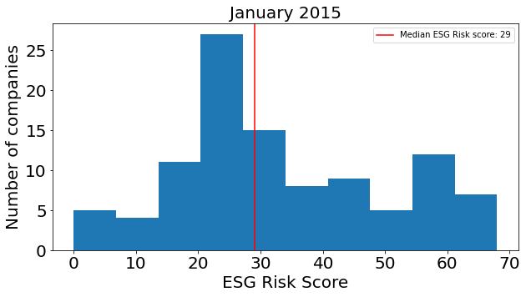
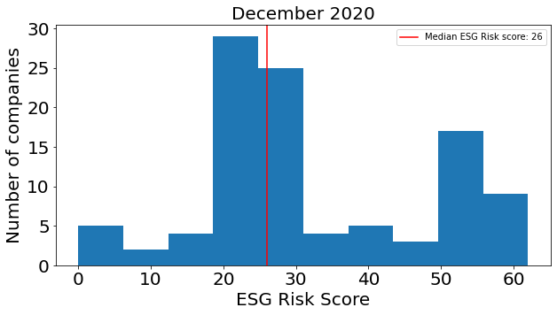
WHERE ARE WE HEADED?
Median ESG Risk score on border of being in Low risk category, Extreme high risk companies work on reducing ESG Risk score
Added value of ESG in terms of diversification of multifactor portfolios
ESG as a smart beta strategy
Post covid impact to strongly favour ESG based investment strategies
Shift from ESG as a long term metric to short term risk measure

Slide 23

THE FUTURE OF ESG INVESTING LOOKS BRIGHT!

