Slide 1

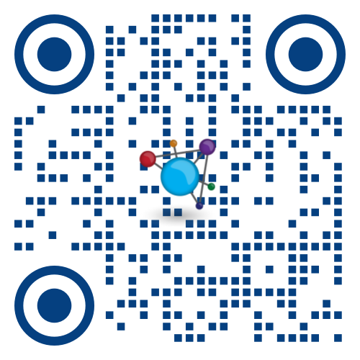
MicrobeTrace 2.0: Live demo
https://microbetrace.cdc.gov/MicrobeTrace/

Slide 2
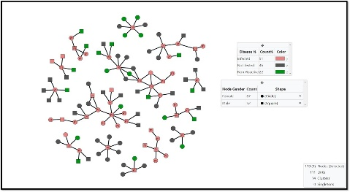
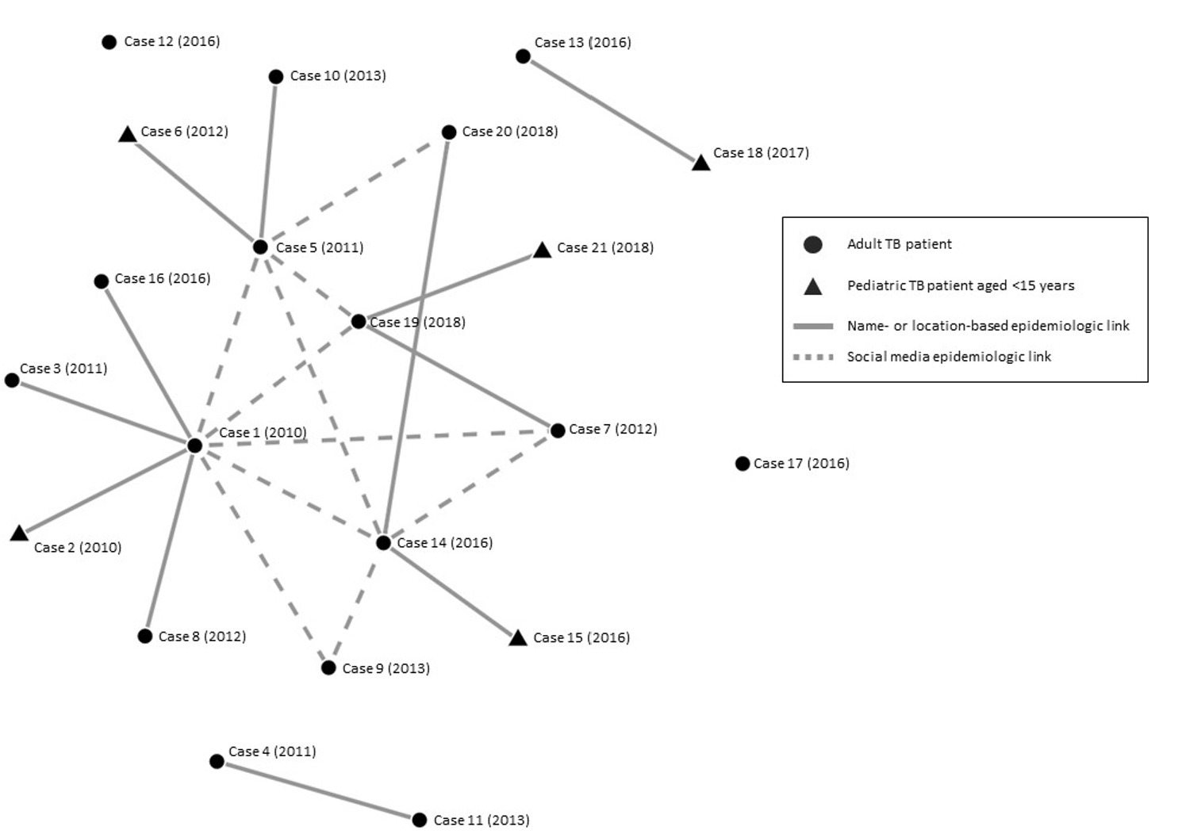
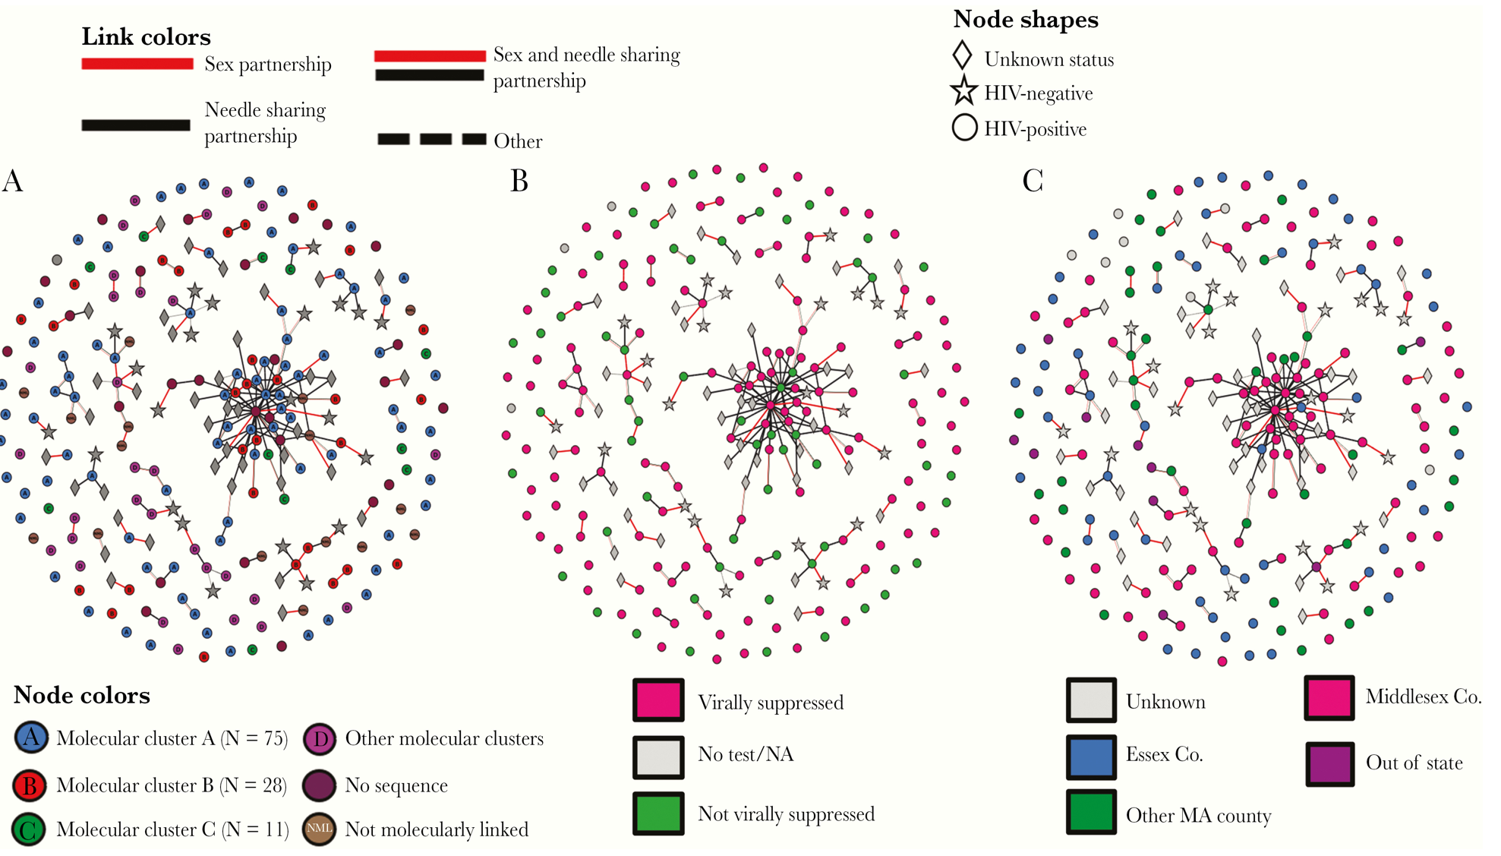
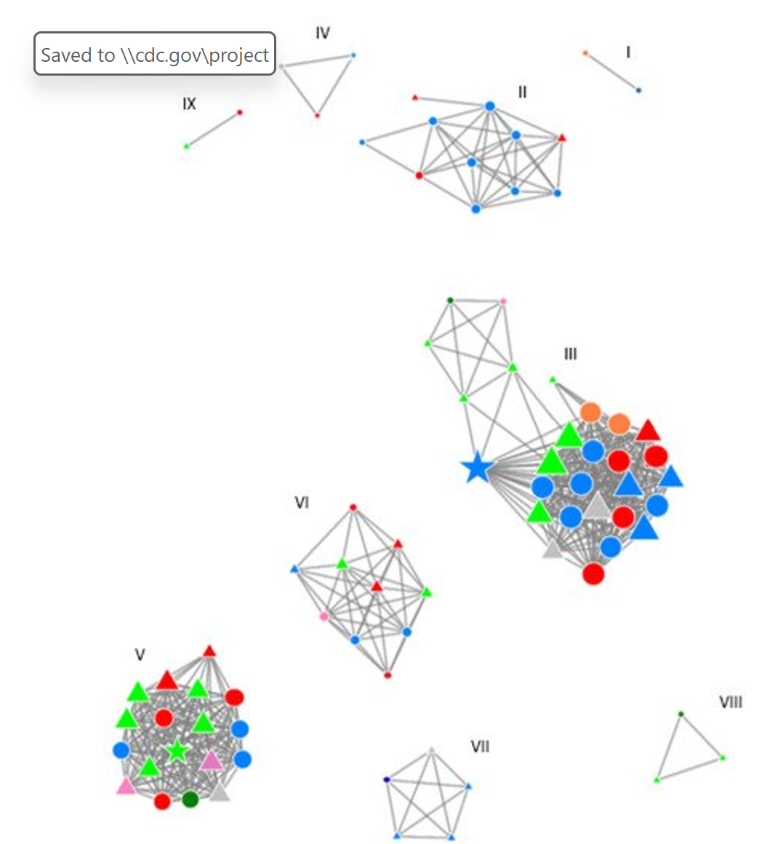
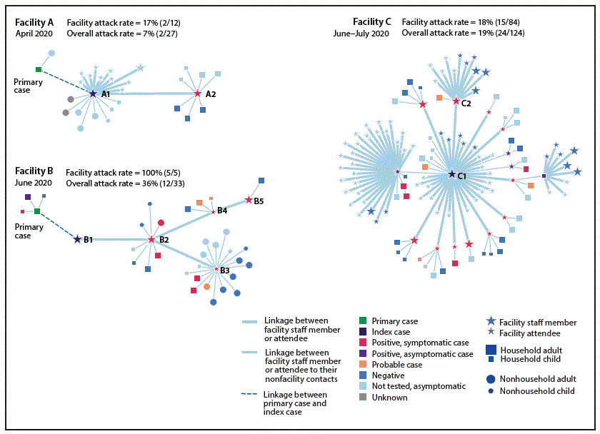
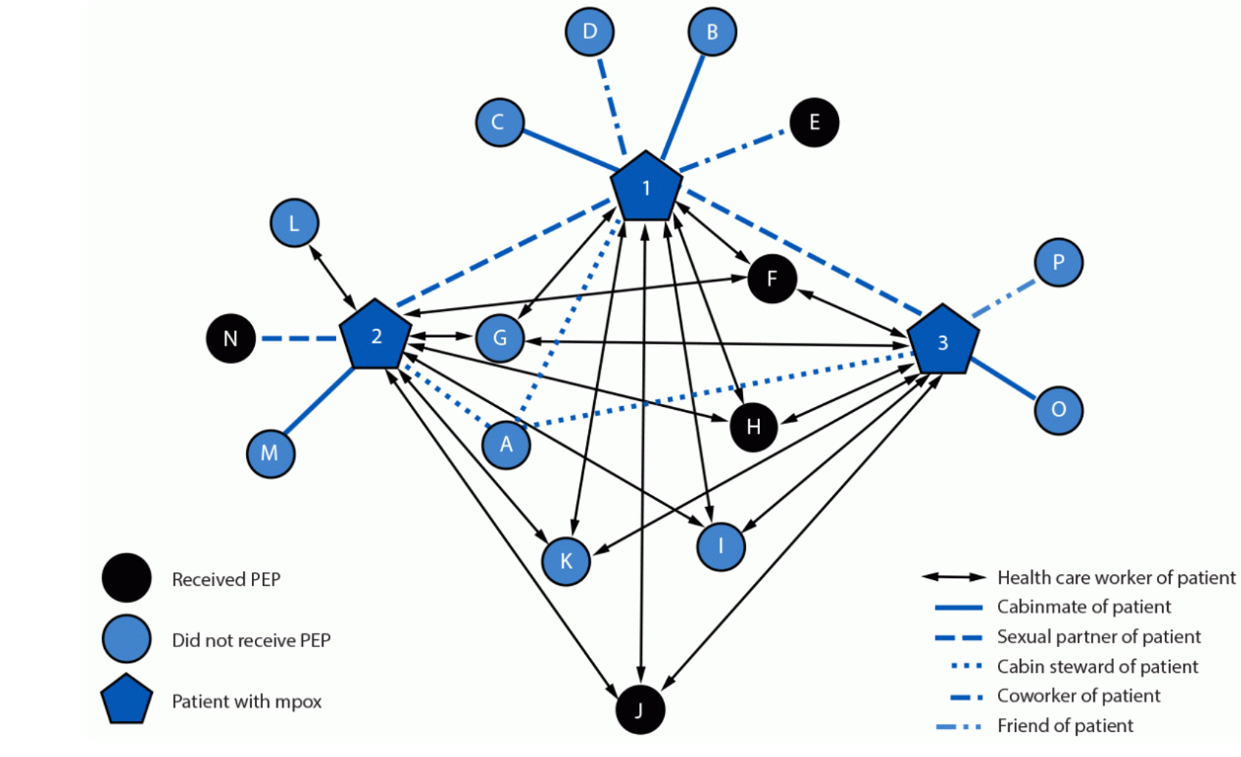
MicrobeTrace Supports Outbreak Investigations Across Multiple Pathogens
Syphilis outbreak- AR
TB outbreak- AR
HIV outbreak- MA
SARS CoV2 outbreak- UT
MPOX cruise ship outbreak
HCV transmission- Netherlands-Belgium

Slide 3

MicrobeTrace 2.0: Looking ahead
Continued partner engagement and iterative improvement
Development roadmap
Automation of testing
Transmission network statistical analysis
Optimal cluster distance threshold prediction
Cloud-based version for higher computational power
Expanded adoption across programs and platforms

Slide 4
MicrobeTrace resources
MicrobeTrace resource toolkit https://cdcgov.github.io/MEBT/microbetrace/
MicrobeTrace Wiki https://github.com/CDCgov/MicrobeTrace/wiki
MicrobeTrace Helpdesk email: microbetrace@cdc.gov
Current version (PROD v 2.0) https://microbetrace.cdc.gov/MicrobeTrace/

Slide 5
Thank you! Questions?

Slide 6
MicrobeTrace Exercise: Acinetobacter baumannii outbreak
Mayra Trujillo, Kansas DHE
Meghan Maloney, Connecticut DOH

Slide 7
Exercise Overview
Acinetobacter baumannii outbreak
Find a partner and work together
From the Github Repository: https://github.com/DNA-Bioboss/2026_AMD_Academy_MicrobeTrace_S1.git, download and/or clone the data into a folder on your computer
Go to https://microbetrace.cdc.gov/MicrobeTrace/
Open the MicrobeTrace Instructions document and begin
If you have any question, let us know
We’ll stop to discuss the activity 15 min before switching sessions

Slide 8
Microbe Trace Exercise: Candida auris outbreak
Mayra Trujillo, Kansas DHE
Meghan Maloney, Connecticut DOH

Slide 9
Exercise Overview
Candida auris outbreak
Find a partner and work together
From the Github Repository: https://github.com/DNA-Bioboss/2026_AMD_Academy_MicrobeTrace_S2.git, download and/or clone the data into a folder on your computer
Go to https://microbetrace.cdc.gov/MicrobeTrace/
Open the MicrobeTrace Instructions document and begin
If you have any question, let us know
We’ll stop to discuss the activity 15 min before switching sessions

Slide 10

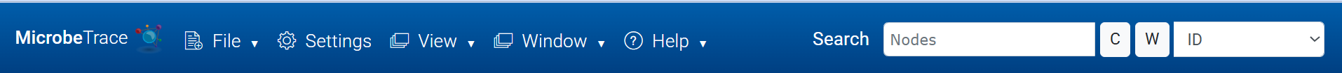
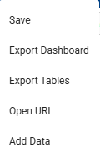
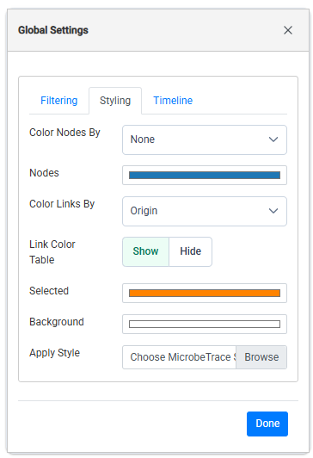
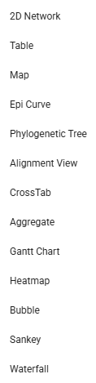

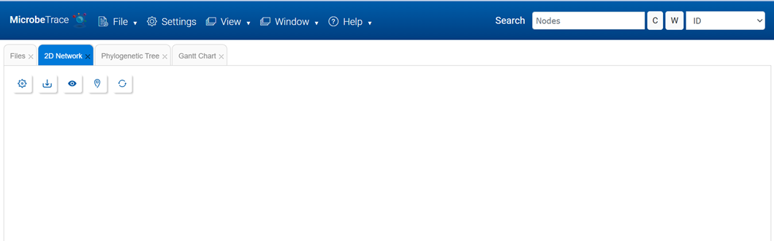



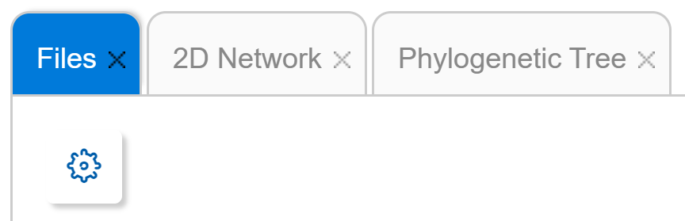
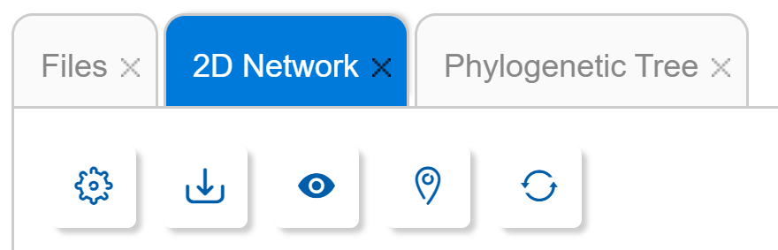
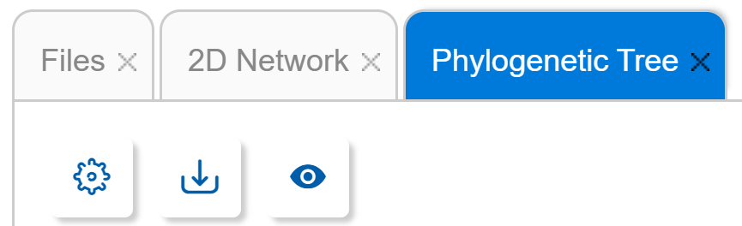
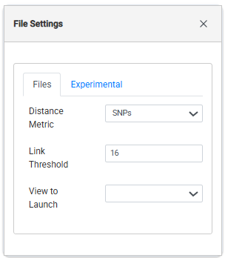
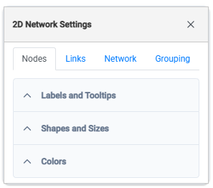
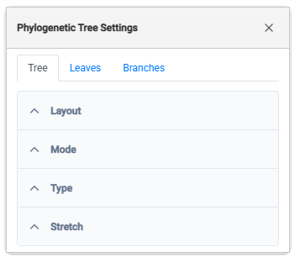
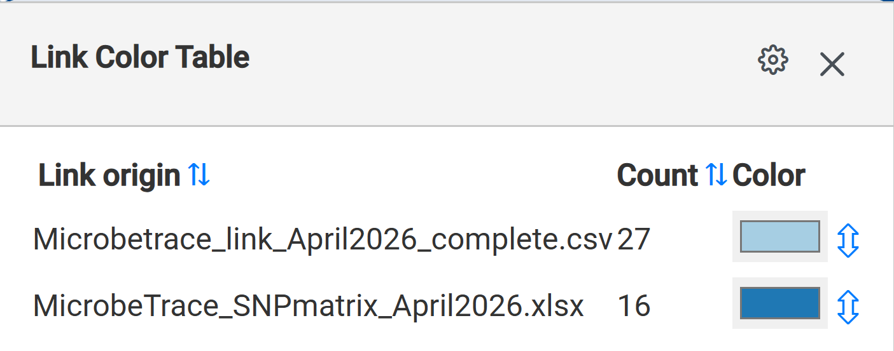
Navigation Guide
Selecting “Reload” exits the session and goes back to the “Add File” screen.
“Fullscreen” toggles to and from a full screen view.
Styles and Sessions can be saved.
Allows you to add data to the current analysis.
Opens the Global Settings Menu. Allows link and node style settings and genetic distance cut-off values to be customized.
Selecting “View” displays a list of data visualizations to add to the current project.
Pin all Nodes: This button will “freeze” the network.
Center and Scale: You can zoom in and out on the network using the mouse roller. This button re-scales and centers it back to the original size on the screen.
Selecting the Toggle Settings button once displays the settings menu for the active view, selecting it again hides the menu.

