Slide 1
Mapping a multi-facility Carbapenem-resistant Acinetobacter baumannii transmission network using MicrobeTrace
Mayra Trujillo, MS, Molecular Epidemiologist
April 2026

Slide 2
Learning objectives
After participating in this session, you should be able to:
Describe what MicrobeTrace is and its role in public health data visualization
Describe what MicrobeTrace is and its role in public health data visualization
Explain the key functions and capabilities of MicrobeTrace
Define transmission networks and their relevance to outbreak investigations
Identify the types of data and information required to use MicrobeTrace effectively

Slide 3

MicrobeTrace
What is MicrobeTrace?
A powerful, secure data visualization tool to map transmission networks and associated data
Various analytical tools
Handles various data inputs
Pathogen agnostic
Operates entirely on your web-browser
Does NOT communicate information over the web
https://microbetrace.cdc.gov/MicrobeTrace/
Notes:
Now, let me give a bit more detail about what MicrobeTrace is. As I mentioned previously, it is a powerful, secure data visualization tool that can be used to map transmission networks. However, transmission networks are not the only things MicrobeTrace can visualize. It can also display histograms, SNP heatmap matrices, nucleotide sequence alignments, phylogenetic trees, and maps showing the geographic locations of uploaded cases.
Because MicrobeTrace supports these different visualizations, it is able to handle a variety of data inputs.
Also, MT is pathogen-agnostic meaning it can used for any pathogen capable of causing an outbreak. While it was originally developed for HIV surveillance, it has since been used across a wide range of diseases. For example, I use it frequently when collaborating with the healthcare associated infections team for CPO outbreak investigations.
The best part is, that MicrobeTrace runs entirely within your web browser and does not transmit any information over the web, which is critical for maintaining data security and HIPAA compliance.

Slide 4
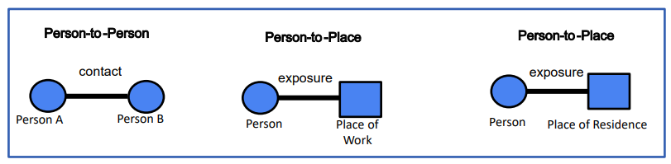
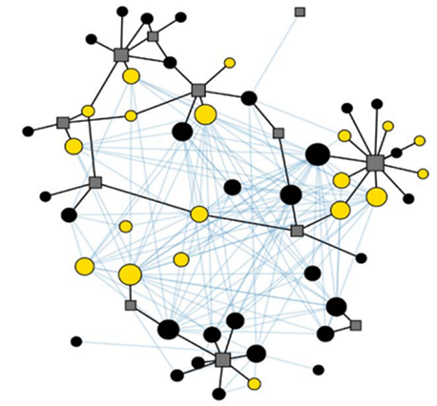
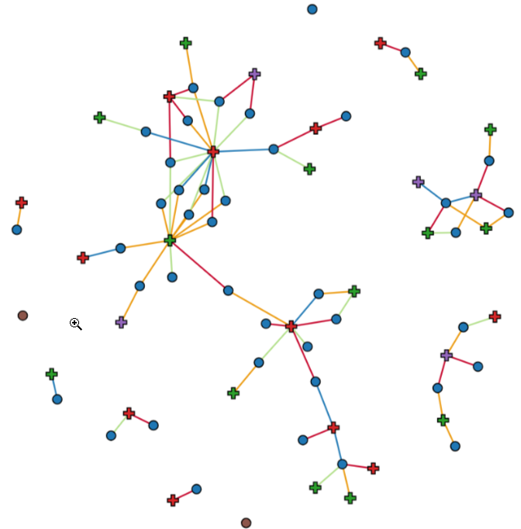
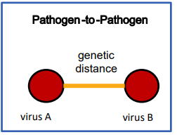
Transmission Networks
What are Transmission Networks?
Types of Networks
Connections of all individuals within a group
Epidemiological Networks
Genetic Distance Networks
https://microbetrace.cdc.gov/MicrobeTrace/
Notes:
Transmission networks provide fine-grained insight into transmission patterns by visualizing connections among individuals within a group. These networks can be epidemiological or based on genetic distance. MicrobeTrace allows both network types to be visualized simultaneously, enabling integrated interpretation of genomic and epidemiologic data.

Slide 5
Why map transmission networks?
Identifies and characterizes disease incidence and transmission hotspots
Enables spatial-temporal analysis of data
Allows fine-grain resolution of transmission dynamics by combining genomic and epidemiologic data
Informs outbreak-specific intervention efforts
Informs future prevention strategies
Notes:
So why do we map transmission networks?
First, they help us identify where transmission is happening, allowing us to pinpoint hotspots and understand disease incidence.
They also let us analyze outbreaks across both space and time, which is critical for understanding how transmission evolves, not just where it starts.
By integrating epidemiologic and genomic data, transmission networks give us a much more fine-grained view of who may be connected to whom, beyond what either data source can show alone.
All of this directly supports outbreak-specific intervention decisions, like where to focus contact tracing or infection control efforts.
And finally, these insights don’t just help with the current outbreak, they also inform future prevention and preparedness strategies.

Slide 6
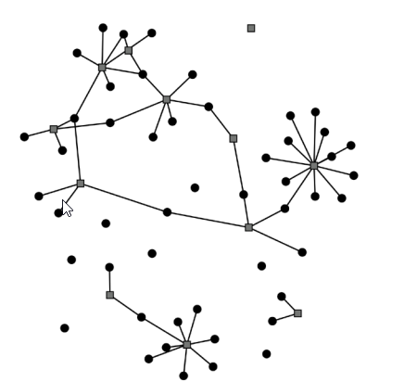
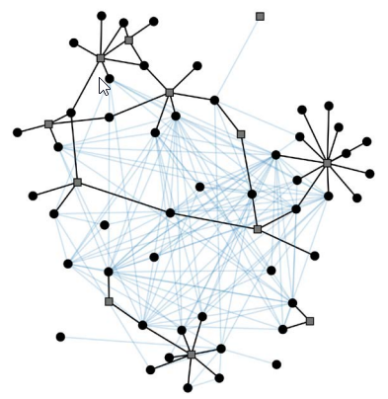
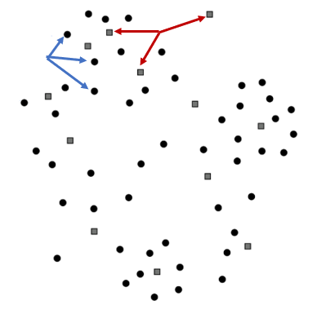
Transmission Network Example
No Links
Person-to-Place Links
Genetic Links
cdc.gov/amd/pdf/slidesets/toolkitmodule_3.2-508c.pdf
Notes:
Now, let me show how MT TN come to be.
The first image shows nodes of an outbreak. Where circular nodes represent people, and squares represent facilities or locations.
The second image shows Person-to-Place Links. I’ve done that by adding epidemiological data, such as an edge list, that we’ve gathered through investigation, and now we can see the links appear.
In the last image we see Genetic Links. By adding genomic data and we can start to visualize which groups may have similar genetic sequences

Slide 7
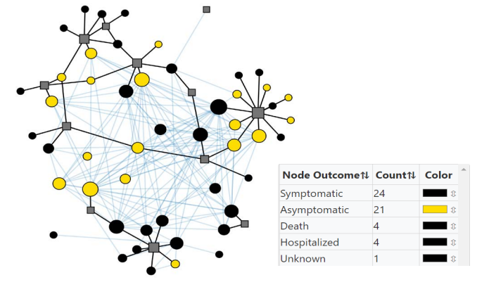
Transmission Network Example
Layered Information
cdc.gov/amd/pdf/slidesets/toolkitmodule_3.2-508c.pdf
Notes:
MT is customizable, allowing you to layer other information:
Such as sizing the nodes by how many genetic links they have.
Even color the nodes by outcomes
This gives you a better picture of how transmission patterns form and connect.

Slide 8
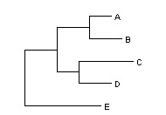

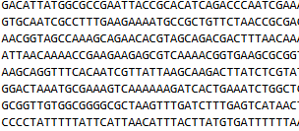

What data is needed? Other data types
Line list
Newick files
Contact tracing
Raw sequencing files
https://www.ncbi.nlm.nih.gov/nuccore/CP180030.1?report=fasta
https://www.researchgate.net/figure/A-simple-tree-example-described-in-Newick-format-A02-B0303-C05_fig2_41531382
Notes:
What type of data is needed to create a MT TN?
First you’ll need a line list, where each row represents a case or individual.
The line list may also include relevant demographic or epidemiological data.
Second, you’ll need linking data, in this instance an edge list. This list defines relationships between individuals such as who visited which facility, who was exposed or who had contact with who.
To take full advantage of MT, you’ll want to add some type of sequencing data whether it be newick files, raw sequencing, snp matrices, etc..

Slide 9
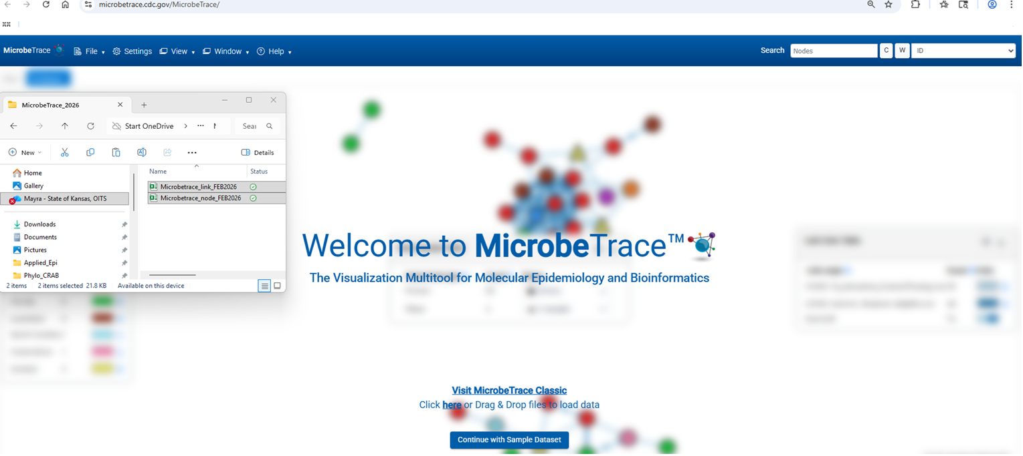
Loading Data to MicrobeTrace
From the Github Repository (https://github.com/DNA-Bioboss/2026_AMD_Academy_MicrobeTrace_S1.git), download and/or clone the data into a folder on your computer.
Go to https://microbetrace.cdc.gov/MicrobeTrace/
Select the recently downloaded files, then drag and drop to load the files
https://microbetrace.cdc.gov/MicrobeTrace/
Notes:
So now I’m going to show a demo. If you want to follow along.
Go to google and type in microbetrace, and on a second tap go to github download the
Notice that that we are loading the files NOT uploading files

Slide 10
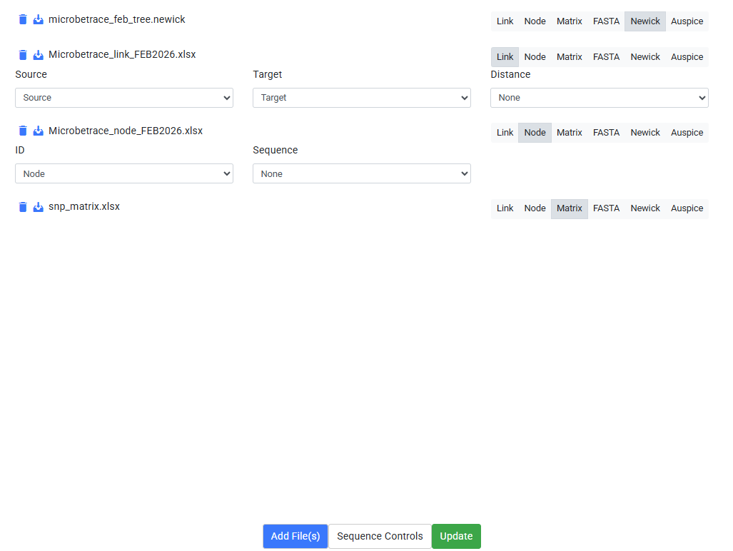
Loading Data to MicrobeTrace…continued
Select the correct data type
Select the column that represents the ID for each dataset
Click “Launch”
Notes:
READ SLIDE
It is crucial that the same IDs are used consistently across both the edge list and the contact list to ensure data linkage.

Slide 11
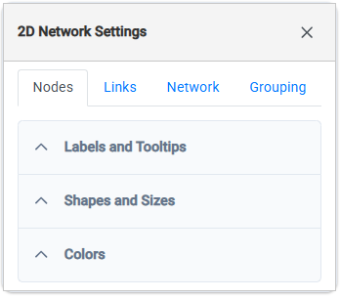
Customizing Networks
Nodes and links can be customized in the Toggle Network Setting Menu accessed clicking the “cog” icon
Labels and Tooltips
Shapes and Sizes
Colors
Notes:
READ SLIDE

Slide 12
Demo

Slide 13

Mayra Trujillo, MS
Molecular Epidemiologist
Informatics and Molecular Epidemiology Program
Kansas Department of Health and Environment
785-600-8674
mayra.trujillo@ks.gov

Slide 14

Thank You/Questions

