Slide 1
Mapping a multi-facility Carbapenem-resistant Acinetobacter baumannii (CRAB) outbreak using MicrobeTrace
April 8, 2025

Slide 2

What is MicrobeTrace?
A powerful, secure data visualization tool to map transmission networks and associated data
Handles various data inputs
Various analytical tools
Operates entirely on your web-browser
Does NOT communicate information over the web
https://microbetrace.cdc.gov/MicrobeTrace/

Slide 3
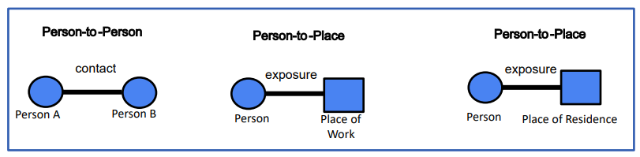
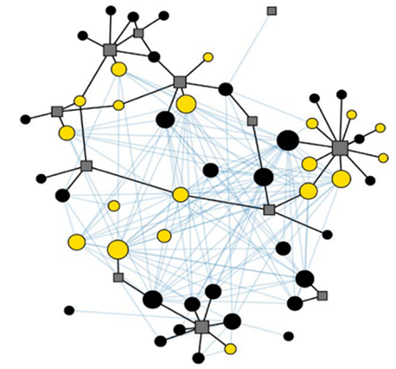
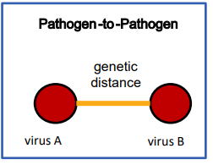
Transmission Networks
What are transmission networks?
Connections of all individuals within a group
Types of Networks
Epidemiological Networks
Genetic Distance Networks
https://microbetrace.cdc.gov/MicrobeTrace/

Slide 4
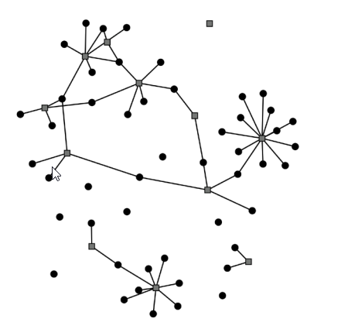
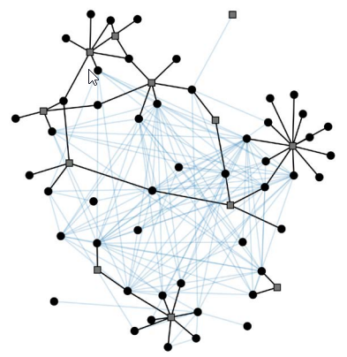
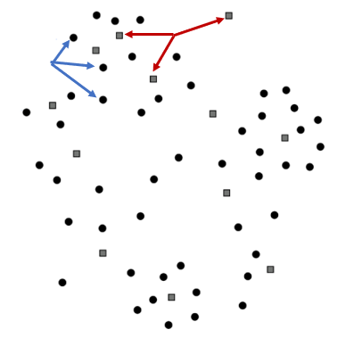
Transmission Network Example
No Links
Person-to-Place Links
Genetic Links

Slide 5
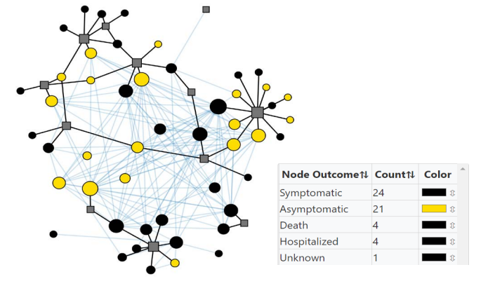
Transmission Network Example
Layered Information

Slide 6
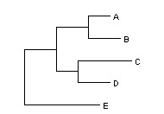

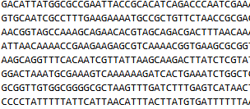

Data Inputs
What data is needed? Other data types
Line list
Newick files
Contact tracing
Raw sequencing files

Slide 7
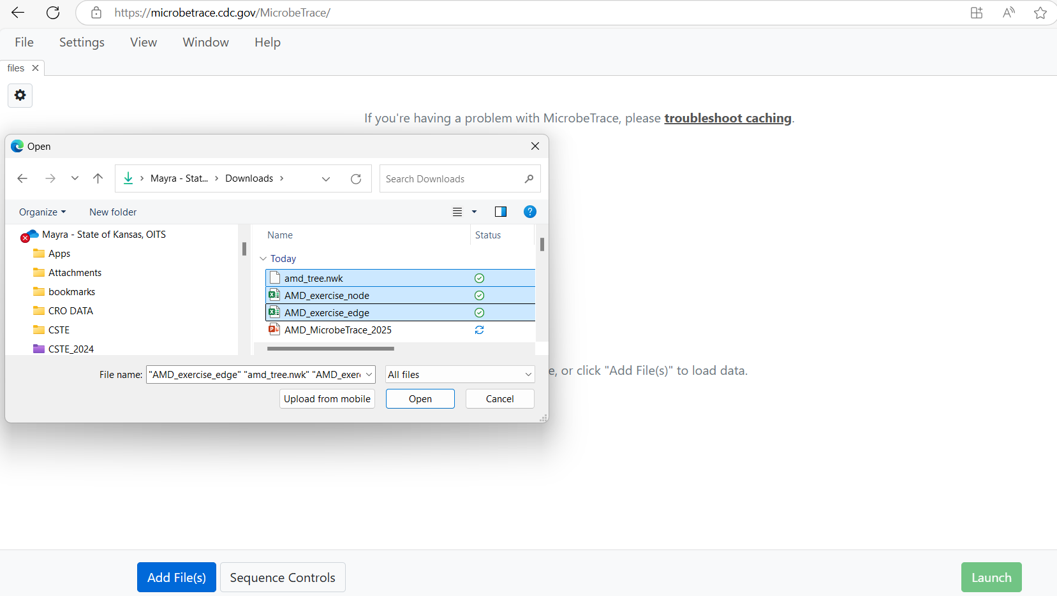
Loading Data to MicrobeTrace
From the Github Repository (https://github.com/DNA-Bioboss/AMD-Academy-2025.git), download and/or clone the data into a folder on your computer.
Go to https://microbetrace.cdc.gov/MicrobeTrace/
Click the blue “Add File(s)”
Select the recently downloaded files and load the files

Slide 8
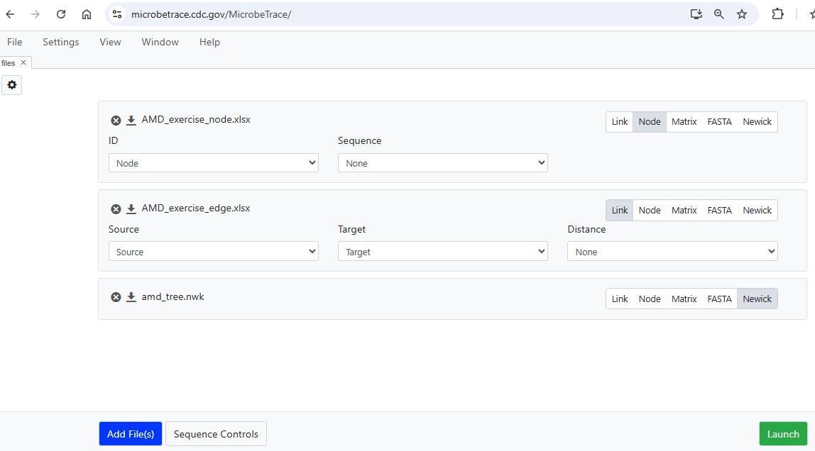
Loading Data to MicrobeTrace…continued
Select the correct data type
Select the column that represents the ID for each dataset
Click “Launch”

Slide 9
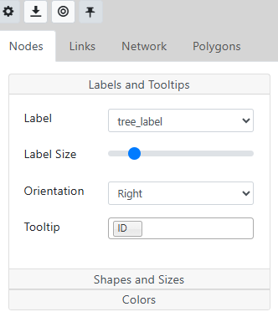
Customizing Networks
Nodes and links can be customized in the Toggle Network Setting Menu accessed clicking the “cog” icon
Labels and Tooltips
Shapes and Sizes
Colors

Slide 10
Demo

Slide 11
Questions?

