Slide 1
Mapping a multi-facility Carbapenem-resistant Acinetobacter baumannii transmission network (or outbreak?) using MicrobeTrace
Presenter | Date
Notes:
General Guidelines
PowerPoints must be reviewed by Communications before being presented for the first time. Please send completed PowerPoints to Philip Harris at least three business days before the presentation. For presentations that are part of conferences where more than ten KDHE employees presenting, please allow no less than 7 business days. All PowerPoints must be on an approved KDHE template, or the one provided by the conference organizer. By submitting a presentation for review you acknowledge that you have read, and to the best of your ability followed the guidelines presented below.
• PowerPoint templates are located on the KDHE intranet.
• Follow the 7 x 7 rule; try to place no more than 7 words per line and have no more than 7 lines of text.
• Font should all be Arial, except the mission statement in the footer of each slide.
• Header font size should be at least 36 pt., while body font size should be at least 18 pt.
• Photo sources may be 8 pt. font.
• Please include the Presentation Name, Presenter First and Last Name their credentials, if any, and the date (Month Day, Year) on title slide.
• Strongly consider including a head shot of the presenter at either the beginning or end of the presentation with their contact information (Name, Title, Phone Number and Email Address). Head shots are free for agency staff, contact Brandon Clasen at Brandon.Clasen@ks.gov to get yours taken.
• Please do not change the existing color scheme.
• Please do not include URL links, unless the PowerPoint is being used digitally.
• Please do not use any clip art or photos pulled off the internet. KDHE Communications has a subscription to iStock. These high-quality photos are available to programs at no cost. To obtain photos, first search the Agency Image Library on KDHE intranet, download and use what you need. To obtain photos email Kynedee Hodges at Kynedee.Hodges@ks.gov; or place the link of the iStock photo into the slide where you would like the image added. Exceptions are made when the agency cannot shoot or purchase a certain image, and you are responsible for providing proper credit to the source of the photo.

Slide 2
MicrobeTrace
Brief Introduction 15min
Demo 15min
Exercise 40min
Discussion 15min

Slide 3

MicrobeTrace
What is MicrobeTrace?
A powerful, secure data visualization tool to map transmission networks and associated data
Handles various data inputs
Various analytical tools
Operates entirely on your web-browser
Does NOT communicate information over the web
https://microbetrace.cdc.gov/MicrobeTrace/

Slide 4
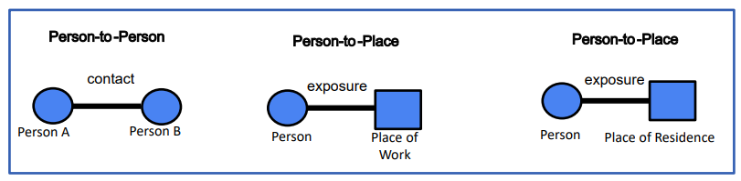
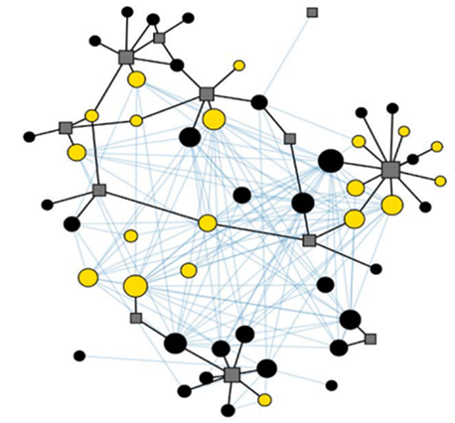
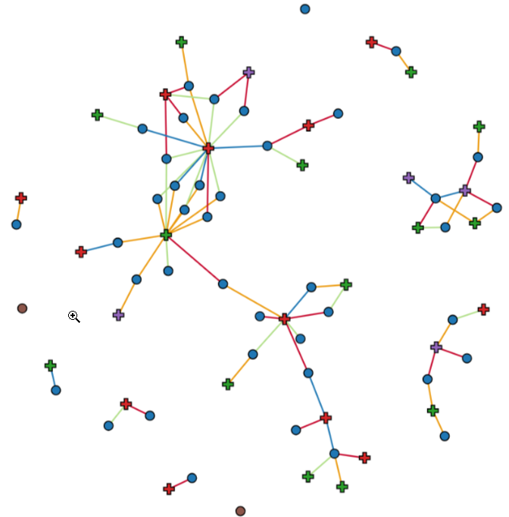
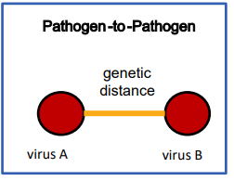
Transmission Networks
What are transmission networks?
Types of Networks
Connections of all individuals within a group
Epidemiological Networks
Genetic Distance Networks
https://microbetrace.cdc.gov/MicrobeTrace/

Slide 5
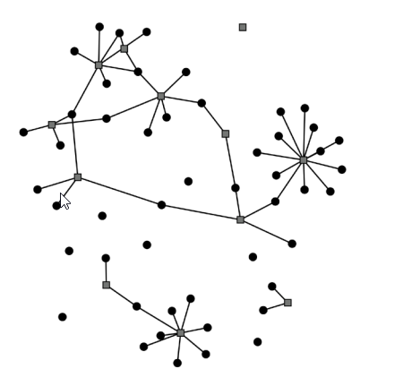
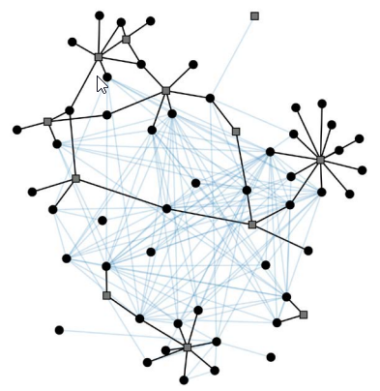
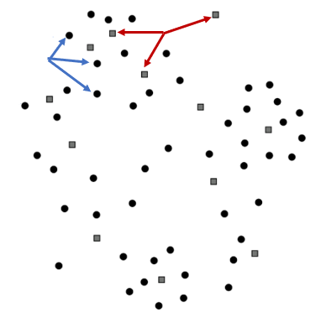
Transmission Network Example
No Links
Person-to-Place Links
Genetic Links
cdc.gov/amd/pdf/slidesets/toolkitmodule_3.2-508c.pdf
Notes:
No Links:
Squares are locations
Circles are ppl
Person-to-Place Links:
Now we add epidemiological data that we’ve gathered through investigations, and we can see the links appear
Genetic Links:
Now we add genomic data like from a phylogenetic tree and we can start to visualize which

Slide 6
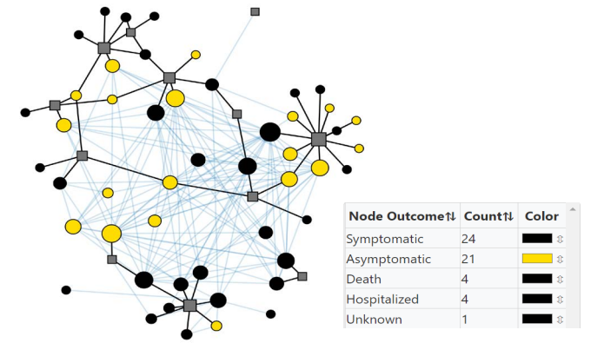
Transmission Network Example
Layered Information
cdc.gov/amd/pdf/slidesets/toolkitmodule_3.2-508c.pdf
Notes:
You can layer other information:
Such as sizing the nodes by how many genetic links they have.
Even color the nodes the outcomes
This gives you a better picture of how this network comes together

Slide 7
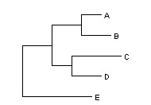

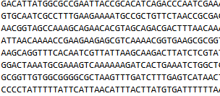

What data is needed? Other data types
Line list
Newick files
Contact tracing
Raw sequencing files
https://www.ncbi.nlm.nih.gov/nuccore/CP180030.1?report=fasta
https://www.researchgate.net/figure/A-simple-tree-example-described-in-Newick-format-A02-B0303-C05_fig2_41531382

Slide 8
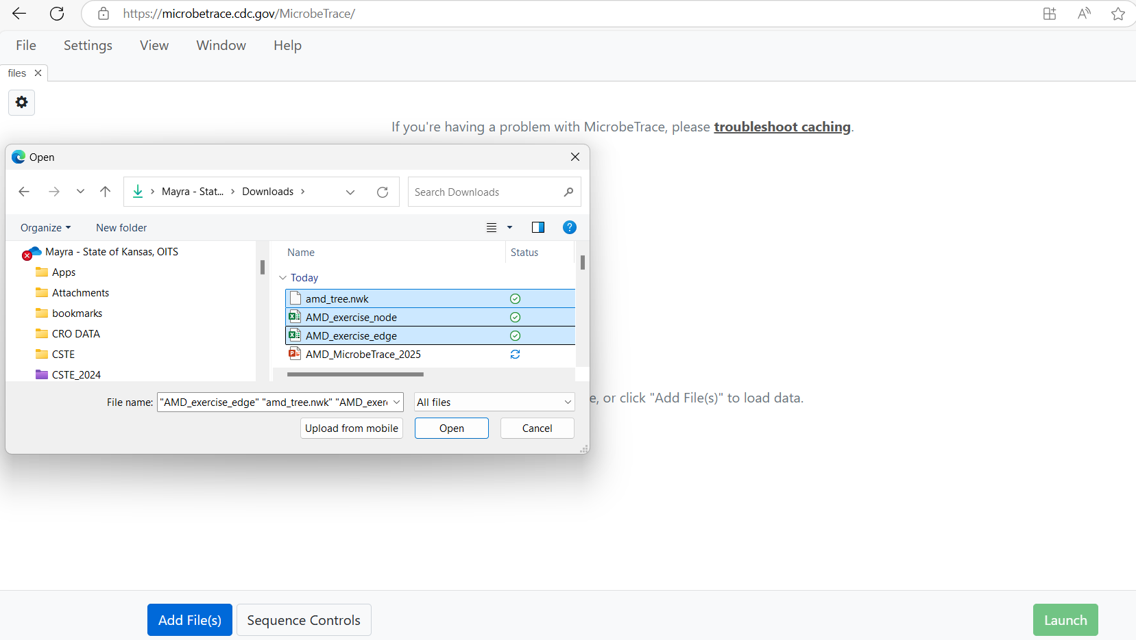
Loading Data to MicrobeTrace
From the Github Repository (https://github.com/halosere/Genomic-Epidemiology/blob/main/AMD%20Academy%202024), download and/or clone the data into a folder on your computer.
Go to https://microbetrace.cdc.gov/MicrobeTrace/
Click the blue “Add File(s)”
Select the recently downloaded files and load the files
Notes:
Notice that that we are loading the files NOT uploading files

Slide 9
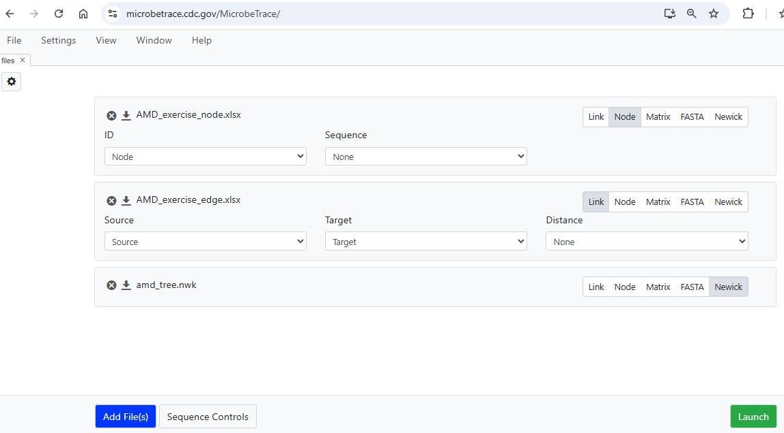
Loading Data to MicrobeTrace…continued
Select the correct data type
Select the column that represents the ID for each dataset
Click “Launch”
Notes:
It is crucial that the same IDs are used consistently across both the edge list and the contact list to ensure data linkage.

Slide 10
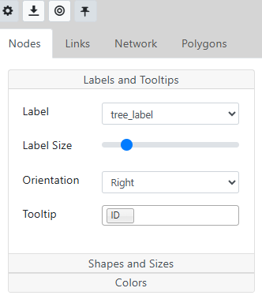
Customizing Networks
Nodes and links can be customized in the Toggle Network Setting Menu accessed clicking the “cog” icon
Labels and Tooltips
Shapes and Sizes
Colors

Slide 11
Demo

Slide 12

Thank You/Questions

