Slide 1
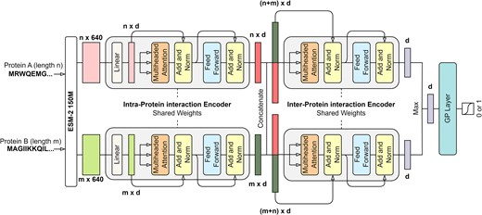

Slide 2
Uses Gaussian Process rather than dense layer for classification
  Approximated by Laplace approximation of the random fourier feature expansion of the GP posterior (??? need to learn this)
  Spectral normalization (???) of hidden layer weights
Detects OOD input and adjusts the interaction probability accordingly
Reduced false positive rates.

