Slide 1
The transcriptomic response of neuroblastoma cells to hypoxia
Authors:
Simon Kelterborn, Xheni Meci, Holger Scholz
Katharina , Karin Kirschner, Helena Landstorfer

Slide 2
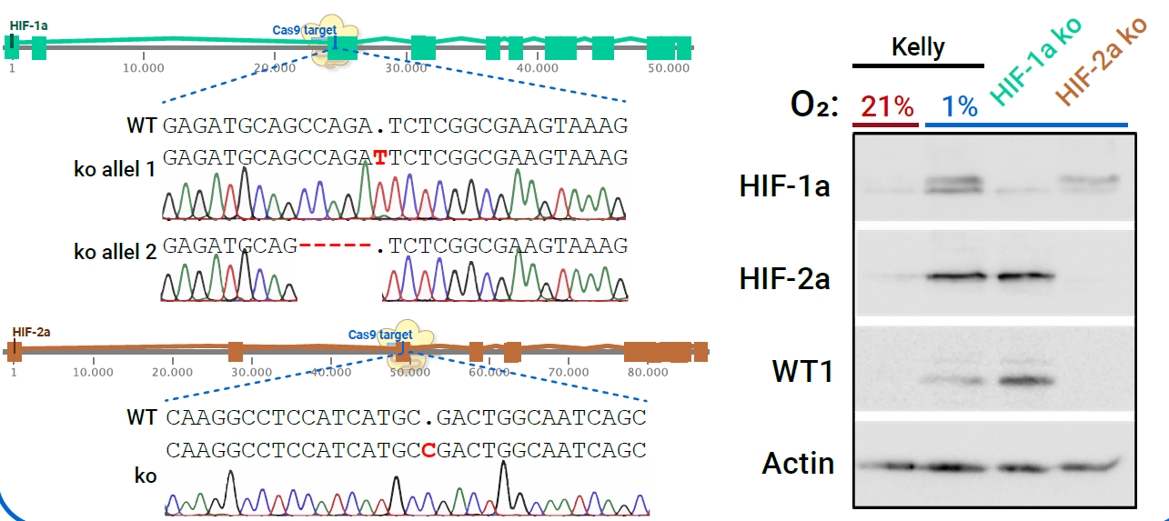
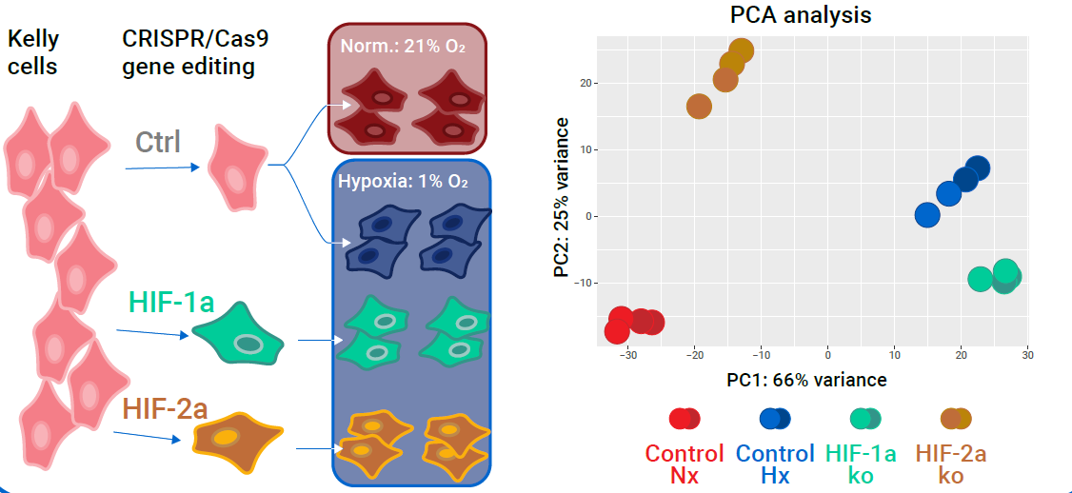
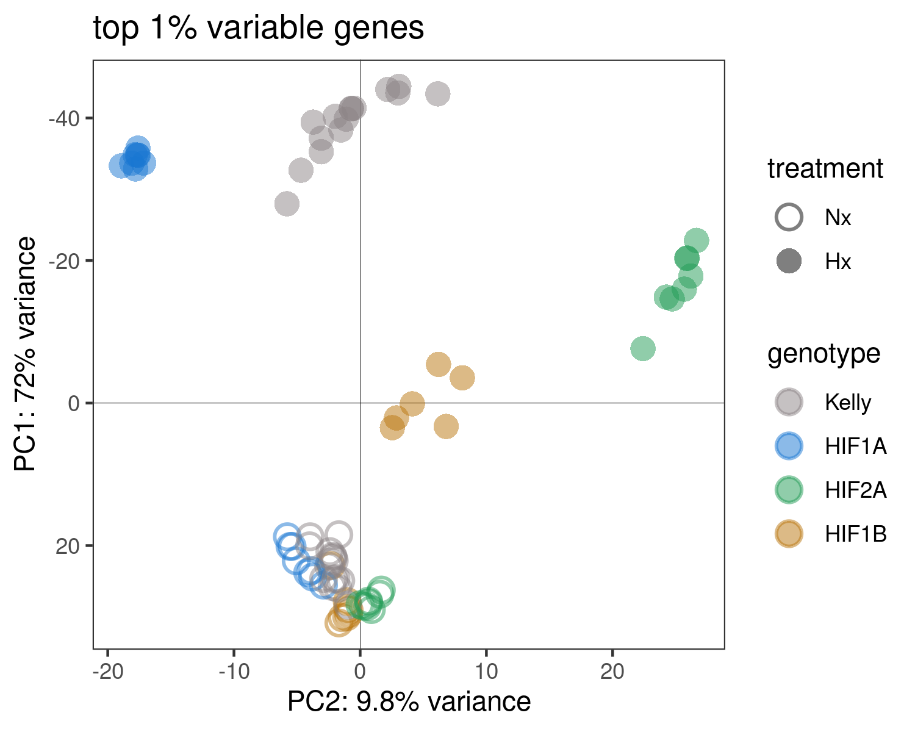
Fig. 1
Generation of HIF-KOs
Hif1b-KO
Hif1b WB
Nx Samples
RNA-Seq experiment
+ Hif1b

Slide 3
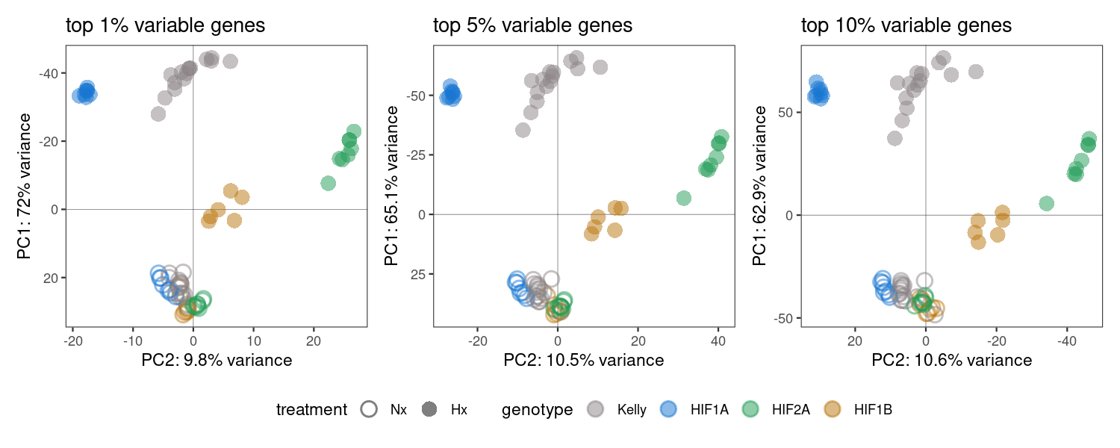
Fig. 1 - variants
1%, 5%, or 10% genes?

Slide 4
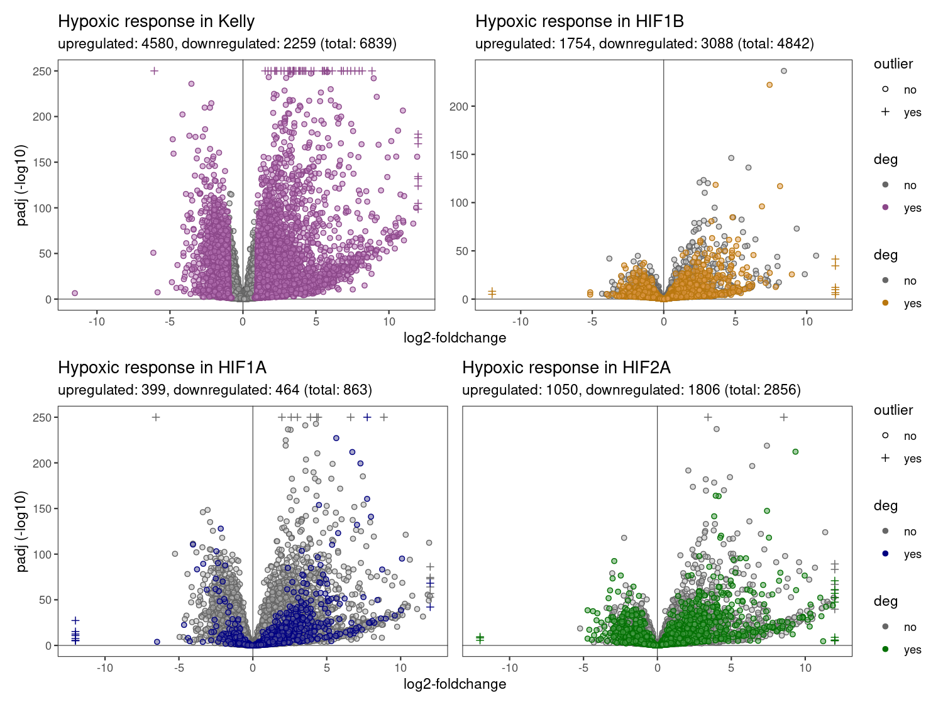
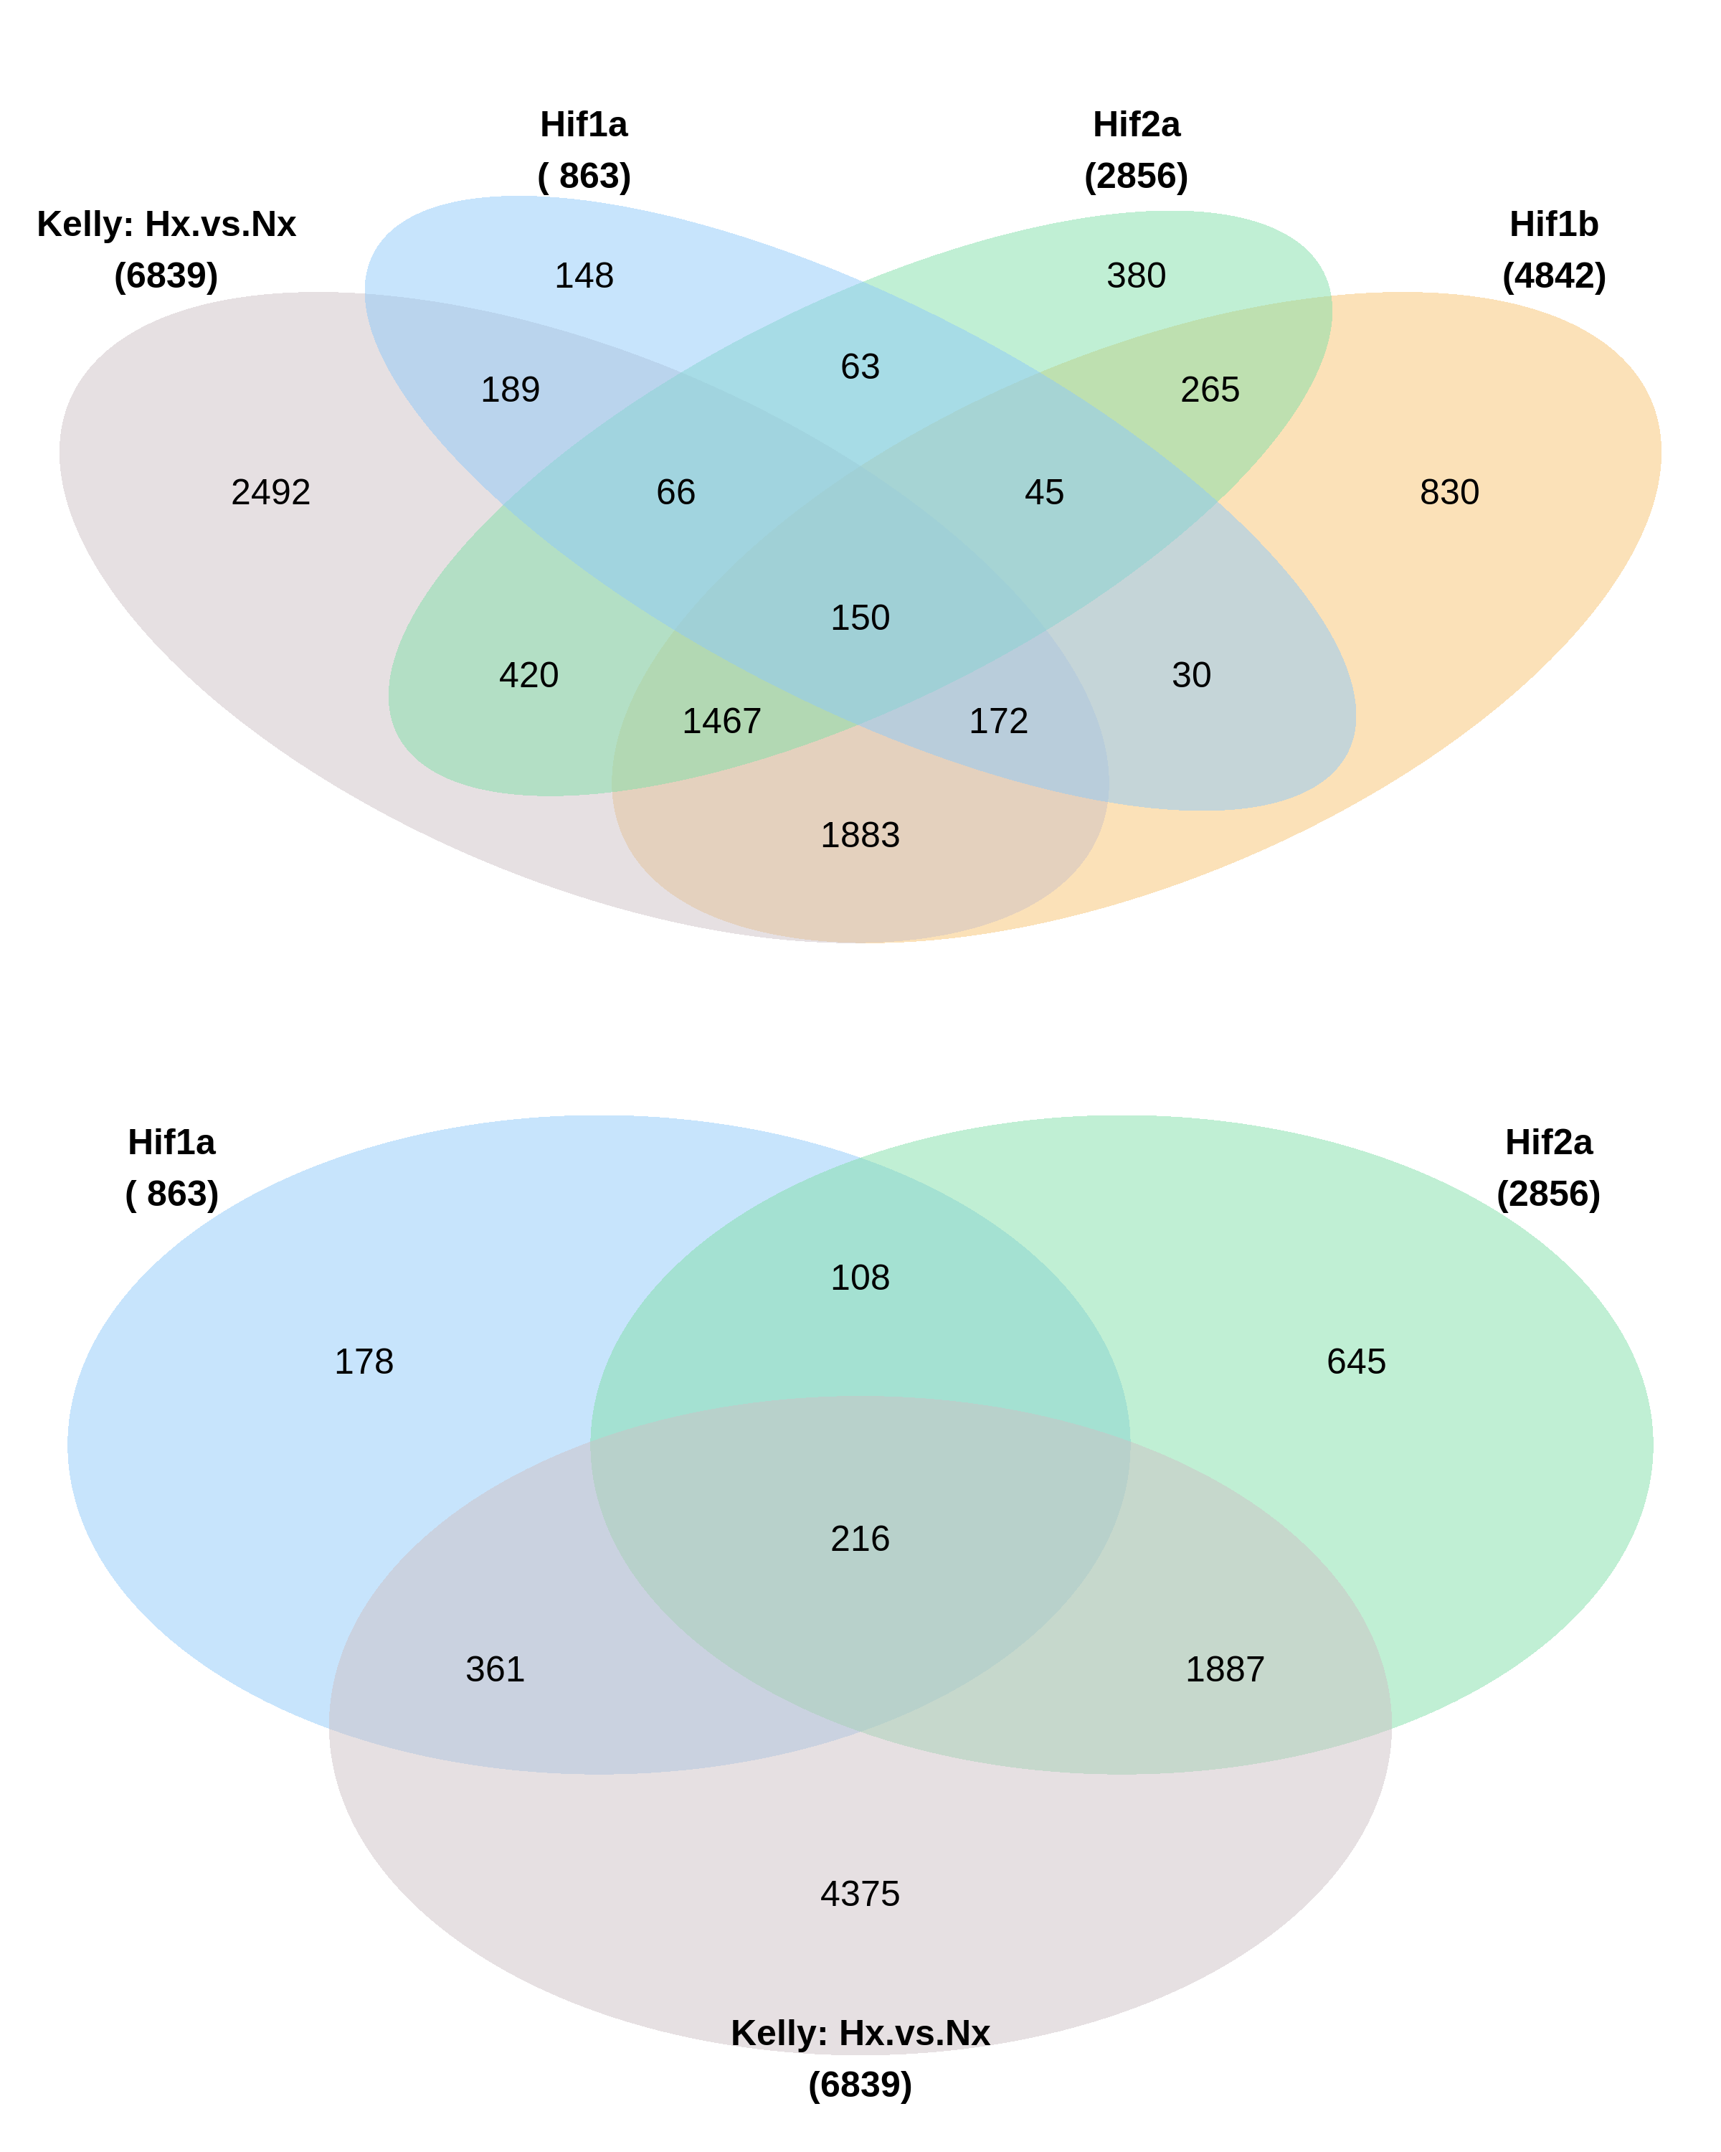
Fig. 2
Hypoxia induced genes
Cutoff: padj < 0.05,
log2-FC > 1,
baseMean > 0
-> Plotted are the points of the hypoxic response in each cellline (Hif1a: Hx vs. Nx)
-> Colored are the genes with different hypoxic effect compared to Kelly (Hif1a Hx-Nx vs. Kelly Hx-Nx)

Slide 5
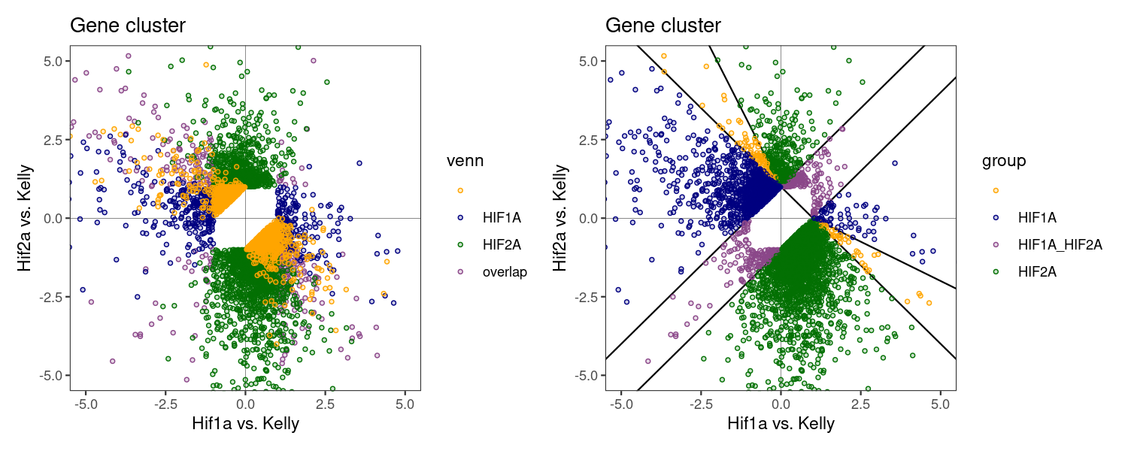
Fig. 3
Hif1a / Hif2a specific genes
HIF1A: 1736
HIF2A: 3133
HIF1A_HIF2A: 334
„orange“: 171
-> Only few „parallel“: 334
-> Assign corners to HIF1A/HIF2A?

Slide 6
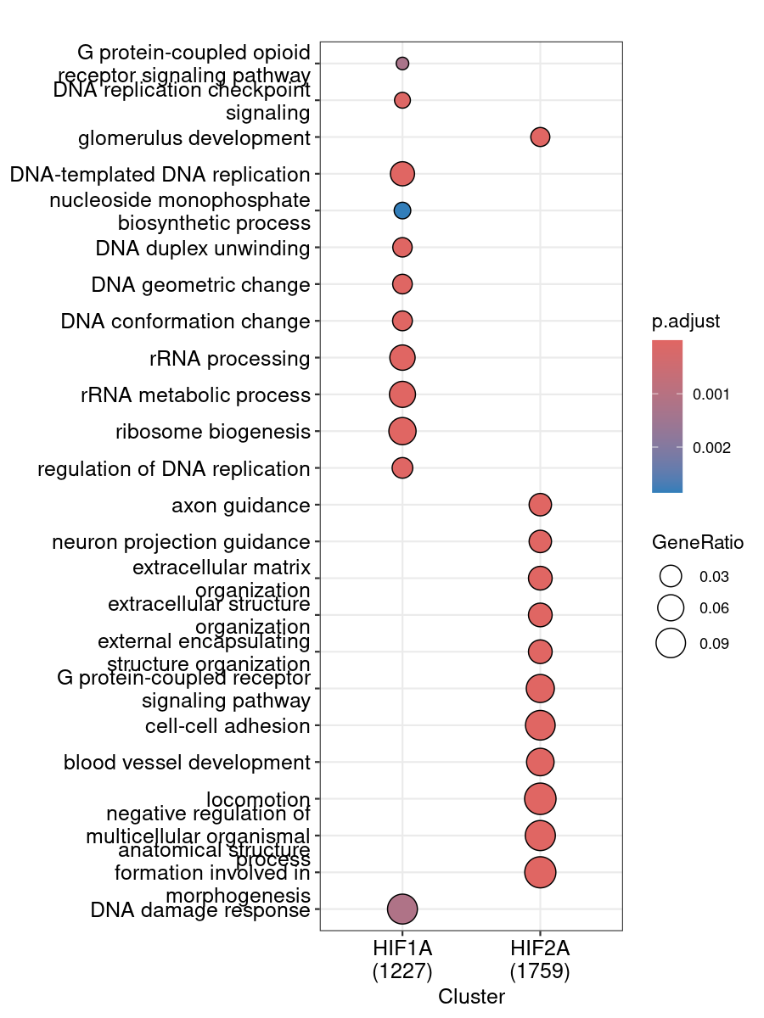
Fig. 4
GO-terms
KEGG

Slide 8
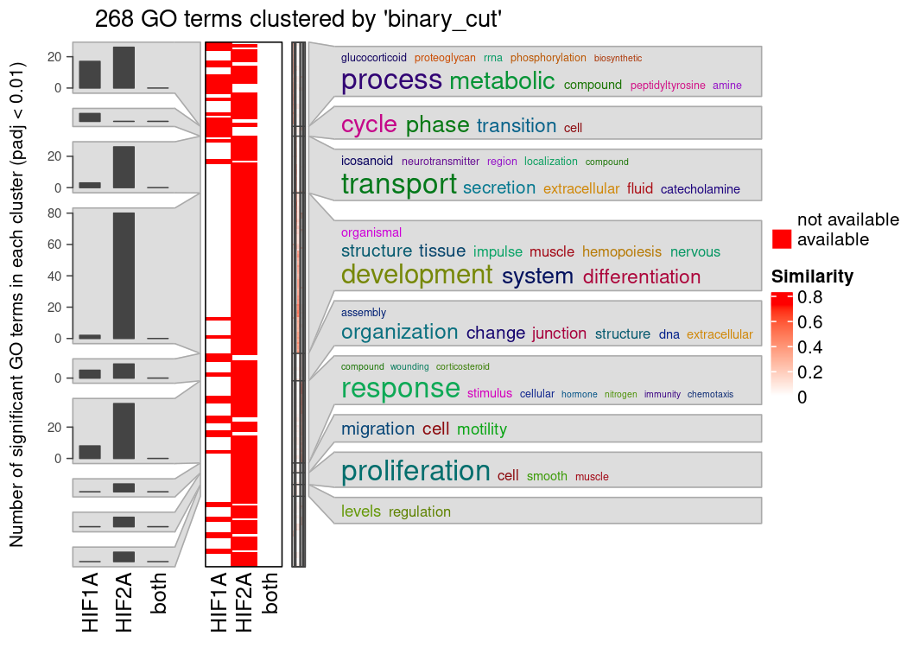

Slide 10
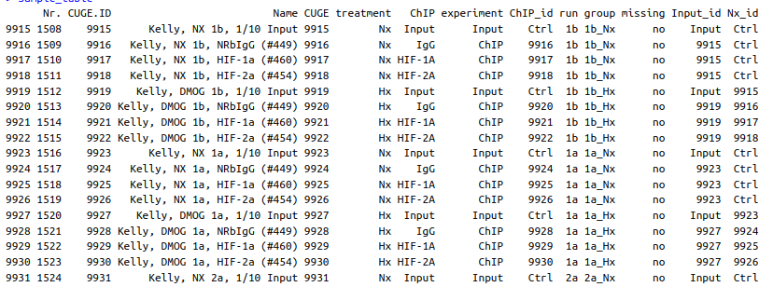
Extra: Kelly ChIP-Seq
1.) MACS peak calling
2.) Peaks - IgG
3.) Peaks -Nx

Slide 11
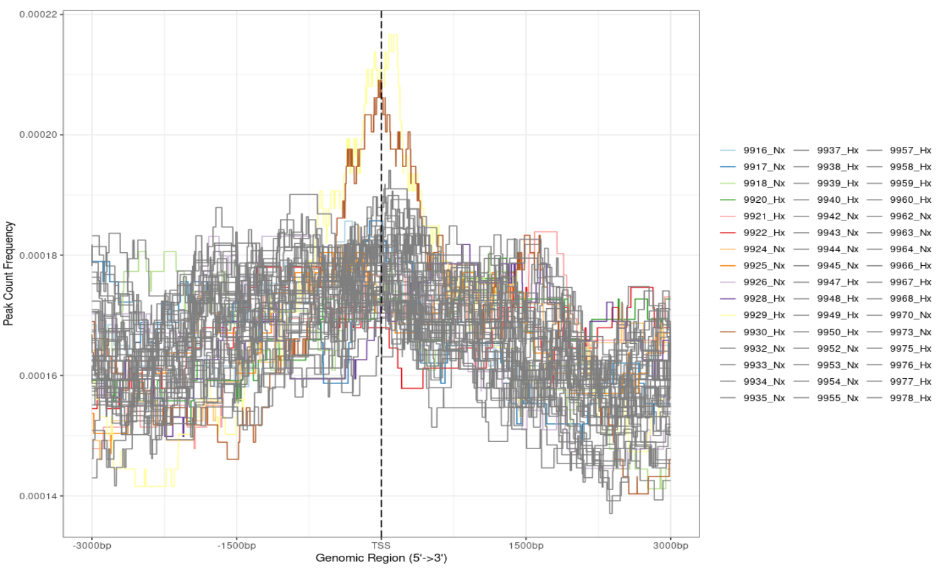

Slide 12
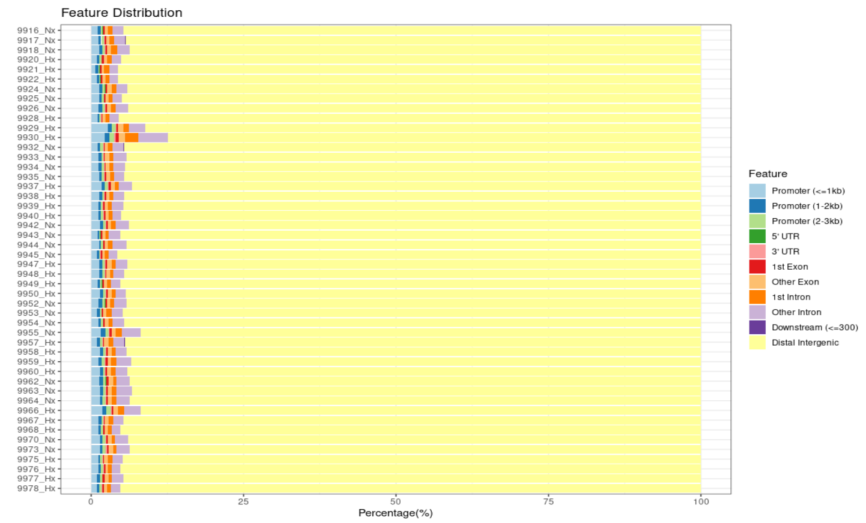

Slide 14
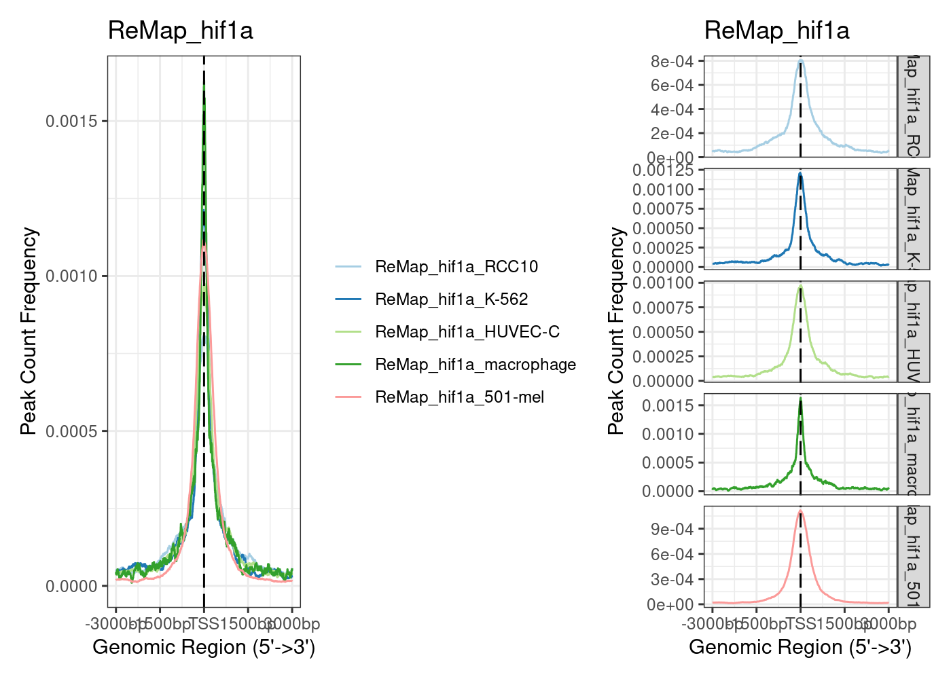
Other ChIP datasets: ReMAP

Slide 15
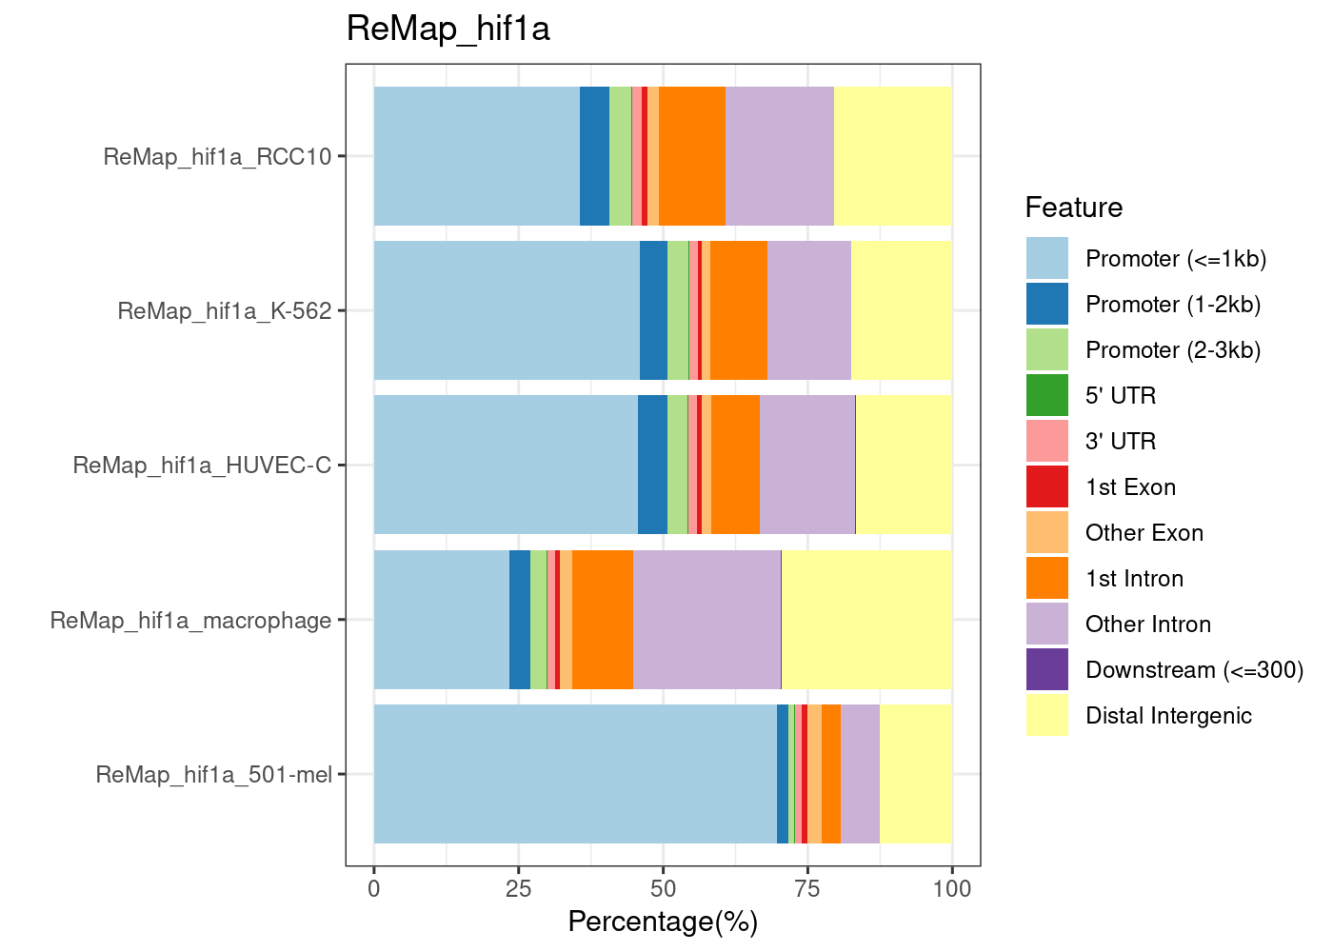
Other ChIP datasets: ReMAP

Slide 16
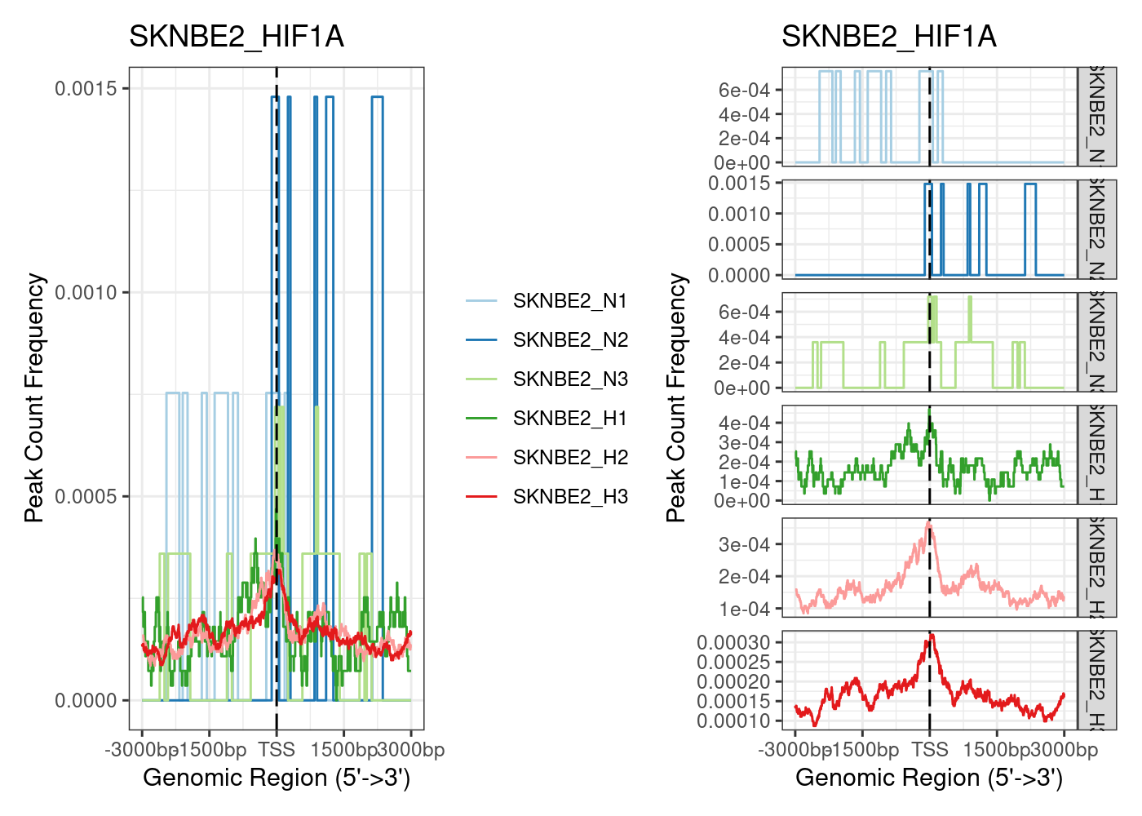
Other ChIP datasets: SKNBE2

Slide 17
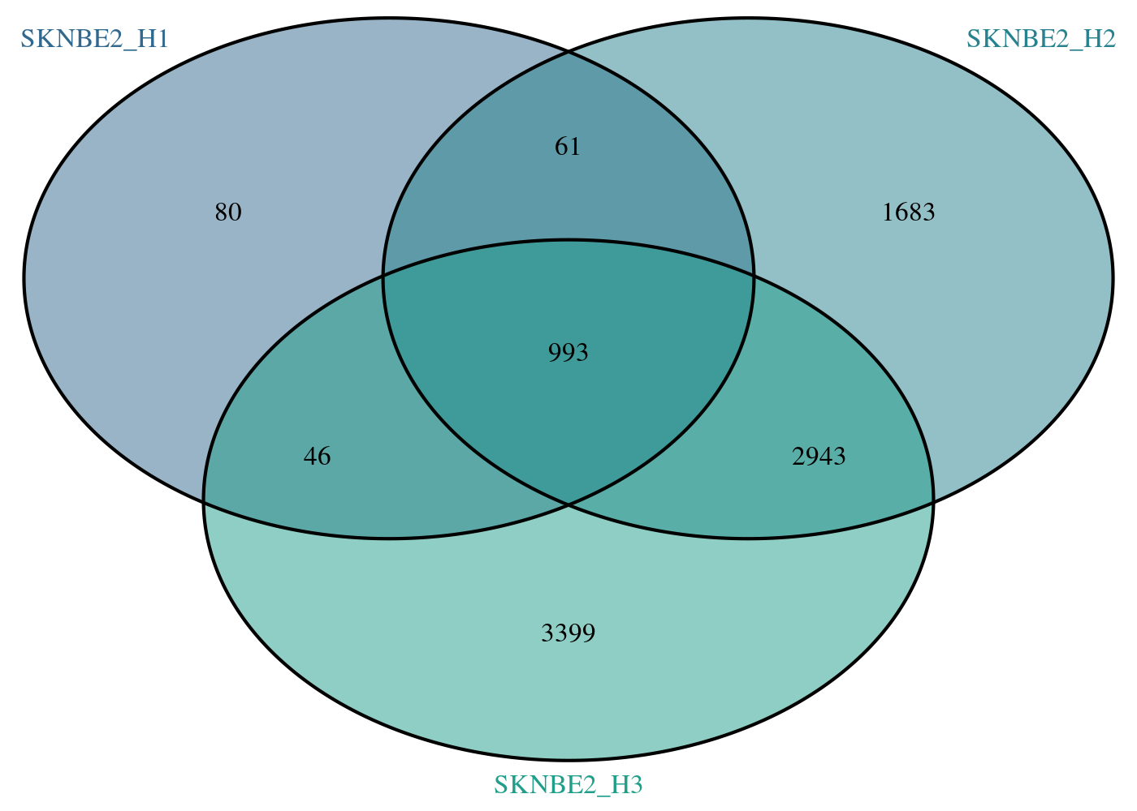
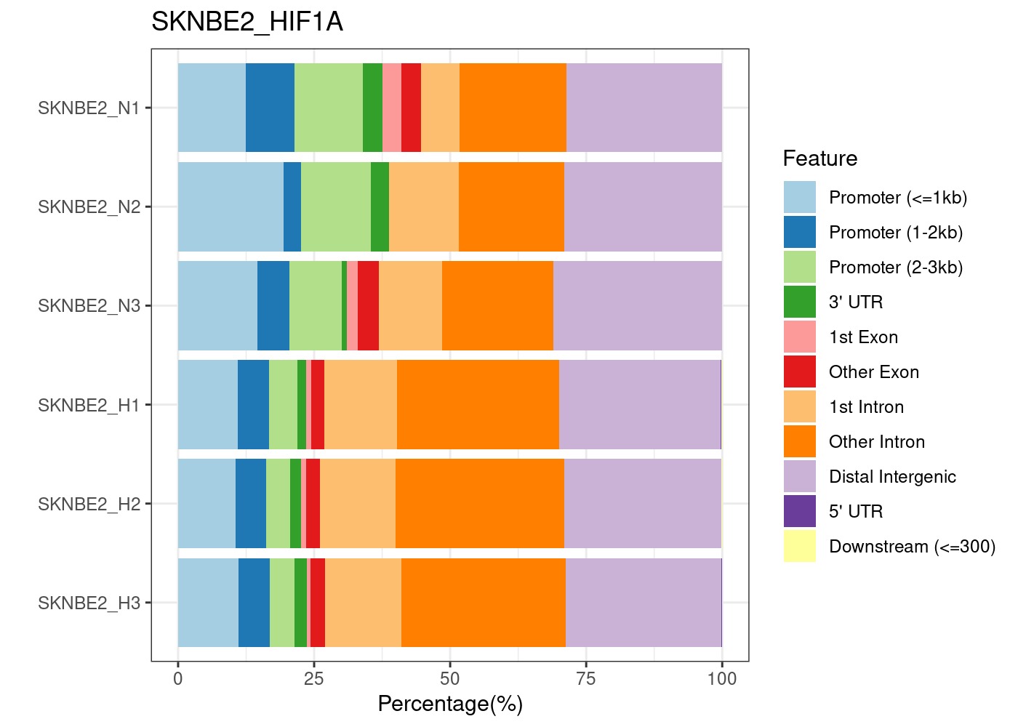
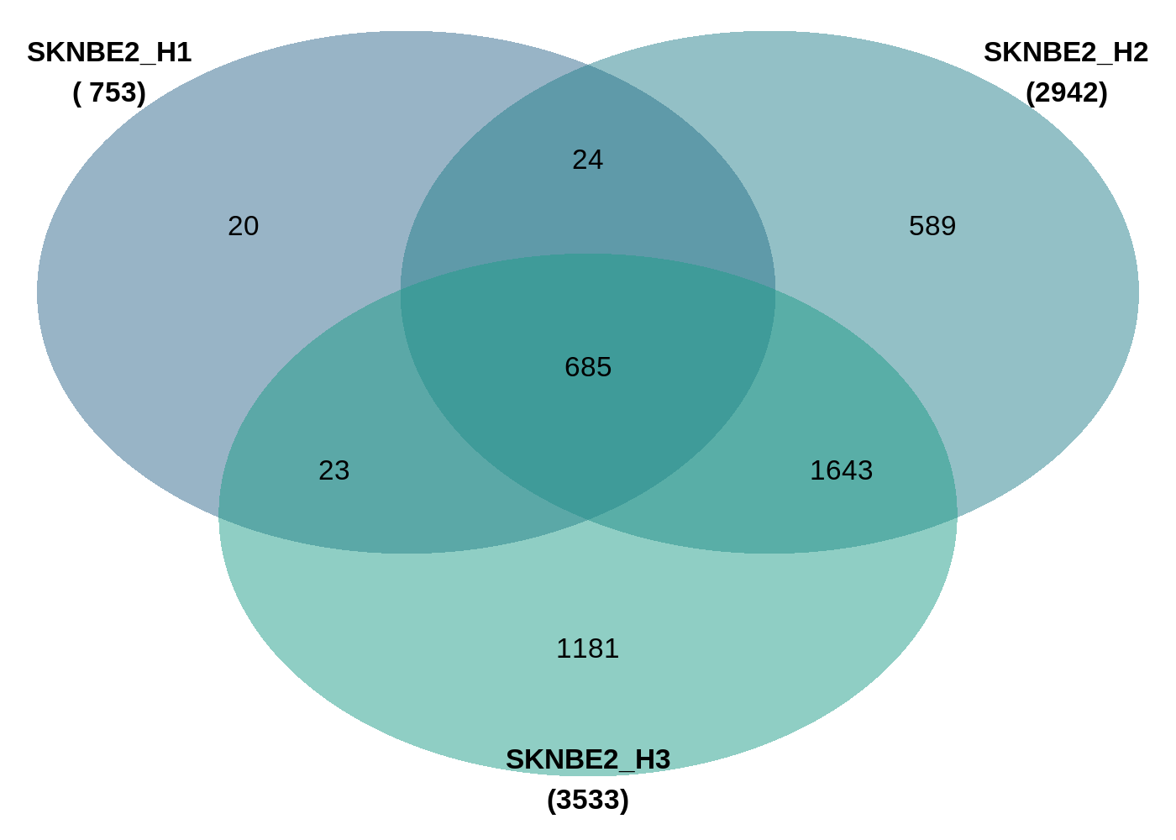
Other ChIP datasets: SKNBE2
Peaks
Genes

Slide 18
Other ChIP datasets: SKNBE2

Slide 19
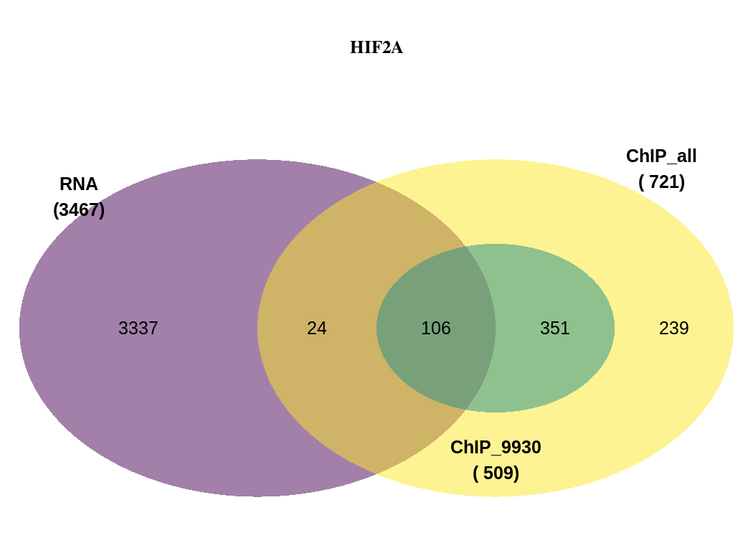

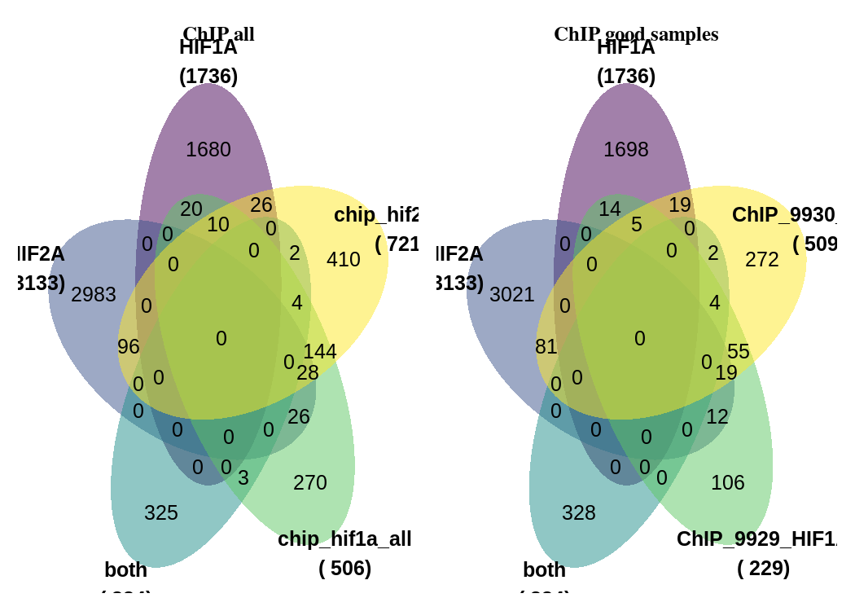
Figure 5: Compare RNA-Seq with own ChIP data

Slide 20
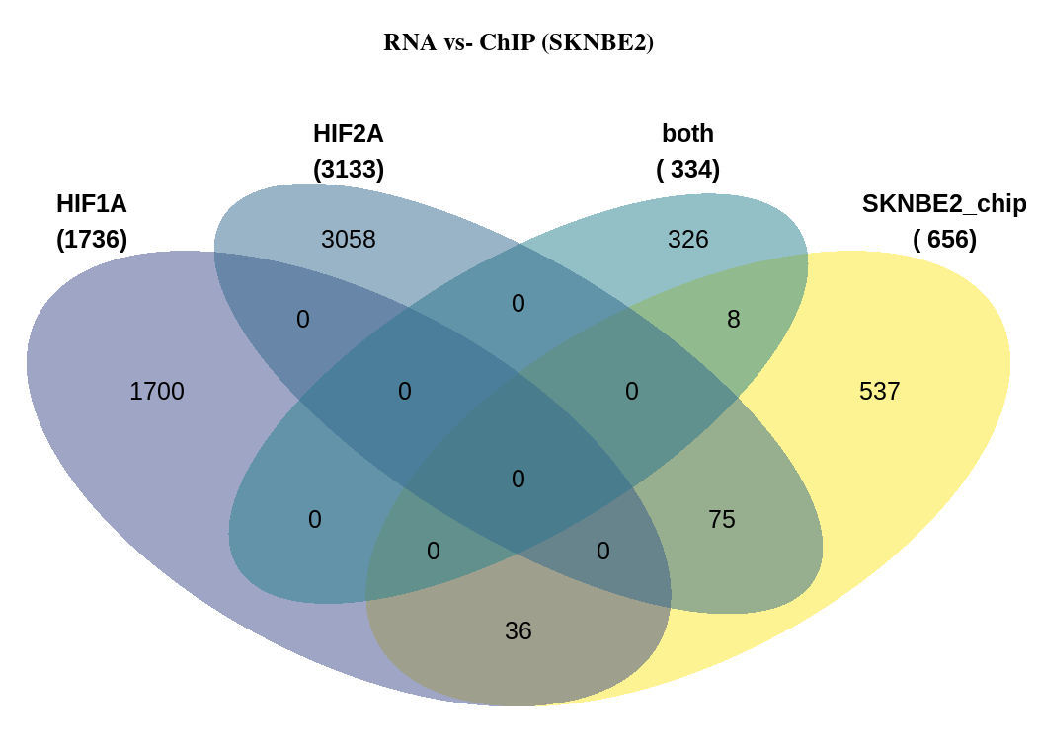
Figure 5: Compare RNA-Seq with SKNBE2

Slide 21
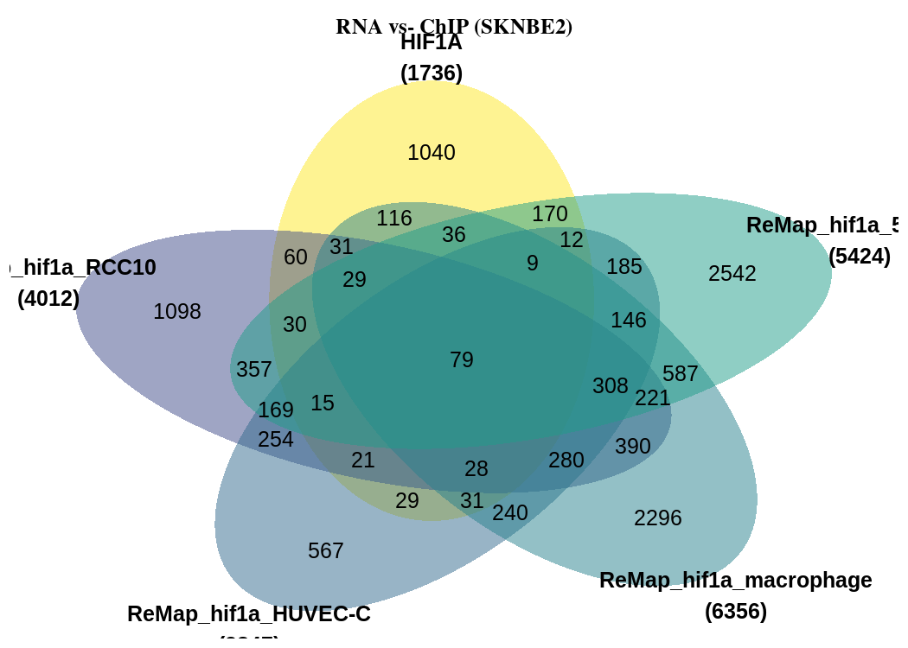
Figure 5: Compare RNA-Seq with ReMAP

