Slide 1
The transcriptomic response of neuroblastoma cells to hypoxia
Authors:
Simon Kelterborn, Holger Scholz
Katharina , Karin Kirschner
Xheni, Helena,

Slide 2
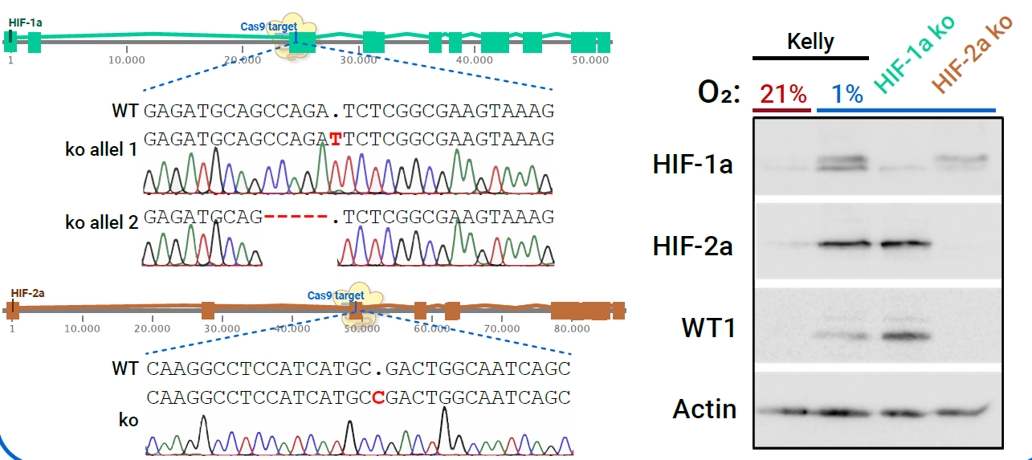
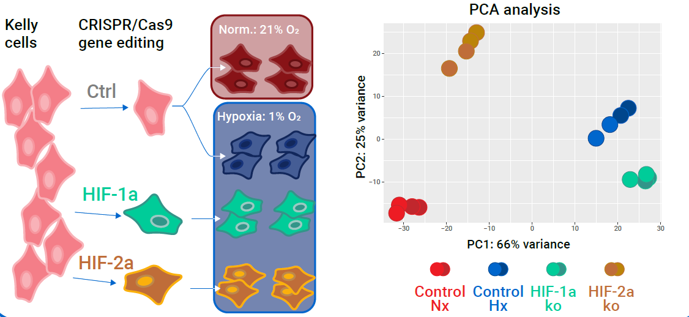
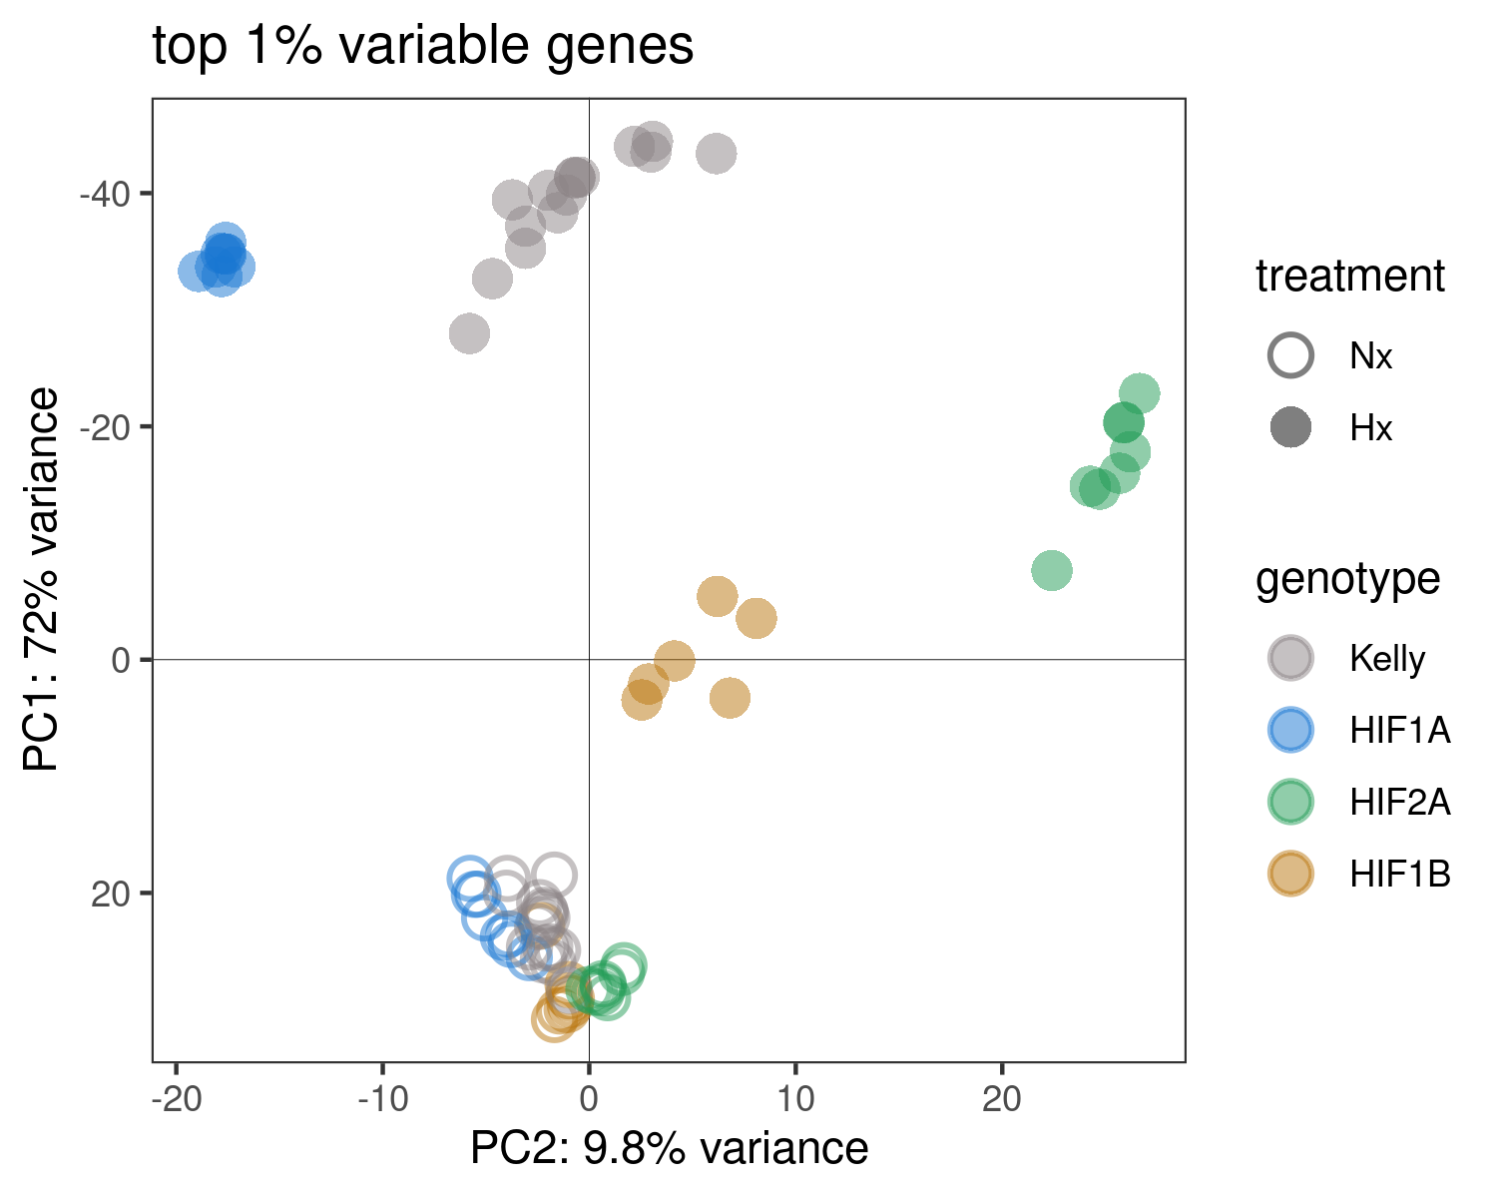
Fig. 1
Generation of HIF-KOs
Hif1b-KO
Hif1b WB
Nx Samples
RNA-Seq experiment
+ Hif1b

Slide 3
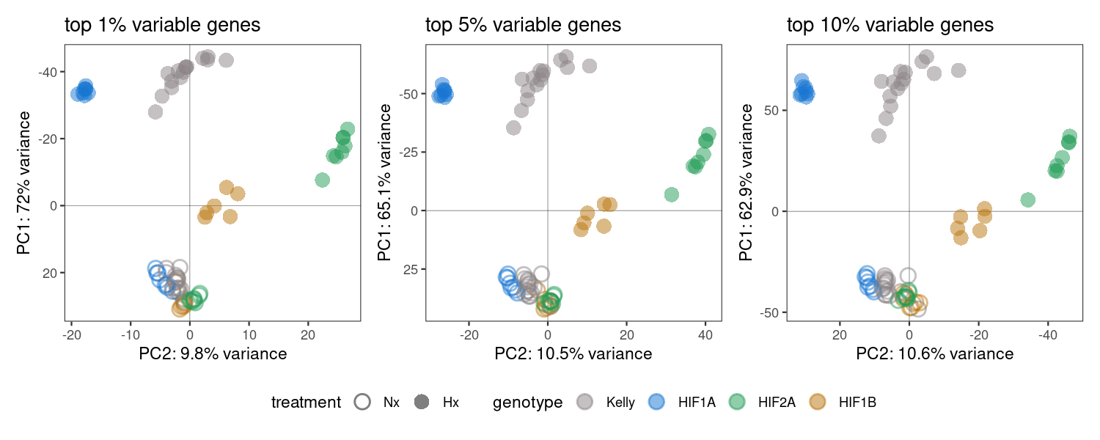
Fig. 1 - variants
1%, 5%, or 10% genes?

Slide 4
Fig. 2
Hypoxia induced genes

