Slide 1
The transcriptomic response of neuroblastoma cells to hypoxia
Authors:
Simon Kelterborn, Xheni Meci, Holger Scholz
Katharina , Karin Kirschner, Helena Landstorfer

Slide 2
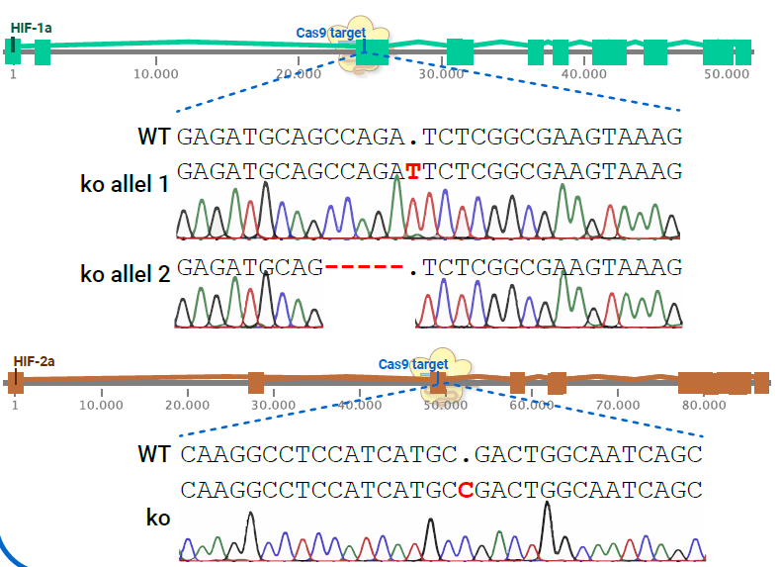
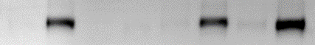
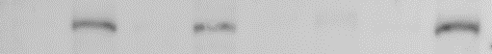
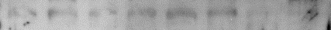

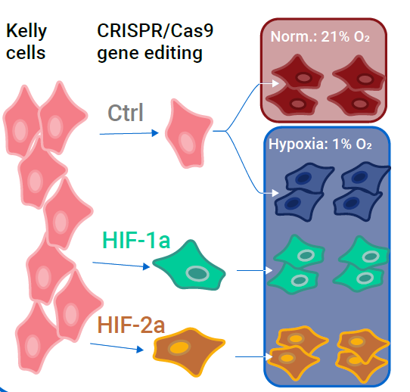
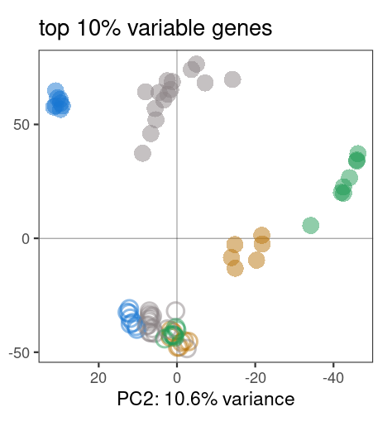
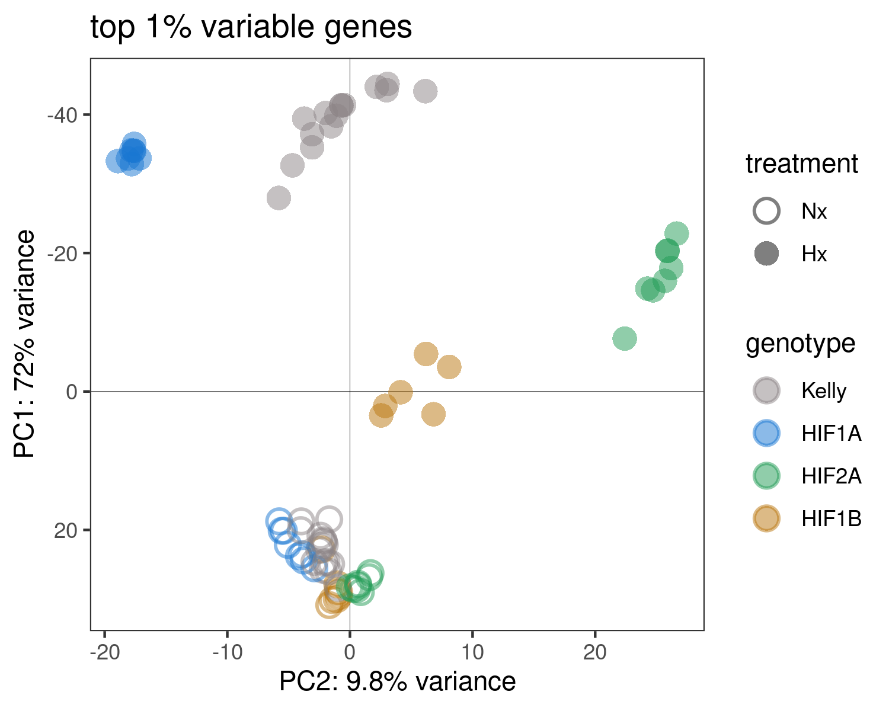
Fig. 1
Generation of HIF-KOs
A
B
empty vector
delHIF-1α
delHIF-2α
delHIF-1β/ARNT
Nx Hx
Nx Hx
Nx Hx
Nx Hx
HIF-1α
HIF-2α
HIF-1β/ARNT
ACTIN
+ Hif1b-KO
RNA-Seq experiment
C
D
+ Hif1b
Notes:
To Do:
General:
Naming of mutants
HIF-1α-ko, delHIF-1α, ΔHIF-2α
Colours
A)
- add Hif1b gene knock-out;
HIF2a sequencing of second allel?
B)
Faint band in Hif-1b
C)
include sheme?
add Hif1b
D)
Colours?

Slide 3
Fig. 1
Figure 1. Overview of the experimental design and generation and characterization of HIF-knockout (KO) Kelly cells.
(A) Schematic representation of the CRISPR/Cas9-mediated knockout of HIF-1α,HIF-2α and HIF-1β in Kelly cells. Sequencing chromatograms confirm the small insertions or deletions resulting in frame shifts in the coding seqeunce in the respective genes.
(B) Immunoblot analysis of HIF-1α, HIF-2α, and HIF-1β protein expression in Kelly cells treated with empty vector and HIF-ko Kelly celllines.
(C) Schematic illustration of the RNA-Seq experiment. Control, HIF-1α, HIF-2α and HIF-1β knockout Kelly cells (delHIF-1α, delHIF-2α and delHIF-1β) were were exposed to normoxia (21% O₂) and hypoxic (0.5% O₂) conditions and subjected to RNA sequencing. The experiment was repeated 4 times and each repetition was carried out in triplicates.
(D) Principal component analysis (PCA) plot based on the top 10% most variable genes across all samples. Each dot represents a sample, colored according to the treatment (normoxia or hypoxia) and genotype (WT or HIF-ko).
Interpretation:
Samples align well over replicates
Normoxic samples cluster together across all genotypes
Under hypoxia genotypes seperate in different cluster, distinct hypoxia response in each HIF-ko
HIF1b-ko hypoxic samples show highest similarity to normoxia samples (lowest hypoxic response across all genotypes)

Slide 4
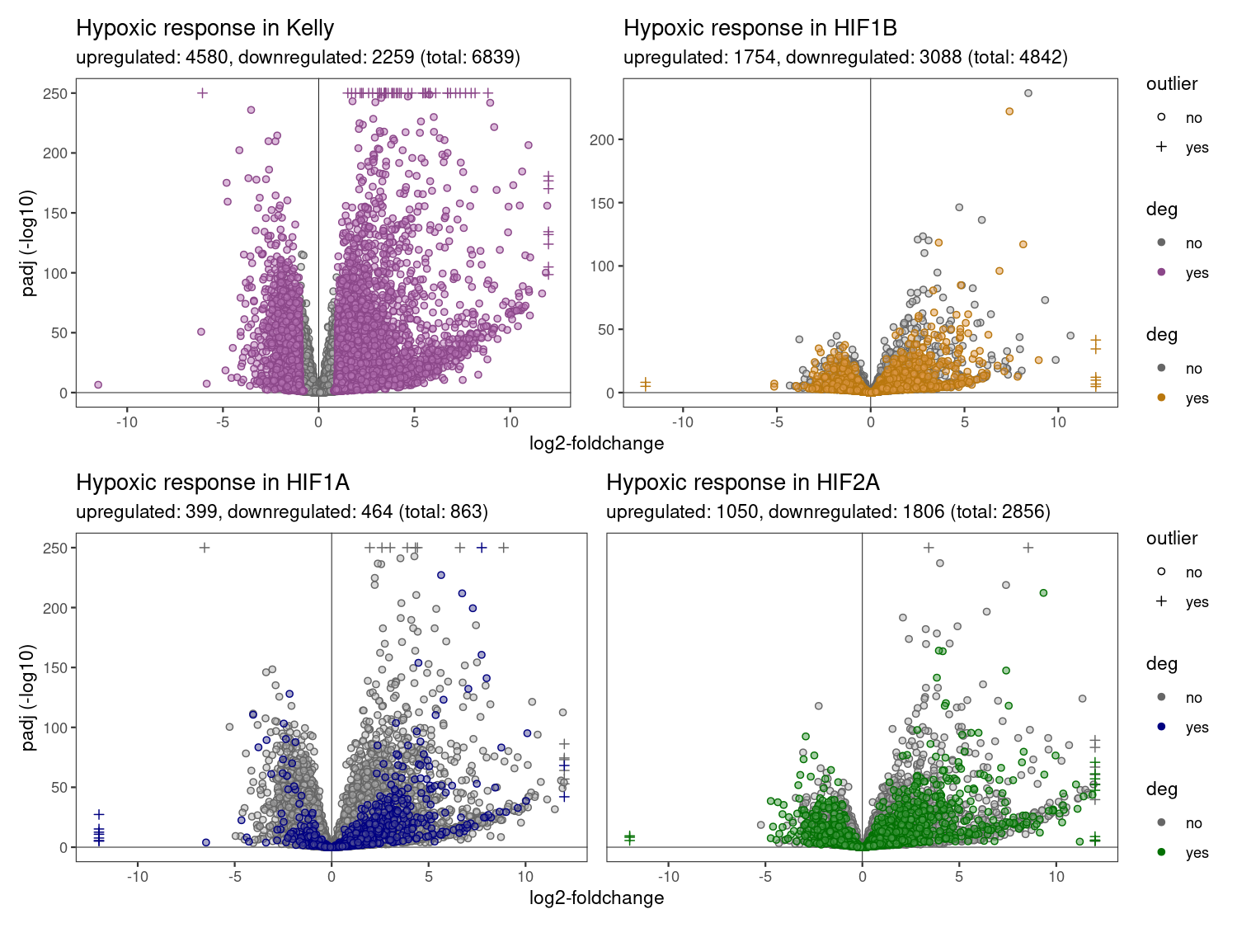
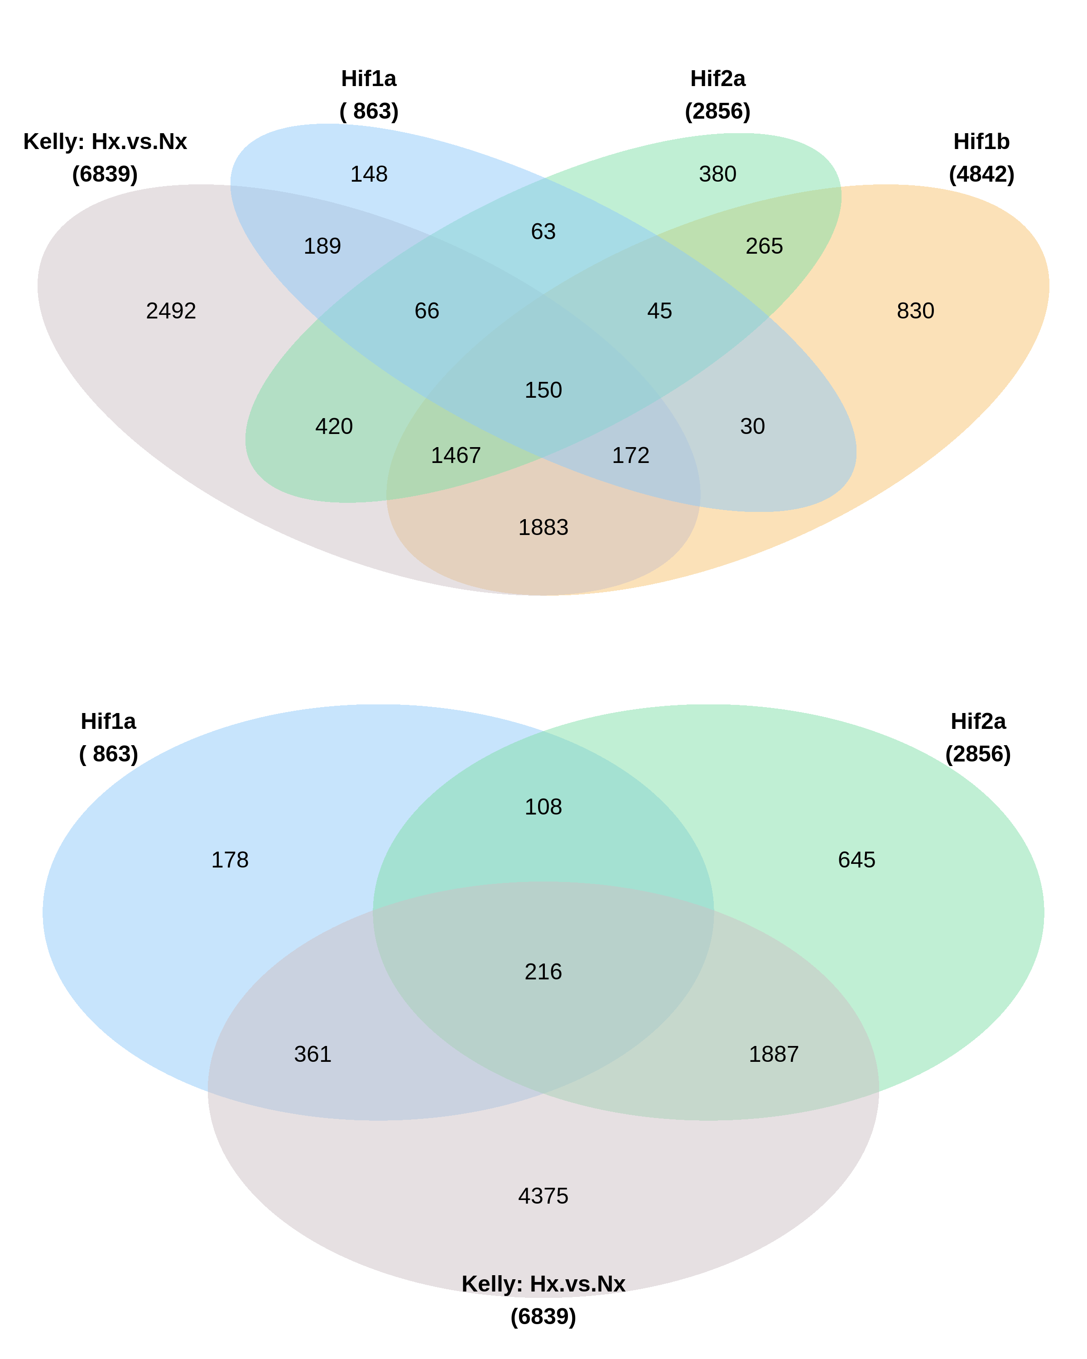
Fig. 2
Hypoxia induced genes
A
B
Cutoff: padj < 0.05,
log2-FC > 1,
baseMean > 0
-> Plotted are the points of the hypoxic response in each cellline (Hif1a: Hx vs. Nx)
-> Colored are the genes with different hypoxic effect compared to Kelly (Hif1a Hx-Nx vs. Kelly Hx-Nx)
Notes:
A)
3 categorys: ns, significant, different from Kelly
B)
- 4,3,2 groups? Suggest 2 groups: Hif1a & Hif2a

Slide 5
Fig. 2
Figure 2. Hypoxia induced genes.
A) Volcano plots illustrating differentially expressed genes (DEGs) in control Kelly cells (purple) and HIF-1α (blue), HIF-2α (green) and HIF-1β (yellow) knockout cells under hypoxic (0.5% O₂) compared to normoxic (21% O₂) conditions. Blue dots represent significantly differential expressed genes (p_{adjusted} < 0.05, log2foldchange > 1 or log2foldchange < -1). Coloured dots in mutant cell lines (purple, green, yellow) represent genes with a significantly different hypoxic effectcompared to Control Kelly cells.
B) Overlap of differentially expressed genes between HIF1a and HIF2a (+ Hif1B and all hypoxic genes in control Kelly cells)
Interpretation:
In all three HIF-ko, less genes are differentially expressed under hypoxia
HIF1a-ko shows least ko effect, most similiar to Kelly (863 genes differ from Kelly hypoxia effect)
HIF2a-ko shows stronger differences, 2856 genes are differentially expressed under hypoxia compared to Kelly
HIF1a-ko and HIF2a-ko show only some overlap (324 genes are differently expressed in both HIF-1a-ko and HIF-2a-ko)

Slide 6
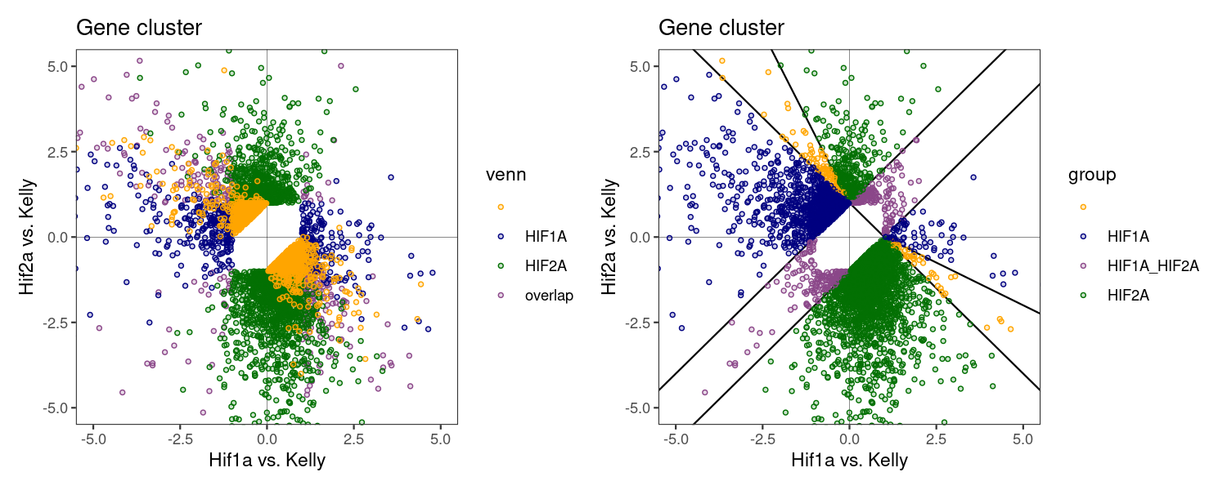
Fig. 3
Hif1a / Hif2a specific genes
HIF1A: 1736
HIF2A: 3133
HIF1A_HIF2A: 334
„orange“: 171
-> Only few „parallel“: 334
-> Assign corners to HIF1A/HIF2A?
Notes:
Example counts plot!

Slide 7
Figure 3. Grouping genes in HIF-1a and HIF-2a responsive genes
A) Dot plot shows the effect (log2foldchange) of the knockout when comparing the hypoxic effect in the mutant cell line with the control Kelly cells. A positive value indicates a change in expression in the same direction as the Kelly control (Gene A is upregulated under hypoxia in Kelly cells and more upregulated in the mutant cell line) whereas a negative value results from opposite expression patterns (Gene B is upregulated under hypoxia in Kelly cells but less upregulated or downregulated in the mutant cell line). The disruption of HIF-1a leads to a higher hypoxic response of HIF2a genes and vice versa. In order to compensate for this overshoot, negative effects were given higher significance than positive effects.
Interpretation:
only very few genes that show same disrupted hypoxic response in HIF1A-ko and HIF2A-ko (purple).
Twice as many HIF2a (3133) genes than HIF1A (1736)

Slide 8
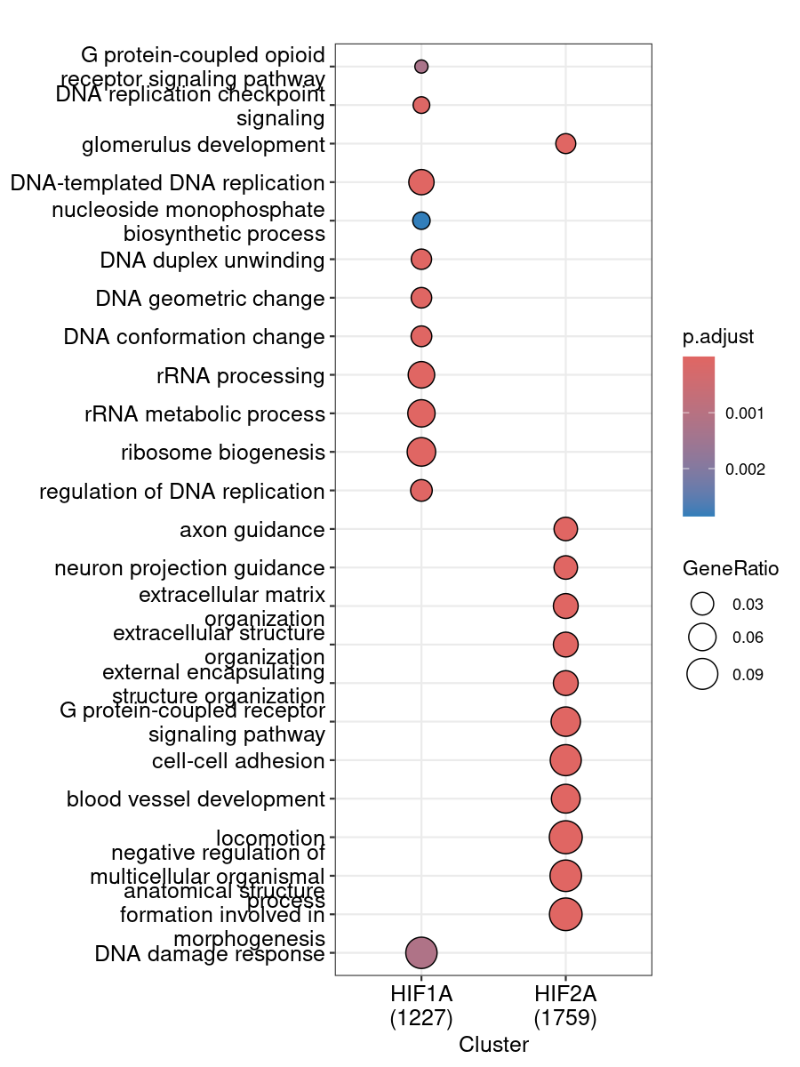
Fig. 4
GO-terms
KEGG

Slide 9
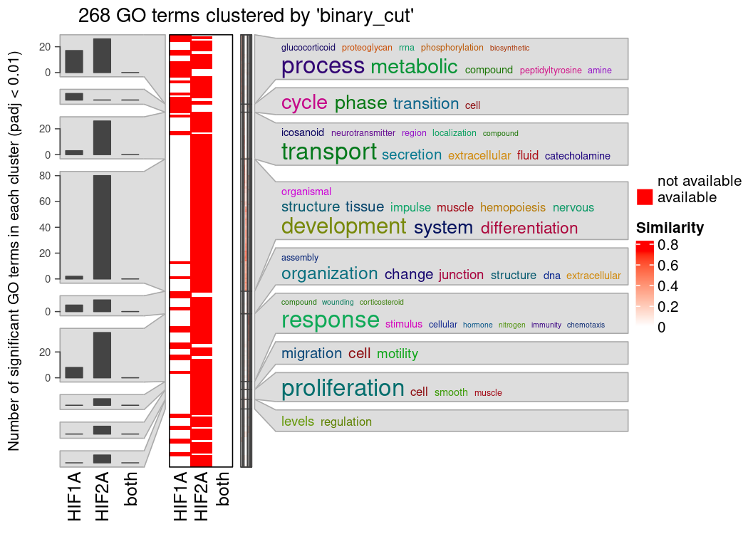
Notes:
Separate figures for HIF1A and HIF2a!

Slide 10
Figure 4. GO-terms analyis.
A) HIF-1a and HIF-2a responsive genes were screend for enriched GO-terms.
Interpretation:
Distinct gene programms for HIF1a and HIF2a.
HIF1a regulates cell state and cell cycle genes
HIF2a regulates extracellular functions

Slide 11
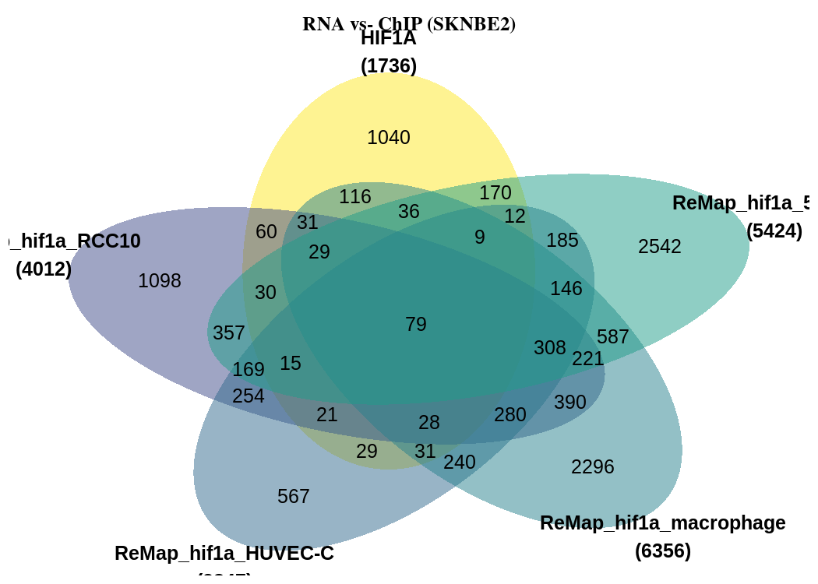
Figure 5: Compare RNA-Seq with ChIP-Seq results

Slide 12
Figure 4. Compare gene list with ChIP-Seq data from online databases
A) ChIP-seq data was taken from ReMAP database and gene lists were compared with RNA-Seq results.
Interpretation:
Genes differ for each tissue.
Core set of conserved 79 HIF-1A genes

Slide 15
old figures

Slide 16
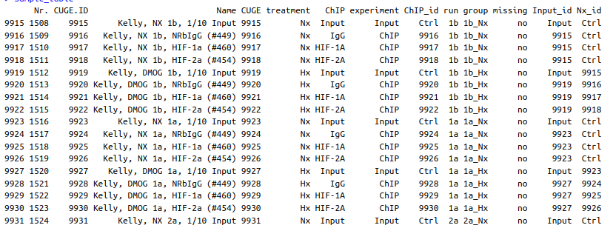
Extra: Kelly ChIP-Seq
1.) MACS peak calling
2.) Peaks - IgG
3.) Peaks -Nx

Slide 17
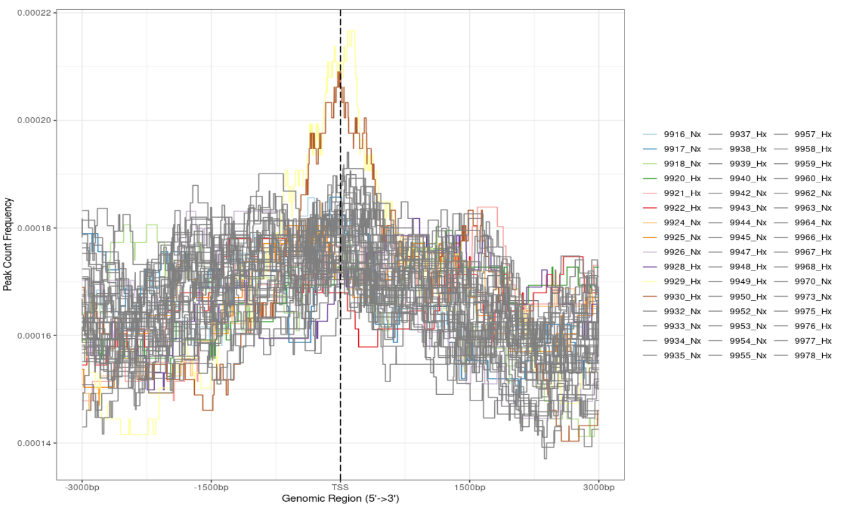

Slide 18
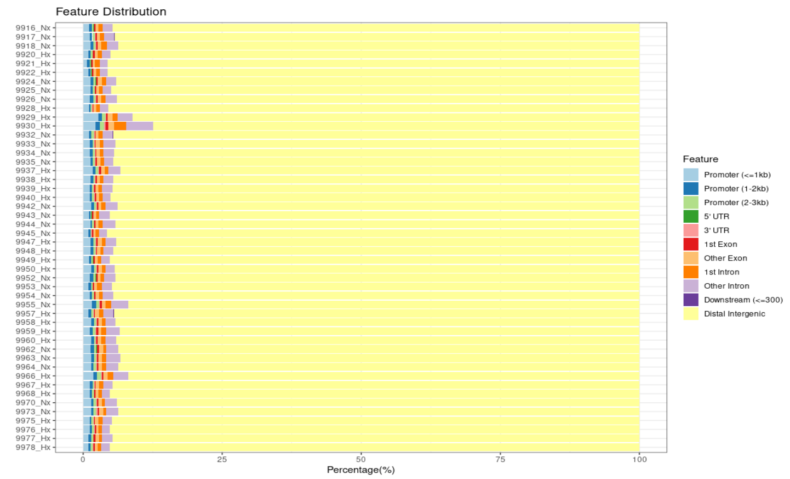

Slide 20
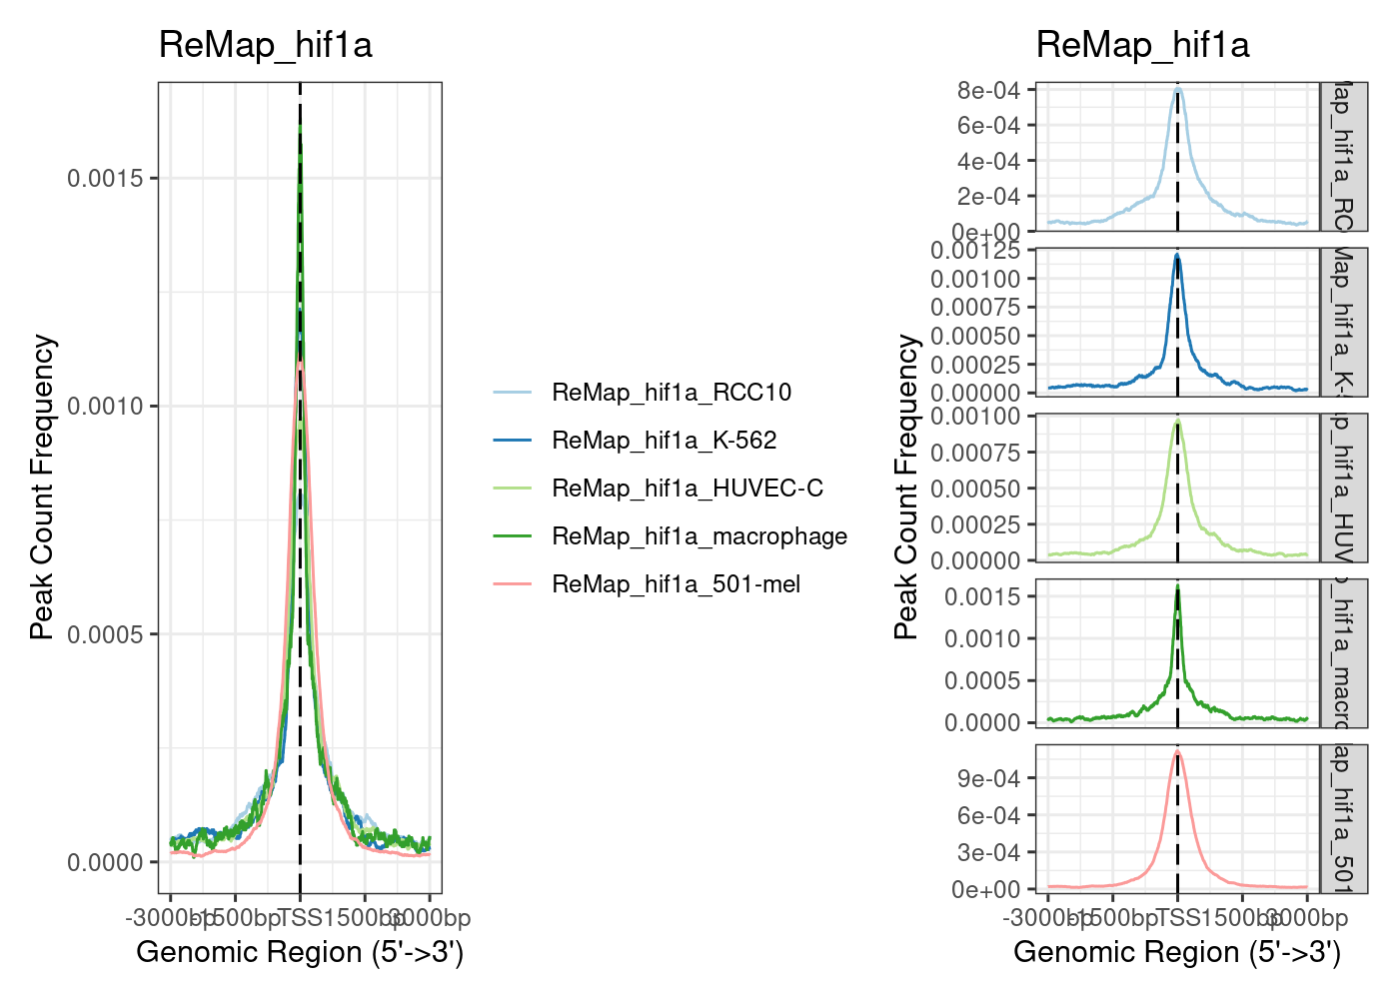
Other ChIP datasets: ReMAP

Slide 21
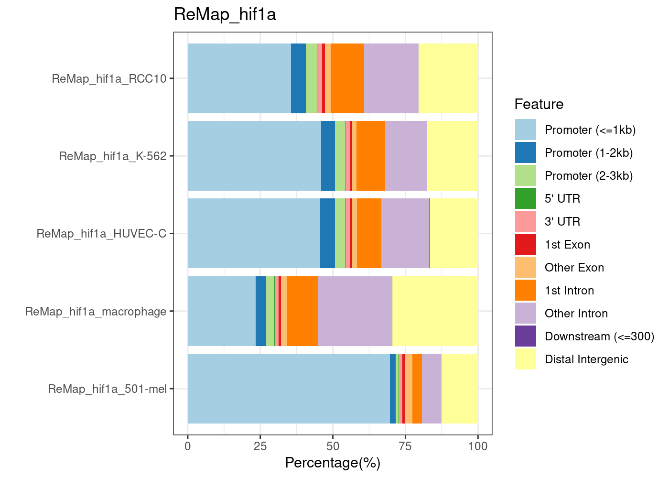
Other ChIP datasets: ReMAP

Slide 22
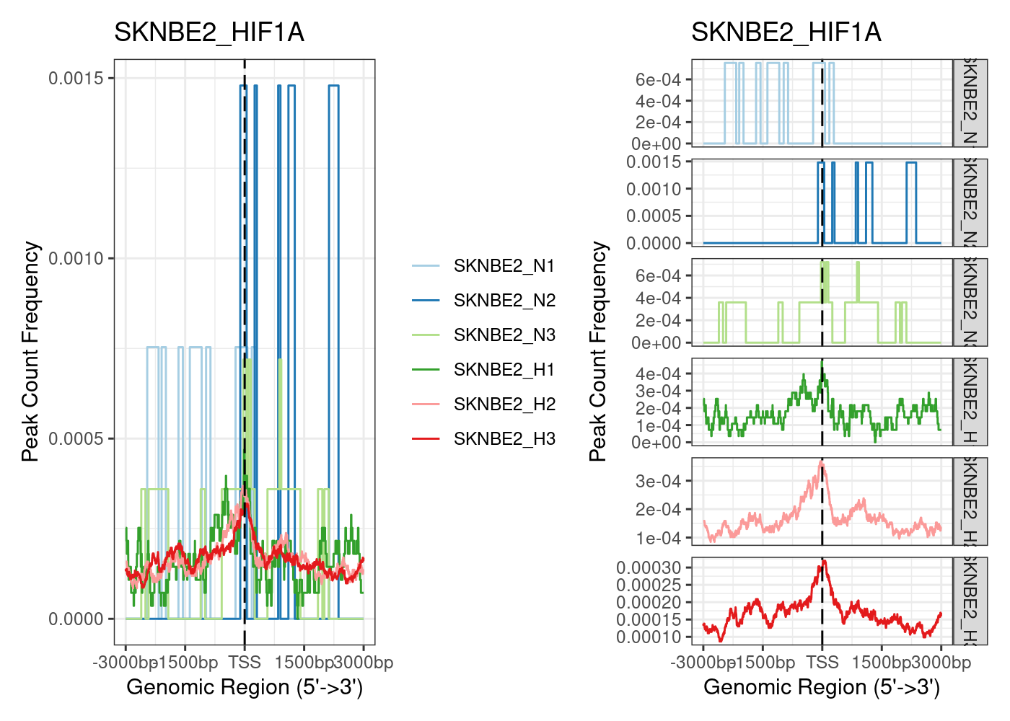
Other ChIP datasets: SKNBE2

Slide 23
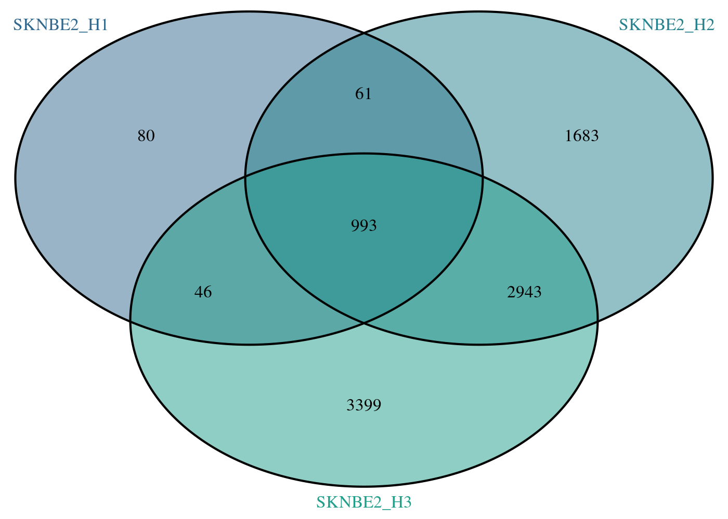
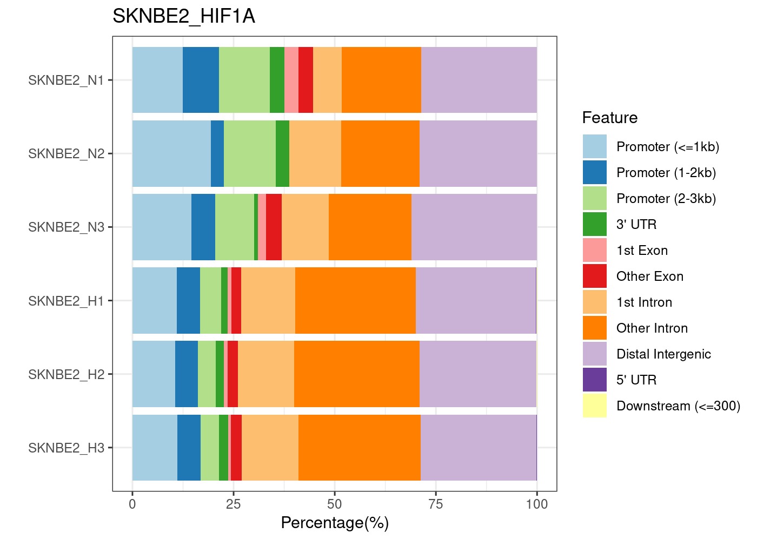
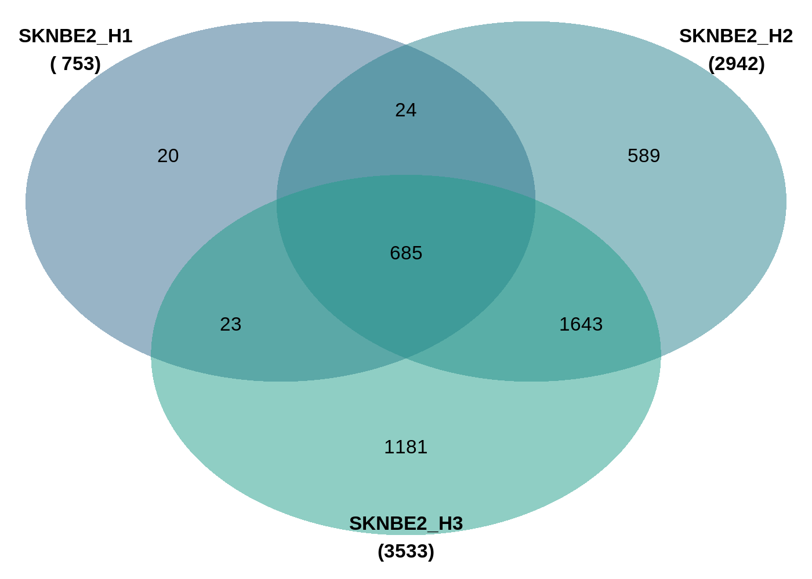
Other ChIP datasets: SKNBE2
Peaks
Genes

Slide 24
Other ChIP datasets: SKNBE2

Slide 25
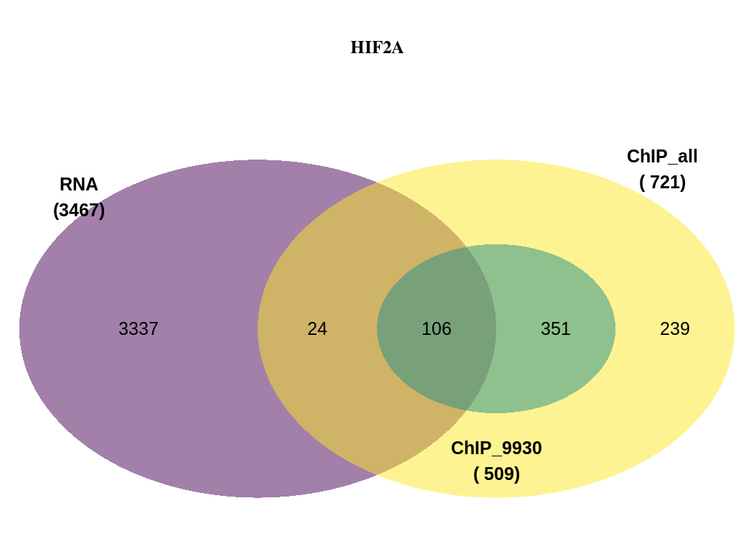

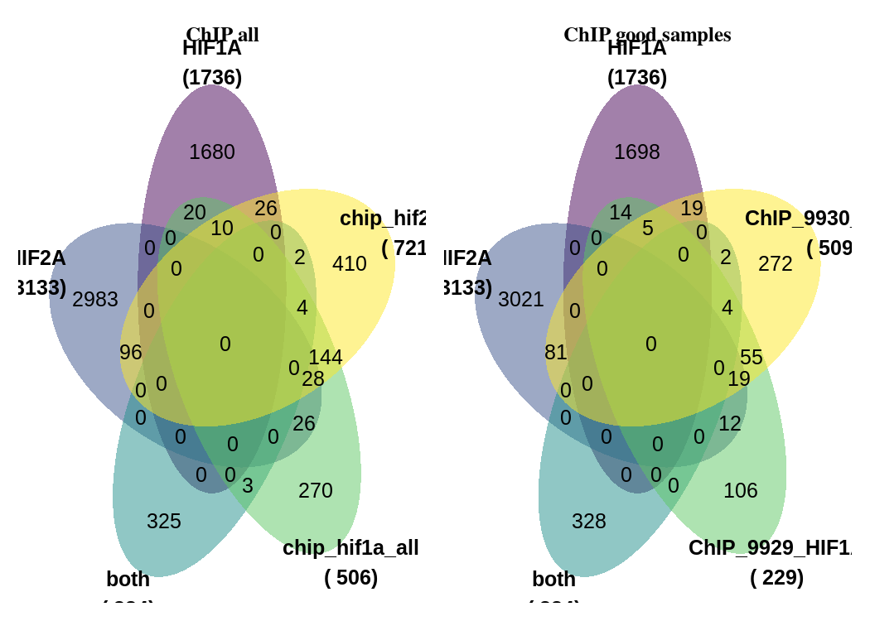
Figure 5: Compare RNA-Seq with own ChIP data

Slide 26
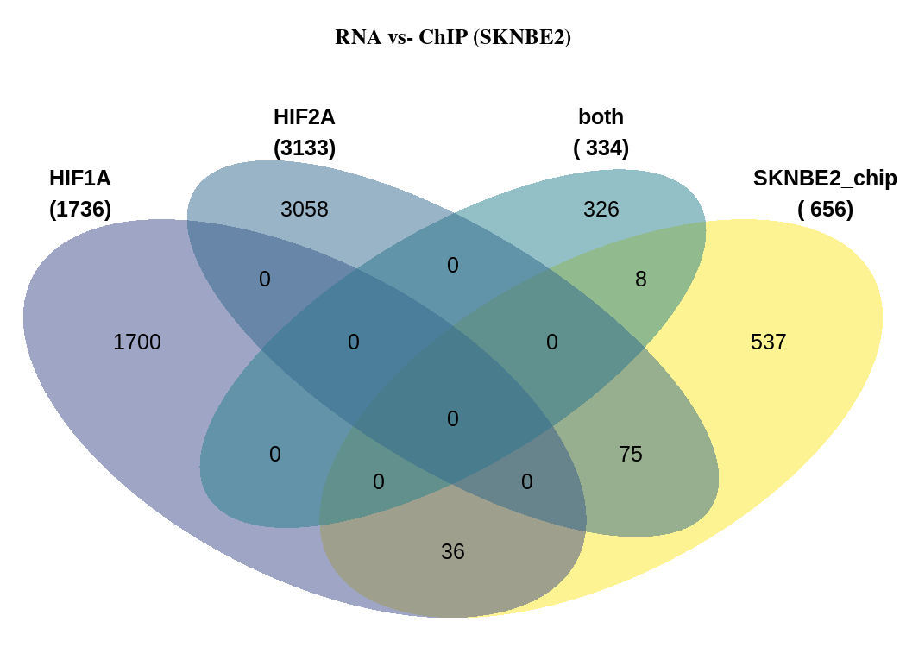
Figure 5: Compare RNA-Seq with SKNBE2

Slide 27
Figure 5: Compare RNA-Seq with ReMAP

