Slide 1
Workshop: Basic UNIX for Biologists

Slide 2
Have you ever….
tried to open a very large file (like FASTQ) in PC/Mac?
searching for a specific piece of information from large number of files?
wanted to rename large number of files?
combine large number of files into one big file?
got frustrated with excel auto-correcting your favorite gene?
wanted to run a program that isn’t available on your operating system?
bored of doing same things over and over?
You Need UNIX

Slide 3
What is UNIX?
Widely used multiuser operating system
Linux: free version of UNIX-like operating system
Red Hat Enterprise Linux, Ubuntu, and CentOS
Used on high-end workstations, database servers, web servers and managing shared resources
Standard features include:
Security, reliability, scalability
supports multi-user (as in 100s)

Slide 4
Can I learn UNIX?
Yes! Absolutely. Anyone can if they want.
No more difficult than learning Word, Excel or Powerpoint
Biggest difference
In Unix: You type the command to execute
In Word: You use your mouse to execute a command
Remember. In the Terminal, “don’t touch the mouse”

Slide 5

Kernel and Shells
SHELL
USER 1
KERNEL
USER N
HARDWARE
SHELL types:
Bourne Shell (sh)
C shell (csh)
TC shell (tcsh)
Korn shell (ksh)
Bourne Again Shell (bash)
Z shell (zsh)
Notes:
I am telling you this for your information. These are the advantages you get by using Unix. All of this is done transparently.
You all the time interact with the computer using shell, today we are using a different shell to interact with the computer

Slide 6
Organization
Root Directory, whole tree starts from here
Contains fundamental executables (i.e., binaries) generally used by all users on the system
All users home directories are located here
/
..
etc
dev
home
Parent
Directory
usr
bin
.
My Home!
arnstrm
user2
user3
lib
~
Home
Present
Directory
folder1
folder2
Relative path for fileA:
./folder2/fileA
Absolute path for fileA:
/home/arnstrm/folder2/fileA
fileA
Shortcut:
~/folder2/fileA
Notes:
Stress again that this is just background that is important but will see often and get practice with in the exercises.
Explain all the directrories
Show this slide again after the ls command, to display how the folders are orgainzed

Slide 7
How to get started?
Mac OS: Native application called “Terminal” allows you to run UNIX commands. No installation necessary, just search for the program and start using it!
Linux OS: Again, pre-installed in the OS. Search for either Terminal/Console program and can start running UNIX commands.
Windows OS: Requires emulators for running UNIX commands. Popular options include:
Git BASH: msysgit.github.io
Cygwin : www.cygwin.com
Currently, best option for running UNIX. Installation takes only few seconds

Slide 8
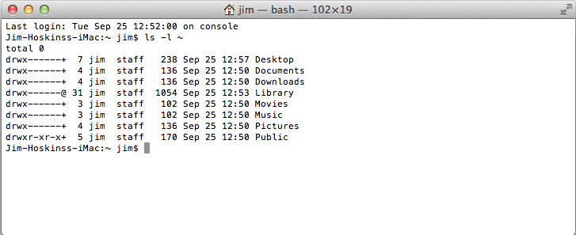

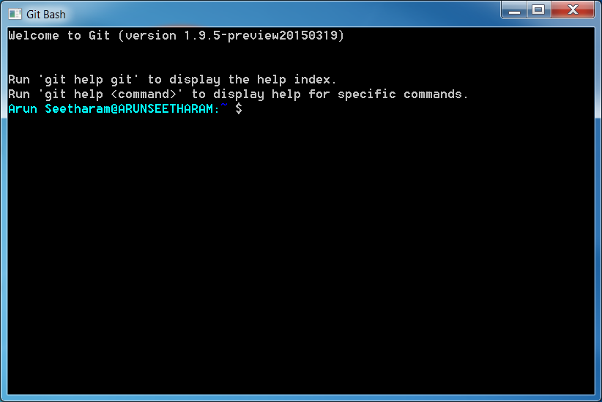

Terminal
If you plan on using Git Bash (Windows), consider upgrading the default Windows terminal to something better. ConEmu, Console 2 are some of the options.
If you don’t plan to use UNIX locally, but want to connect to remote computers to run the commands, Putty, OpenSSH are some ideal choices.

Slide 9
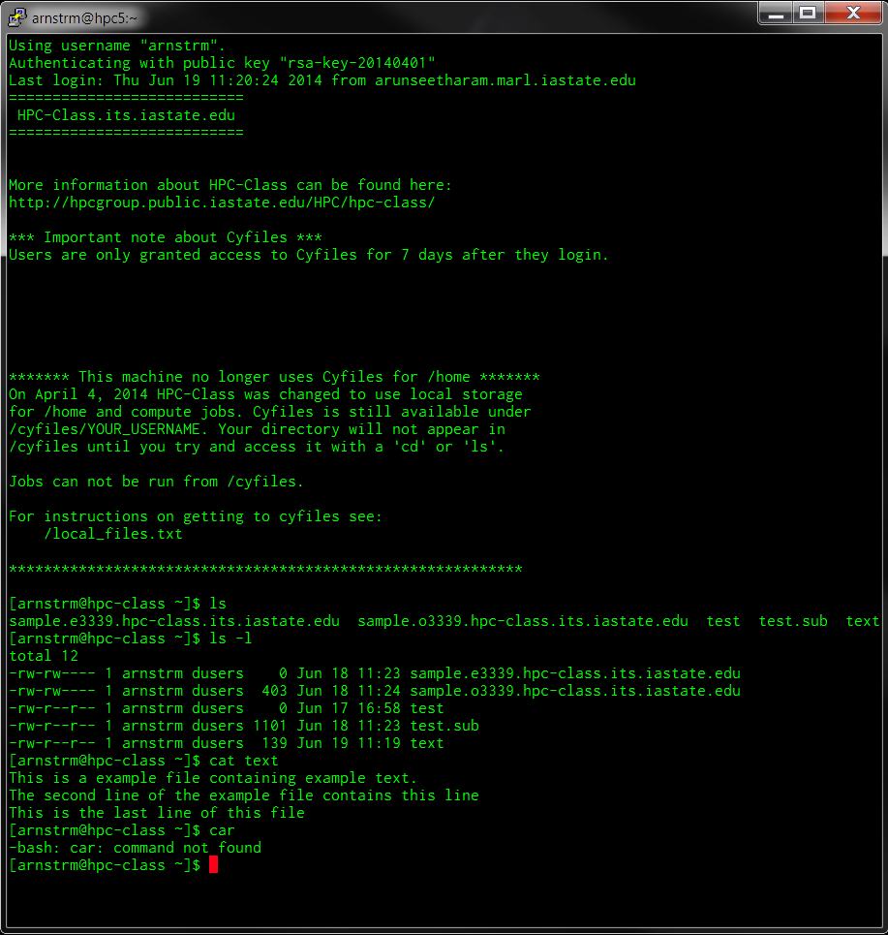
Terminal
welcome message
prompt
command
argument
standard out
standard error

Slide 10
Some tips before starting
Write down the commands on a sheet of paper as you move through the exercise
Typing first few letters of command/file and then pressing TAB will auto complete the word. Pressing TAB-TAB, displays all matching commands/files for the letters you typed.
Use arrow keys to cycle through your command history (up and down).
Commands are case sensitive (eg. Cat ≠ cat)
Do not use space or special characters for naming files/folders
Be careful before you delete, there is no recycle bin.
Be familiar with the syntax and options for the commands

Slide 11
Some tips before starting
At any time to cancel a executed command, press “CTRL+C” (“Ctrl” key and letter “c” key pressed together): C for Cancel!
Many commands use “q” or “Esc” to quit/exit
Double check your commands: chances are, most of the times you don’t see an error, instead, you get wrong results.
To clear the screen: Ctrl+L
Some universal variables makes it easier to find things
$HOME
$SHELL
$PATH
$HOSTNAME

Slide 12
Navigation
Commands you should know:
ls : list
cd : change directory
pwd : print working directory

Slide 13
Changing directory
# for changing directory (i.e., jumping from one directory to another), we use
# ‘cd’ command.
# the usual way is to tell which directory you want to change
~$ cd DIRECOTRY
# will change to DIRECTORY
# It is important that you need to specify either relative or absolute path for the
# Now, try this:
~$ cd WORKSHOP_FILES
~$ ls
# What files do you see?
# Note: you can also use “./WORKSHOP_FILES”, they both mean same
# Now type:
~$ cd ..
~$ ls
# do you see same files?
# as mentioned before, .. is a shortcut for ‘previous directory’
# similarly, . is a shortcut for ‘present directory’

Slide 14
Knowing your location
# from the ‘WORKSHOP_FILES’ directory, run this
~$ pwd
/home/arnstrm/WORKSHOP_FILES
# it prints the working directory (the directory you are presently located)
# this is very useful as you can easily know your location at any point of time
# Now, try this:
~$ cd ~
~$ pwd
/home/arnstrm
# Why did that happen? ~ is the shortcut for home!
# typing in cd without any argument also brings you back to home directory!
~$ cd –
/home/arnstrm/WORKSHOP_FILES
~$ pwd
/home/arnstrm/WORKSHOP_FILES
# Similarly, - is the shortcut for the previous location

Slide 15
Listing files
# go to the ‘BASIC’ folder in ‘WORKSHOP_FILES’
~$ ls
FILE_1.txt FILE_3.txt FILE_5.txt FILE_7.txt FILE_9.txt
FILE_2.txt FILE_4.txt FILE_6.txt FILE_8.txt FILE_10.txt
# it prints the contents of that directory. But knowing the files is pretty basic stuff
# to achieve more with the same command, we can use arguments
~$ ls –l
total 36
-rw-rw-r-- 1 arnstrm arnstrm 17 Jul 1 21:31 FILE_1.txt
-rw-rw-r-- 1 arnstrm arnstrm 0 Jul 1 21:51 FILE_2.txt
-rw-rw-r-- 1 arnstrm arnstrm 17 Jul 1 21:31 FILE_3.txt
-rw-rw-r-- 1 arnstrm arnstrm 17 Jul 1 21:31 FILE_4.txt
-rw-rw-r-- 1 arnstrm arnstrm 17 Jul 1 21:50 FILE_5.txt
-rw-rw-r-- 1 arnstrm arnstrm 17 Jul 1 21:31 FILE_6.txt
-rw-rw-r-- 1 arnstrm arnstrm 17 Jul 1 21:52 FILE_7.csv
-rw-rw-r-- 1 arnstrm arnstrm 17 Jul 1 21:31 FILE_8.txt
-rw-rw-r-- 1 arnstrm arnstrm 17 Jul 1 21:31 FILE_9.txt
-rw-rw-r-- 1 arnstrm arnstrm 132 Jul 1 21:51 FILE_10.txt
# here, using –l changed the way the files are displayed
Notes:
WORKSHOP_FILES make sure everyone is in the right place (downloaded).

Slide 16
Listing files
# There are many options available, some important ones are:
# -t (based on time modified)
# -S (size based listing)
# -X (extension)
# -a (all files, displays hidden files in the directory)
# You can merge several options together too! eg.,
~$ ls –lt
total 36
-rw-rw-r-- 1 arnstrm arnstrm 17 Jul 1 21:52 FILE_7.csv
-rw-rw-r-- 1 arnstrm arnstrm 0 Jul 1 21:51 FILE_2.txt
-rw-rw-r-- 1 arnstrm arnstrm 132 Jul 1 21:51 FILE_10.txt
-rw-rw-r-- 1 arnstrm arnstrm 17 Jul 1 21:50 FILE_5.txt
-rw-rw-r-- 1 arnstrm arnstrm 17 Jul 1 21:31 FILE_1.txt
-rw-rw-r-- 1 arnstrm arnstrm 17 Jul 1 21:31 FILE_3.txt
-rw-rw-r-- 1 arnstrm arnstrm 17 Jul 1 21:31 FILE_4.txt
-rw-rw-r-- 1 arnstrm arnstrm 17 Jul 1 21:31 FILE_6.txt
-rw-rw-r-- 1 arnstrm arnstrm 17 Jul 1 21:31 FILE_8.txt
-rw-rw-r-- 1 arnstrm arnstrm 17 Jul 1 21:31 FILE_9.txt
# what is the difference you notice? Try other options given above and see what it does.

Slide 17
Getting help
How do you keep track of all the options for every single command? Luckily, there is manual page for each of them!
man command : show the man page of a command
command --help : show a brief help text (some commands)
Try this for the commands you just learnt!
Yes, there is a man page for man command as well!

Slide 18
Getting help
# Let’s look at an example, open man page for the ls command
~$ man ls
LS(1) User Commands LS(1)
NAME
ls - list directory contents
SYNOPSIS
ls [OPTION]... [FILE]...
DESCRIPTION
List information about the FILEs (the current directory by default). Sort entries alphabetically if none of -cftuvSUX nor --sort.
Mandatory arguments to long options are mandatory for short options too.
-a, --all
do not ignore entries starting with .
To EXIT, press ‘q’
Notes:
Introduce yourself what is your background
Last half hour exercise designed to work independently :

Slide 19
Copy and Move
Two commands, that have similar syntax, but slightly different options:
cp : copy files and directories
mv : move or rename files and directories
Syntax for both these commands are as follows:
cp Source Destination
mv Source Destination
You can use, absolute path, relative path or no path at all for these commands.
Lets try out some examples:

Slide 20
Copy command
# Let’s create a backup copy for all the workshop files before we start changing it
# this will allow us to restore all the files if anything wrong happens
~$ cd ~
# change to home
~$ pwd
# check location
~$ ls
# list files, do you see ‘WORKSHOP_FILES’ here?
~$ cp WORKSHOP_FILES BACKUP_FILES
cp: omitting directory `WORKSHOP_FILES'
# WHY DID THIS COMMAND DID NOT WORK?
~$ man cp
# So we are missing the options to copy folders!
~$ cp -r WORKSHOP_FILES BACKUP_FILES
# Did this work? How do you check if it worked?
~$ ls
# Do you see the copied folder?
# What does the ‘-r’ option do here?
Notes:
Introduce yourself what is your background
Last half hour exercise designed to work independently :

Slide 21
Move command
# Let’s rename the copied files to something else
~$ cd ~
# change to home
~$ pwd
# check location
~$ ls
# list files, do you see ‘WORKSHOP_FILES’ here?
~$ mv BACKUP_FILES tutorials
# Nice, you didn’t need to use any options like ‘cp’ command
~$ man mv
# what options do you think might be useful?
# specifically, what does these options do?
# -n : no overwriting of files
# -u : update only new files to destination
Notes:
Introduce yourself what is your background
Last half hour exercise designed to work independently :

Slide 22
File and Directory creation/deletion
Directory
mkdir : make directory
rmdir : remove directory
Files
touch : creates an empty file
rm : removes file
Editing the file
nano : default command line file editor

Slide 23
Making directory
# Let’s rename the copied files to something else
~$ cd ~
# change to home
~$ pwd
# check location
~$ ls
# list files, do you see ‘WORKSHOP_FILES’ here?
~$ cd WORKSHOP_FILES
~$ ls
# If you see familiar files here, let’s create a new directory
~$ mkdir FirstDirectory
~$ ls
# do you see the new directory here?
~$ man mkdir
# what options do you think might be useful?
# specifically, what does this option do?
# -p : make parent directories
Notes:
Introduce yourself what is your background
Last half hour exercise designed to work independently :

Slide 24
Deleting directory
# Let’s rename the copied files to something else
~$ cd ~
# change to home
~$ pwd
# check location
~$ ls
# list files, do you see ‘WORKSHOP_FILES’ here?
~$ cd WORKSHOP_FILES
~$ ls
# If you see familiar files here, let’s delete the new directory (FirstDirectory)
~$ rmdir FirstDirectory
~$ ls
# do you see the directory?
~$ rmdir delete_me
# why did this command not work?
~$ man rmdir
# what options do you think might be useful to delete the above folder?
# -r : remove directories and their contents
# -f : force
Notes:
Introduce yourself what is your background
Last half hour exercise designed to work independently :

Slide 25
File creation
# Let’s create and edit our first file, make sure you are in WORKSHOP_FILES
~$ pwd
/home/arnstrm/WORKSHOP_FILES
~$ touch firstfile
~$ ls
AT_cDNA.fa RefSeq.faa basic firstfile genes_b.gff ids_a.txt
AT_genes.gff Sequences delete_me genes_a.gff ids.txt ids_b.txt
# do you see your file?
# let’s add some contents to it
~$ nano firstfile
# what happened?
Notes:
Introduce yourself what is your background
Last half hour exercise designed to work independently :

Slide 26
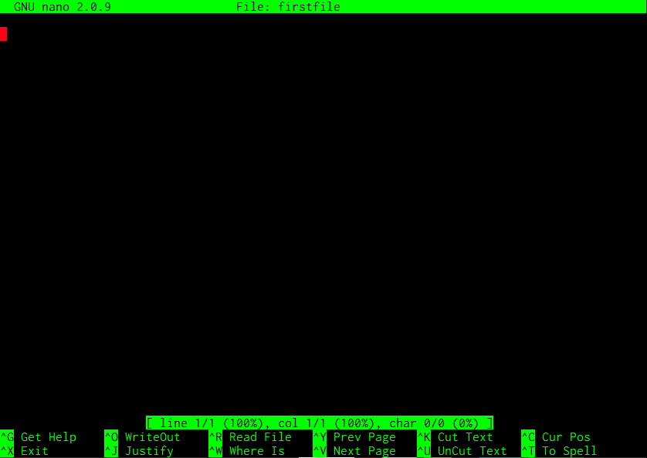
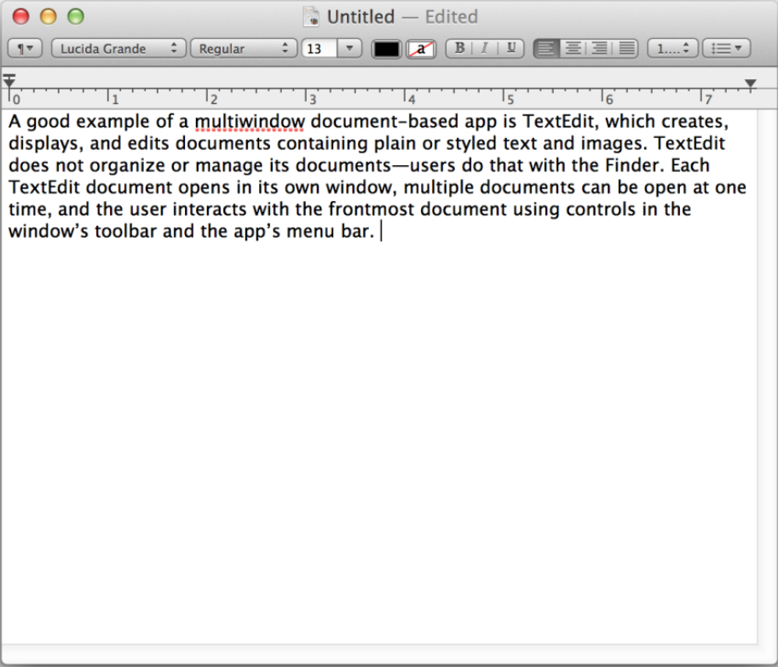
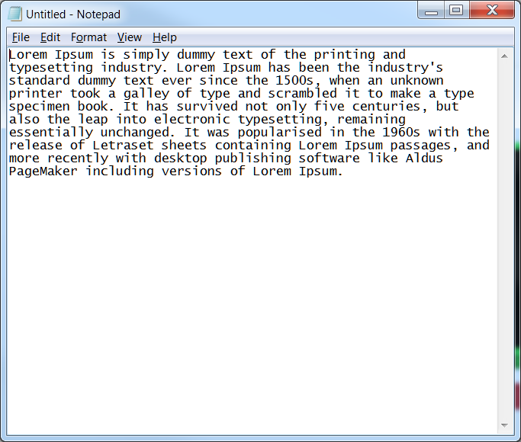


File creation
Title bar
Cursor
Menu/options
Editing area
Editing area
Add whatever text you want to add here (by just typing), once done you can exit by pressing Ctrl(^) + X, then answer yes “Y” to save changes (or “N” to discard changes)
Editing area
Menu/options
Notes:
Introduce yourself what is your background
Last half hour exercise designed to work independently :

Slide 27
Reading files
Commands
less : make directory
more : remove directory
cat : creates an empty file
head : removes file
tail : default command line file editor

Slide 28
Reading files
# Let’s rename the copied files to something else
~$ cd ~
# change to home
~$ pwd
# check location
~$ ls
# list files, do you see ‘WORKSHOP_FILES’ here?
~$ cd WORKSHOP_FILES
~$ ls
# If you see familiar files here, let’s create a new directory
~$ mkdir FirstDirectory
~$ ls
# do you see the new directory here?
~$ man mkdir
# what options do you think might be useful?
# specifically, what does this option do?
# -p : make parent directories
Notes:
Introduce yourself what is your background
Last half hour exercise designed to work independently :

Slide 29
Reading files
# Let’s rename the copied files to something else
~$ cd ~
# change to home
~$ pwd
# check location
~$ ls
# list files, do you see ‘WORKSHOP_FILES’ here?
~$ cd WORKSHOP_FILES
~$ ls
# If you see familiar files here, let’s create a new directory
~$ mkdir FirstDirectory
~$ ls
# do you see the new directory here?
~$ man mkdir
# what options do you think might be useful?
# specifically, what does this option do?
# -p : make parent directories
Notes:
Introduce yourself what is your background
Last half hour exercise designed to work independently :

Slide 30
Reading files
# Let’s rename the copied files to something else
~$ cd ~
# change to home
~$ pwd
# check location
~$ ls
# list files, do you see ‘WORKSHOP_FILES’ here?
~$ cd WORKSHOP_FILES
~$ ls
# If you see familiar files here, let’s create a new directory
~$ mkdir FirstDirectory
~$ ls
# do you see the new directory here?
~$ man mkdir
# what options do you think might be useful?
# specifically, what does this option do?
# -p : make parent directories
Notes:
Introduce yourself what is your background
Last half hour exercise designed to work independently :

Slide 31
Compressing and Archiving
Compress/Decompress
zip: make directory
gzip : remove directory
Archiving
tar: make directory

Slide 32
Compressing/decompressing
# Let’s rename the copied files to something else
~$ cd ~
# change to home
~$ pwd
# check location
~$ ls
# list files, do you see ‘WORKSHOP_FILES’ here?
~$ cd WORKSHOP_FILES
~$ ls
# If you see familiar files here, let’s create a new directory
~$ mkdir FirstDirectory
~$ ls
# do you see the new directory here?
~$ man mkdir
# what options do you think might be useful?
# specifically, what does this option do?
# -p : make parent directories
Notes:
Introduce yourself what is your background
Last half hour exercise designed to work independently :

Slide 33
Archiving
# Let’s rename the copied files to something else
~$ cd ~
# change to home
~$ pwd
# check location
~$ ls
# list files, do you see ‘WORKSHOP_FILES’ here?
~$ cd WORKSHOP_FILES
~$ ls
# If you see familiar files here, let’s create a new directory
~$ mkdir FirstDirectory
~$ ls
# do you see the new directory here?
~$ man mkdir
# what options do you think might be useful?
# specifically, what does this option do?
# -p : make parent directories
Notes:
Introduce yourself what is your background
Last half hour exercise designed to work independently :

Slide 34
Pipes and Redirects

Slide 35
File permissions and properties

Slide 36
Processing files
sort
uniq
cut
split
paste
join
tr
wc
comm
diff

