Slide 1
Workshop: Basic UNIX for Biologists
Arun Seetharam
Genome Informatics Facility

Slide 2
About me
Masters in Plant Biotechnology, Univ. of Agricultural Sciences, Dharwad.
PhD in Evolutionary Biology, Indiana State University (2012)
Post-doc experience @ Bioinformatics core, Purdue University (2012-2013)
Post-doc @ Genome Informatics Facility, Iowa State University (2014-)
Currently working on Genome Assembly and annotation of various plants and animals, and also on other bioinformatics projects at GIF.

Slide 3
Have you ever….
tried to open a very large file (like FASTQ) in PC/Mac?
searching for a specific piece of information from large number of files?
wanted to rename large number of files?
combine large number of files into one big file?
got frustrated with excel auto-correcting your favorite gene?
wanted to run a program that isn’t available on your operating system?
bored of doing same things over and over?
You Need UNIX

Slide 4
What is UNIX?
Widely used multiuser operating system
Linux: free version of UNIX-like operating system
Red Hat Enterprise Linux, Ubuntu, and CentOS
Used on high-end workstations, database servers, web servers and managing shared resources
Standard features include:
Security, reliability, scalability
supports multi-user (as in 100s)

Slide 5
Can I learn UNIX?
Yes! Absolutely. Anyone can if they want.
No more difficult than learning Word, Excel or Powerpoint
Biggest difference
In Unix: You type the command to execute
In Word: You use your mouse to execute a command
Remember. In the Terminal, “don’t touch the mouse”

Slide 6

Kernel and Shells
SHELL
USER 1
KERNEL
USER N
HARDWARE
SHELL types:
Bourne Shell (sh)
C shell (csh)
TC shell (tcsh)
Korn shell (ksh)
Bourne Again Shell (bash)
Z shell (zsh)
Notes:
I am telling you this for your information. These are the advantages you get by using Unix. All of this is done transparently.
You all the time interact with the computer using shell, today we are using a different shell to interact with the computer

Slide 7
Organization
Root Directory, whole tree starts from here
Contains fundamental executables (i.e., binaries) generally used by all users on the system
All users home directories are located here
/
..
etc
dev
home
Parent
Directory
usr
bin
.
My Home!
arnstrm
user2
user3
lib
~
Home
Present
Directory
folder1
folder2
Relative path for fileA:
./folder2/fileA
Absolute path for fileA:
/home/arnstrm/folder2/fileA
fileA
Shortcut:
~/folder2/fileA
Notes:
Stress again that this is just background that is important but will see often and get practice with in the exercises.
Explain all the directrories
Show this slide again after the ls command, to display how the folders are orgainzed

Slide 8
How to get started?
Mac OS: Native application called “Terminal” allows you to run UNIX commands. No installation necessary, just search for the program and start using it!
Linux OS: Again, pre-installed in the OS. Search for either Terminal/Console program and can start running UNIX commands.
Windows OS: Requires emulators for running UNIX commands. Popular options include:
Git BASH: msysgit.github.io
Cygwin : www.cygwin.com
Currently, best option for running UNIX. Installation takes only few seconds

Slide 9
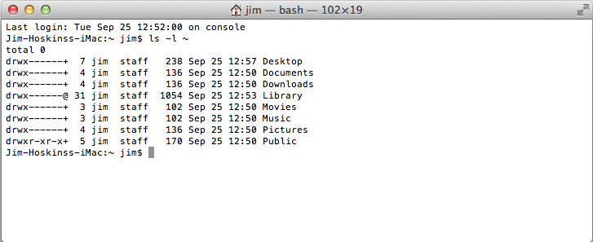

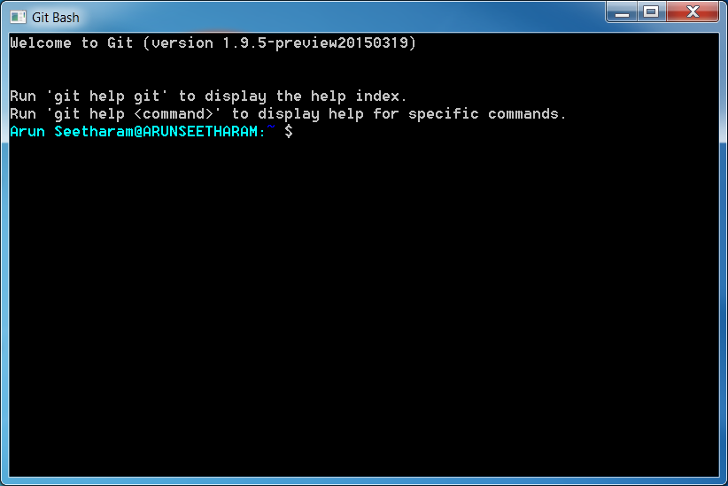

Terminal
If you plan on using Git Bash (Windows), consider upgrading the default Windows terminal to something better. ConEmu, Console 2 are some of the options.
If you don’t plan to use UNIX locally, but want to connect to remote computers to run the commands, Putty, OpenSSH are some ideal choices.

Slide 10
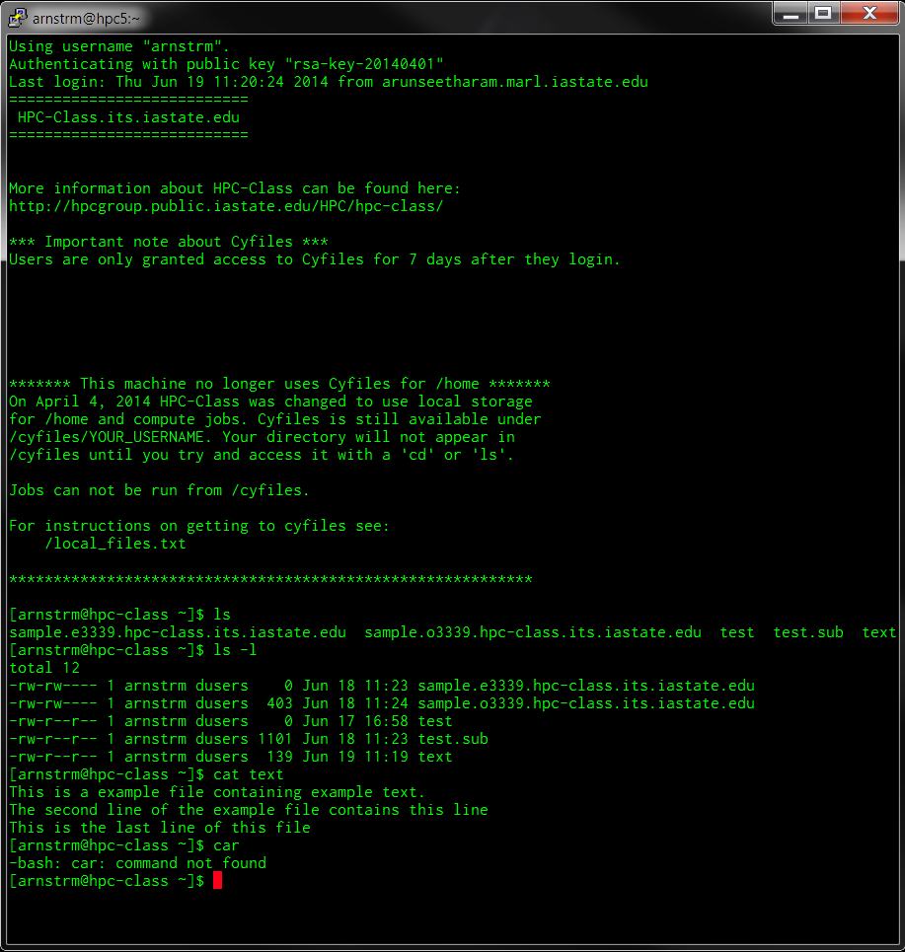
Terminal
welcome message
prompt
command
argument
standard out
standard error

Slide 11
Some tips before starting
Write down the commands on a sheet of paper as you move through the exercise
Typing first few letters of command/file and then pressing TAB will auto complete the word. Pressing TAB-TAB, displays all matching commands/files for the letters you typed.
Use arrow keys to cycle through your command history (up and down).
Commands are case sensitive (eg. Cat ≠ cat)
Do not use space or special characters for naming files/folders
Be careful before you delete, there is no recycle bin.
Be familiar with the syntax and options for the commands

Slide 12
Some tips before starting
At any time to cancel a executed command, press “CTRL+C” (“Ctrl” key and letter “c” key pressed together): C for Cancel!
Many commands use “q” or “Esc” to quit/exit
Double check your commands: chances are, most of the times you don’t see an error, instead, you get wrong results.
To clear the screen: Ctrl+L
Some universal variables makes it easier to find things
$HOME
$SHELL
$PATH
$HOSTNAME

Slide 13
Navigation
Commands you should know:
ls : list
cd : change directory
pwd : print working directory

Slide 14
Changing directory
# for changing directory (i.e., jumping from one directory to another), we use
# ‘cd’ command.
# the usual way is to tell which directory you want to change
~$ cd DIRECOTRY
# will change to DIRECTORY
# It is important that you need to specify either relative or absolute path for the
# Now, try this:
~$ cd WORKSHOP_FILES
~$ ls
# What files do you see?
# Note: you can also use “./WORKSHOP_FILES”, they both mean same
# Now type:
~$ cd ..
~$ ls
# do you see same files?
# as mentioned before, .. is a shortcut for ‘previous directory’
# similarly, . is a shortcut for ‘present directory’

Slide 15
Knowing your location
# from the ‘WORKSHOP_FILES’ directory, run this
~$ pwd
/home/arnstrm/WORKSHOP_FILES
# it prints the working directory (the directory you are presently located)
# this is very useful as you can easily know your location at any point of time
# Now, try this:
~$ cd ~
~$ pwd
/home/arnstrm
# Why did that happen? ~ is the shortcut for home!
# typing in cd without any argument also brings you back to home directory!
~$ cd –
/home/arnstrm/WORKSHOP_FILES
~$ pwd
/home/arnstrm/WORKSHOP_FILES
# Similarly, - is the shortcut for the previous location

Slide 16
Listing files
# go to the ‘basic’ folder in ‘WORKSHOP_FILES’
~$ ls
FILE_1.txt FILE_3.txt FILE_5.txt FILE_7.txt FILE_9.txt
FILE_2.txt FILE_4.txt FILE_6.txt FILE_8.txt FILE_10.txt
# it prints the contents of that directory. But knowing the files is pretty basic stuff
# to achieve more with the same command, we can use arguments
~$ ls –l
total 36
-rw-rw-r-- 1 arnstrm arnstrm 17 Jul 1 21:31 FILE_1.txt
-rw-rw-r-- 1 arnstrm arnstrm 0 Jul 1 21:51 FILE_2.txt
-rw-rw-r-- 1 arnstrm arnstrm 17 Jul 1 21:31 FILE_3.txt
-rw-rw-r-- 1 arnstrm arnstrm 17 Jul 1 21:31 FILE_4.txt
-rw-rw-r-- 1 arnstrm arnstrm 17 Jul 1 21:50 FILE_5.txt
-rw-rw-r-- 1 arnstrm arnstrm 17 Jul 1 21:31 FILE_6.txt
-rw-rw-r-- 1 arnstrm arnstrm 17 Jul 1 21:52 FILE_7.csv
-rw-rw-r-- 1 arnstrm arnstrm 17 Jul 1 21:31 FILE_8.txt
-rw-rw-r-- 1 arnstrm arnstrm 17 Jul 1 21:31 FILE_9.txt
-rw-rw-r-- 1 arnstrm arnstrm 132 Jul 1 21:51 FILE_10.txt
# here, using –l changed the way the files are displayed
Notes:
WORKSHOP_FILES make sure everyone is in the right place (downloaded).

Slide 17
Listing files
# There are many options available, some important ones are:
# -t (based on time modified)
# -S (size based listing)
# -X (extension)
# -a (all files, displays hidden files in the directory)
# You can merge several options together too! eg.,
~$ ls –lt
total 36
-rw-rw-r-- 1 arnstrm arnstrm 17 Jul 1 21:52 FILE_7.csv
-rw-rw-r-- 1 arnstrm arnstrm 0 Jul 1 21:51 FILE_2.txt
-rw-rw-r-- 1 arnstrm arnstrm 132 Jul 1 21:51 FILE_10.txt
-rw-rw-r-- 1 arnstrm arnstrm 17 Jul 1 21:50 FILE_5.txt
-rw-rw-r-- 1 arnstrm arnstrm 17 Jul 1 21:31 FILE_1.txt
-rw-rw-r-- 1 arnstrm arnstrm 17 Jul 1 21:31 FILE_3.txt
-rw-rw-r-- 1 arnstrm arnstrm 17 Jul 1 21:31 FILE_4.txt
-rw-rw-r-- 1 arnstrm arnstrm 17 Jul 1 21:31 FILE_6.txt
-rw-rw-r-- 1 arnstrm arnstrm 17 Jul 1 21:31 FILE_8.txt
-rw-rw-r-- 1 arnstrm arnstrm 17 Jul 1 21:31 FILE_9.txt
# what is the difference you notice? Try other options given above and see what it does.

Slide 18
Copy and Move
Two commands, that have similar syntax, but slightly different options:
cp : copy files and directories
mv : move or rename files and directories
Syntax for both these commands are as follows:
cp Source Destination
mv Source Destination
You can use, absolute path, relative path or no path at all for these commands.
Lets try out some examples:

Slide 19
Getting help
How do you keep track of all the options for every single command? Luckily, there is manual page for each of them!
man command : show the man page of a command
command --help : show a brief help text (some commands)
Try this for the commands you just learnt!
Yes, there is a man page for man command as well!

Slide 20
Getting help
# Let’s look at an example, open man page for the ls command
~$ man ls
LS(1) User Commands LS(1)
NAME
ls - list directory contents
SYNOPSIS
ls [OPTION]... [FILE]...
DESCRIPTION
List information about the FILEs (the current directory by default). Sort entries alphabetically if none of -cftuvSUX nor --sort.
Mandatory arguments to long options are mandatory for short options too.
-a, --all
do not ignore entries starting with .
To EXIT, press ‘q’
Notes:
Introduce yourself what is your background
Last half hour exercise designed to work independently :

Slide 21
Copy command
# Let’s create a backup copy for all the workshop files before we start changing it
# this will allow us to restore all the files if anything wrong happens
~$ cd ~
# change to home
~$ pwd
# check location
~$ ls
# list files, do you see ‘WORKSHOP_FILES’ here?
~$ cp WORKSHOP_FILES BACKUP_FILES
cp: omitting directory `WORKSHOP_FILES'
# WHY DID THIS COMMAND DID NOT WORK?
~$ man cp
# So we are missing the options to copy folders!
~$ cp -r WORKSHOP_FILES BACKUP_FILES
# Did this work? How do you check if it worked?
~$ ls
# Do you see the copied folder?
# What does the ‘-r’ option do here?
Notes:
Introduce yourself what is your background
Last half hour exercise designed to work independently :

Slide 22
Move command
# Let’s rename the copied files to something else
~$ cd ~
# change to home
~$ pwd
# check location
~$ ls
# list files, do you see ‘WORKSHOP_FILES’ here?
~$ mv BACKUP_FILES tutorials
# Nice, you didn’t need to use any options like ‘cp’ command
~$ man mv
# what options do you think might be useful?
# specifically, what does these options do?
# -n : no overwriting of files
# -u : update only new files to destination
Notes:
Introduce yourself what is your background
Last half hour exercise designed to work independently :

Slide 23
File and Directory creation/deletion
Directory
mkdir : make directory
rmdir : remove directory
Files
touch : creates an empty file
rm : removes file
Editing the file
nano : default command line file editor

Slide 24
Making directory
# Let’s rename the copied files to something else
~$ cd ~
# change to home
~$ pwd
# check location
~$ ls
# list files, do you see ‘WORKSHOP_FILES’ here?
~$ cd WORKSHOP_FILES
~$ ls
# If you see familiar files here, let’s create a new directory
~$ mkdir FirstDirectory
~$ ls
# do you see the new directory here?
~$ man mkdir
# what options do you think might be useful?
# specifically, what does this option do?
# -p : make parent directories
Notes:
Introduce yourself what is your background
Last half hour exercise designed to work independently :

Slide 25
Deleting directory
# Let’s rename the copied files to something else
~$ cd ~
# change to home
~$ pwd
# check location
~$ ls
# list files, do you see ‘WORKSHOP_FILES’ here?
~$ cd WORKSHOP_FILES
~$ ls
# If you see familiar files here, let’s delete the new directory (FirstDirectory)
~$ rmdir FirstDirectory
~$ ls
# do you see the directory?
~$ rmdir delete_me
# why did this command not work?
~$ man rmdir
# what options do you think might be useful to delete the above folder?
# -r : remove directories and their contents
# -f : force
Notes:
Introduce yourself what is your background
Last half hour exercise designed to work independently :

Slide 26
File creation
# Let’s create and edit our first file, make sure you are in WORKSHOP_FILES
~$ pwd
/home/arnstrm/WORKSHOP_FILES
~$ touch firstfile
~$ ls
AT_cDNA.fa RefSeq.faa basic firstfile genes_b.gff ids_a.txt
AT_genes.gff Sequences delete_me genes_a.gff ids.txt ids_b.txt
# do you see your file?
# let’s add some contents to it
~$ nano firstfile
# what happened?
Notes:
Introduce yourself what is your background
Last half hour exercise designed to work independently :

Slide 27
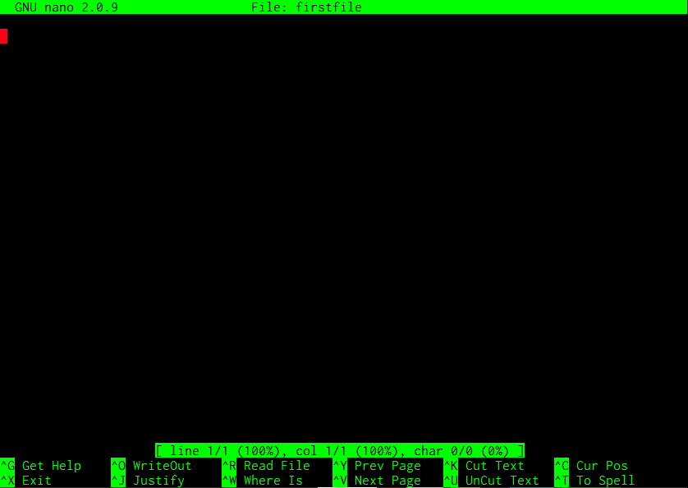
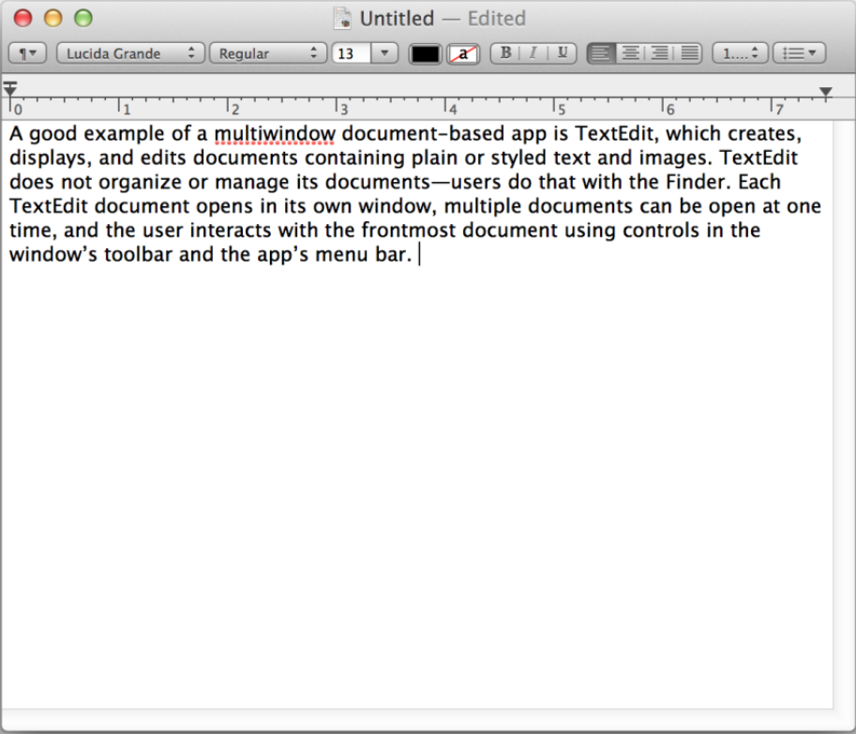
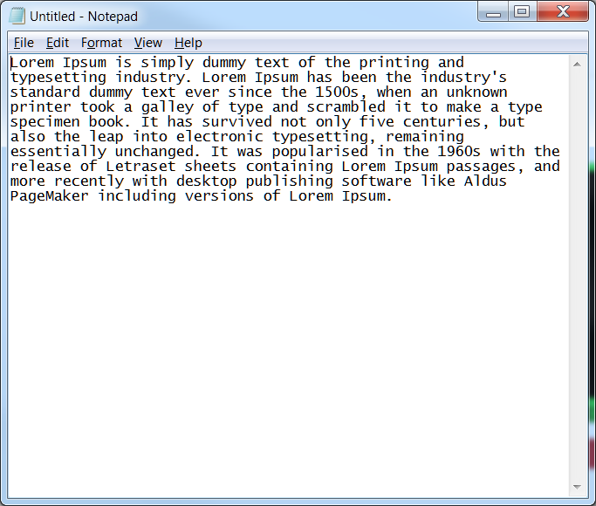


File creation
Title bar
Cursor
Menu/options
Editing area
Editing area
Add whatever text you want to add here (by just typing), once done you can exit by pressing Ctrl(^) + X, then answer yes “Y” to save changes (or “N” to discard changes)
Editing area
Menu/options
Notes:
Introduce yourself what is your background
Last half hour exercise designed to work independently :

Slide 28
Reading files
Commands
less : view file with more options
more : view file with less options
cat : catalog a file
head : show the head portion of the files
tail : show the tail end of the file

Slide 29
Reading files
# Make sure you are in WORKSHOP_FILES directory
~$ pwd
/home/arnstrm/WORKSHOP_FILES
# try these commands:
~$ more AT_cDNA.fa
# Opens a file for reading and allows you to browse using arrow keys
~$ less AT_cDNA.fa
# pretty much like more, but has more options
~$ cat AT_cDNA.fa
# ‘cat’alog a file: displays entire file
~$ head AT_cDNA.fa
# display “head” or first portion of the file (default is first 10 lines)
~$ tail AT_cDNA.fa
# display “tail” or end portion of the file (default is last 10 lines)
# open man page for these commands to see numerous options that are available
# how do you change the default 10 lines for head and tail? -n 25
# how to do you search for a word in less or more command? Try /genes after opening
# how do you print non-printing characters with cat command? -t
Notes:
Introduce yourself what is your background
Last half hour exercise designed to work independently :

Slide 30
Compressing and Archiving
Compress/Decompress
zip: compress or decompress using zip algorithm
gzip : compress or decompress using gnu-zip algorithm
Archiving
tar: tape archive, does not compress but creates a single bundle of all files/directories. It can be used with compression algorithms to archive and compress at the same time.
Why compression?
Reduces disk space
Easier to distribute/handling
Backing up the data

Slide 31
Compressing/decompressing
# Make sure you are in WORKSHOP_FILES directory
~$ pwd
/home/arnstrm/WORKSHOP_FILES
# check files:
~$ ls -l
# to zip a file (compression)
~$ zip AT_cDNA.fa.zip AT_cDNA.fa
# check files again
~$ ls -l
# Notice the size difference?
# now, try this
~$ unzip AT_cDNA.fa.zip
~$ gzip AT_cDNA.fa
~$ ls -l
# to decompress
~$ gunzip AT_cDNA.fa.gz
~$ ls -l
# you can zip a directory or several files together, but gzip works on single file
Notes:
Introduce yourself what is your background
Last half hour exercise designed to work independently :

Slide 32
Compressing/decompressing
# Some more examples
~$ cd basic
# check files:
~$ ls
# all files have txt extension
~$ zip -r files.zip . -i *.txt
# check files again
~$ ls -l
# Notice a new file? That is compressed file, archived file (all files with txt files)
~$ cd ..
~$ zip -r basic.zip basic
~$ ls -l
# basic.zip is compressed directory of basic
Notes:
Introduce yourself what is your background
Last half hour exercise designed to work independently :

Slide 33
Archiving
# Make sure you are in WORKSHOP_FILES directory
~$ pwd
/home/arnstrm/WORKSHOP_FILES
# check files:
~$ cd ..
~$ ls -l
# archive backed up folder (BACKUP_FILES)
~$ tar –cvf BACKUP_FILES.tar BACKUP_FILES
~$ ls -l
# there is a archived file (BACKUP_FILES.tar)
# option c=compress, v=verbose, f=files
# but if you want to compress and archive
~$ tar –czvf BACKUP_FILES.tar.gz BACKUP_FILES
~$ ls -l
# z= uses GNU zip compression to compress the files
# using x(eXtract) instead of c, extracts the archive file
~$ tar –xvf BACKUP_FILES.tar
~$ tar –xvzf BACKUP_FILES.tar.gz
# many other compression types can also be used (bzip2, lz, xz etc.,)
Notes:
Introduce yourself what is your background
Last half hour exercise designed to work independently :

Slide 34
Pipes and Redirects
Data that is displayed on screen (stdout/stderr) can also be redirected to desired places (eg., a new file, new command)
> (greater than sign) redirects the data from the command to another file (outside)
< (less than sign) redirects the data into the command (from a file)
>> (double greater than sign), just like the >, but doesn’t clobber the file (appends to the end of the file)
| (pipe) connects the output of one command to another

Slide 35

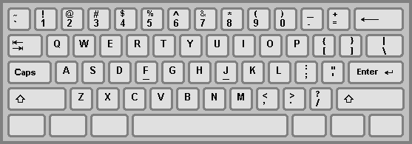
Keyboard

Slide 36
Pipes and Redirects
# Make sure you are in WORKSHOP_FILES directory
~$ pwd
/home/arnstrm/WORKSHOP_FILES
# check files:
~$ ls –l
# you’ll see the list of files here, now try this:
~$ ls -l > list.txt
~$ ls -l
# do you see the list.txt file? Check its content.
# now try this
~$ ls -l >> list.txt
# check the contents of the list.txt again, then try this
~$ ls -l > list.txt
# what is the difference?
# For pipes, try this:
~$ cat RefSeq.faa
# whoa! What happened?
~$ cat RefSeq.faa | less
Notes:
Introduce yourself what is your background
Last half hour exercise designed to work independently :

Slide 37
Regular expressions
Imagine, rather than typing all the file names, you could represent them with a single word
This word or a pattern used to represent files/directories are called regular expression (regex for short).
Simple examples:
* to represent any word: eg. *.txt means all files with txt extension
? to represent a single letter: eg. ?????.txt matches all files with exactly 5 letters, with txt extension.
^ beginning and $ for the end of the word: eg ^text* forces the match for the beginning letters only.

Slide 38
File permissions and properties
Command:
chmod: short for change mode, alters the permissions for files/directories
Other commands to alter properties of files/dirs.:
chgrp : change group
chown : change owner

Slide 39
Changing mode (chmod)
# Make sure you are in WORKSHOP_FILES directory
~$ pwd
/home/arnstrm/WORKSHOP_FILES
# check files:
~$ ls -l
total 8904
-rw-rw-r-- 1 arnstrm arnstrm 8311510 Jun 23 2014 AT_cDNA.fa
-rw-rw-r-- 1 arnstrm arnstrm 756956 Jun 23 2014 AT_genes.gff
-rw-rw-r-- 1 arnstrm arnstrm 6138 Jun 23 2014 RefSeq.faa
drwxrwxr-x 2 arnstrm arnstrm 4096 Jul 1 21:46 Sequences
drwxrwxr-x 2 arnstrm arnstrm 4096 Jul 4 12:15 basic
-rw-rw-r-- 1 arnstrm arnstrm 3929 Jul 4 12:16 basic.zip
drwxrwxr-x 2 arnstrm arnstrm 4096 Jul 1 21:46 delete_me
-rw-rw-r-- 1 arnstrm arnstrm 0 Jul 2 14:40 firstfile
-rw-rw-r-- 1 arnstrm arnstrm 2103 Jun 23 2014 genes_a.gff
-rw-rw-r-- 1 arnstrm arnstrm 2717 Jun 23 2014 genes_b.gff
-rw-rw-r-- 1 arnstrm arnstrm 550 Jun 23 2014 ids.txt
-rw-rw-r-- 1 arnstrm arnstrm 385 Jun 23 2014 ids_a.txt
-rw-rw-r-- 1 arnstrm arnstrm 385 Jun 23 2014 ids_b.txt
Advanced permission, mainly to say type: d= directory, -=regular file, l=shortcut (link), s=permission set by sys admin, etc
Permission for user (you). r=read; w=write; x=execute
Permission for others. r=read; w=write; x=execute
Permission for the group you belong to. r=read; w=write; x=execute
u
g
o
user
group
size
date
filename
Notes:
Introduce yourself what is your background
Last half hour exercise designed to work independently :

Slide 40
Changing mode (chmod)
# Make sure you are in WORKSHOP_FILES directory
~$ pwd
/home/arnstrm/WORKSHOP_FILES
# check files:
~$ chmod g-w RefSeq.faa
# check file permission
~$ chmod g+w RefSeq.faa
# check again
# try all these and see the difference each time you run the command
~$ chmod o+rwx RefSeq.faa
~$ chmod o-rwx RefSeq.faa
~$ chmod u+x RefSeq.faa
# open man page and search how to change the permission for entire directory
~$ chmod –R g-rwx Sequences
Notes:
Introduce yourself what is your background
Last half hour exercise designed to work independently :

Slide 41
Processing files
tr : translate
wc : word count

Slide 42
Processing files
# Make sure you are in WORKSHOP_FILES directory
~$ pwd
/home/arnstrm/WORKSHOP_FILES
# run these commands
~$ tr "ATGC" "atgc" <AT_cDNA.fa >AT_cDNA_tr.fa
~$ tr "ATGC" "AUGC" <AT_cDNA.fa > AT_rna.fa
~$ tr "a-z" "A-Z“ <infile > outfile
# Converts case
# counting words/characters/lines:
~$ wc AT_genes.gff
~$ wc –l AT_genes.gff
~$ wc –c AT_genes.gff
~$ wc –w AT_genes.gff
Notes:
Introduce yourself what is your background
Last half hour exercise designed to work independently :

Slide 43
Processing files
Simple commands to modify output
sort : for sorting
uniq : removing duplicates/printing unique entries

Slide 44
sort
# Make sure you are in WORKSHOP_FILES directory
~$ pwd
/home/arnstrm/WORKSHOP_FILES
# check files:
~$ cat genes.gff
# see the contents of the file, see how chromosomes are ordered. Try this:
~$ sort genes.gff
# did the order change?
# check man page and run the following commands:
~$ sort –k 1,1 –n genes.gff
~$ sort –k 1.4,1.5 –n genes.gff
~$ sort –k 3 genes.gff
~$ sort –k 3 –r genes.gff
# by default, it assumes the fields (columns) are separated by tab, but you can change this using -t option.
Notes:
Introduce yourself what is your background
Last half hour exercise designed to work independently :

Slide 45
uniq
# Make sure you are in WORKSHOP_FILES directory
~$ pwd
/home/arnstrm/WORKSHOP_FILES
# check files:
~$ cat ids.txt
# see the contents of the file, many duplicate accession numbers are present. Try this:
~$ uniq –c ids.txt
# what are those numbers?
~$ uniq –d ids.txt
# what are these ids (check the previous results for hint)?
~$ uniq –u ids.txt
# prints unique ids only
# remember, files should be sorted before you use the uniq command!
# can you come up with single command to sort and call uniq on a file?
# Hint: pipes
Notes:
Introduce yourself what is your background
Last half hour exercise designed to work independently :

Slide 46
Comparing files
diff (difference) reports differences between files
comm (common) command compares two sorted files line by line

Slide 47
Comparing files
# Make sure you are in WORKSHOP_FILES directory
~$ pwd
/home/arnstrm/WORKSHOP_FILES
# run these commands
~$ diff -y ids_a.txt ids_b.txt
# are these files different?
# now try:
~$ comm ids_a.txt ids_b.txt
~$ comm -1 ids_a.txt ids_b.txt
~$ comm -2 ids_a.txt ids_b.txt
~$ comm -3 ids_a.txt ids_b.txt
# what’s the difference?
Notes:
Introduce yourself what is your background
Last half hour exercise designed to work independently :

Slide 48
Divide files content
cut : divide the file vertically
split : divide the file horizontally
1
3
cut
split

Slide 49
cut
# Make sure you are in WORKSHOP_FILES directory
~$ pwd
/home/arnstrm/WORKSHOP_FILES
# run these commands
~$ cut -f 1 AT_genes.gff
~$ cut -f 1,4 AT_genes.gff
~$ cut -f 1-4 AT_genes.gff
fields (columns) are separated by tab, but you can change this using -d (delimiter) option.
~$ cut –d “,” -f 1-4 AT_genes.gff
# use comma instead of tab for delimiting fields (columns)
# see man page for more options
Notes:
Introduce yourself what is your background
Last half hour exercise designed to work independently :

Slide 50
split
# Make sure you are in WORKSHOP_FILES directory
~$ pwd
/home/arnstrm/WORKSHOP_FILES
# to split files
~$ split -l 10 ids.txt
~$ ls -l
# do you see new files? Check their contents
# you can modify the default behavior using -d (for numerical suffixes) as well as
# providing meaningful prefixes
~$ split –d -l 10 ids.txt split_ids_
# to divide them based on size instead of lines, use the -b (bytes) option
~$ split –d -b 100 ids.txt split_ids_size_
Notes:
Introduce yourself what is your background
Last half hour exercise designed to work independently :

Slide 51
Merging files
cat : concatenate the files
paste : combine 2 files horizontally
join : combine 2 files horizontally, but based on a specific key column present in both files
A1 X1
B2 X2
C3 X4
D4 X5
A1 Y1
B2 Y2
C3 Y4
D4 Y5
A1 X1 Y1
B2 X2 Y2
C3 X3 Y4
D4 X4 Y5
paste
cat
join

Slide 52
Merging files
# Make sure you are in WORKSHOP_FILES directory
~$ pwd
/home/arnstrm/WORKSHOP_FILES
# to merge files using cat
~$ cd sequences
~$ ls -l
# do you see many files, each file has a single sequence in it
# to merge them into a single file:
~$ cat *.fa >> sequences.fasta
~$ cd ..
# similarly, to use paste, just:
~$ paste ids_a.txt ids_b.txt >> combined_ids.txt
# check files to see if the contents are same as what you were expecting
~$ join -1 1 -2 3 genes_a.gff genes_b.gff # 1st field from the 1st file and 3rd field from the 2nd file is used to merge
Notes:
Introduce yourself what is your background
Last half hour exercise designed to work independently :

Slide 53
Downloading commands
wget : get the www link
curl : copy URL
# Make sure you are in WORKSHOP_FILES directory
~$ pwd
/home/arnstrm/WORKSHOP_FILES
# download file
~$ wget http://goo.gl/CDXx15
# if you don’t have wget, try curl
~$ curl –O http://goo.gl/CDXx1
# when you do ls, you should see a gzipped file “Gmax_189_annotation_info.txt.gz”

