Slide 1
Introduction to High Performance Computing and Basic Linux
Arun Seetharam
Genome Informatics Facility

Slide 2
Genome Informatics Facility
Collaborate with faculty
Data analysis/bioinformatics support
Grant review, data analysis methods text, data management plan
Develop computational resources
Mentor post doctorates and graduate students
Publish and present at conferences
Advise bioinformatics undergraduate club
Meet the needs and communicate well with a diverse faculty to help facilitate NGS research on campus.

Slide 3
Outline: Session 1
Next Generation DNA sequencing
UNIX operating system
High Performance Computing clusters
Getting started with UNIX commands
Navigation
File manipulation
File content manipulation
Compression/decompression and archiving

Slide 4
Outline: Session 2
Getting started with UNIX commands
Pipes are redirects
Regular expressions
Advanced UNIX commands
Running jobs on HPC-class

Slide 5



Next Generation Sequencing: Timeline
>1000 genomes
Human & mouse
Genome Projects
A. thaliana
D. melanogaster
C. elegans
E. coli
OX174
HIV-1
H. influenzae
1950
1960
1970
1980
1990
2000
2010
1953: DNA structure
1977: Sanger Sequencing
1977: Maxam-Gilbert sequencing
1st Gen
1983: PCR
1986: semi-automated /capillary
Sequencing Technology
1988: multi-capillary
1993: Pyrosequencing
2004: 454
2006: Agencourt SOLiD/ AB
2nd Gen
(Next Gen)
2007: Illumina/Solexa GA
2008: Roche/454 GS FLX
2010: Illumina Hi-Seq 2000
2010: PGM (MiSeq, ionT)
2012-13:
PacBio SMRT
Nanopore minION
3rd Gen
Wikipedia and other sources

Slide 6
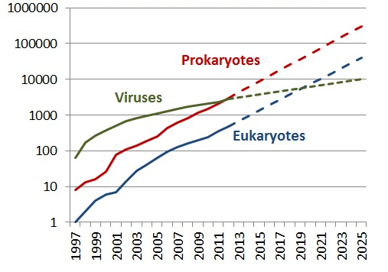
Cumulative Sequenced Genomes
Wikipedia

Slide 7
Next Generation Sequencing Platforms
DNA sequencing
First Generation
Individual Sequencing Reaction
Next Generation
Massive Parallel Seq Reactions
3rd Generation
Single Molecule DNA sequencing
Sanger
Roche 454
ABI SOLiD
Illumina
PacBio
Nanopore
Cloning/ chain termination
Cluster on solid phase
Emulsion PCR
Cluster Generation
Sequencing by electrophoresis
Pyrosequencing
Sequencing by ligation
Sequencing by Synthesis
Fluorescent signal capture
Electric signal capture
wikipedia and various vendor websites

Slide 8
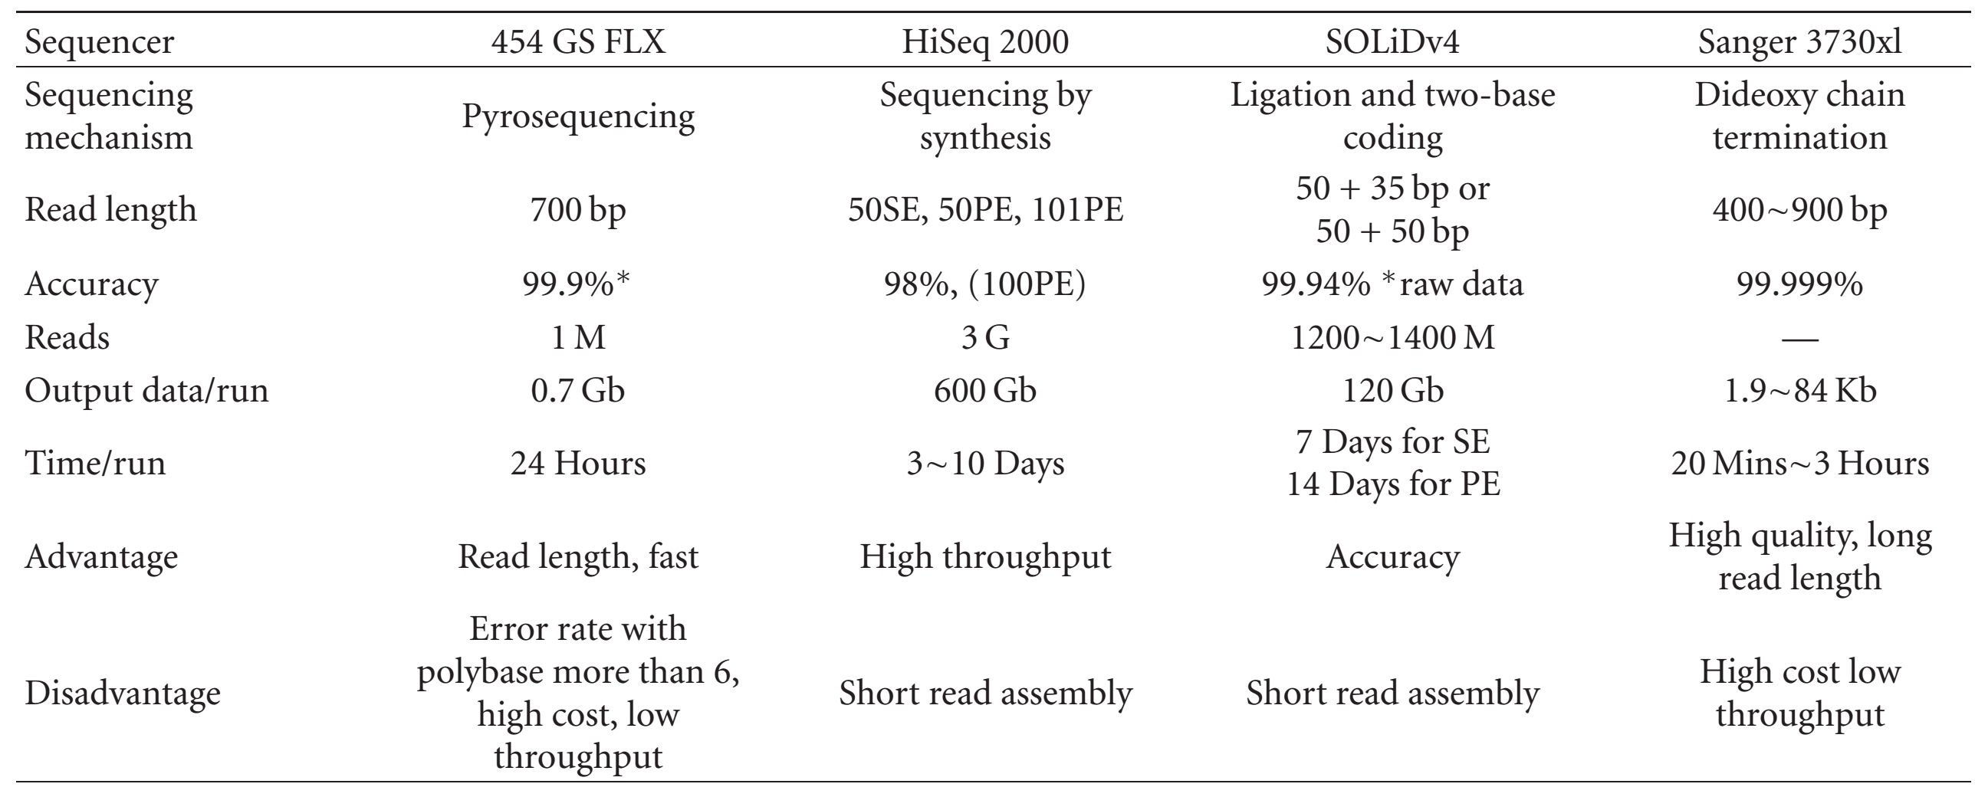
Next Generation Sequencing Platforms
Liu et al., Journal of Biomedicine and Biotechnology, 2012 Article-ID 251364

Slide 9
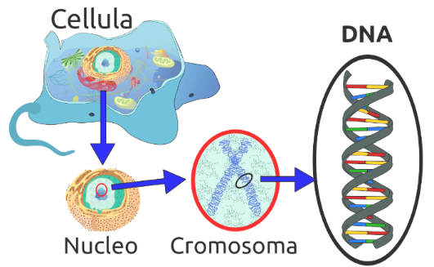

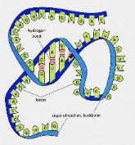



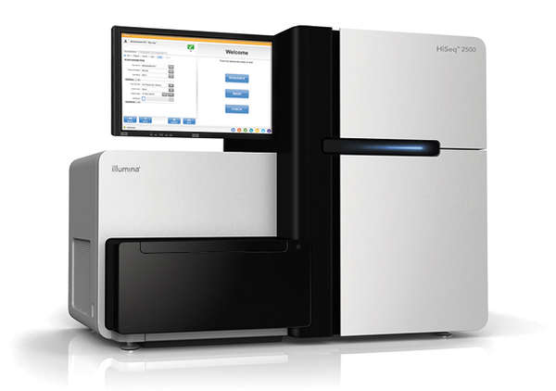
Applications of NGS
Reduced representation
cDNA
mRNA
Genomic DNA
Targeted DNA capture
RNAseq
Hi-C
MNase-seq
DNAseq
ChIP-seq
MedIP-seq
RADseq, GBS
Wikipedia and other sources

Slide 10
Some definitions
FastA format/FastQ format: format to store the sequence information
Reads: Sequencing machines output individual sequences called reads
Header or read information
1
2
3
4
1
2
3
4
@HWI-ST412:228:C0E8MACXX:2:1101:3023:2187 1:N:0:TGACCA
CCTGGTCCAGCTCGTACACGATGGGGATCCCTGTGGGCAGGTTCAGCTCCATGATGGCCTGGTCGGACATCC
+
BBCFFEFFFDHHHJIIJJJJIIJJIJIIGIJJIIJJJJJJJBGHIJIJJJJGIJJIJGHHHHHFFDDDDDDC
@HWI-ST412:228:C0E8MACXX:2:1101:3381:2149 1:N:0:TGACCA
CTTGCAGCATGGCTGACCAACTGACTGAAGAGCAGATTGCAGAGTTCAAAGAAGCTTTTTCACTATTTGACA
+
@@CDDFFFGDFHHJGIJJJJJJJJJJJIJGJJJJJIHJJJJIJB?DHIGHGIHHGHGIJIJJJJIJJJIJJJ
actual sequence
Individual read
Associated quality (PHRED score)

Slide 11
Reads, Contigs, Scaffolds
Paired end reads: Sequence from same DNA molecule sequenced in a way by which they are at a specific distance from each other.
Reads
Contigs
Scaffolds
Gaps

Slide 12
Have you ever….
tried to open a very large file (like FASTQ) in PC/Mac?
searching for a specific piece of information from large number of files?
wanted to rename large number of files?
combine large number of files into one big file?
got frustrated with excel auto-correcting your favorite gene?
wanted to run a program that isn’t available on your operating system?
bored of doing same things over and over?
You Need UNIX

Slide 13
What is UNIX?
Widely used multiuser operating system
Linux: free version of UNIX-like operating system
Red Hat Enterprise Linux, Ubuntu, and CentOS
Used on high-end workstations, database servers, web servers and managing shared resources
Standard features include:
Security, reliability, scalability
supports multi-user (as in 100s)

Slide 14
Can I learn UNIX?
Yes! Absolutely. It is just another way of operating your computer
No more difficult than learning Word, Excel or Powerpoint
Biggest difference
In Unix: You type the command to execute
In Word: You use your mouse to execute a command
Remember. In the Terminal, “don’t touch the mouse”

Slide 15

Kernel and Shells
SHELL
USER 1
KERNEL
USER N
HARDWARE
SHELL types:
Bourne Shell (sh)
C shell (csh)
TC shell (tcsh)
Korn shell (ksh)
Bourne Again Shell (bash)
Z shell (zsh)
Notes:
I am telling you this for your information. These are the advantages you get by using Unix. All of this is done transparently.
You all the time interact with the computer using shell, today we are using a different shell to interact with the computer

Slide 16

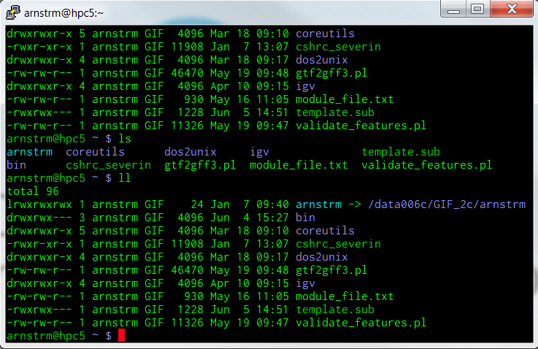

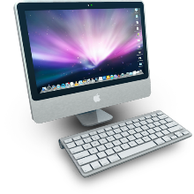
High Performance Computing (HPC)
HPC-class (education)
48 compute nodes
16 processors/node (768 total)
64Gb RAM/node (3.0Tb total)
Lightning3 (research)
17 compute nodes
32 processors/node (384 total)
256Gb RAM/node (3.2Tb total)
Compute Nodes
Condo (research)
316 compute nodes (max)
8 processors/node (2528 total)
8Gb RAM/node (3.5Tb total)
Head Node
Terminal
SSH
Notes:
Can throw almost anything at it.
Lightning3 is a shared resource that researchers have been buying into it.
Condo will be an order of magnitude more nodes.

Slide 17

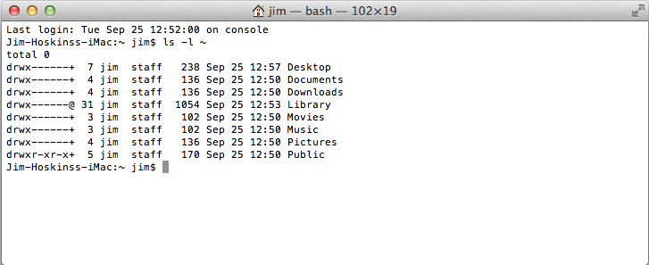
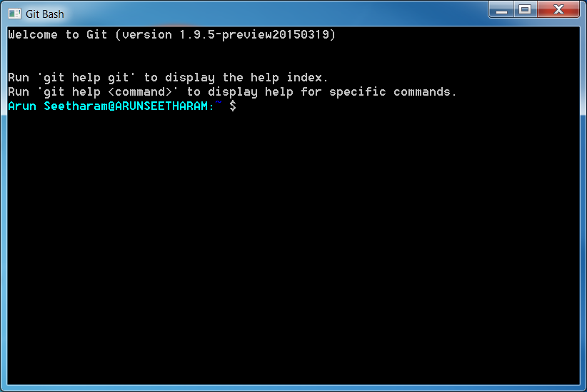

Terminal
If you plan on using Git Bash (Windows), consider upgrading the default Windows terminal to something better. ConEmu, Console 2 are some of the options.
If you don’t plan to use UNIX locally, but want to connect to remote computers to run the commands, Putty, OpenSSH are some ideal choices.

Slide 18
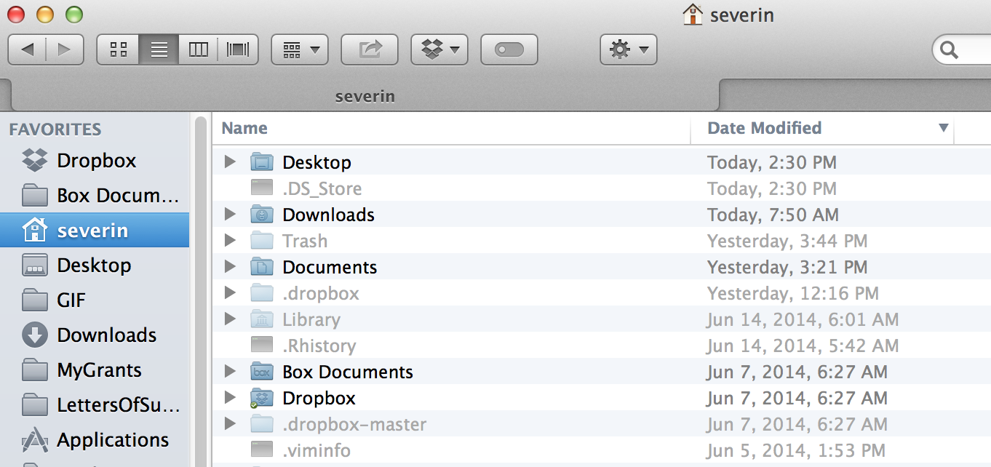
Terminal

Slide 19
How to get started?
Mac OS: Native application called “Terminal” allows you to run UNIX commands. No installation necessary, just search for the program and start using it!
Linux OS: Again, pre-installed in the OS. Search for either Terminal/Console program and can start running UNIX commands.
Windows OS: Requires emulators for running UNIX commands. Popular options include:
Git BASH: msysgit.github.io
Cygwin : www.cygwin.com
Currently, best option for running UNIX. Installation takes only few seconds

Slide 20
How to get started?
# open the terminal and connect to the HPC-Class cluster
~$ ssh –X your_netID@hpc-class.its.iastate.edu
# press enter
# it may ask you if you want to add HPC-class to the known hosts list, say yes.
# Then enter your ISU password
# Note: You’ll not see the password while typing (not even stars!)
Warning: Permanently added 'hpc-class.its.iastate.edu' (RSA) to the list of known hosts.
arnstrm@hpc-class.its.iastate.edu's password:
Last login: Tue Mar 29 09:38:05 2016 from gifnas.biotech.iastate.edu

Slide 21
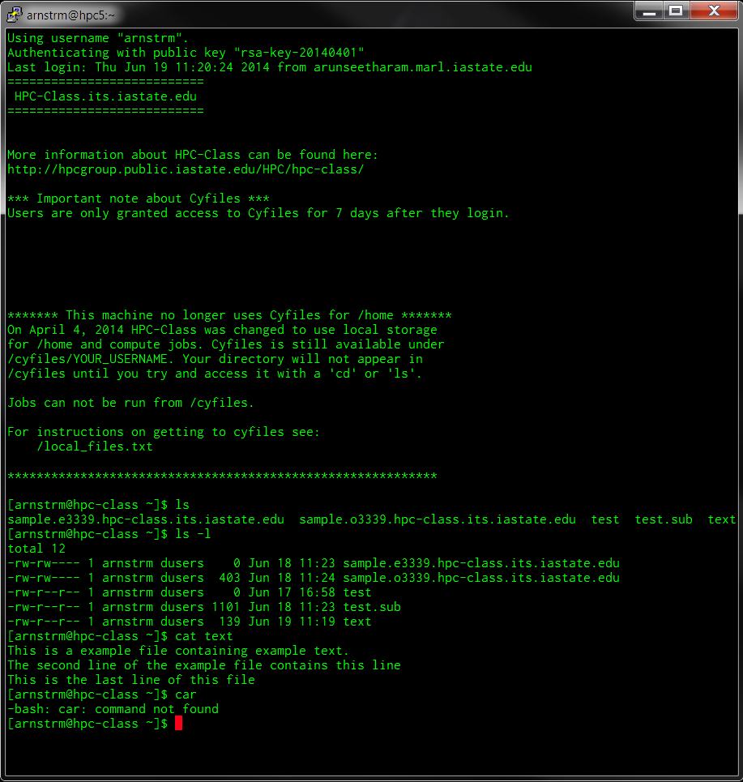
Terminal
welcome message
prompt
command
argument
standard out
standard error

Slide 22
Organization
Root Directory, whole tree starts from here
Contains fundamental executables (i.e., binaries) generally used by all users on the system
All users home directories are located here
/
..
etc
dev
home
Parent
Directory
usr
bin
.
My Home!
arnstrm
user2
user3
lib
~
Home
Present
Directory
folder1
folder2
Relative path for fileA:
./folder2/fileA
Absolute path for fileA:
/home/arnstrm/folder2/fileA
fileA
Shortcut:
~/folder2/fileA
Notes:
Stress again that this is just background that is important but will see often and get practice with in the exercises.
Explain all the directrories
Show this slide again after the ls command, to display how the folders are orgainzed

Slide 23
Some tips before starting
Write down the commands on a sheet of paper as you move through the exercise
Typing first few letters of command/file and then pressing TAB will auto complete the word. Pressing TAB-TAB, displays all matching commands/files for the letters you typed.
Use arrow keys to cycle through your command history (up and down).
Commands are case sensitive (eg. Cat ≠ cat)
Do not use space or special characters for naming files/folders
Be careful before you delete, there is no recycle bin.
Be familiar with the syntax and options for the commands

Slide 24
Some tips before starting
At any time to cancel a executed command, press “CTRL+C” (“Ctrl” key and letter “c” key pressed together): C for Cancel!
Many commands use “q” or “Esc” to quit/exit
Double check your commands: chances are, most of the times you don’t see an error, instead, you get wrong results.
To clear the screen: Ctrl+L
Some universal variables makes it easier to find things
$HOME
$SHELL
$PATH
$HOSTNAME

Slide 25
Downloading Class Materials
# Hand-outs/files are available for download at
# https://github.com/ISUgenomics/basic_UNIX_2015/blob/master/UNIX_exercises_all.pdf
# Type these commands
~$ cd
# and press enter
~$ git clone https://github.com/ISUgenomics/basic_UNIX_2015.git
# and press enter
# you’ll see some text on the screen after that, it is just download progress
# when you see your ~$ you’re done with downloading files
Initialized empty Git repository in /home/arnstrm/basic_UNIX_2015/.git/
remote: Counting objects: 98, done.
remote: Total 98 (delta 0), reused 0 (delta 0), pack-reused 98
Unpacking objects: 100% (98/98), done.
~$
~$ ls
# and press enter
basic_UNIX_2015
~$ mv basic_UNIX_2015/WORKSHOP_FILES ./
# you’re all set to begin learning the UNIX!

Slide 26
Navigation
Commands you should know:
ls : list
cd : change directory
pwd : print working directory

Slide 27
Changing directory
# for changing directory (i.e., jumping from one directory to another), we use
# ‘cd’ command.
# the usual way is to tell which directory you want to change
~$ cd DIRECOTRY
# will change to DIRECTORY
# It is important that you need to specify either relative or absolute path for the
# Now, try this:
~$ cd WORKSHOP_FILES
~$ ls
# What files do you see?
# Note: you can also use “./WORKSHOP_FILES”, they both mean same
# Now type:
~$ cd ..
~$ ls
# do you see same files?
# as mentioned before, .. is a shortcut for ‘previous directory’
# similarly, . is a shortcut for ‘present directory’

Slide 28
Knowing your location
# from the ‘WORKSHOP_FILES’ directory, run this
~$ pwd
/home/arnstrm/WORKSHOP_FILES
# it prints the working directory (the directory you are presently located)
# this is very useful as you can easily know your location at any point of time
# Now, try this:
~$ cd ~
~$ pwd
/home/arnstrm
# Why did that happen? ~ is the shortcut for home!
# typing in cd without any argument also brings you back to home directory!
~$ cd –
/home/arnstrm/WORKSHOP_FILES
~$ pwd
/home/arnstrm/WORKSHOP_FILES
# Similarly, - is the shortcut for the previous location

Slide 29
Listing files
# go to the ‘basic’ folder in ‘WORKSHOP_FILES’
~$ ls
FILE_1.txt FILE_3.txt FILE_5.txt FILE_7.txt FILE_9.txt
FILE_2.txt FILE_4.txt FILE_6.txt FILE_8.txt FILE_10.txt
# it prints the contents of that directory. But knowing the files is pretty basic stuff
# to achieve more with the same command, we can use arguments
~$ ls –l
total 36
-rw-rw-r-- 1 arnstrm arnstrm 17 Jul 1 21:31 FILE_1.txt
-rw-rw-r-- 1 arnstrm arnstrm 0 Jul 1 21:51 FILE_2.txt
-rw-rw-r-- 1 arnstrm arnstrm 17 Jul 1 21:31 FILE_3.txt
-rw-rw-r-- 1 arnstrm arnstrm 17 Jul 1 21:31 FILE_4.txt
-rw-rw-r-- 1 arnstrm arnstrm 17 Jul 1 21:50 FILE_5.txt
-rw-rw-r-- 1 arnstrm arnstrm 17 Jul 1 21:31 FILE_6.txt
-rw-rw-r-- 1 arnstrm arnstrm 17 Jul 1 21:52 FILE_7.csv
-rw-rw-r-- 1 arnstrm arnstrm 17 Jul 1 21:31 FILE_8.txt
-rw-rw-r-- 1 arnstrm arnstrm 17 Jul 1 21:31 FILE_9.txt
-rw-rw-r-- 1 arnstrm arnstrm 132 Jul 1 21:51 FILE_10.txt
# here, using –l changed the way the files are displayed
Notes:
WORKSHOP_FILES make sure everyone is in the right place (downloaded).

Slide 30
Listing files
# There are many options available, some important ones are:
# -t (based on time modified)
# -S (size based listing)
# -X (extension)
# -a (all files, displays hidden files in the directory)
# You can merge several options together too! eg.,
~$ ls –lt
total 36
-rw-rw-r-- 1 arnstrm arnstrm 17 Jul 1 21:52 FILE_7.csv
-rw-rw-r-- 1 arnstrm arnstrm 0 Jul 1 21:51 FILE_2.txt
-rw-rw-r-- 1 arnstrm arnstrm 132 Jul 1 21:51 FILE_10.txt
-rw-rw-r-- 1 arnstrm arnstrm 17 Jul 1 21:50 FILE_5.txt
-rw-rw-r-- 1 arnstrm arnstrm 17 Jul 1 21:31 FILE_1.txt
-rw-rw-r-- 1 arnstrm arnstrm 17 Jul 1 21:31 FILE_3.txt
-rw-rw-r-- 1 arnstrm arnstrm 17 Jul 1 21:31 FILE_4.txt
-rw-rw-r-- 1 arnstrm arnstrm 17 Jul 1 21:31 FILE_6.txt
-rw-rw-r-- 1 arnstrm arnstrm 17 Jul 1 21:31 FILE_8.txt
-rw-rw-r-- 1 arnstrm arnstrm 17 Jul 1 21:31 FILE_9.txt
# what is the difference you notice? Try other options given above and see what it does.

Slide 31
Copy and Move
Two commands, that have similar syntax, but slightly different options:
cp : copy files and directories
mv : move or rename files and directories
Syntax for both these commands are as follows:
cp Source Destination
mv Source Destination
You can use, absolute path, relative path or no path at all for these commands.
Lets try out some examples:

Slide 32
Getting help
How do you keep track of all the options for every single command? Luckily, there is manual page for each of them!
man command : show the man page of a command
command --help : show a brief help text (some commands)
Try this for the commands you just learnt!
Yes, there is a man page for man command as well!

Slide 33
Getting help
# Let’s look at an example, open man page for the ls command
~$ man ls
LS(1) User Commands LS(1)
NAME
ls - list directory contents
SYNOPSIS
ls [OPTION]... [FILE]...
DESCRIPTION
List information about the FILEs (the current directory by default). Sort entries alphabetically if none of -cftuvSUX nor --sort.
Mandatory arguments to long options are mandatory for short options too.
-a, --all
do not ignore entries starting with .
To EXIT, press ‘q’
Notes:
Introduce yourself what is your background
Last half hour exercise designed to work independently :

Slide 34
Copy command
# Let’s create a backup copy for all the workshop files before we start changing it
# this will allow us to restore all the files if anything wrong happens
~$ cd ~
# change to home
~$ pwd
# check location
~$ ls
# list files, do you see ‘WORKSHOP_FILES’ here?
~$ cp WORKSHOP_FILES BACKUP_FILES
cp: omitting directory `WORKSHOP_FILES'
# WHY DID THIS COMMAND DID NOT WORK?
~$ man cp
# So we are missing the options to copy folders!
~$ cp -r WORKSHOP_FILES BACKUP_FILES
# Did this work? How do you check if it worked?
~$ ls
# Do you see the copied folder?
# What does the ‘-r’ option do here?
Notes:
Introduce yourself what is your background
Last half hour exercise designed to work independently :

Slide 35
Move command
# Let’s rename the copied files to something else
~$ cd ~
# change to home
~$ pwd
# check location
~$ ls
# list files, do you see ‘WORKSHOP_FILES’ here?
~$ mv BACKUP_FILES tutorials
# Nice, you didn’t need to use any options like ‘cp’ command
~$ man mv
# what options do you think might be useful?
# specifically, what does these options do?
# -n : no overwriting of files
# -u : update only new files to destination
Notes:
Introduce yourself what is your background
Last half hour exercise designed to work independently :

Slide 36
File and Directory creation/deletion
Directory
mkdir : make directory
rmdir : remove directory
Files
touch : creates an empty file
rm : removes file
Editing the file
nano : default command line file editor

Slide 37
Making directory
# Let’s rename the copied files to something else
~$ cd ~
# change to home
~$ pwd
# check location
~$ ls
# list files, do you see ‘WORKSHOP_FILES’ here?
~$ cd WORKSHOP_FILES
~$ ls
# If you see familiar files here, let’s create a new directory
~$ mkdir FirstDirectory
~$ ls
# do you see the new directory here?
~$ man mkdir
# what options do you think might be useful?
# specifically, what does this option do?
# -p : make parent directories
Notes:
Introduce yourself what is your background
Last half hour exercise designed to work independently :

Slide 38
Deleting directory
# Let’s rename the copied files to something else
~$ cd ~
# change to home
~$ pwd
# check location
~$ ls
# list files, do you see ‘WORKSHOP_FILES’ here?
~$ cd WORKSHOP_FILES
~$ ls
# If you see familiar files here, let’s delete the new directory (FirstDirectory)
~$ rmdir FirstDirectory
~$ ls
# do you see the directory?
~$ rmdir delete_me
# why did this command not work?
~$ man rmdir
Notes:
Introduce yourself what is your background
Last half hour exercise designed to work independently :

Slide 39
File creation
# Let’s create and edit our first file, make sure you are in WORKSHOP_FILES
~$ pwd
/home/arnstrm/WORKSHOP_FILES
~$ touch firstfile
~$ ls
AT_cDNA.fa RefSeq.faa basic firstfile genes_b.gff ids_a.txt
AT_genes.gff Sequences delete_me genes_a.gff ids.txt ids_b.txt
# do you see your file?
# let’s add some contents to it
~$ nano firstfile
# what happened?
Notes:
Introduce yourself what is your background
Last half hour exercise designed to work independently :

Slide 40
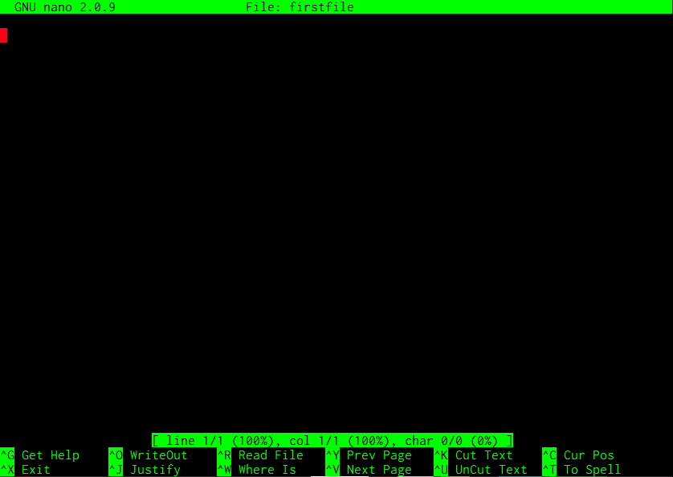
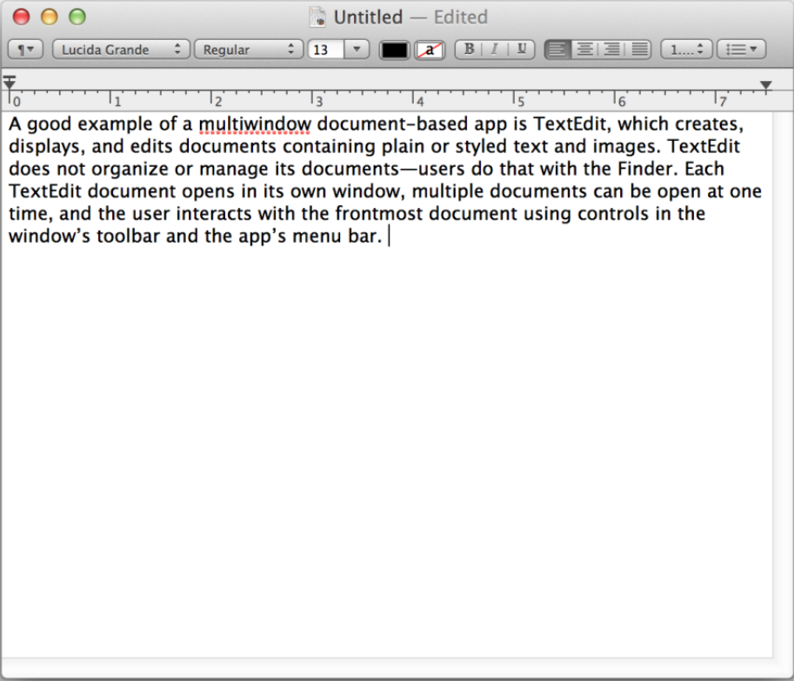
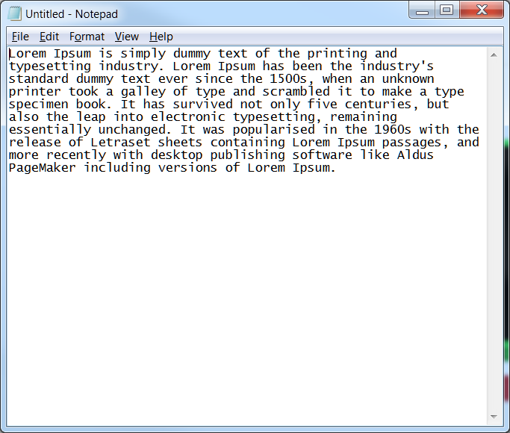


File creation
Title bar
Cursor
Menu/options
Editing area
Editing area
Add whatever text you want to add here (by just typing), once done you can exit by pressing Ctrl(^) + X, then answer yes “Y” to save changes (or “N” to discard changes)
Editing area
Menu/options
Notes:
Introduce yourself what is your background
Last half hour exercise designed to work independently :

Slide 41
Reading files
Commands
less : view file with more options
more : view file with less options
cat : catalog a file
head : show the head portion of the files
tail : show the tail end of the file

Slide 42
Reading files
# Make sure you are in WORKSHOP_FILES directory
~$ pwd
/home/arnstrm/WORKSHOP_FILES
# try these commands:
~$ more AT_cDNA.fa
# Opens a file for reading and allows you to browse using arrow keys
~$ less AT_cDNA.fa
# pretty much like more, but has more options
~$ cat AT_cDNA.fa
# ‘cat’alog a file: displays entire file
~$ head AT_cDNA.fa
# display “head” or first portion of the file (default is first 10 lines)
~$ tail AT_cDNA.fa
# display “tail” or end portion of the file (default is last 10 lines)
# open man page for these commands to see numerous options that are available
# how do you change the default 10 lines for head and tail? -n 25
# how to do you search for a word in less or more command? Try /genes after opening
# how do you print non-printing characters with cat command? -t
Notes:
Introduce yourself what is your background
Last half hour exercise designed to work independently :

Slide 43
Compressing and Archiving
Compress/Decompress
zip: compress or decompress using zip algorithm
gzip : compress or decompress using gnu-zip algorithm
Archiving
tar: tape archive, does not compress but creates a single bundle of all files/directories. It can be used with compression algorithms to archive and compress at the same time.
Why compression?
Reduces disk space
Easier to distribute/handling
Backing up the data

Slide 44
Compressing/decompressing
# Make sure you are in WORKSHOP_FILES directory
~$ pwd
/home/arnstrm/WORKSHOP_FILES
# check files:
~$ ls -l
# to zip a file (compression)
~$ zip AT_cDNA.fa.zip AT_cDNA.fa
# check files again
~$ ls -l
# Notice the size difference?
# now, try this
~$ unzip AT_cDNA.fa.zip
~$ gzip AT_cDNA.fa
~$ ls -l
# to decompress
~$ gunzip AT_cDNA.fa.gz
~$ ls -l
# you can zip a directory or several files together, but gzip works on single file
Notes:
Introduce yourself what is your background
Last half hour exercise designed to work independently :

Slide 45
Compressing/decompressing
# Some more examples
~$ cd basic
# check files:
~$ ls
# all files have txt extension
~$ zip -r files.zip . -i *.txt
# check files again
~$ ls -l
# Notice a new file? That is compressed file, archived file (all files with txt files)
~$ cd ..
~$ zip -r basic.zip basic
~$ ls -l
# basic.zip is compressed directory of basic
Notes:
Introduce yourself what is your background
Last half hour exercise designed to work independently :

Slide 46
Archiving
# Make sure you are in WORKSHOP_FILES directory
~$ pwd
/home/arnstrm/WORKSHOP_FILES
# check files:
~$ cd ..
~$ ls -l
# archive backed up folder (BACKUP_FILES)
~$ tar –cvf BACKUP_FILES.tar BACKUP_FILES
~$ ls -l
# there is a archived file (BACKUP_FILES.tar)
# option c=compress, v=verbose, f=files
# but if you want to compress and archive
~$ tar –czvf BACKUP_FILES.tar.gz BACKUP_FILES
~$ ls -l
# z= uses GNU zip compression to compress the files
# using x(eXtract) instead of c, extracts the archive file
~$ tar –xvf BACKUP_FILES.tar
~$ tar –xvzf BACKUP_FILES.tar.gz
# many other compression types can also be used (bzip2, lz, xz etc.,)
Notes:
Introduce yourself what is your background
Last half hour exercise designed to work independently :

Slide 47
Recap
Navigation commands: ls, pwd, cd
File/Directory operations:
Directory related: mkdir, rmdir
File creation: touch, nano
File view: less, more, cat, head, tail,
Copy/Move: cp, mv
Compression/Archiving: tar, gzip, zip, unzip, gunzip
Help pages: man

Slide 48
Pipes and Redirects
Data that is displayed on screen (stdout/stderr) can also be redirected to desired places (eg., a new file, new command)
> (greater than sign) redirects the data from the command to another file (outside)
< (less than sign) redirects the data into the command (from a file)
>> (double greater than sign), just like the >, but doesn’t clobber the file (appends to the end of the file)
| (pipe) connects the output of one command to another

Slide 49

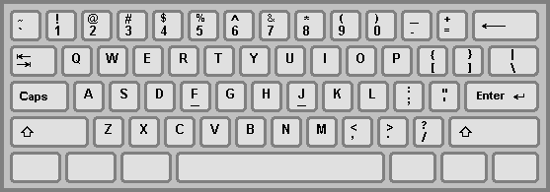
Keyboard

Slide 50
Pipes and Redirects
# Make sure you are in WORKSHOP_FILES directory
~$ pwd
/home/arnstrm/WORKSHOP_FILES
# check files:
~$ ls –l
# you’ll see the list of files here, now try this:
~$ ls -l > list.txt
~$ ls -l
# do you see the list.txt file? Check its content.
# now try this
~$ ls -l >> list.txt
# check the contents of the list.txt again, then try this
~$ ls -l > list.txt
# what is the difference?
# For pipes, try this:
~$ cat RefSeq.faa
# whoa! What happened?
~$ cat RefSeq.faa | less
Notes:
Introduce yourself what is your background
Last half hour exercise designed to work independently :

Slide 51
Regular expressions
Imagine, rather than typing all the file names, you could represent them with a single word
This word or a pattern used to represent files/directories are called regular expression (regex for short).
Simple examples:
* to represent any word: eg. *.txt means all files with txt extension
? to represent a single letter: eg. ?????.txt matches all files with exactly 5 letters, with txt extension.
^ beginning and $ for the end of the word: eg ^text* forces the match for the beginning letters only.

Slide 52
grep
# Make sure you are in WORKSHOP_FILES directory
~$ pwd
/home/arnstrm/WORKSHOP_FILES
# Try these commands
~$ grep “>” AT_cDNA.fa
~$ grep -c “>” AT_cDNA.fa
~$ grep -n “>” AT_cDNA.fa
~$ grep “>” AT_cDNA.fa |less
# you can search for anything, including text or patterns
~$ grep -i "transcription factor" AT_cDNA.fa
# you can color them for easy reading
~$ grep --color -i "transcription factor" AT_cDNA.fa
# similarly, to use paste, just:
~$ grep --color -i "transcription factor" AT_cDNA.fa | grep “chr1”

Slide 53
sed
# normally, has 4 parts for this command
# sed 'OPERATION/MATCH/REPLACEMENT/FLAGS' FILENAME
~$ pwd
/home/arnstrm/WORKSHOP_FILES
# Try these commands
~$ sed 's/chr/chromosome/g’ AT_cDNA.fa
# well, that didn’t help much, try again with this:
~$ sed 's/chr/chromosome/g’ AT_cDNA.fa |less
# we can still make it easy to read:
~$ sed 's/chr/chromosome/g’ AT_cDNA.fa | grep “>”
# printing specific line is easy:
~$ sed ‘52p’ AT_cDNA.fa
# or range of lines:
~$ sed ‘52,55p’ AT_cDNA.fa
# you can delete a line too:
~$ sed ‘1d’ AT_cDNA.fa | head
~$ head AT_cDNA.fa

Slide 54
awk
awk 'PATTERN {ACTION}' FILENAME
$0
BEGIN
$1
$2
$3
$4
NR==1
NR==2
NR==3
NR==4
NR==5
NR==6
NR==7
NR==8
NR==9
NR==10
NR==11
#Chr Start End Name
Chr1 11 200 gene1
Chr1 26 350 gene2
Chr1 33 430 gene3
Chr1 48 510 gene4
Chr1 57 670 gene5
Chr1 65 770 gene6
Chr1 75 890 gene7
Chr1 83 900 gene8
Chr1 91 1010 gene9
NF==4, $NF==gene1
END
FS
RS
(tab)
(new line)

Slide 55
awk
~$ awk NF FILE # Deletes all blank lines ~$ awk 'NF > 0' FILE # Deletes all blank lines ~$ awk 'NF > 4' FILE # Prints only lines with more than 4 fields ~$ awk '$NF > 4' FILE # Prints only lines with value of the 4th filed > 4 ~$ awk 'END { print $NF }' FILE # Prints value of the last field of the last line ~$ awk 'NR==25,NR==100' FILE # Prints lines between 25 and 100 ~$ awk 'NR==50' FILE # Prints 50th line of input ~$ awk 'NR < 26' FILE # Prints first 25 lines
~$ awk 'NR > 25' FILE # Prints file after 25th line
~$ awk 'END { print NR }' FILE # Prints the last line of the file
~$ awk '{ print NF ":" $0 }' FILE # Prints number of fields in front of every line
~$ awk '{ print FNR ":" $0 }' FILE # Prints line number in front of every line
~$ awk '$5 == "abc123"' FILE # Prints lines which have 'abc123' in 5th field
~$ awk 'BEGIN { ORS="\n\n" }; 1' FILE # Double spaces the file
~$ awk '{ print $1, $2 }' FILE # Prints only 1st and 2nd field
~$ awk '{ print $2, $1 }' FILE # Prints only 2nd and 1st field (swapping columns)
~$ awk '{ $2 = ""; print }' FILE # Prints the file without 2nd column
~$ awk '/REGEX/' FILE # Prints all the lines having REGEX
~$ awk '!/REGEX/' FILE # Prints all the lines not having the REGEX

Slide 56
File permissions and properties
Command:
chmod: short for change mode, alters the permissions for files/directories
Other commands to alter properties of files/dirs.:
chgrp : change group
chown : change owner

Slide 57
Changing mode (chmod)
# Make sure you are in WORKSHOP_FILES directory
~$ pwd
/home/arnstrm/WORKSHOP_FILES
# check files:
~$ ls -l
total 8904
-rw-rw-r-- 1 arnstrm arnstrm 8311510 Jun 23 2014 AT_cDNA.fa
-rw-rw-r-- 1 arnstrm arnstrm 756956 Jun 23 2014 AT_genes.gff
-rw-rw-r-- 1 arnstrm arnstrm 6138 Jun 23 2014 RefSeq.faa
drwxrwxr-x 2 arnstrm arnstrm 4096 Jul 1 21:46 Sequences
drwxrwxr-x 2 arnstrm arnstrm 4096 Jul 4 12:15 basic
-rw-rw-r-- 1 arnstrm arnstrm 3929 Jul 4 12:16 basic.zip
drwxrwxr-x 2 arnstrm arnstrm 4096 Jul 1 21:46 delete_me
-rw-rw-r-- 1 arnstrm arnstrm 0 Jul 2 14:40 firstfile
-rw-rw-r-- 1 arnstrm arnstrm 2103 Jun 23 2014 genes_a.gff
-rw-rw-r-- 1 arnstrm arnstrm 2717 Jun 23 2014 genes_b.gff
-rw-rw-r-- 1 arnstrm arnstrm 550 Jun 23 2014 ids.txt
-rw-rw-r-- 1 arnstrm arnstrm 385 Jun 23 2014 ids_a.txt
-rw-rw-r-- 1 arnstrm arnstrm 385 Jun 23 2014 ids_b.txt
Advanced permission, mainly to say type: d= directory, -=regular file, l=shortcut (link), s=permission set by sys admin, etc
Permission for user (you). r=read; w=write; x=execute
Permission for others. r=read; w=write; x=execute
Permission for the group you belong to. r=read; w=write; x=execute
u
g
o
user
group
size
date
filename
Notes:
Introduce yourself what is your background
Last half hour exercise designed to work independently :

Slide 58
Changing mode (chmod)
# Make sure you are in WORKSHOP_FILES directory
~$ pwd
/home/arnstrm/WORKSHOP_FILES
# check files:
~$ chmod g-w RefSeq.faa
# check file permission
~$ chmod g+w RefSeq.faa
# check again
# try all these and see the difference each time you run the command
~$ chmod o+rwx RefSeq.faa
~$ chmod o-rwx RefSeq.faa
~$ chmod u+x RefSeq.faa
# open man page and search how to change the permission for entire directory
~$ chmod –R g-rwx Sequences
Notes:
Introduce yourself what is your background
Last half hour exercise designed to work independently :

Slide 59
Processing files
tr : translate
wc : word count

Slide 60
Processing files
# Make sure you are in WORKSHOP_FILES directory
~$ pwd
/home/arnstrm/WORKSHOP_FILES
# run these commands
~$ tr "ATGC" "atgc" <AT_cDNA.fa >AT_cDNA_tr.fa
~$ tr "ATGC" "AUGC" <AT_cDNA.fa > AT_rna.fa
~$ tr "a-z" "A-Z“ <infile > outfile
# Converts case
# counting words/characters/lines:
~$ wc AT_genes.gff
~$ wc –l AT_genes.gff
~$ wc –c AT_genes.gff
~$ wc –w AT_genes.gff
Notes:
Introduce yourself what is your background
Last half hour exercise designed to work independently :

Slide 61
Processing files
Simple commands to modify output
sort : for sorting
uniq : removing duplicates/printing unique entries

Slide 62
sort
# Make sure you are in WORKSHOP_FILES directory
~$ pwd
/home/arnstrm/WORKSHOP_FILES
# check files:
~$ cat genes.gff
# see the contents of the file, see how chromosomes are ordered. Try this:
~$ sort genes.gff
# did the order change?
# check man page and run the following commands:
~$ sort –k 1,1 –n genes.gff
~$ sort –k 1.4,1.5 –n genes.gff
~$ sort –k 3 genes.gff
~$ sort –k 3 –r genes.gff
# by default, it assumes the fields (columns) are separated by tab, but you can change this using -t option.
Notes:
Introduce yourself what is your background
Last half hour exercise designed to work independently :

Slide 63
uniq
# Make sure you are in WORKSHOP_FILES directory
~$ pwd
/home/arnstrm/WORKSHOP_FILES
# check files:
~$ cat ids.txt
# see the contents of the file, many duplicate accession numbers are present. Try this:
~$ uniq –c ids.txt
# what are those numbers?
~$ uniq –d ids.txt
# what are these ids (check the previous results for hint)?
~$ uniq –u ids.txt
# prints unique ids only
# remember, files should be sorted before you use the uniq command!
# can you come up with single command to sort and call uniq on a file?
# Hint: pipes
Notes:
Introduce yourself what is your background
Last half hour exercise designed to work independently :

Slide 64
Comparing files
diff (difference) reports differences between files
comm (common) command compares two sorted files line by line

Slide 65
Comparing files
# Make sure you are in WORKSHOP_FILES directory
~$ pwd
/home/arnstrm/WORKSHOP_FILES
# run these commands
~$ diff -y ids_a.txt ids_b.txt
# are these files different?
# now try:
~$ comm ids_a.txt ids_b.txt
~$ comm -1 ids_a.txt ids_b.txt
~$ comm -2 ids_a.txt ids_b.txt
~$ comm -3 ids_a.txt ids_b.txt
# what’s the difference?
Notes:
Introduce yourself what is your background
Last half hour exercise designed to work independently :

Slide 66
Divide files content
cut : divide the file vertically
split : divide the file horizontally
1
3
cut
split

Slide 67
cut
# Make sure you are in WORKSHOP_FILES directory
~$ pwd
/home/arnstrm/WORKSHOP_FILES
# run these commands
~$ cut -f 1 AT_genes.gff
~$ cut -f 1,4 AT_genes.gff
~$ cut -f 1-4 AT_genes.gff
fields (columns) are separated by tab, but you can change this using -d (delimiter) option.
~$ cut –d “,” -f 1-4 AT_genes.gff
# use comma instead of tab for delimiting fields (columns)
# see man page for more options
Notes:
Introduce yourself what is your background
Last half hour exercise designed to work independently :

Slide 68
split
# Make sure you are in WORKSHOP_FILES directory
~$ pwd
/home/arnstrm/WORKSHOP_FILES
# to split files
~$ split -l 10 ids.txt
~$ ls -l
# do you see new files? Check their contents
# you can modify the default behavior using -d (for numerical suffixes) as well as
# providing meaningful prefixes
~$ split –d -l 10 ids.txt split_ids_
# to divide them based on size instead of lines, use the -b (bytes) option
~$ split –d -b 100 ids.txt split_ids_size_
Notes:
Introduce yourself what is your background
Last half hour exercise designed to work independently :

Slide 69
Merging files
cat : concatenate the files
paste : combine 2 files horizontally
join : combine 2 files horizontally, but based on a specific key column present in both files
A1 X1
B2 X2
C3 X4
D4 X5
A1 Y1
B2 Y2
C3 Y4
D4 Y5
A1 X1 Y1
B2 X2 Y2
C3 X3 Y4
D4 X4 Y5
paste
cat
join

Slide 70
Merging files
# Make sure you are in WORKSHOP_FILES directory
~$ pwd
/home/arnstrm/WORKSHOP_FILES
# to merge files using cat
~$ cd sequences
~$ ls -l
# do you see many files, each file has a single sequence in it
# to merge them into a single file:
~$ cat *.fa >> sequences.fasta
~$ cd ..
# similarly, to use paste, just:
~$ paste ids_a.txt ids_b.txt >> combined_ids.txt
# check files to see if the contents are same as what you were expecting
~$ join -1 1 -2 3 genes_a.gff genes_b.gff # 1st field from the 1st file and 3rd field from the 2nd file is used to merge
Notes:
Introduce yourself what is your background
Last half hour exercise designed to work independently :

Slide 71
Downloading commands
wget : get the www link
curl : copy URL
# Make sure you are in WORKSHOP_FILES directory
~$ pwd
/home/arnstrm/WORKSHOP_FILES
# download file
~$ wget http://goo.gl/CDXx15
# if you don’t have wget, try curl
~$ curl –O http://goo.gl/CDXx1
# when you do ls, you should see a gzipped file “Gmax_189_annotation_info.txt.gz”

Slide 72
Other advanced commands
grep : to match/find a pattern from a file
sed : stream editing the files
awk : manipulating the files

Slide 73
Running Jobs on HPC-Class
Head-node (computer that is connected to all the compute clusters, to which you login), has limited capacity
Running jobs (time and memory consuming commands) on head-nodes will make sysadmin’s very angry and other users mad!
You should use portable batch system (PBS) job scheduler, that follows a queue structure to run the jobs

Slide 74
What is PBS
A simple text file with all the requirements for running your job
For eg:
Memory requirement
Desired number of processors
Length of time you want to run the job
Type of queue you want to use (optional)
Additionally, you can also specify where to write output and error files as well as give name for your job while running on HPC

Slide 75
Sample Submission Script
# this file is saved as template.sub
~$ cat template.sub
#!/bin/bash
#PBS -l vmem=64Gb,pmem=8Gb,mem=64Gb
#PBS -l nodes=1:ppn=8:ib
#PBS -l walltime=48:00:00
#PBS -o BATCH_OUTPUT -e BATCH_ERRORS
#PBS -N JOBNAME
# You can also create a script using this html utility
# http://hpcgroup.public.iastate.edu/HPC/hpc-class/hpcclass_script_writer.html

Slide 76
Sample job
# first, download this compressed and archived file
~$ wget www.gif.biotech.iastate.edu/arnstrm/class.tar.gz
# see if the file was downloaded
~$ ls
# extract and uncompress
~$ tar xvzf class.tar.gz
# check again
~$ ls
# change in to the extracted folder
~$ cd class
~$ ls
# take a look at the contents
~$ qsub QualTest.sub
# check status of your job
~$ qstat -a
# view results
~$ firefox Test_R1_fastqc.html
~$ firefox Test_R2_fastqc.html

