Slide 1
A prototype version of De-noising Diffusion Probabilistic Model
Santanu Das
(MA24M021)

Slide 2
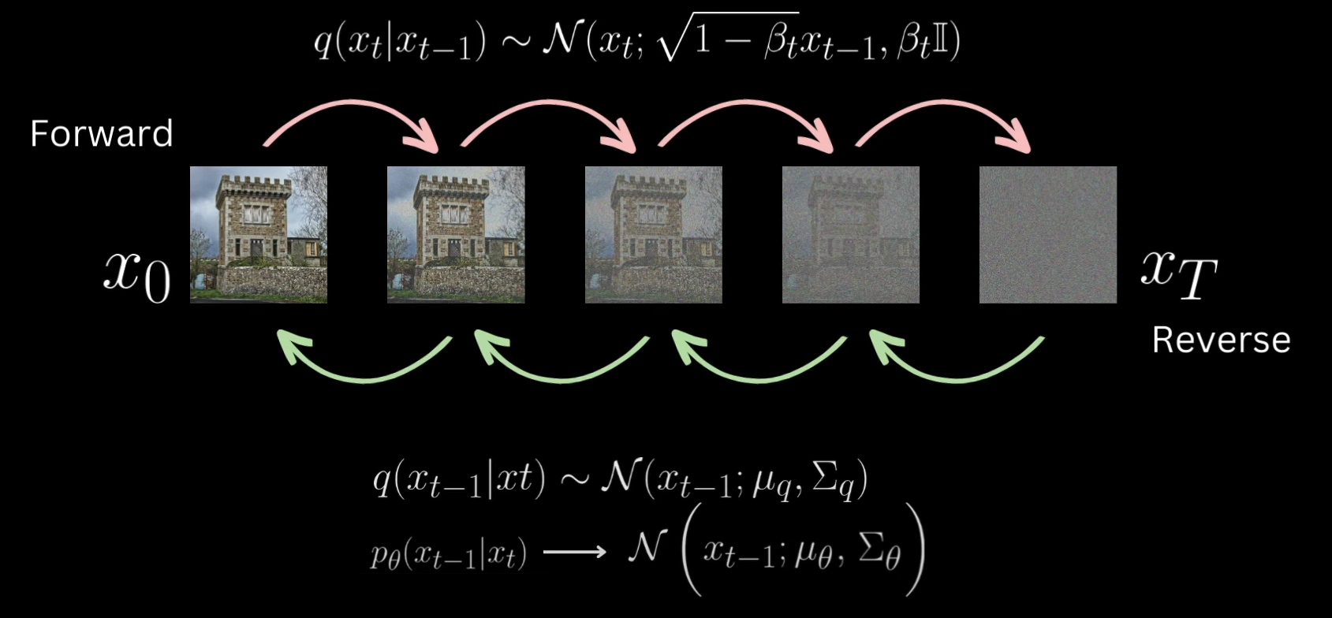
Forward and Reverse Process:
In forward process we introduce Gaussian noise and in reverse process from a noisy image try to generate the a new image by mitigating the noises. Both processes are Markov. Only depends on its last past step.

Slide 3
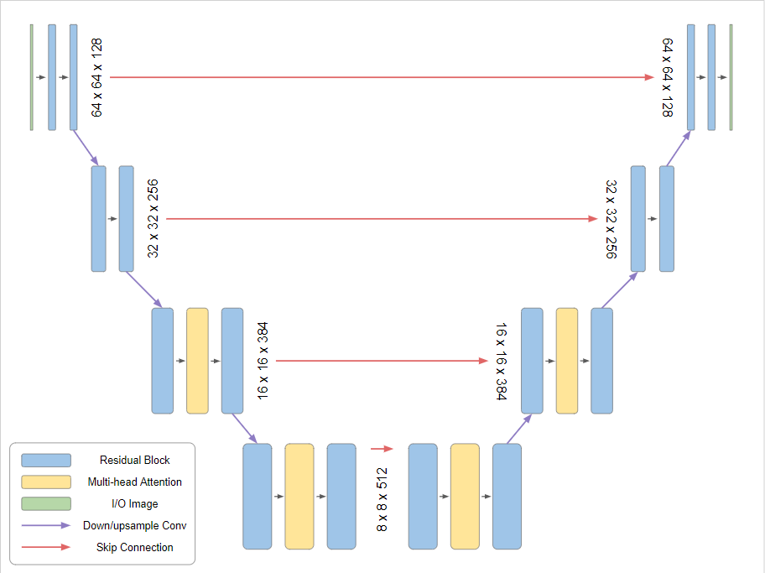
Model Architecture:
ResNet Block:
Input features (x)
→ GroupNorm
→ SiLU activation
→ Conv 3×3
Inject time embedding
Continue processing
→ GroupNorm
→ SiLU activation
→ Dropout (regularization)
→ Conv 3×3
Skip connection
ResNet → Self-Attention → ResNet
The image width and height and the number of channels is different in the prototype model here it is shown for demonstration purpose.

Slide 4
DDPM Comparison:
Aspect | Original DDPM | Prototype version of DDPM | Key Differences
Diffusion Steps | 1000 | 200 | 5x fewer steps
Beta Schedule | Linear | Linear | Same approach
Beta Start | 1.00×10^-4 | 1.00×10^-4 | Identical
Beta End | 0.02 | 0.02 | Identical
Base Channels | 128 | 8, 16 ,128 | for less number of parameters
Channel Multipliers | (1,2,4,4) | (1,2,2,2) | Less depth variation
Attention Resolutions | 16x16 (single) | 16x16 (single) | Same resolution
ResNet Blocks per Level | 2 | 2 | Same
Dropout Rate | 0.1 (CIFAR10 only) | 0.1 | Same
Learning Rate | 2.00×10^-4 | 2.00×10^-4 | Identical
Optimizer | Adam | Adam | Same
Batch Size | 128 | 8 | 16x smaller
Total Epochs | 800k steps (~4000 epochs) | 50, 100 | much shorter
Image Size | 32x32 | 32x32 | Same
Dataset | CIFAR10, CelebA, etc. | CIFAR10 (only) | Same primary dataset

Slide 5
DDPM Comparison:
Dataset | CIFAR10, CelebA, etc. | CIFAR10 | Same primary dataset
Loss Function | MSE | MSE | Same
Time Embedding Dimension | 256 | 256 | Same
Activation Function | SiLU/Swish | SiLU | Same function
Normalization | Group Norm (32 groups) | Group Norm (8 groups) | smaller groups
Data Augmentation | Horizontal flipping | None | no augmentation
Evaluation Frequency | Every few epochs | Every 10 epochs | less frequent
FID Evaluation | Standard metric | Integrated via torchmetrics
Model Parameter Count | ~35M (estimated) | Configurable (~smaller) | smaller model
Skip Connections | U-Net skip connections | U-Net skip connections | Same architecture pattern
Attention Mechanism | Multi-head self-attention | Multi-head self-attention | Same mechanism
Checkpoint Saving | Periodic | Every 10 epochs + final | For model evaluation
Random Seed | Not specified | 42 (fixed) | reproducible

Slide 6
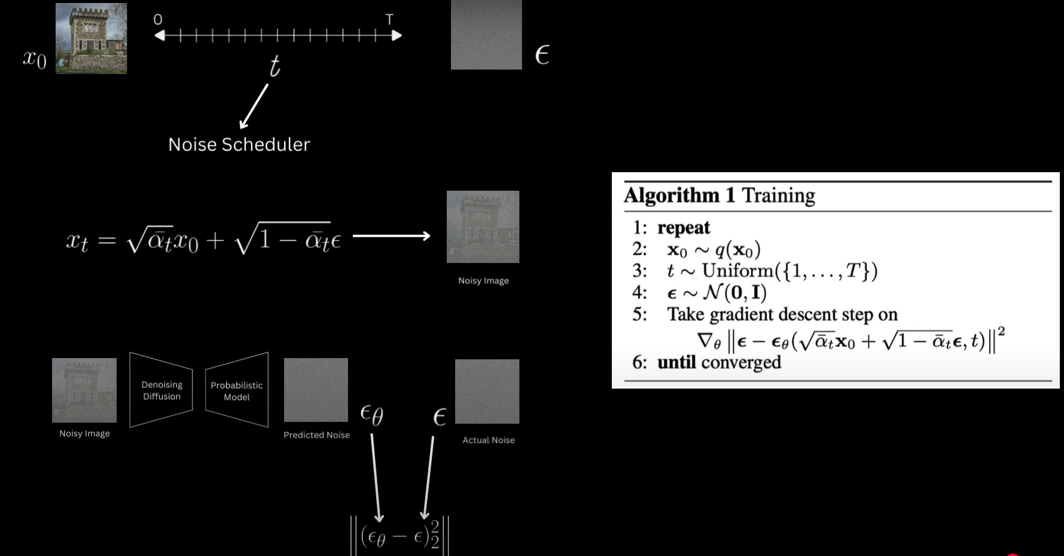
Training Process:

Slide 7
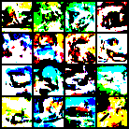
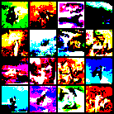
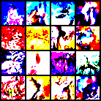
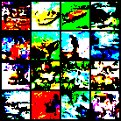
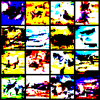
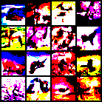
Results: (for base-channels =16)
Progressive Generation of the images: (on CIFAR-10 dataset)
FID = 256.56 (at the epoch 10)
FID=250.74 (at the epoch 20)
FID= 263.84 (at the epoch 30)
FID =259.12 (at the epoch 40)
FID=234.35 (at the epoch 50)
Generated image after the model has been trained completely

Slide 8
Conclusion:
For a perfect and accurate result, we have to run more epochs (as mentioned inthe paper).
Have to save model checkpoints frequently and generate the images along with that for supervision.
Have to try with different type of optimizer for better results. ( with weight decay and scheduler)
Hyper-parameter tuning needs more computation power.

