Slide 1
Version Control with Git
Dr. Devki Nandan Jha
Oxford e-Research Centre
Department of Engineering Science

Slide 2
Outline
Version Control
Motivation
Concepts
Terminology
Git
Introduction
Commands
Collaborating with Git using GitHub

Slide 3



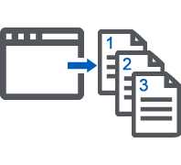
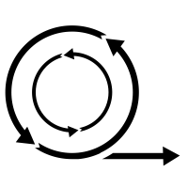


Version Control: Motivation
Collaboration
Backup
Coordination
Agile
Store versions
Due Diligence
Track changes

Slide 4
Version Control: Concepts
also known as revision control, or source control
is all about managing multiple versions of documents, programs, etc.
Almost all “real” projects use some kind of version control
Essential for production-ready programming tasks in industry
Essential for team projects, but also very useful for individual projects
Some well-known version control systems are CVS, Subversion, Mercurial, and Git

Slide 5
Why Version Control?
For working by yourself:
Gives you a “time machine” for going back to earlier versions
Gives you great support for different versions (standalone, web app, etc.) of the same basic project
For working with others:
Greatly simplifies concurrent work
Merging changes
Know who did what and when (in your group project)

Slide 6
Git: Introduction
Setup:
You need Git installed on your system
You can access it in a UNIX Terminal, Terminal in mac or Git Bash on Windows
Download and install Git for your operating system:
https://git-scm.com/downloads
Note: Git is primarily a command-line tool

Slide 7
Version Control: Terminology
Repository/Repo
Working Directory
Commit
Branch
Checkout
SHA

Slide 8
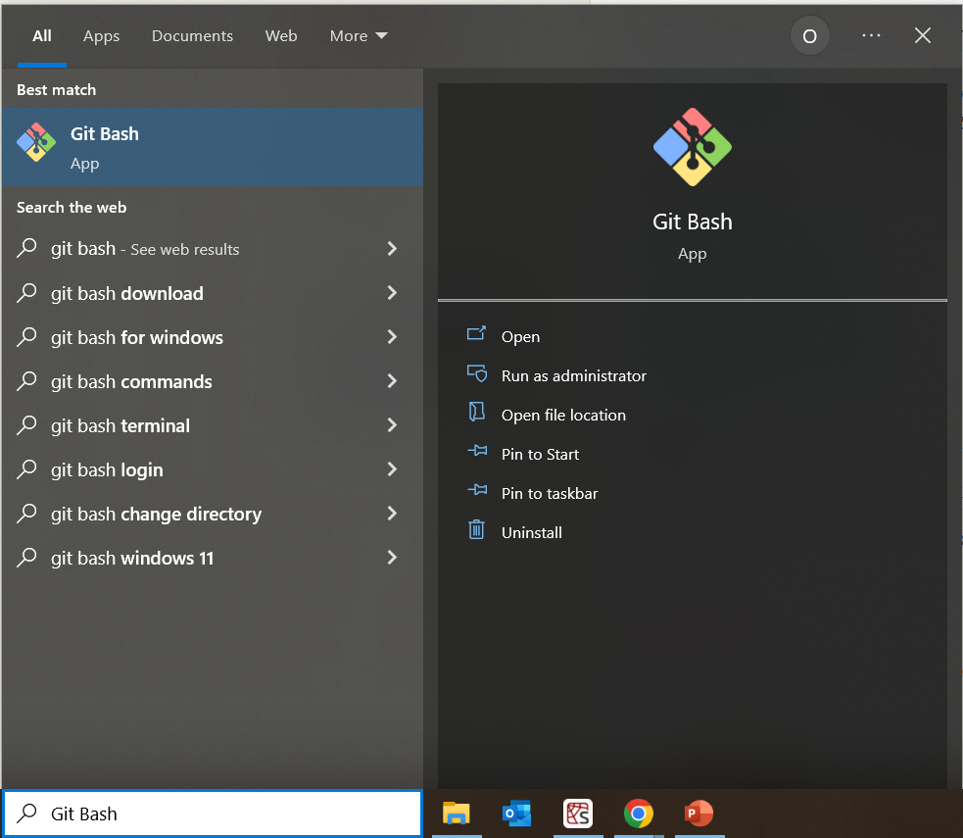
Version Control: Terminology
Open Git Bash

Slide 9
Version Control: Terminology
Repository/Repo
is a directory that contains the project work
local or remote copy
Create repo
mkdir test_repo
cd test_repo
Create a file
Use VI (Mac/Linux)
Right click -> New -> File Type (Windows)

Slide 10
Version Control: Terminology
Repository/Repo
Working Directory
File system you are currently working on

Slide 11
Basic Git Commands
git init
git status
git add <filename> /git add .
git commit -m “message”
git log –stat
git clone
git ignore

Slide 12
Basic Git Commands
git init
This initialises the repository (a directory named .git)
You seldom (if ever) need to look inside this directory
git status
git add <filename> /git add .
git commit -m “message”
git log –stat
git clone
git ignore

Slide 13
Basic Git Commands
git init
git status
Shows the status of the working directory
git add <filename> /git add .
git commit -m “message”
git log –stat
git clone
git ignore

Slide 14
Basic Git Commands
git init
git status
git add <filename> /git add .
This adds the specified/all the current files to the repository
The period at the end is part of this command!
Period means “this directory”
git commit -m “message”
git log –stat
git clone
git ignore

Slide 15
Basic Git Commands
git init
git status
git add <filename> /git add .
git commit -m “message”
Stash changes in the directory
The message is helpful in checking the code later
git log –stat
git clone
git ignore

Slide 16
Basic Git Commands
git init
git status
git add <filename> /git add .
git commit -m “message”
git log --stat
View the commit history
git clone
git ignore

Slide 17
Basic Git Commands
git init
git status
git add <filename> /git add .
git commit -m “message”
git log –stat
git clone
These make an exact copy of the repository at the given URL
git ignore

Slide 18
Basic Git Commands
git init
git status
git add <filename> /git add .
git commit -m “message”
git log –stat
git clone
git ignore
Ignore a file while using any git command

Slide 19


Git: working with remote repo
Alice
Shared Remote Repository

Slide 20

Git: working with remote repo
Alice
Bob
Shared Remote Repository

Slide 21
Git: working with remote repo
Alice
Frank
Bob
Shared Remote Repository

Slide 22

Git: working with remote repo
Alice
Frank
Bob
Shared Remote Repository

Slide 23
GitHub
Hosting medium/website for your Git repositories
Offers powerful collaborative abilities
A god indicator of what you code, how much you code and the quality of code
Git vs GitHub
Git is a free, open source widely used version control system, downloadable to your local machine. It logs changes made to a group of designated computer files, referred to as Git Repository or Repo
GitHub, an online service for hosting and sharing Git repositories remotely

Slide 24
GitHub
Create a free GitHub account on https://github.com/.

Slide 25
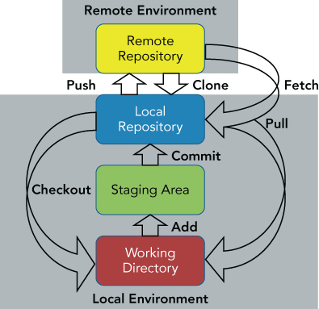
GitHub
Create a free GitHub account on https://github.com/.
Basic Git Model: Combined (Local + Remote)

Slide 26
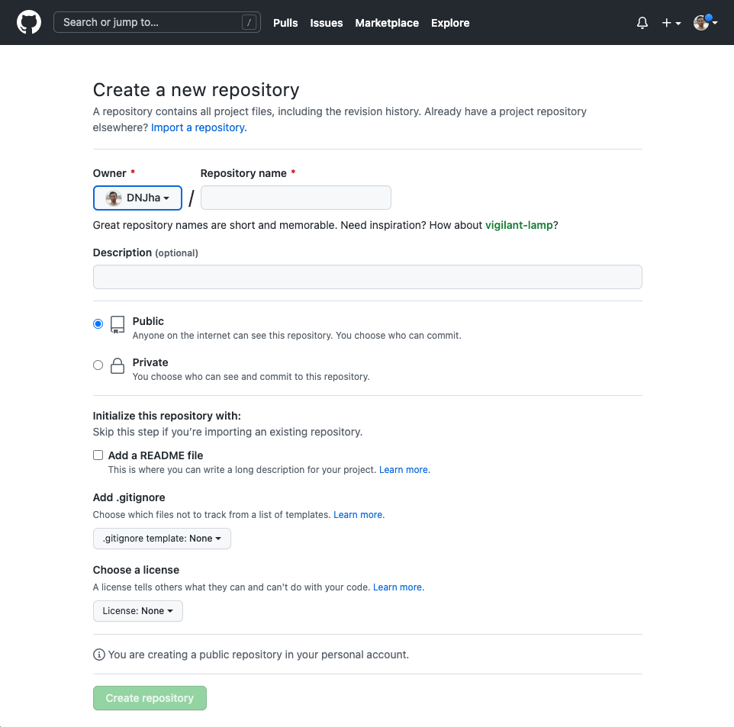
Extra Commands
Create a remote GitHub repo

Slide 27
Extra Commands
git push
Publish local repository to the remote repository
git pull
Get changes from a remote repository and merge them into your own repository
git fetch
Download the contents from a remote repository
git fetch command is similar to git pull.
git pull command does both a git fetch and git merge into your local branch

Slide 28
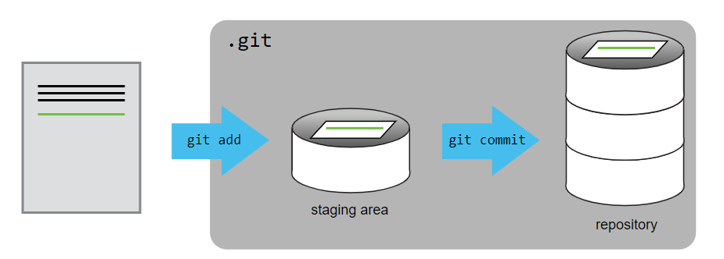
Git – Staging Area

Slide 29
Questions Mail id: devki.jha@eng.ox.ac.uk Website: https://dnjha.github.io

Slide 30
Version Control: Terminology
Repository/Repo
Working Directory
Commit
Set of snapshots for a mini file system
e.g., save point during a video game
Branch
Checkout
SHA

Slide 31
Version Control: Terminology
Repository/Repo
Working Directory
Commit
Branch
New line of development that diverges from the main line
The new line can continue without altering the main line.
Checkout
SHA

Slide 32
Version Control: Terminology
Repository/Repo
Working Directory
Commit
Branch
Checkout
act of switching between different versions of a target entity (branch)
It is possible to checkout many things from a repository
SHA

Slide 33
Version Control: Terminology
Repository/Repo
Working Directory
Commit
Branch
Checkout
SHA (Secure Hash Algorithm)
Basically, an ID number for each commit
e.g., “5b654b3e63db67017ba7df8b3a3f838661ac00b2bd1a3efa456a90bfb4a03469”

Slide 34
Git: Introduction
Configure Git by opening a terminal window and entering the following commands:
$ git config --global user.name "Your Name"
$ git config --global user.email "your@email"
You only need to do this once
If you want to use a different name/email address for a particular project, you can change it for just that project
cd to the project directory
Use the above commands, but leave out the --global

Slide 35
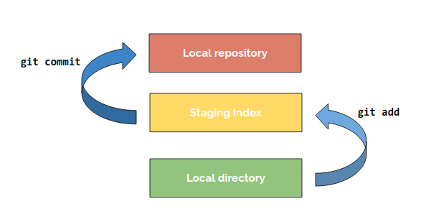
Basic Git Commands
Basic Git Model: Local

