Slide 1
Coding Warriors
Our C++ program about physics formulas and rules

Slide 2
Our Team
Denis Kolev - Scrum Trainer Kliment Tenev - Q&A Engineer Yusmen Osman - Backend Developer Alexander Baev - Backend Developer

Slide 3
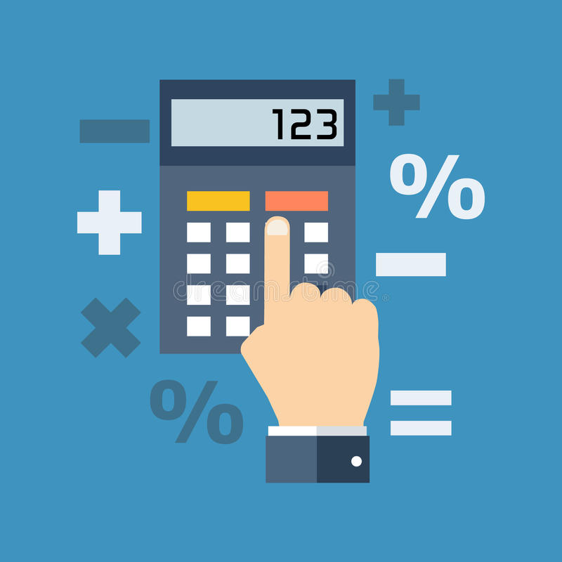
Idea Of The Project
Our idea is to make a useful C++ program that can help you when you are having trouble with physics formulas and rules and when you have to make certain calculations

Slide 4
Stages Of Progress
01
02
03
04
Coming Up With An Idea
Realizing The Idea
Before we started working we had to decide what the program was going to be about
We chose the best idea we had and turned it into a C++ program
Creating The Documentation
Checking For Errors
We wrote down everything related to the final product and the process of making it
We went back and checked for any grammatical errors

Slide 5







Apps, Tools and Programming Languages We’ve Used

Slide 6
Thank You For Your Attention!

