Slide 1
Cloud Computing and Big Data Big Data Pulling it all together
Oxford University
Software Engineering Programme
Nov 2015

Slide 2
Contents
Understanding the bigger picture
What are the different components
Message queueing and collection systems
Map-Reduce and DAG systems
Realtime Systems
Fast databases for speed
Visualisation and Dashboards

Slide 3

The big picture
Visualisation System
NoSQL or SQL database
Visualisation Store
DAG pipeline Map-Reduce Micro-batch etc
Realtime
Master data
Storage
Data collection models, queueing
The World

Slide 4
The big picture
You have immutable master data
You create a set of processes to:
Collect that data
Store master data
Process data
Visualise and present
Some of those processes act on batch and others on real-time data

Slide 5
How to choose the components?
Two main approaches:
Best of breed
Choose the best available component in each space
Stack
Choose a curated stack that a team or organization is providing/selling/supporting

Slide 6
Collection / Queuing systems
Two ways of making the choice
The protocol
The middleware
Protocols
ZeroMQ, MQTT, AMQP, STOMP, Kafka Protocol, Rendevouz, etc
Middleware
Kafka, Apollo, Mosquitto, QPid, MQ, Tibco, WSO2, etc

Slide 7
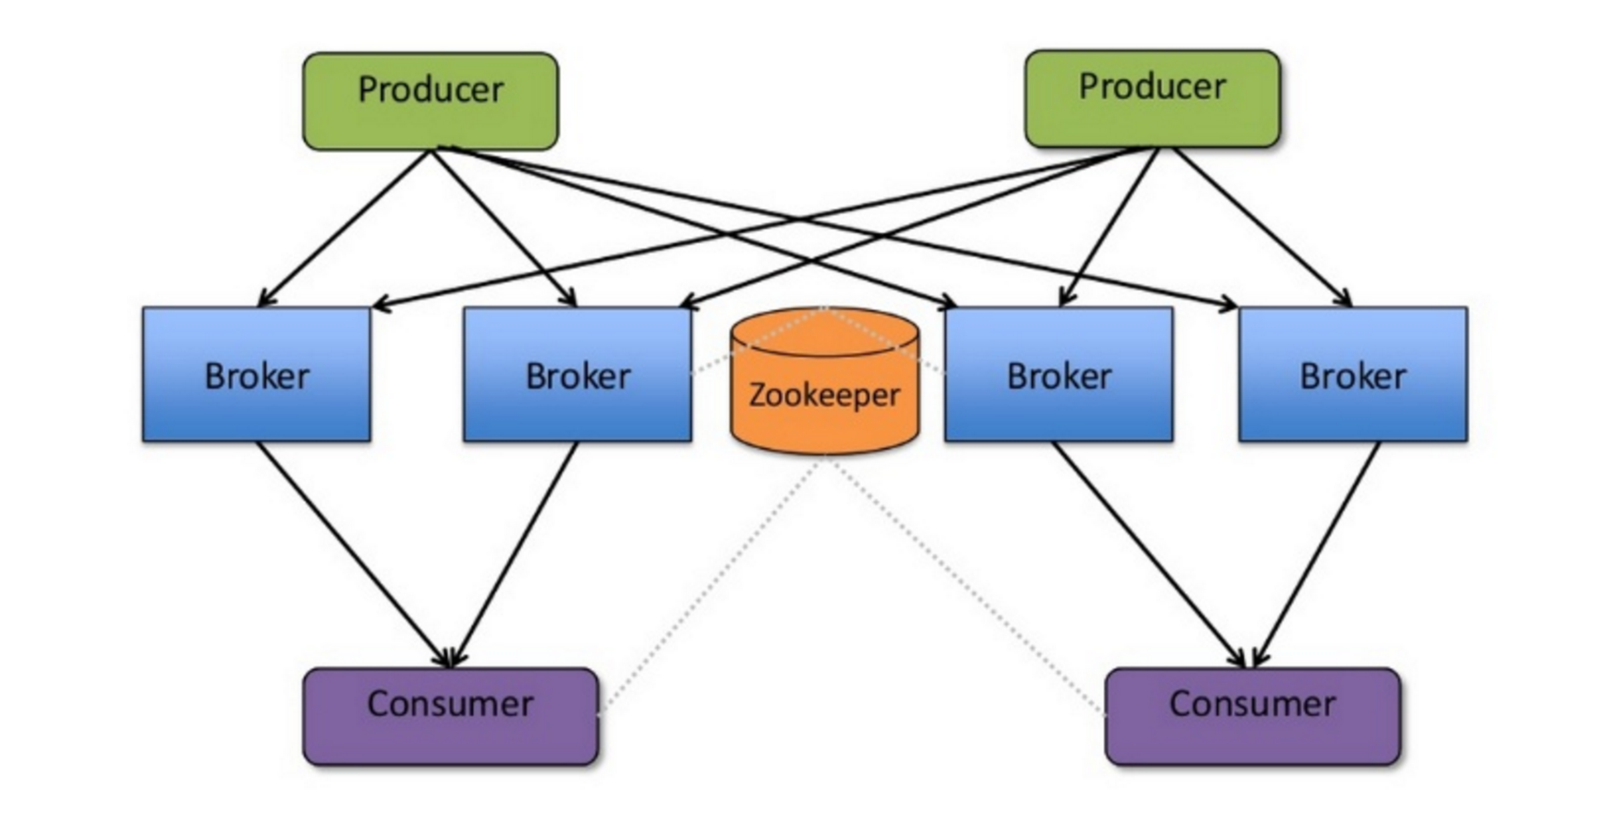
Apache Kafka
Source: http://www.slideshare.net/charmalloc/

Slide 8
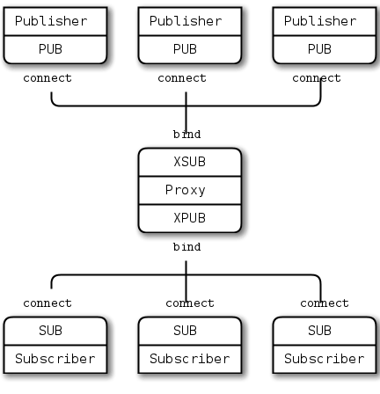
ZeroMQ

Slide 9
Processing approaches
Apache Hadoop
Tried and tested
More flexible since YARN
Widely supported
Massive ecosystem
Apache Spark
Newer architecture
Significant performance
Many capabilities built in
Package management

Slide 10
Other processing approaches
Apache Tez
Hortonworks project
DAG model
Designed to fit between YARN and Pig/Hive/etc

Slide 11
Cluster management systems
YARN
Part of Hadoop but significantly rebuilt since Hadoop 1
Mesos
Popular Apache project
Built to be a resource manager for a complete datacenter
Supports many workloads (e.g. Docker as well as Spark)

Slide 12
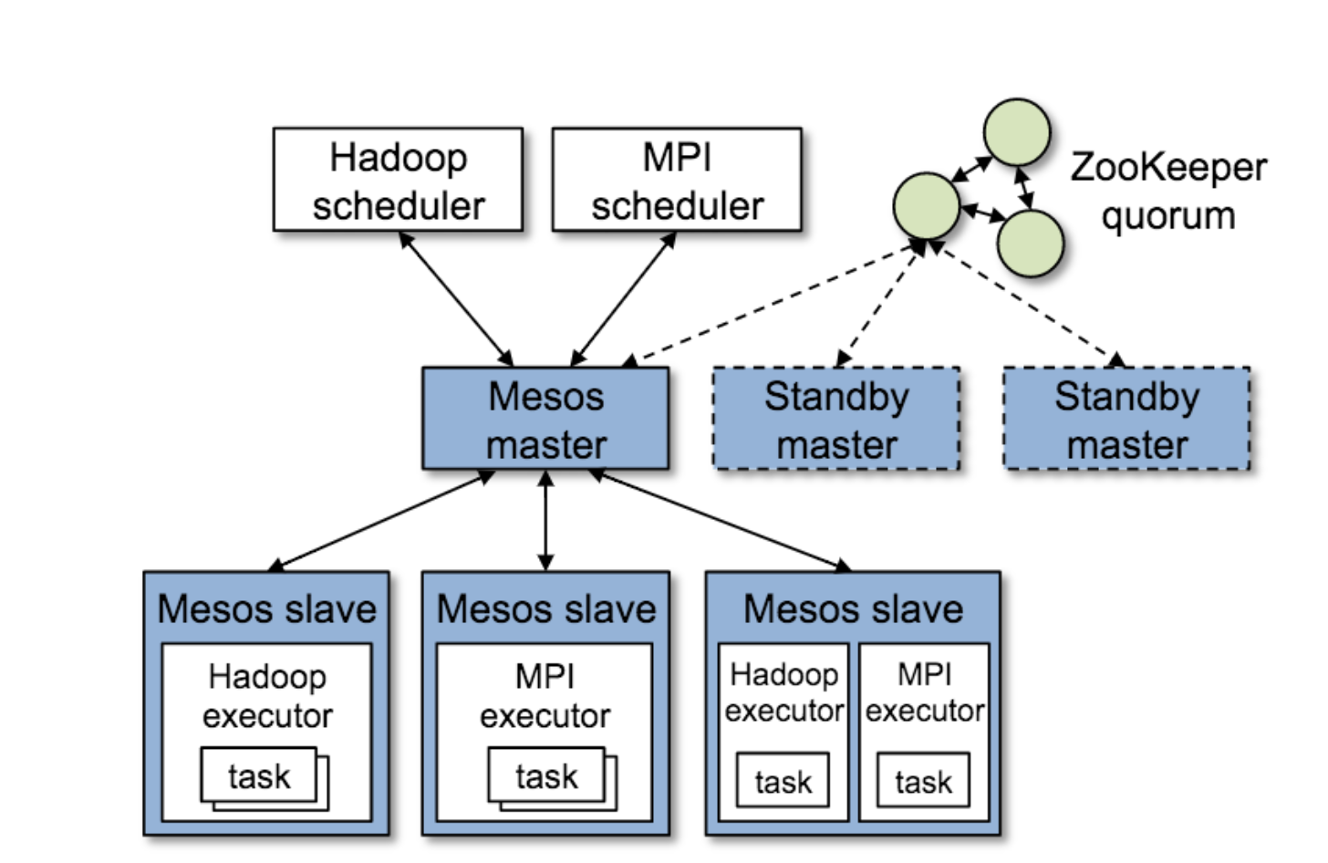
Apache Mesos

Slide 13
Realtime
Apache Storm
Highly flexible model
Supports pure streaming and micro-batch
Lots of plugins
Apache Spark
Micro-batch only
Integrates cleanly into Spark (fewer components)
Some plugins and more being developed

Slide 14
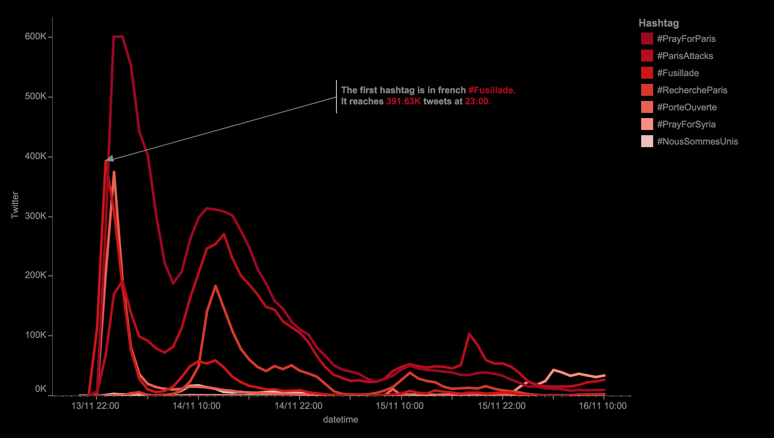
Visualisation

Slide 15
Visualisation approaches
Full products
Tableau, Qlik, SAS, GoodData
Web-based systems
Tableau Public, Datawrapper, Raw, Plotly
Developer oriented
D3.js, dygraphs, Python charting, Leaflet, Fusion Charts, Google Charts, etc

Slide 16
Fortune top 10 big data companies fortune.com/2014/06/13/these-big-data-companies-are-ones-to-watch/
MapR – Apache Hadoop
MemSQL
Databricks – Apache Spark
Platfora – Apache Hadoop
Splunk
Teradata – Apache Hadoop
Palantir – Hadoop, Cassandra, Lucene
Premise
Datameer – Apache Hadoop
Cloudera – Apache Hadoop
Hortonworks – Apache Hadoop
MongoDB – MongoDB
Trifacta – Apache Hadoop
Rapid Web Application Development with MongoDB and the JVM – Trisha Gee – Tuesday 16:15

Slide 17
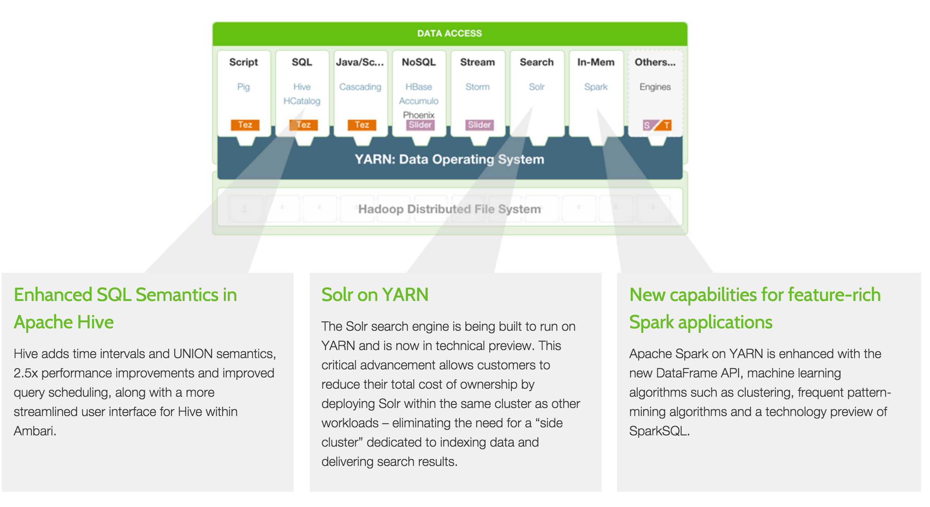
Hortonworks

Slide 18
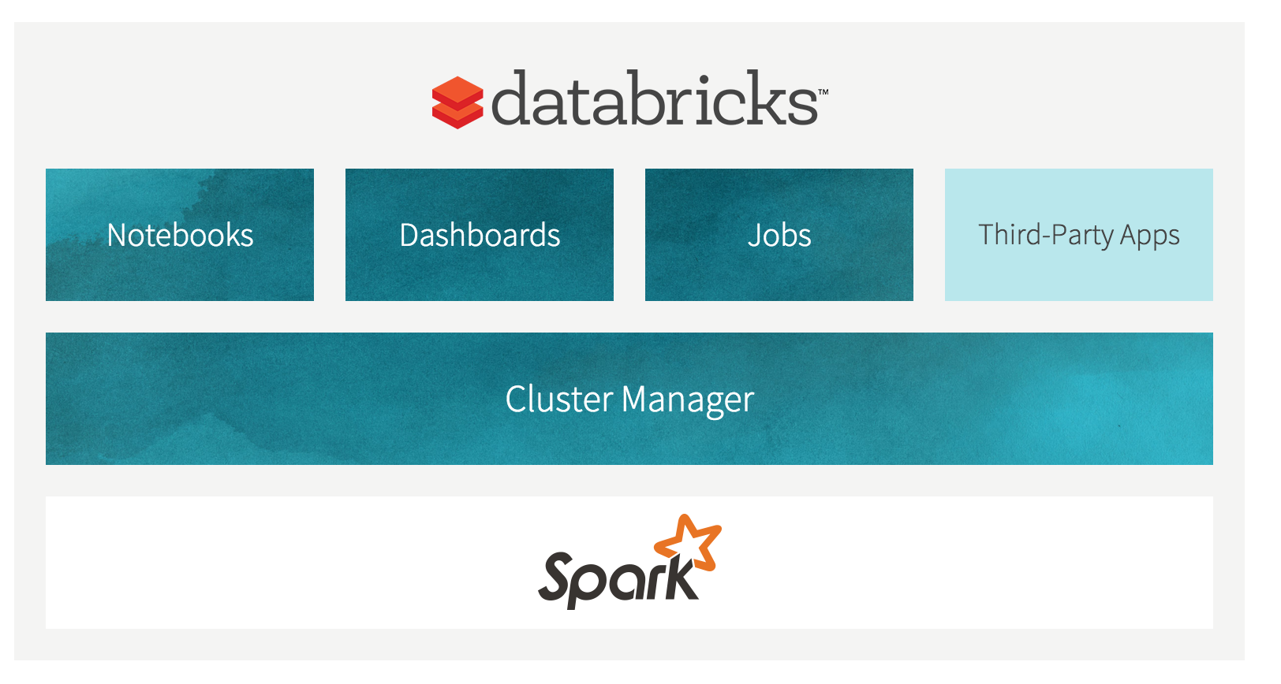
Databricks

Slide 19
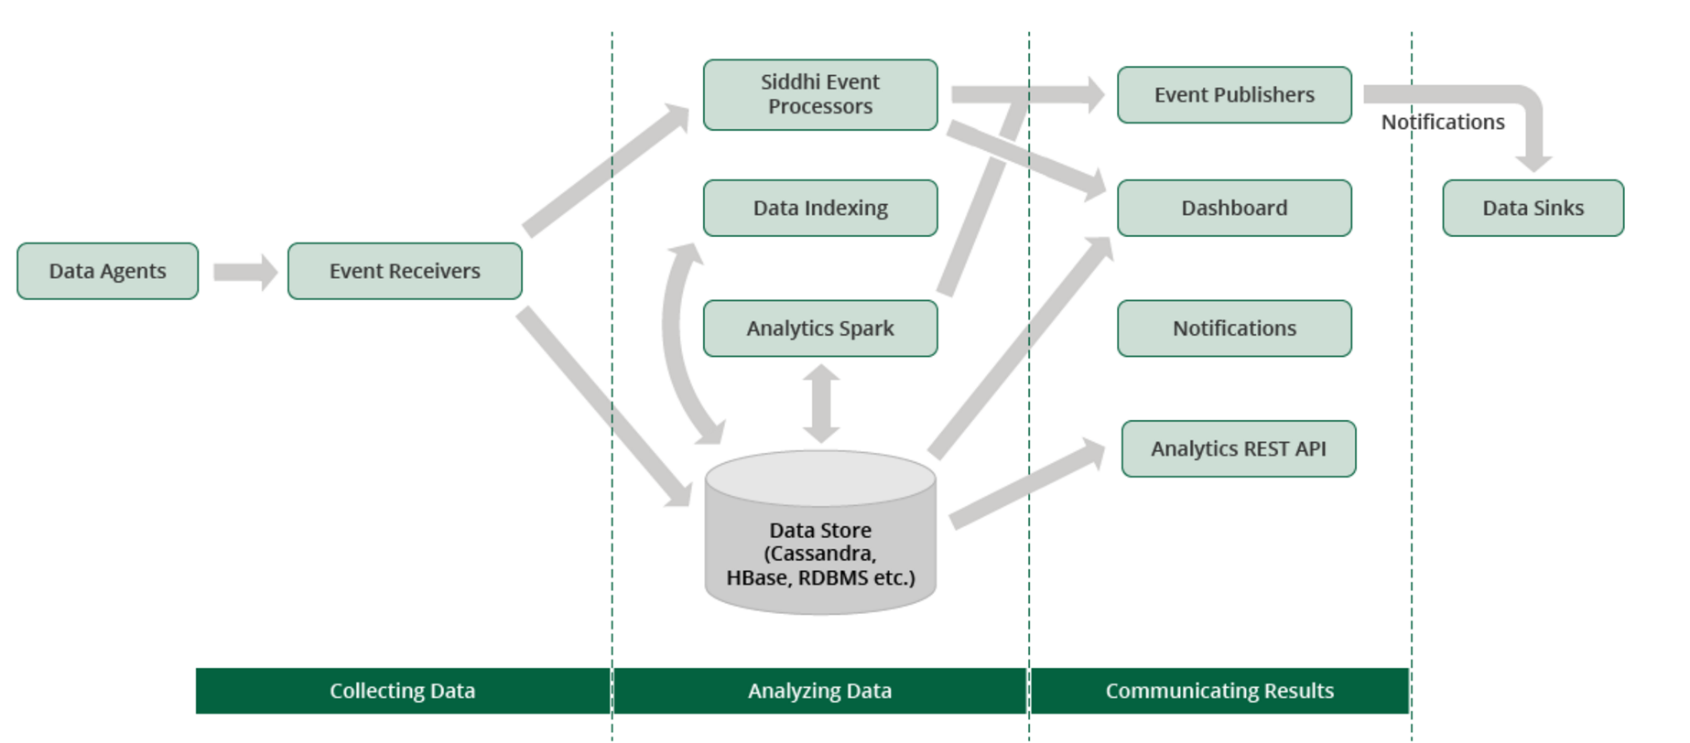
WSO2 DAS

Slide 20
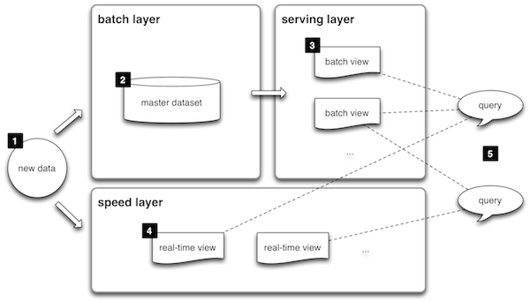
Lambda

Slide 21
The real answer
You are on the bleeding edge
Expect to have some pain

Slide 22
Questions?

