Slide 1
Introduction Cloud Computing and Big Data (CLO)
Oxford University
Software Engineering Programme
Nov 2015

Slide 2
Introduction
Aims
Pre-requisites
Contents
Connections
Resources
Rules of Engagement
Introductions

Slide 3
Aims
Understanding of Principles of Cloud Computing and Big Data
Theoretical background and origins
Practical experience of different technologies
Architecture and Design
Wider context

Slide 4
Pre-requisites
Covered by the Pre-Study Guide!
Command line tooling and Unix commands
SQL and data manipulation
Understanding of networking, servers and distributed computing

Slide 5
Contents
Origins and Background
Using Cloud Services
Map Reduce and other big data algorithms
Cloud Computing Theory
NoSQL and scalable storage
Case studies
Open Source big data and cloud systems
Emerging cloud technologies
Cloud Computing Security

Slide 6
Practicals
TBD

Slide 7
Connections
Objects (OOR, OOD, OOP, DPA, SPL)
Formal techniques (SEM, SDE)
Concurrency (CDS, ACT, MOB)
Security (SPR, SRO, DES, NES)

Slide 8
Resources

Slide 9
Rules of Engagement
Ask questions as we go along
We will “park” any that are better answered later
Don’t wait till the end to ask or raise concerns
Timings are flexible
Please keep mobile phones silent or better still turned off

Slide 10
First Run!
This is the first running of this course
Please take that into consideration:
There will be bugs!
Please help out:
Please create new issues on the Github repository
https://github.com/pzfreo/ox-clo/issues/new

Slide 11
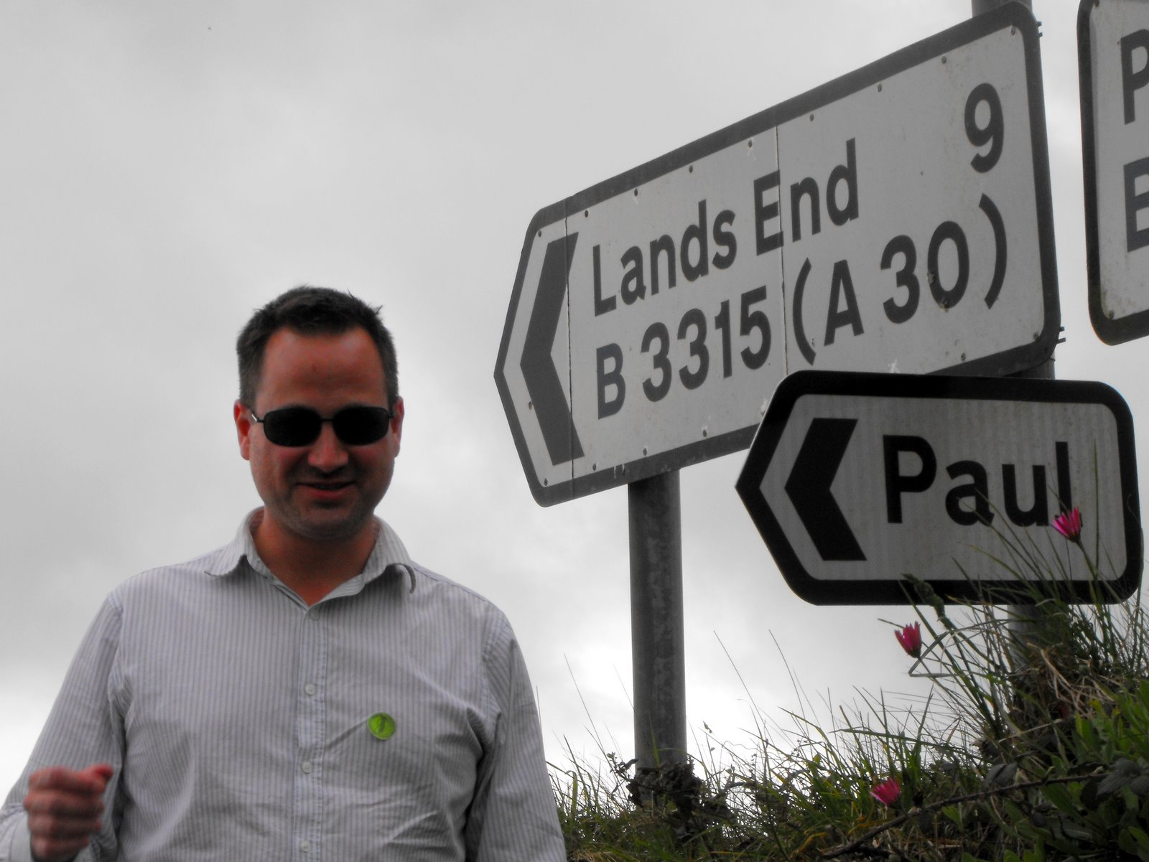
Paul Fremantle
CTO and Co-Founder of WSO2 (2005-2015)
Previously Senior Technical Staff Member, IBM WebSphere architecture
Co-Chair Web Services Reliable eXchange at OASIS (WSRM)
VP, Apache Synapse and Member of ASF
MA in Maths and Philosophy
MSc in Computation (1995)
Teaches SOA module
Part time PhD student
Plays the tin whistle

Slide 12
You?

Slide 13
Approximate Schedule
Monday | Tuesday | Wednesday | Thursday | Friday
Introduction

Slide 14

Let’s get started

