Slide 1
Cloud Computing and Big Data Machine Learning
Oxford University
Software Engineering Programme
Nov 2015

Slide 2
Contents
Definitions and terminology
The overall process
Main techniques
Algorithms and examples
Big Data Machine Learning
R and PMML
Spark MLLib
Introduction to the lab

Slide 3
Definition of Machine Learning
Algorithms that can learn from data

Slide 4
Definition of Machine Learning
Algorithms that can learn from data
Ok that was a circular definition ☺

Slide 5
Definition take 2
Algorithms that can analyse a set of data and then make predictions when new data comes in
The more data that they analyse, the better the predictions

Slide 6
Learning phase
Labelled Data
Extraction of features
Model
Learning

Slide 7
Usage phase
Model
New Data
Algorithm
Label

Slide 8
Terminology
Sample
Some incoming data to be analysed
E.g. a JPG picture
Feature
Some quantifiable data from the sample
E.g. colour, height, width, pixel data, etc
Label
Some useful information about the sample that we wish to categorise:
E.g. looking at a picture this is a person
Model
The output of some learning algorithm
The parameterization of an algorithm that can be run against new data

Slide 9
Types of learning
Supervised
The required labels are known
Aiming to find an algorithm that correctly identifies these
Iterative exploration and refinement
Unsupervised
The labels are not known
The system identifies new classifications

Slide 10
Types of machine learning
Classification
Regression / Prediction
Clustering
Recommendation and Collaborative Filtering
Frequent Pattern mining

Slide 11
Classification
Identifying a class into which this sample fits
E.g. look at a picture and decide this is a piece of fruit
Google Photos demo

Slide 12
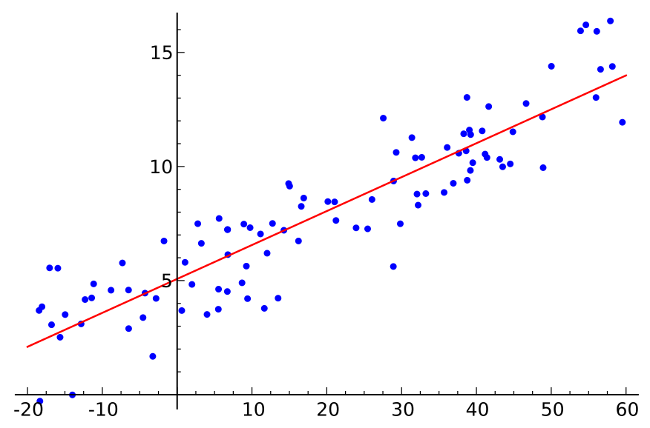
Regression
Applying a model based on previous data
Allows prediction of future state
Many statistical techniques

Slide 13
Regression vs Classification
Regression produces a real number or numbers
i.e. a continuously varying answer or answers
Classification identifies a set or element of a set
E.g. False, Blue, Person, High-Value Customer

Slide 14
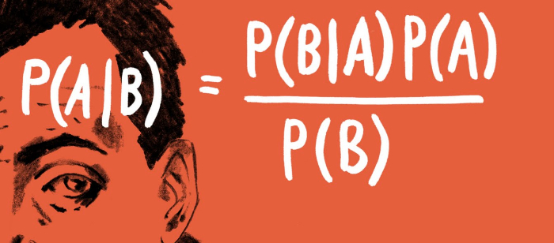
Bayes Theorem

Slide 15
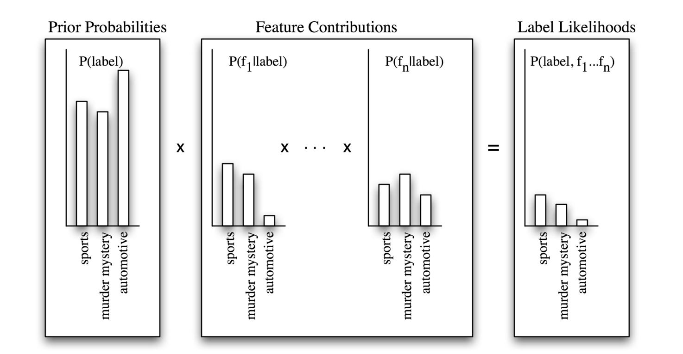
Classification Algorithms
Naïve Bayes

Slide 16
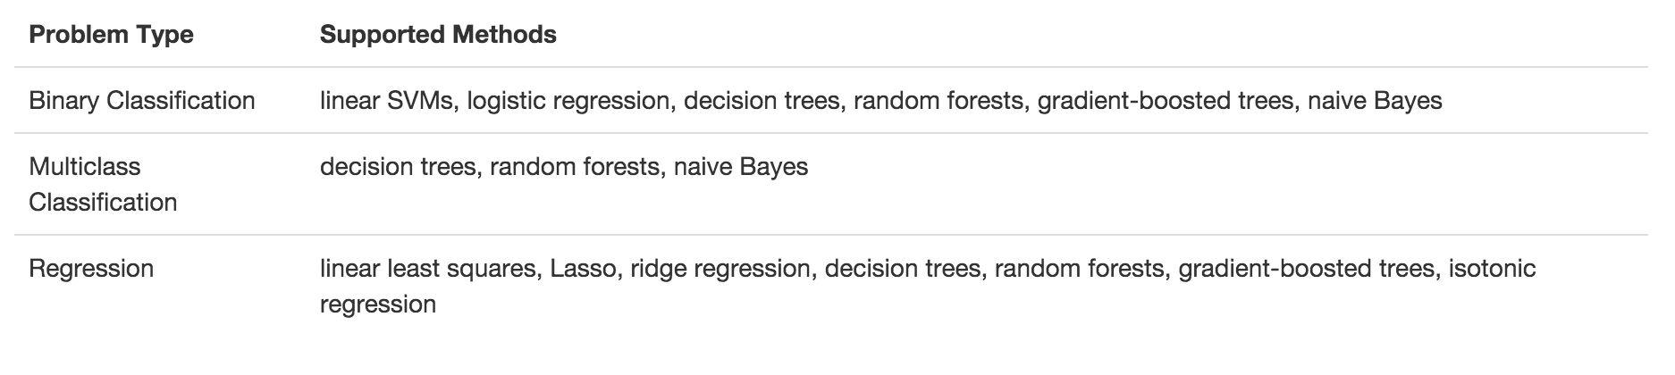
Spark MLLib’s algorithms

Slide 17
Clustering
Grouping items into clusters
Where items in a cluster are more similar to each other than to items in other clusters
Basically creating the classifications from the data rather than applying them a priori

Slide 18
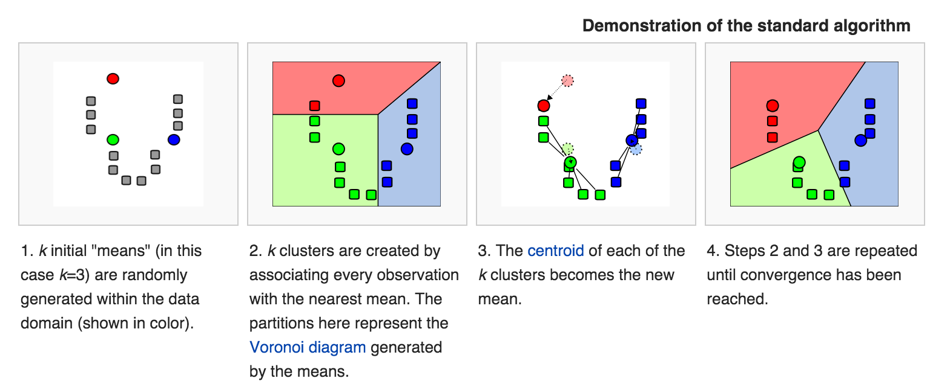
K-Means Clustering

Slide 19
MLLib’s clustering
K-means
Gaussian mixture
Power iteration clustering (PIC)
Latent Dirichlet allocation (LDA)
Streaming k-means

Slide 20
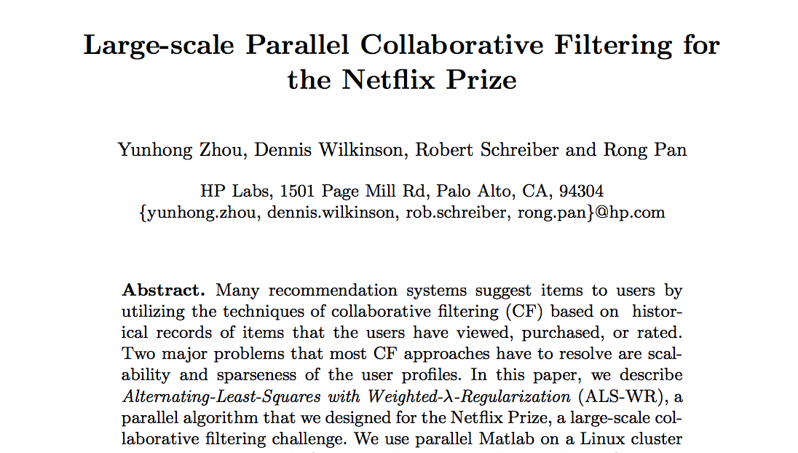
Recommendation and Collaborative Filtering
Given a user’s interaction with items, what else are they likely to prefer

Slide 21
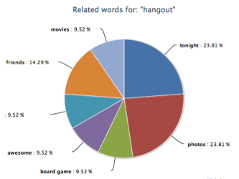
Frequent Pattern Mining

Slide 22
MLLib FPM
Frequent pattern mining
FP-growth
association rules
PrefixSpan

Slide 23
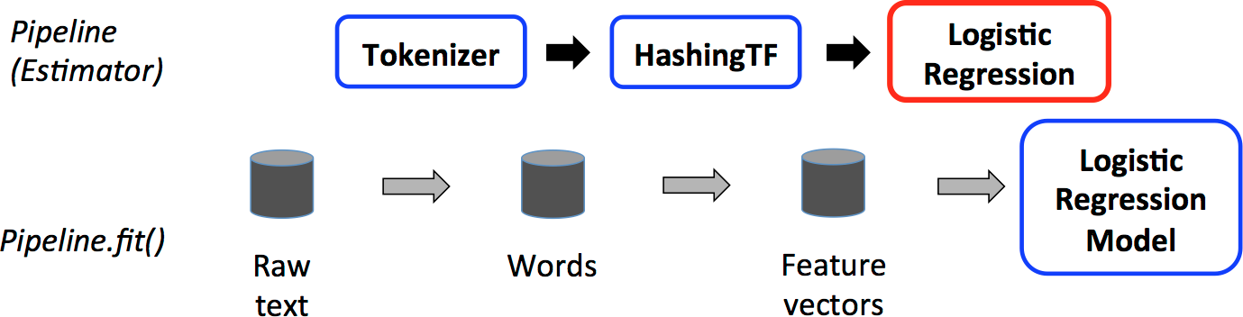
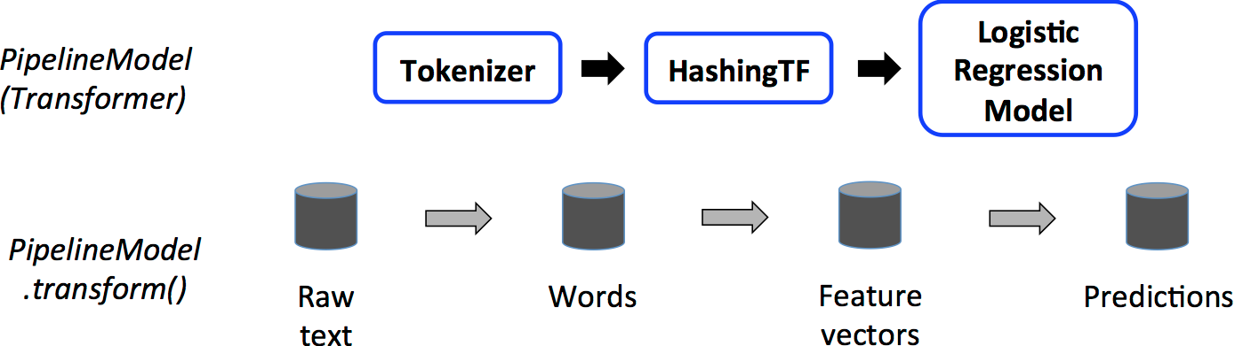
Spark MLLib Pipelines
TRAINING
USAGE

Slide 24
Big Data ML
Obviously we can learn more insights with more data
Many examples
Netflix competition
Google, Facebook, Twitter etc are all doing big data ML
Obviously we want the right algorithms:
E.g. Kmeans++ is a parallelizable version of Kmeans
MLLib and Mahout come pre-built with these

Slide 25
Recap
Machine Learning is a powerful way of gaining insight and value from big data
Recommendation
Classification and prediction
Clustering and understanding
Etc

Slide 26
Questions?

