Slide 1
Cloud Computing and Big Data Hadoop Adjuncts and Extras
Oxford University
Software Engineering Programme
Nov 2015

Slide 2
Hadoop related projects at Apache
Ambari
Web based monitoring for Hadoop
HBase
Scalable, Distributed database
Hive
SQL query language for Map Reduce
Pig
Dataflow and execution language for parallel execution
Mahout
Machine Learning
Chukwa
Log collection and processing on top of Hadoop
Spark
Large scale data processing on top of YARN or Mesos
Sqoop
Transfer of data into Hadoop from traditional databases
Tez
Going beyond Map Reduce on top of YARN

Slide 3
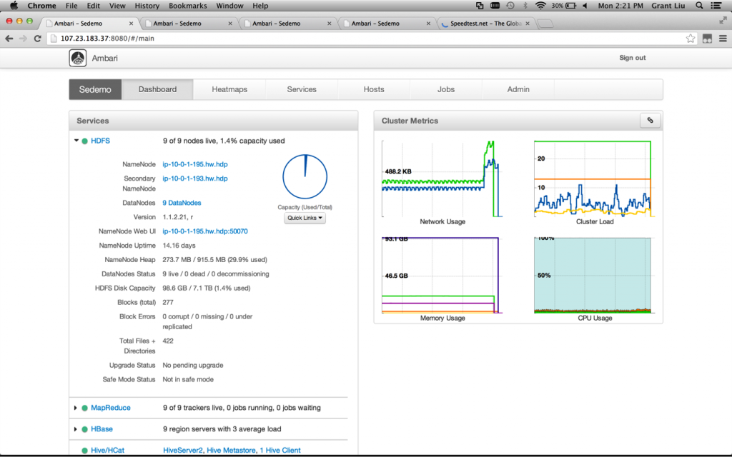

Apache Ambari http://ambari.apache.org

Slide 4
Apache HBase
More in the NoSQL section

Slide 5

Apache Hive http://hive.apache.org
Just like SQL except it generates Map Reduce jobs
Works on Hadoop and Spark
Part of SparkSQL
Includes DDL (Data Definition Language) as well as SQL
Makes many processing tasks very simple

Slide 6
Hive example
CREATE TABLE page_view(viewTime INT, userid BIGINT,
page_url STRING, referrer_url STRING,
ip STRING COMMENT 'IP Address of the User')
COMMENT 'This is the page view table'
PARTITIONED BY(dt STRING, country STRING)
STORED AS SEQUENCEFILE;
LOAD DATA LOCAL INPATH /tmp/pv_2008-06-08_us.txt INTO TABLE page_view PARTITION(date='2008-06-08', country='US')
INSERT OVERWRITE TABLE xyz_com_page_views
SELECT page_views.*
FROM page_views
WHERE page_views.date >= '2008-03-01' AND page_views.date <= '2008-03-31' AND
page_views.referrer_url like '%xyz.com';

Slide 7
Apache Pig http://pig.apache.org
Pig is a language for parsing, sorting, and working with data from HDFS
Pig scripts are runnable on Hadoop MapReduce
Very effective approach

Slide 8
Pig Latin example
raw = LOAD 'excite.log' USING PigStorage('\t') AS (user, time, query);
clean1 = FILTER raw BY org.apache.pig.tutorial.NonURLDetector(query);
clean2 = FOREACH clean1 GENERATE user, time, org.apache.pig.tutorial.ToLower(query) as query;
houred = FOREACH clean2 GENERATE user, org.apache.pig.tutorial.ExtractHour(time) as hour, query;
ngramed1 = FOREACH houred GENERATE user, hour, flatten(org.apache.pig.tutorial.NGramGenerator(query)) as ngram;
ngramed2 = DISTINCT ngramed1;
hour_frequency1 = GROUP ngramed2 BY (ngram, hour);
hour_frequency2 = FOREACH hour_frequency1 GENERATE flatten($0), COUNT($1) as count;
uniq_frequency1 = GROUP hour_frequency2 BY group::ngram;
uniq_frequency2 = FOREACH uniq_frequency1 GENERATE flatten($0), flatten(org.apache.pig.tutorial.ScoreGenerator($1));
uniq_frequency3 = FOREACH uniq_frequency2 GENERATE $1 as hour, $0 as ngram, $2 as score, $3 as count, $4 as mean;
filtered_uniq_frequency = FILTER uniq_frequency3 BY score > 2.0;
ordered_uniq_frequency = ORDER filtered_uniq_frequency BY (hour, score);
STORE ordered_uniq_frequency INTO '/tmp/tutorial-results' USING PigStorage();

Slide 9
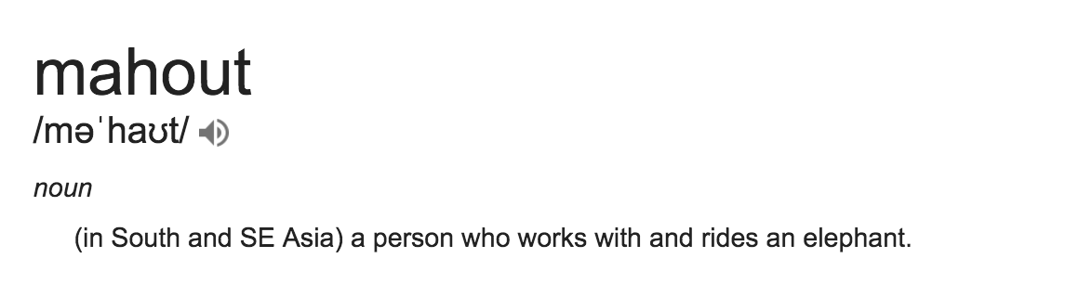

Slide 10

Apache Mahout http://mahout.apache.org
A system for creating scalable machine learning and data mining systems
Clustering
Classification
Recommendation
Frequent ItemSet

Slide 11
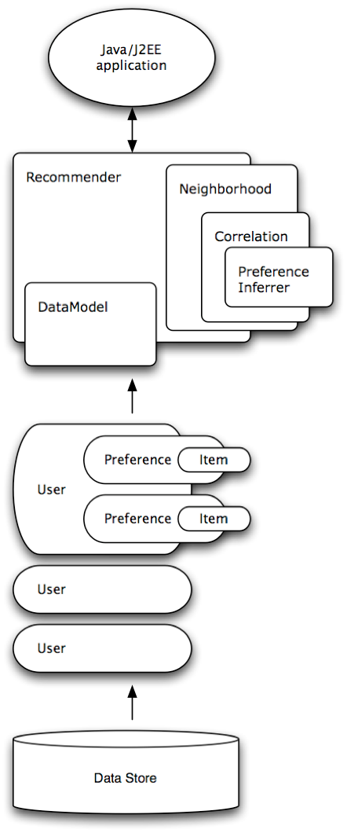
e.g. Recommender
Takes users preferences
“Likes”
Estimates preferences for other items
For example, which books you might like to read next

Slide 12
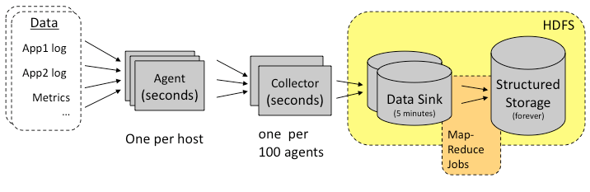
Apache Chukwa http://chukwa.apache.org

Slide 13
Spark
Much more later!

Slide 14
Apache Tez http://tez.apache.org
Support for complex Directed Acyclic Graphs (DAGs) on top of YARN
Supports in memory jobs
Simplifies work that would previously be in multiple MR jobs
Designed to support Pig and Hive

Slide 15
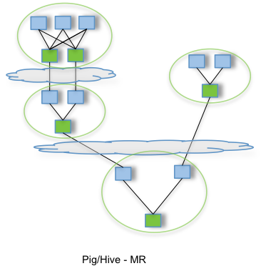
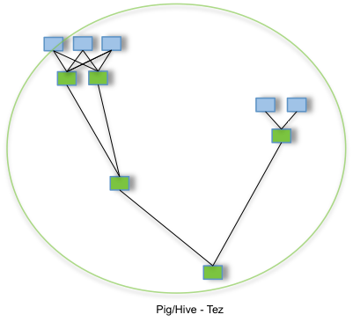
Tez

Slide 16
Apache Avro
A compact data storage and transmission system
Uses schemas of data to ensure it can be read by the receiver
Supports dynamic typing
Used by RPC or data collection systems
Fast binary protocols
Also supports storage
Hence used by many Big Data apps including Hadoop and Spark

Slide 17
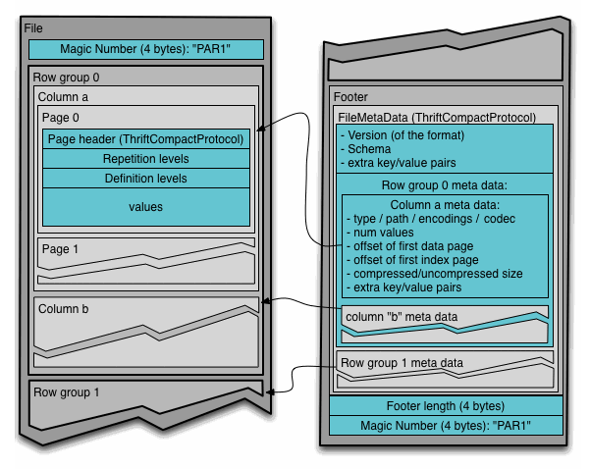
Apache Parquet
Apache Parquet is a columnar data storage model
Works with Hadoop, Spark and many others
Efficient storage of data
Based on another Google system called Dremel

Slide 18
Questions?

