Slide 1
Course Introduction Cloud Computing and Big Data (CLO)
Oxford University
Software Engineering Programme
Nov 2015

Slide 2
Introduction
Aims
Pre-requisites
Contents
Objectives
Resources
Rules of Engagement
Introductions

Slide 3
Aims
Understanding of Principles of Cloud Computing and Big Data
Theoretical background and origins
Practical experience of different technologies
Architecture and Design
Wider context

Slide 4
Pre-requisites
Covered by the Pre-Study Guide
Command line tooling and Unix commands
Some Python programming and text editors
SQL and data manipulation
Understanding of networking, servers and distributed computing

Slide 5
Format
A mixture of lectures and practical labs
Lectures aim to provide the wider context and background
Independent of specific technologies
Labs are based on specific technologies
Designed to demonstrate the principles

Slide 6
Lab model
Local Virtual Machine
Ubuntu
Pre-installed big data software
E.g. Apache Hadoop and Spark, Docker, etc
Amazon Web Services
Virtual machines in the cloud

Slide 7
Contents

Slide 8
Practicals
TBD

Slide 9
Specific Objectives
Understand the principles of cloud computing
Theory of scalability
Including scalability and deployment
IaaS frameworks, PaaS, containers
Understand Big Data approaches, technologies and techniques
Theoretical background and approaches
Including Map Reduce, NoSQL, Realtime
Be able to design and implement scalable cloud and big data systems
Understand and implement effective Open Source systems on Amazon EC2

Slide 10
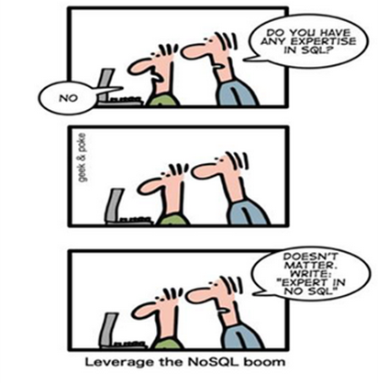
Improve your CV?

Slide 11
Beyond the scope of this course
Detailed Data Science techniques
Implementing a private cloud
Although we will look at technologies for private cloud
Understanding all of Hadoop, Spark, Mesos, CoreOS, etc

Slide 12
Resources

Slide 13
Rules of Engagement
Ask questions as we go along
We will “park” any that are better answered later
Don’t wait till the end to ask or raise concerns
If you don’t ask we can’t help you

Slide 14
First Run!
This is the first running of this course
Please take that into consideration:
There will be bugs!
Please help out:
Please create new issues on the Github repository
https://github.com/pzfreo/ox-clo/issues/new

Slide 15
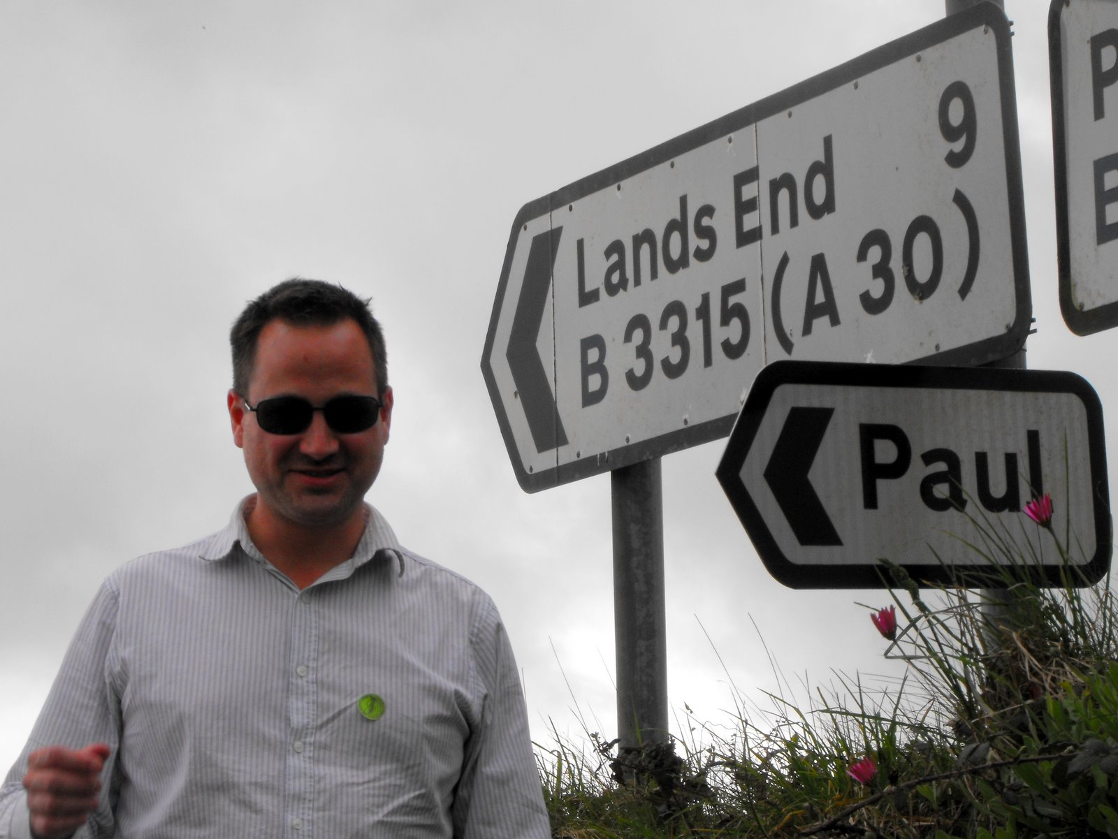
Paul Fremantle
CTO and Co-Founder of WSO2 (2005-2015)
Previously Senior Technical Staff Member, IBM WebSphere architecture
VP, Apache Synapse and Member of ASF
MA in Maths and Philosophy
MSc in Computation (1995)
Teaches SOA module
Part time PhD student
Plays the tin whistle

Slide 16
You?

Slide 17
Approximate Schedule
Monday | Tuesday | Wednesday | Thursday | Friday
 | Recap and Review | Recap and Review | Recap and Review | Recap and Review
Overall Introductions First Cloud lab exercise | Introduction to Big Data and case studies Hadoop Lab 1 | Spark and R R lab | Containers and Docker Docker Lab | Overview and Recap Presentation Group Exercise
Cloud Overview and case studies Elastic Cloud Lab | Hadoop details, Map-Reduce Spark Lab | Storage and NoSQL NoSQL Lab | Security and Runtime Monitoring Lab | Final Thoughts and Assignment
Cloud Theory Platform-as-a-Service, scaling Cloud deployment exercise | Intro to Spark Spark cluster lab | Visualisation Visualisation Lab | Realtime Big Data Realtime Lab

Slide 18

Let’s get started

