Slide 1
Cloud Computing and Big Data Apache Spark and More
Oxford University
Software Engineering Programme
Nov 2015

Slide 2
Contents
What is wrong with Hadoop?
Apache Spark
PySpark / Python
SparkSQL and Hive
SparkR
Spark and Yarn
Spark and Mesos

Slide 3
Issues with Hadoop
Hadoop is fundamentally all about Map Reduce
Though v2 did allow for other approaches
Based on cheap commodity hardware
But….
Not based on cheap commodity hardware with lots of memory!

Slide 4
Hadoop and Disk
Hadoop does everything via replicated disk images
Intermediate results are stored on disk
Slow for many operations
Including Machine Learning
No support for interactive processing

Slide 5
Improved Approach
A new model based on memory
But what about reliability?!

Slide 6
Apache Spark
Started in 2009 at UC Berkeley
Donated to Apache in 2013
Written on top of JVM mainly in Scala
10x-100x faster than Hadoop
Supports coding in:
Scala
Java
Python
R
Supports an interactive shell
More details in this paper:
http://www.cs.berkeley.edu/~matei/papers/2012/nsdi_spark.pdf

Slide 7
Resilient Distributed Datasets
A logical collection of data
Partitioned across multiple machines
Logs the lineage of the current data
If there is a failure, recreate the data
Developers can specify the persistence and partitioning of RDDs

Slide 8
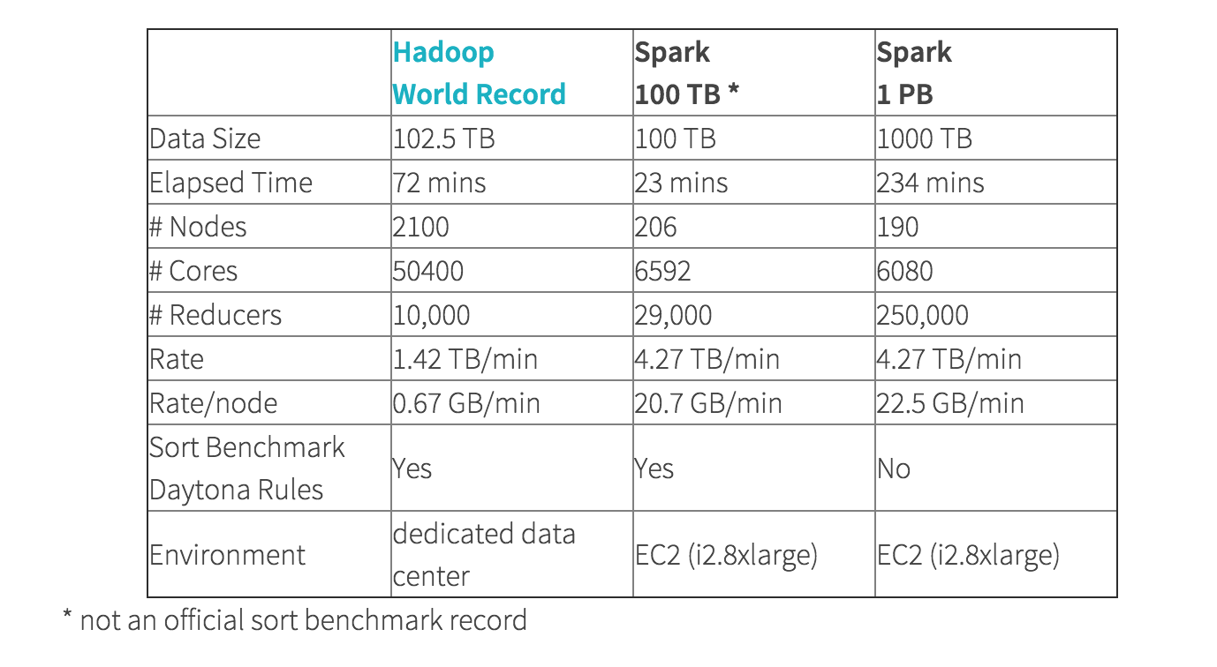
Hadoop vs Spark sorting

Slide 9

Apache Spark cluster model

Slide 10
Apache Spark RDD
Typical operations include
map: apply a function to each line/element
flatMap: can return a sequence not just an element
filter: return element if func(element) is true
reduceByKey: reduces a set of [K,V] key/value pairs
reduce: apply a reducer function
collect: get all the results back to the master (driver) server in the cluster
foreach: apply a function across each element
Operations on RDDs will happen across machines
Be careful!

Slide 11
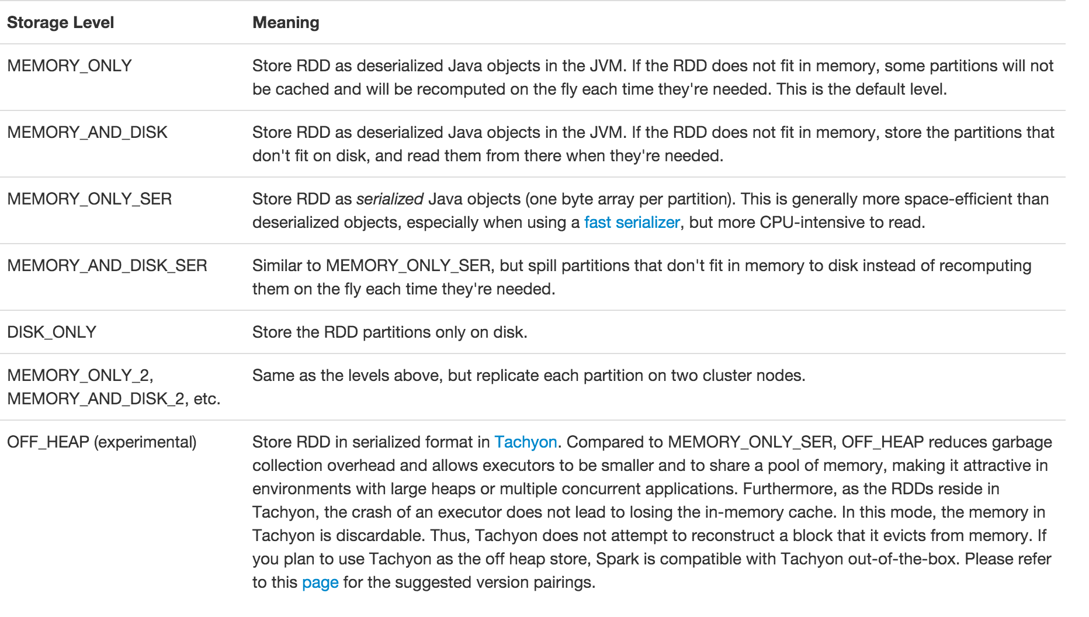
Serialization

Slide 12
Lambda syntax
Lambda’s are unnamed functions
From Alonzo Church’s 1930s work on the Lambda Calculus
Recently added to Java

Slide 13
Lambda syntax in Python
Simply:
lambda x: x.split()
lambda x,y: x+y

Slide 14
Example
sc = SparkContext()
books = sc.textFile(“books/*”)
split = books.flatMap(lambda line: line.split())
numbered = split.map(lambda word: (word, 1))
wordcount = numbered.reduceByKey(lambda a,b: a+b)
for k,v in wordcount.collect():
print k,v
sc.stop()

Slide 15
What doesn’t work in a cluster
counter = 0
rdd = sc.parallelize(data)
# Wrong: Don't do this!!
rdd.foreach(lambda x: counter += x)
print("Counter value: " + counter)

Slide 16
How to count across a cluster?
Accumulators
acc = sc.accumulator()
rdd = sc.parallelize(data) rdd.foreach(lambda x: acc.add(x))

Slide 17
What also doesn’t work
rdd.foreach(println)
Of course this will work when you test in local mode

Slide 18
Spark packages
A wide set of plugins

Slide 19
Time for a lab!

