Slide 1
Cloud Computing and Big Data Apache Cassandra
Oxford University
Software Engineering Programme
Nov 2015

Slide 2
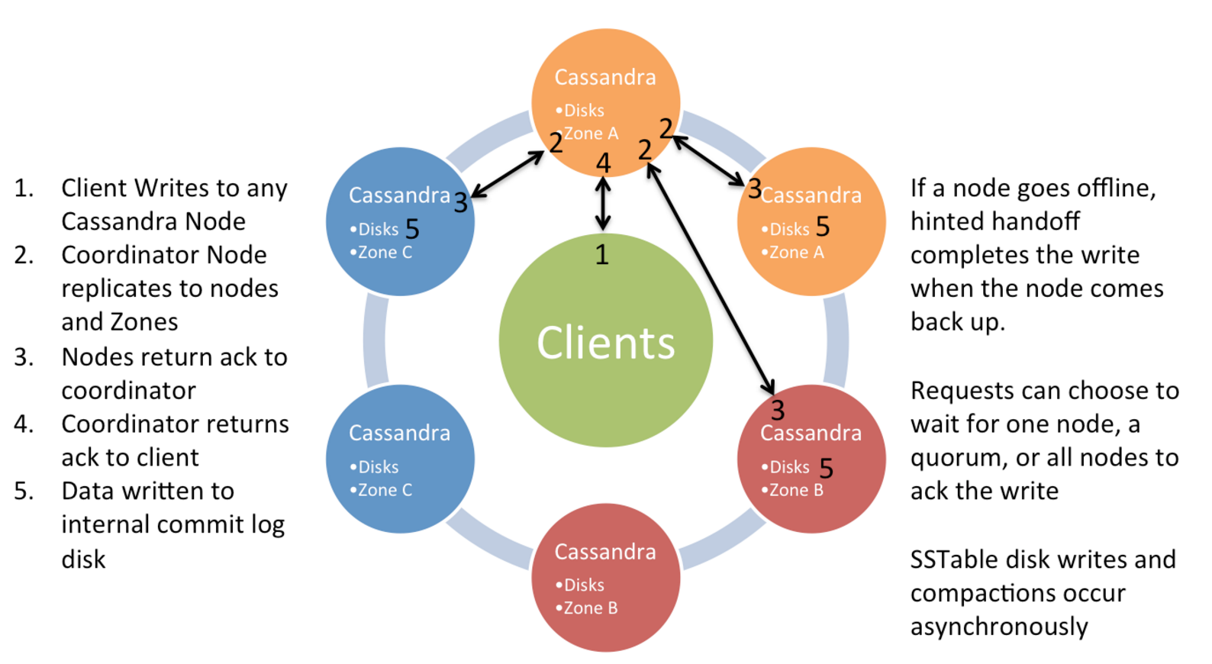
Cassandra Write Model Single Datacentre
Source: Netflix

Slide 3
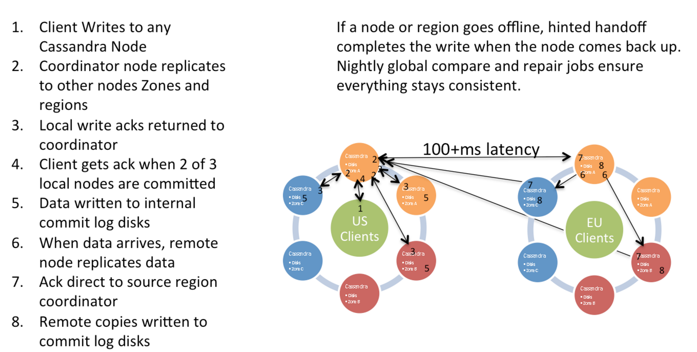
Multi Datacentre Writes
Source: Netflix

Slide 4
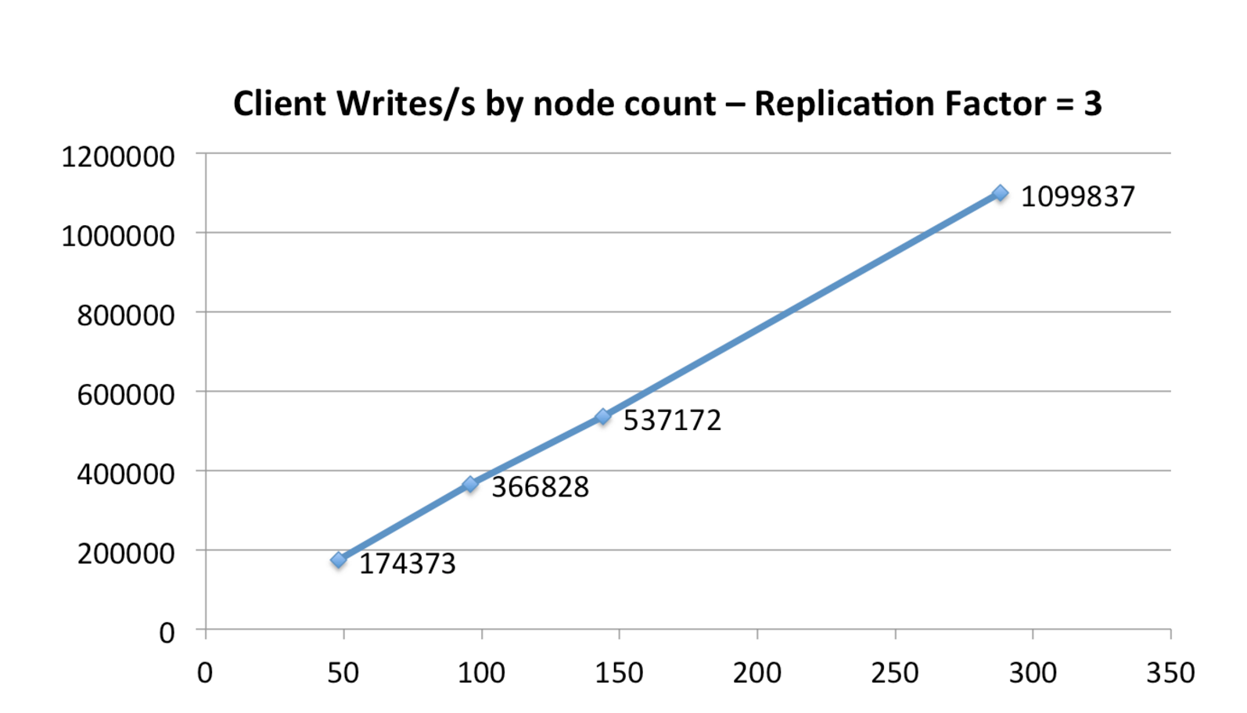
Cassandra Scale Up In Amazon EC2
Source: Netflix

Slide 5
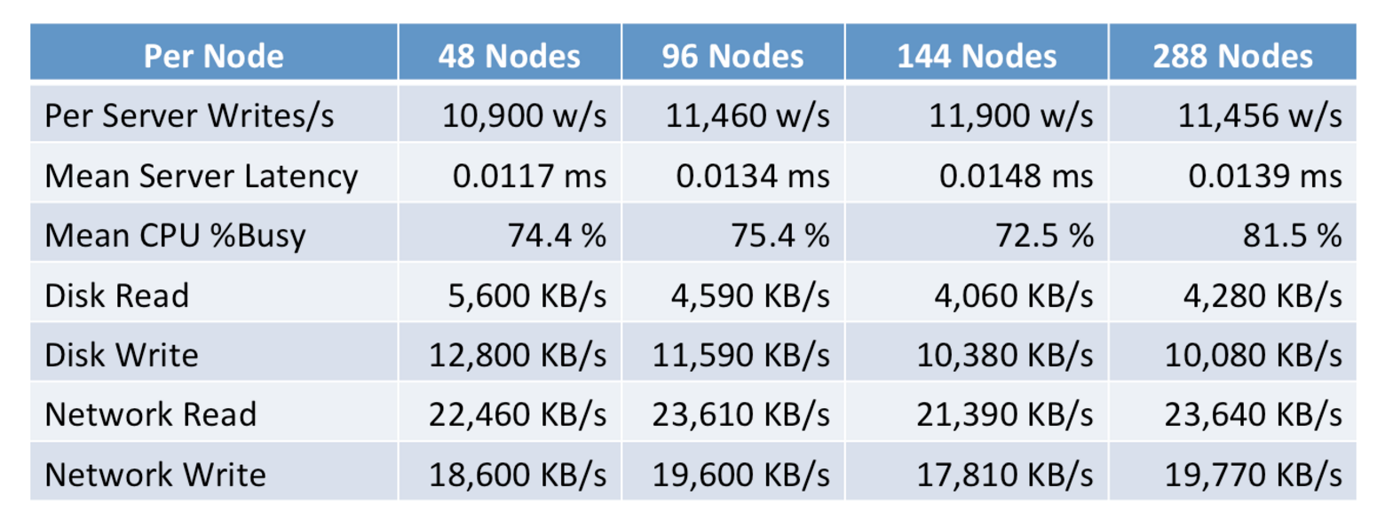
The numbers
Source: Netflix

Slide 6
Cassandra Model
Keyspaces are roughly equivalent to SQL Databases
Encapsulate replication strategies
Column Families roughly equivalent to SQL tables
Generally a different approach vs SQL
Writes are cheap
Indexes are expensive
Normalization is not the goal

Slide 7
Cassandra Model cont.
Inserts are the same as updates
No read first
Data can be marked with a Time to Live (TTL)
Automatically deleted
Deletes are not instant
Deleted rows are marked with a tombstone
Eventually cleaned up
Can re-appear if you do not run node repair after a node failure

Slide 8
Partitioning / Hashing
Two options

Slide 9
Replication

Slide 10
CQL

Slide 11
cassandra.yaml

Slide 12
DataStax OpsCenter

Slide 13
Setting up a cluster in EC2

Slide 14
Questions?

