Slide 1
Cloud Computing and Big Data Hadoop and Map-Reduce
Oxford University
Software Engineering Programme
Nov 2015

Slide 2
Contents
Understanding Map Reduce
Functional programming for scale
Hadoop
Map-reduce in Hadoop
Python
Java
HDFS
Yarn
Pig and Hive
Further reading

Slide 3
Map Reduce
A functional programming pattern:
First apply a function to all data
Map step
This is done in parallel
Then apply a reducer to all outputs of the first step
This is generically non-parallelizable
However, it is possible to make it parallelizable if we first sort the outputs of the first step

Slide 4
Map Reduce example #1 Java
// some input
Integer array[] = {1,2,3,4,5};
// make a Stream of it
Stream<Integer> stream = Arrays.stream(array);
// map then reduce
Integer map_reduced = stream .map(x -> x*x) .reduce(0, (a, b)->a+b);
// should print 55
System.out.println(map_reduced);

Slide 5
Notice how
We could have squared each number in the stream at the same time
Adding them up needed all the results available

Slide 6
Map Reduce example #2 in words
Do a word count on 1000 books:
First count each book (map wc onto book)
Then reduce the outputs to a global wordcount across all books

Slide 7
Making word count more efficient
If we sort the results of the map phase and “shuffle them”
We can then partition the reducer phase

Slide 8
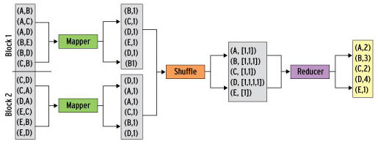
Map/Shuffle/Reduce

Slide 9
Map Reduce in Real Life
Analysing web logs
Summarise by user / cookie
Then aggregate to identify who did what
Analysing twitter data
Who retweeted
Who was retweeted the most
Almost all big data problems can be re-factored into Map Reduce
Some more efficiently than others!

Slide 10
Apache Hadoop
The most famous and popular Map Reduce framework
Open Source
Written in Java, but supports other languages
Runs Map Reduce workloads across a cloud or cluster of machines
Supports a distributed filesystem to store data for these jobs
Provides reliability when servers in the cluster fail

Slide 11
Components of Hadoop
Map Reduce or Other Workloads
Java, Scala, Python, Apache Pig, Apache Hive, etc
YARN (Yet Another Resource Negotiator)
Cluster Resource Management
Hadoop Distributed File System (HDFS)
Redundant Reliable Distributed File System

Slide 12
HDFS in a nutshell
Client
NameNode
Secondary
NameNode
metadata
checkpoint
Data access
DataNode
DataNode
DataNode
DataNode

Slide 13
HDFS details
Good for streaming access to large files, reliability, scale
Not good for random access, small files
Blocks of data 64Mb in size (configurable)
Each block can be replicated across multiple data nodes for High Availability (HA)

Slide 14
HDFS commands
start-dfs.sh
stop-dfs.sh
hadoop fs <command>
e.g. hadoop fs cat /user/hduser/file
hadoop fs mkdir –p /user/hduser/
hadoop fs put localfile /user/hduser/remotefile
hadoop fs get /user/hduser/remotefile localfile

Slide 15
What is YARN?
YARN is the system that runs your code on multiple nodes
Hadoop 2.0 replacement for the cluster manager
Basically a model to distribute and manage workloads
Not just MapReduce but supports other workloads

Slide 16
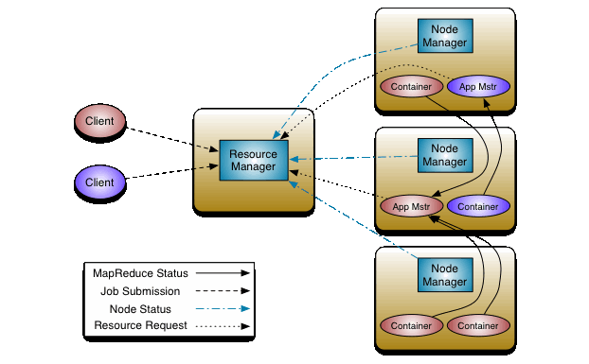
YARN details

Slide 17
Map Reduce in Hadoop
Map reduce in Hadoop actually consists of three steps!
Mapper
Works on a single file, line by line
Combiner
Like a reducer, but still on a single system taking the output of the mapper
Reducer
Takes the outputs of multiple mapper/combiners

Slide 18
The general flow
On the whole, we expect to produce key-value <K,V> pairs from any mapper or reducer
In some cases we may produce <K,V1,V2,..>
The results are stored to file and then read from file

Slide 20
Map Reduce in Java

Slide 21
Map Reduce in Scala

Slide 22
Map Reduce in Python

Slide 23
Apache Pig

Slide 24
Apache Hive

Slide 25
Apache HBase

Slide 26
Other related projects

Slide 27
Summary

Slide 28
Resources

Slide 29
Questions?

