Slide 1

Creating Your Own Admin Panel for DNN 9
Peter Donker
Bring2mind/DNN Connect
Sat 20 Jan 2017, Denver

Slide 2
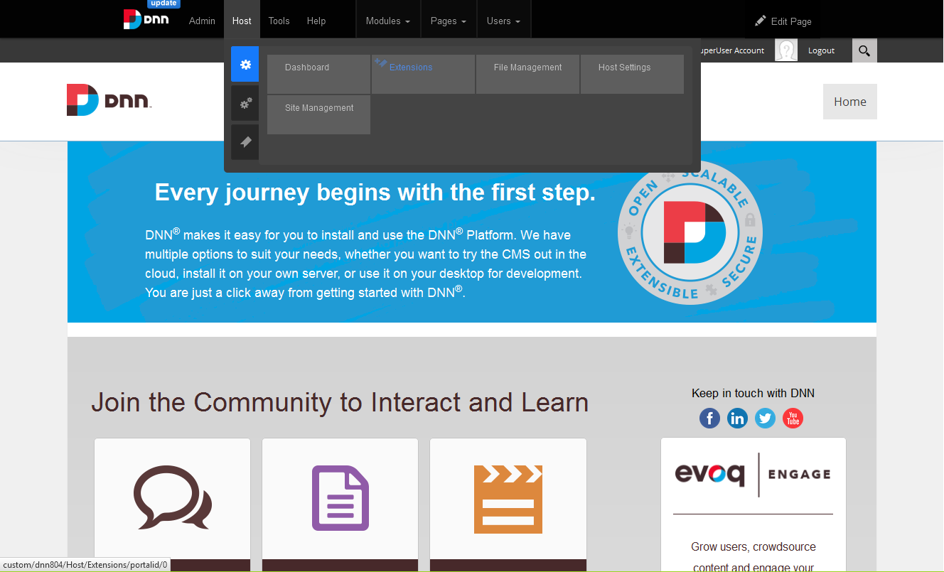
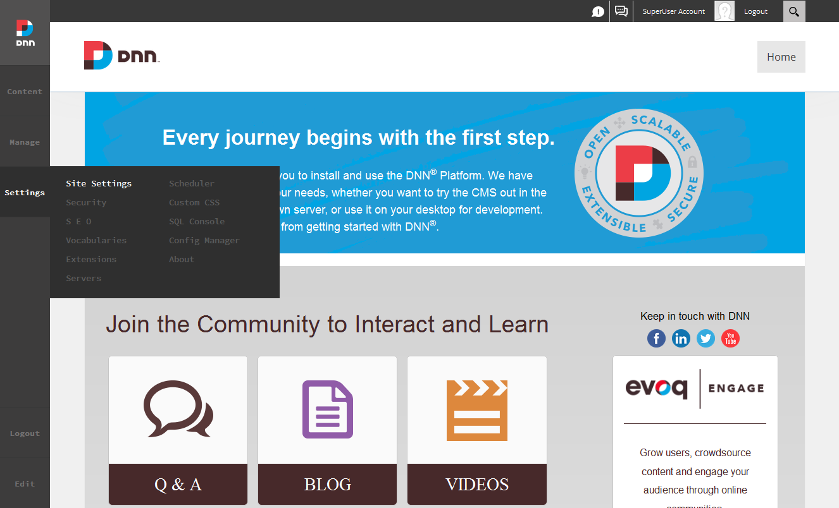
DNN 9 Newness

Slide 3
Use cases
Designed for admin modules like managing users
And for displaying things like status feedback
Extending your own module? For portal wide settings
NBStore
DMX

Slide 4
What is it?
A replacement for the old control bar (which you can still use)
It’s an extension itself!
It’s a mini framework!
Extensions/modules
Permissions
It is really dumb ;-)

Slide 5
What does it do?
Loads an HTML file
Loads a JS file
Loads a CSS file
And outputs that to an Iframe on screen
Finally it will call some methods on your JS file

Slide 6
How does it do this?
Through conventions!
You give your module a path and some “identifier” (no spaces etc)
It will load from DesktopModules/Admin/Dnn.PersonaBar/Modules/YourPath
./identifier.html,
./css/identifier.css and
./scripts/identifier.js
It expects a JS module with the methods “init” and “load”
It will call init when first loaded and load every *subsequent* time the panel is opened

Slide 7
How do you get onboard?
Obey the conventions ;-)
New manifest type :-S

Slide 8
<dotnetnuke type="Package" version="5.0">
<packages>
<package name="Connect.ComponentPackageName" type="PersonaBar" version="01.00.00">
<friendlyName>Connect.ComponentFriendlyName</friendlyName>
<description, iconFile, owner, license, releaseNotes, azureCompatiblity …
<dependencies>
<dependency type="CoreVersion">08.00.00</dependency>
<dependency type="ManagedPackage" version="01.00.00">Dnn.PersonaBar.UI</dependency>
</dependencies>
<components>
<component type="ResourceFile, Assembly, etc
<component type="PersonaBarMenu">
<menu>
<identifier>ComponentID</identifier>
<moduleName>ComponentModuleName</moduleName>
<resourceKey>nav_ComponentResx</resourceKey>
<path>ComponentPath</path>
<mobileSupport>true</mobileSupport>
<parent>Settings</parent>
<order>2</order>
</menu> …

Slide 9
Quick Exploration

Slide 10
For the remainder of this presentation
Forget about PersonaBar permissions

Slide 11
How do we communicate with the server?
It’s not ascx or cshtml, so how do we get and save data?
Through WebAPI obviously

Slide 12
WebAPI 4 PersonaBar
Classic Module
/DesktopModules/Company/Module/API/Controller/Action
PersonaBar Module
/API/PersonaBar/Controller/Action

Slide 13

WebAPI 4 PersonaBar
Classic Module
?
/DesktopModules/Company/Module/API/Controller/Action
PersonaBar Module
/API/PersonaBar/Controller/Action

Slide 14
WebAPI 4 PersonaBar
ModuleId, TabId, Auth Token
Classic Module
?
/DesktopModules/Company/Module/API/Controller/Action
Auth Token
PersonaBar Module
/API/PersonaBar/Controller/Action

Slide 15
WebAPI 4 PersonaBar
ModuleId, TabId, Auth Token
Classic Module
/DesktopModules/Company/Module/API/Controller/Action
DotNetNuke.Web.Api.DnnApiController (DotNetNuke.Web)
Auth Token
PersonaBar Module
/API/PersonaBar/Controller/Action
Dnn.PersonaBar.Library.PersonaBarApiController (Dnn.PersonaBar.Library)

Slide 16
public partial class ConferencesController : ConferenceApiController
{
[HttpGet]
[DnnModuleAuthorize(AccessLevel = DotNetNuke.Security.SecurityAccessLevel.View)]
public HttpResponseMessage Get(int id)
{
[MenuPermission(MenuName = "Connect.Demo", Scope = ServiceScope.Admin)]
public class WidgetController : PersonaBarApiController
{
[HttpGet]
public HttpResponseMessage GetSetting()
{

Slide 17
Main Module

Slide 18
To Business: Creating our Module
Goal is to create a PersonaBar module that allows us to edit a portal wide setting of our module
We’ll use React because (a) it’s what DNN Corp is using and (b) it’s what I’m most familiar with

Slide 19
React 101
<div id="myComponent"></div>
JS

Slide 20
React 101
<div id="myComponent"></div>
Component
Props
State
Events (render)

Slide 21
React 101
<div id="myComponent"></div>
Component
Props
State

Slide 22
React 101
Displaying
props
state
Component 1
props
state
Component 2
props
state
Component 3

Slide 23
React 101
Updating
props
state
Component 1
props
state
Component 2
props
state
Component 3

Slide 24
React 101
Using Flux
Flux
props
state
Component 1
props
state
Component 2
props
state
Component 3

Slide 25
For the remainder of this presentation
Forget about Flux

Slide 26
Let’s Code

Slide 27
Where is the PersonaBar Stuff?
2 Projects under the moniker “AdminExperience”:
Core Library https://github.com/dnnsoftware/Dnn.AdminExperience.Library
Core Extensions https://github.com/dnnsoftware/Dnn.AdminExperience.Extensions

Slide 28
Final Remarks
Uuuuuuge addition to the platform. UI experience is improved bigly as a result
Very much v 1.0
Not much detail on “Extensions” or “Permissions” yet
Expect people to start tugging and pushing this around

Slide 29
Questions

