Slide 1


Digital washing machine
Introduction
Jochen van der Wal

Slide 2
Program Day One

Slide 3
Program Day two

Slide 4
Digital washing machine
Mission
Realize direct access to huge amounts of seized evidence for the tactical investigator
Realize an open, modular extensible architecture
Open Computer Forensics Architecture (ocfa)

Slide 5
Digital washing machine
Goal
Make data easily accessible to investigation team
  Unlock file system
  Unlock files
  Automatic Analysis
With little training for the tactical investigator
With little effort for digital investigator
Let the computer do the hard work
Support many platforms/filesystems/ file formats
Fast
Forensic correct
Modular

Slide 6


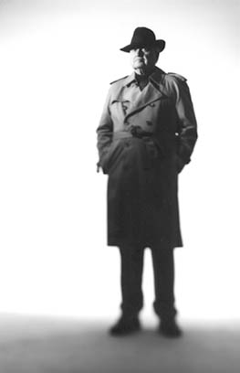
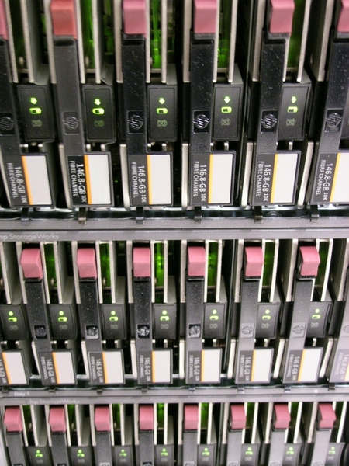
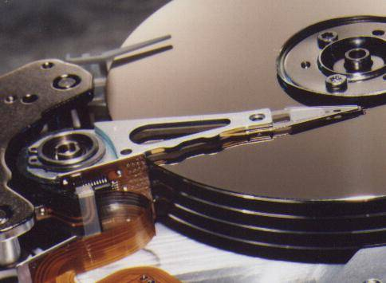

Digitaal Forensisch Onderzoek
Werkwijze tot nu toe
V
A
V
A
V
A
In beslag
genomen
materiaal
1 op 1
kopie
Analyse
tools
Digitaal
rechercheur
Tactisch
rechercheur

Slide 7
Digitaal Forensisch Onderzoek
Werkwijze met digitale wasstraat
Digitale
Wasstraat
Directe
toegang
In beslag
genomen
materiaal
Tactisch
rechercheur
Ondersteuning
Moeilijke materie
Problemen Oplossen
1 op 1
kopie
Digitaal
rechercheur

Slide 8
Sources
Image file
  (Splitted) dd
  Encase image
Directory
Single file
Future (pcap)

Slide 9
Digitale wasstraat
Recursively
process
Digital
Washing machine
rubbish
Information
About the
Evidence,
Like mimetypes,
Creation times,
etc
The actual
Evidence:
Doc’s
Movies
Pictures,
Etc.
Text
Based
Doc’s
Meta
database
Evidence
repository
index
Seize evidence

Slide 10
Digitale Wasstraat
User Interface:
Web-base
Export mogelijkheden
Web-based
meta
overviews
Keyword
search
Digital
Washing machine
Meta
browser
Exports of
Text doc’s
Eg.
Text
Mining
Meta
database
Evidence
repository
index

Slide 11
Unlock filesystems
Find file creation/modification info
Restore the deleted files
Restore lost folders
Find lost clusters

Slide 12
Unlock Files
Filter out the ones you DON'T want
  Windows system files
Filter out the ones you DO want
  Rootkits, child porn, stego tools
Unzip, untar, unpack
Extract mail archives
Annotate files (e.g. file kind, mimetype)
Convert files to easier to read formats (usually plain text)

Slide 13
Digitale Wasstraat
???
unzip
Data:
A
big
?
Data:
?
ZIP
???
manual
file
hash
Text
Mining
DOC
Indexing
images
known
Tactical investigation team

Slide 14
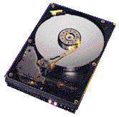
Digitale Wasstraat
Recursief verwerken van digitaal bewijs
In een mailbox kan een mailtje zitten met een zip bijlage waarin een pdf document staat met interessante tekst die geïndexeerd moet worden.
router
modules
mail
zip
pdf2txt

Slide 15
Chain of evidence
Everything resolves to original source
Everything hashed (sha1 and md5)
Trace of route through wash process maintained
Shown in GUI

Slide 16
Modular design
Modules do the job
Tolerance to module failure (queued messages)
(Anycast view later on)
Core modules like:
  router
  dsm
Extra modules like:
  antiword
  zip
  exif
  and so on

Slide 17
Implementation / technology
Platform GNU-Linux
Programming Language C++
Apache webserver with C++ implemented CGI-scrips
Postgresql database
XML-based storage (repository)
ACE messaging framework

Slide 18
Repository
Position:
/var/ocfa/casename/repository
Contain both:
  Metadata files (metastoreentity table)
  Evidence files (evidencestoreentity table)
Name is two leveled sha1 representation:
be/f2/ac53911391f5a3cacdea12a7feae3054f81d
(sha1=bef2ac53911391f5a3cacdea12a7feae3054f81d)
Complete path:
/var/ocfa/casename/repository/be/f2/ac53911391f5a3cacdea12a7feae3054f81d
Store same file only once

Slide 19
Database
Storage of metadata
dsm.conf determines which data will be stored (described later in configuration section)
item
repository
evidence
store
entity
meta
data
info
case ID
evidence source ID
item ID
meta
store
entity

Slide 20
4 views
tool-chain view
routing view
anycast view (messaging view)
library view

Slide 21
Tool-chain view
start
file
digest
derive
zip
alert
Data store module
(DSM)

Slide 22
Router view
file
digest
zip
alert
Router
start
rule list
Data store module

Slide 23
Anycast view
(Messaging)
persistent queues
Tool1
Tool1
anycast
relay
kick
anycast
Tool1
dsm
unicast
Tool2
anycast
Tool2
Router
Router
storage & evidence meta subsystems

Slide 24
Library view
Kick
router
dsm
tool 1
tool 2
anycast
relay
module library
storage
library
evidence
meta
library
evidence
tree
library
message
library
tree module
2
misc library
tree module
1

