Slide 1


Digital Washing machine
Check for EOW (=end of wash)
Jochen van der Wal

Slide 2
Places to check
Browser:
  ppqoverview (Current queues)
  Browse the tree
Process activity
  top -u ocfa
Working directories:
  du -ks /var/ocfa/<casename>/work/default/*
The windows-share directory:
  du -ks /var/ocfa/windows/*

Slide 3
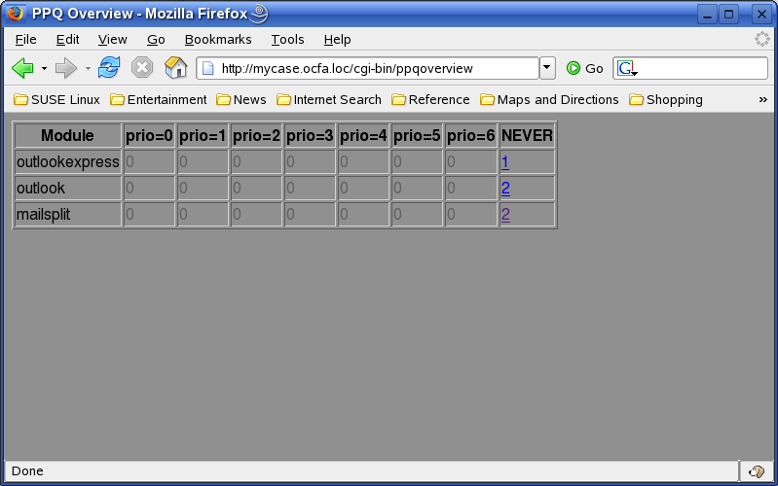
Browser
ppqoverview

Slide 4
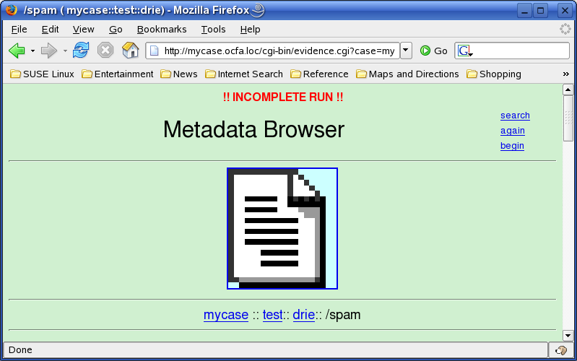
Browser
Browse the tree

