Slide 1
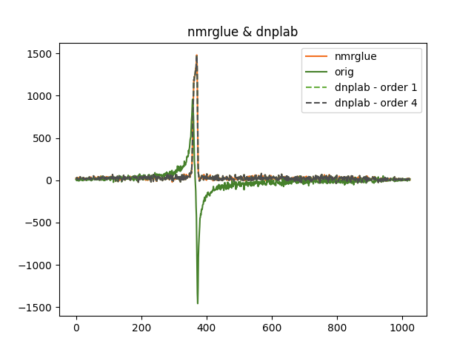
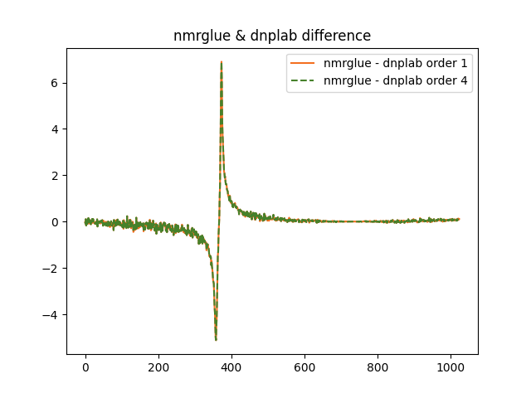
Standard: pivot/index (<- naming)= (True -> take first spectrum as default but)
- standard handling: fold/unfold (look at examples i.e. apodize -> reshape n dim in 1x1 (shape) and all other dimensions are stacked and then you can run autphase)
2 cases: everything has same phase or everything is phased by its own!
Testdata: toluene spectrum dnplab -> ask yen-chun
Copy data (dnpdata.copy() & make sure to add correct proc_attrs)

