Slide 1
image Classification Plus
Logistic Regression，Random Forest，XGBoost，SVM，MIL，MLP
Student: Nianqi Di
Jiayi Zhang
Yiwen Zhang
Junheng Cui
Xuayng Gou
Supervisor: Liu Bo
Date: 2025-10-09

Slide 2
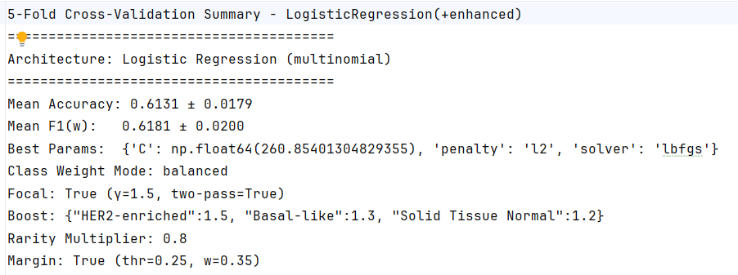
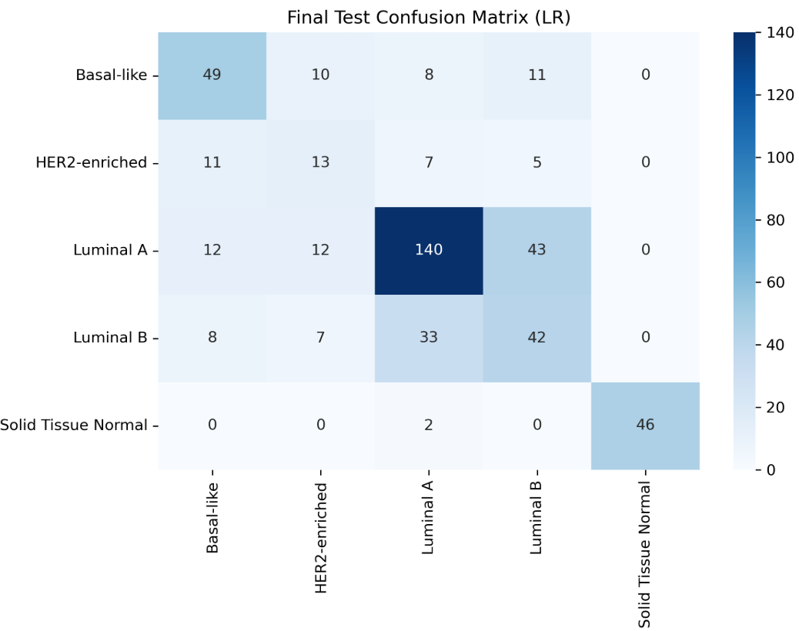
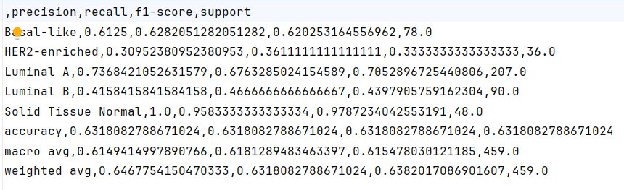
Logistic Regression_plus

Slide 3
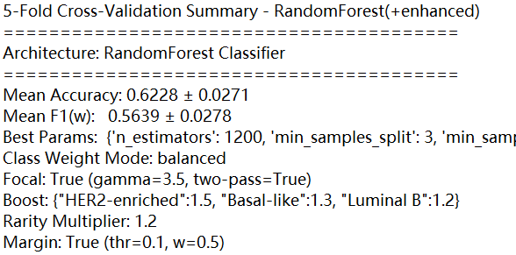
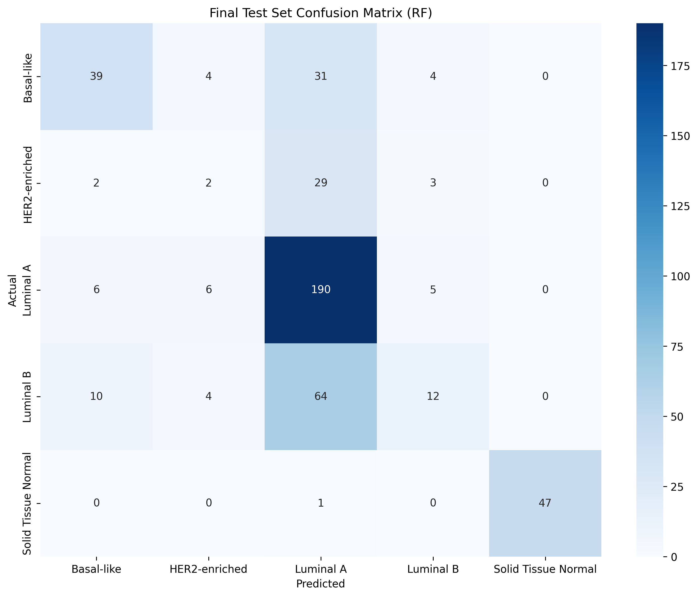
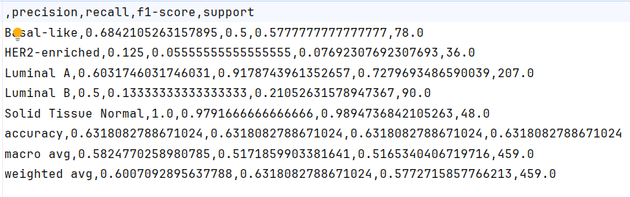
Random Forest_plus

Slide 4
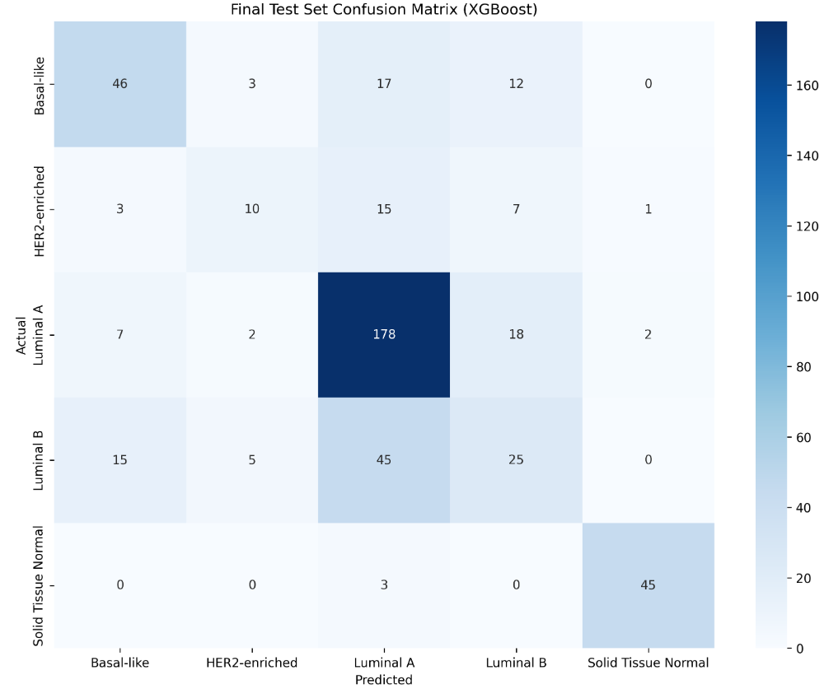
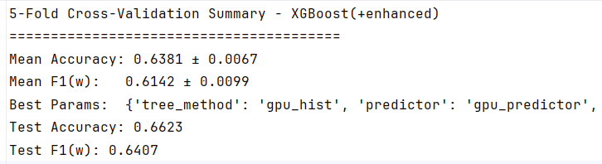
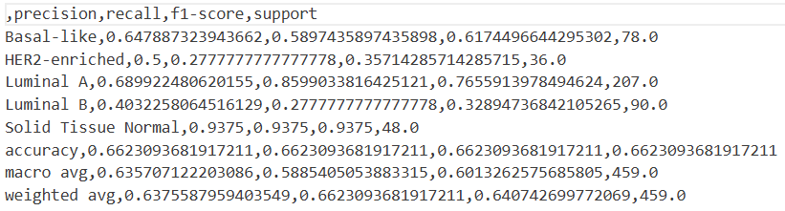
XGBoost_plus

Slide 5
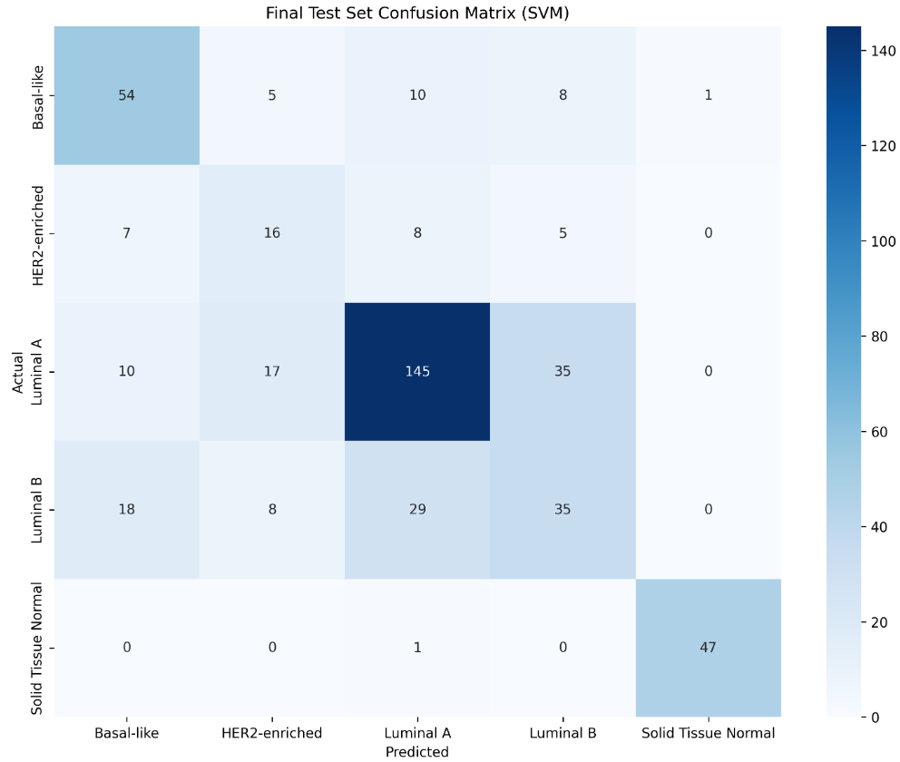
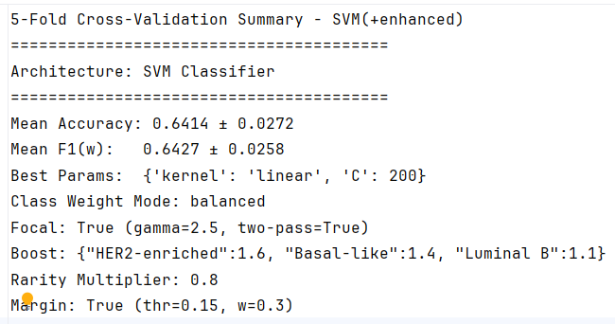
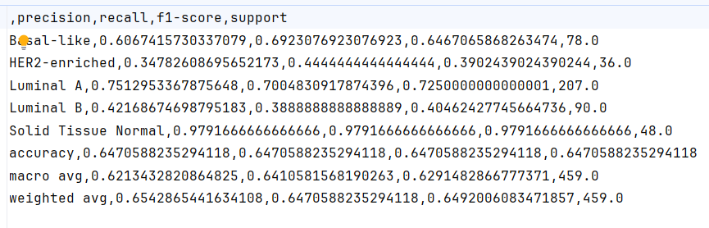
SVM_plus

Slide 6
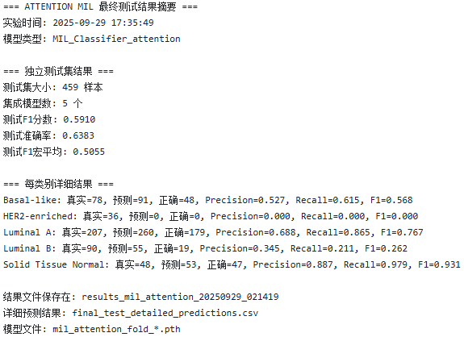
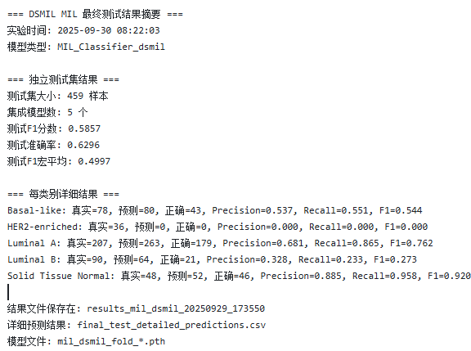
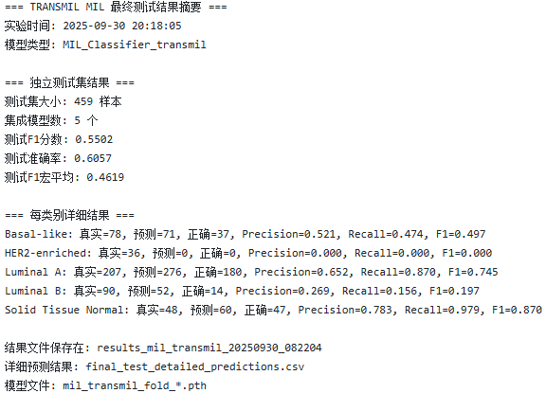
MIL
attention MIL
dsmil MIL
transmil MIL
Test F1-score: 0.5910
Test Accuracy: 0.6383
Test Macro-F1: 0.5055
Test F1-score: 0.5857
Test Accuracy: 0.6296
Test Macro-F1: 0.4997
Test F1-score: 0.5502
Test Accuracy: 0.6057
Test Macro-F1: 0.4619

Slide 7
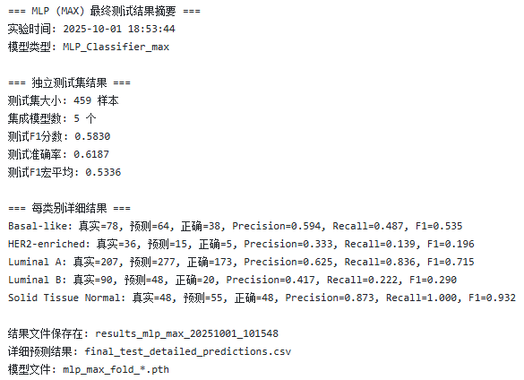
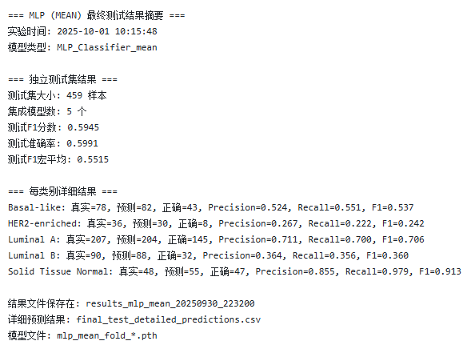
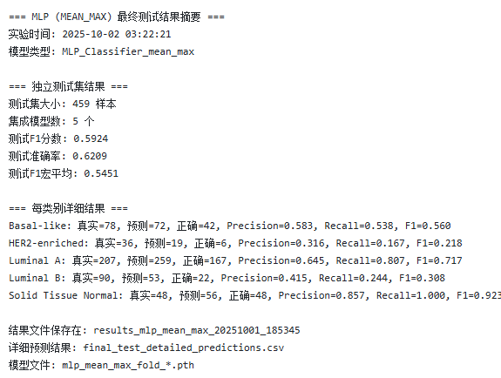
MLP
MLP(MAX)
MLP(MEAN)
MLP(MEAN_MAX)
Test F1-score: 0.5830
Test Accuracy: 0.6187
Test Macro-F1: 0.5336
Test F1-score: 0.5945
Test Accuracy: 0.5991
Test Macro-F1: 0.5515
Test F1-score: 0.5924
Test Accuracy: 0.6209
Test Macro-F1: 0.5336

