Slide 1
Breast Cancer Subtype Classification Based On Gene Expression – Weekly Progress
Student: Nianqi Di
Jiayi Zhang
Yiwen Zhang
Junheng Cui
Xuayng Gou
Supervisor: Liu Bo
Date: 2025-08-07

Slide 2
Weekly Overview
Finalize Random Forest pipeline (CV + visualization)
Implement XGBoost for comparison
Deliver interpretable outputs (Top genes & confusion matrix)

Slide 3
Data Overview
Training set: 848 samples × 4224 genes
Test set: 214 samples (independent)
Class distribution
Basal-like 37 HER2-enriched 16 Luminal A 98 Luminal B 40 Normal 23

Slide 4
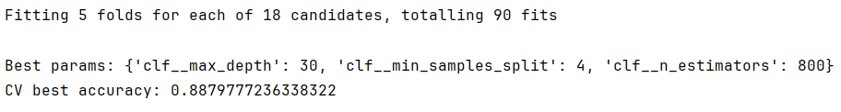
Random Forest Improvements
5-fold stratified CV
Hyper-grid: n_estimators / max_depth / min_samples_split
Handle imbalance: class_weight='balanced'
Best params: n_estimators=800, max_depth=30, min_samples_split=4

Slide 5
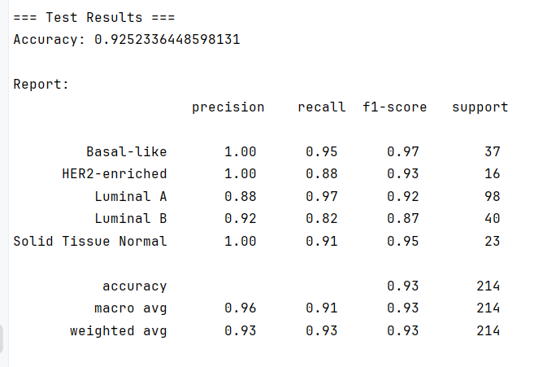
Random Forest Results
Test accuracy: 92.5 %
Overall F1-macro ≈ 0.92
Key insight: HER2-enriched recall rises to 0.88

Slide 6
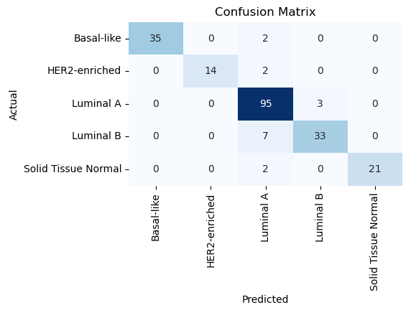
Confusion matrix figure

Slide 7
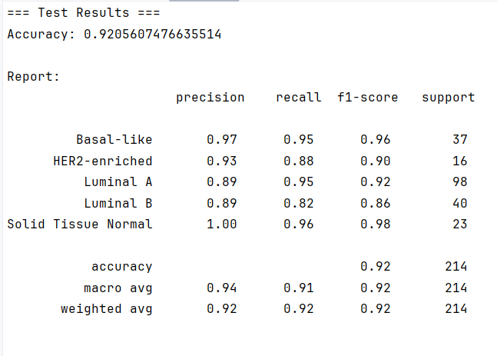
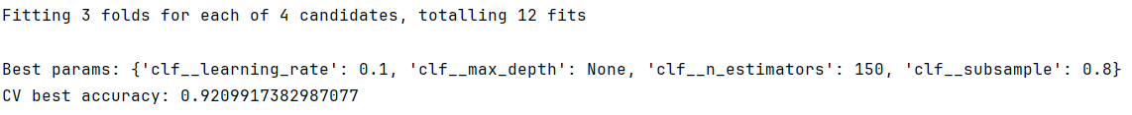
XGBoost Setup
Same pipeline
3-fold CV (for speed)
Params: n_estimators ∈ {150,300}, max_depth ∈ {None,6}, lr=0.1
Test accuracy: 92.1 %
Overall F1-macro ≈ 0.92

Slide 8
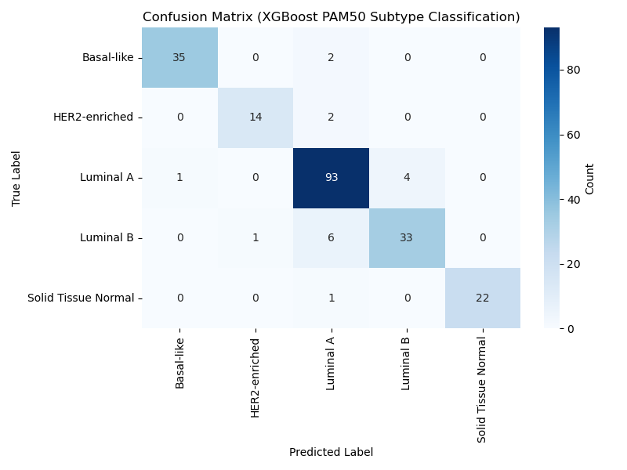
Confusion matrix figure

Slide 9
Model Comparison
.
Metric | RandomForest | XGBoost
Test Acc | 0.925 | 0.921
F1-macro | 0.93 | 0.92
HER2 Recall | 0.88 | 0.88
→ Difference < 1 %, next step: ensemble.

