Slide 1
Breast Cancer Subtype Classification Based On Gene Expression – Week5
Student: Nianqi Di
Jiayi Zhang
Yiwen Zhang
Junheng Cui
Xuayng Gou
Supervisor: Liu Bo
Date: 2025-08-14

Slide 2
Weekly Overview
automatically selected 20 key genes with mRMR;
tuned a Random Forest via RandomizedSearchCV;
used 5-fold stratified CV for robustness;
evaluated and visualized results on a fully independent test set of 214 samples.

Slide 3
Data Overview
Training set: 848 samples × 4224 genes
Test set: 214 samples (independent)
Class distribution
Basal-like 37 HER2-enriched 16 Luminal A 98 Luminal B 40 Normal 23

Slide 4
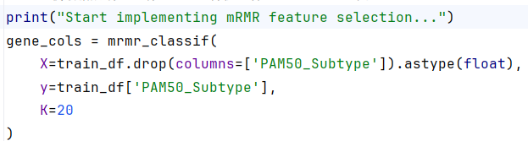
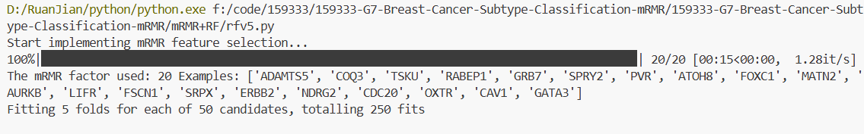
Feature Selection
Algorithm: Max-Relevance Min-Redundancy (mRMR)

Slide 5
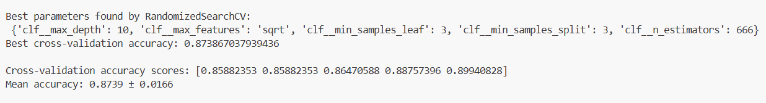
Hyper-parameter Tuning
5-fold stratified CV
Hyper-grid: n_estimators / max_depth / min_samples_split
Best params:
Five-fold CV accuracies range from 85.9 % to 89.9 % with a mean of 87.4 % ± 1.7 %. The low standard deviation confirms model stability across data splits.

Slide 6
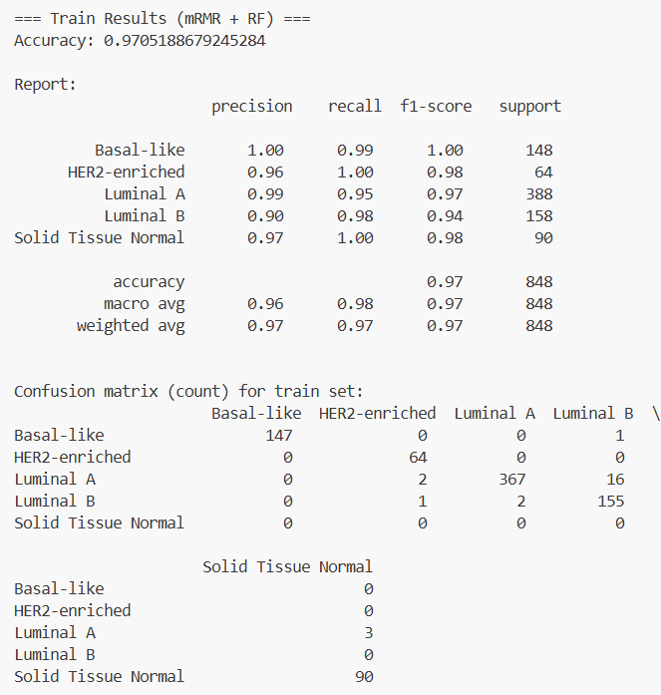
Train Set Result
Train accuracy: 97.1%
for over-fit monitoring only

Slide 7
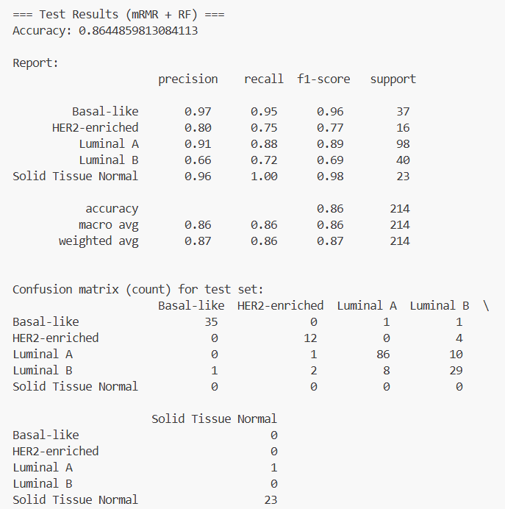
Test Set Result
Test accuracy: 86 %
Overall F1-macro ≈ 0.87

Slide 8
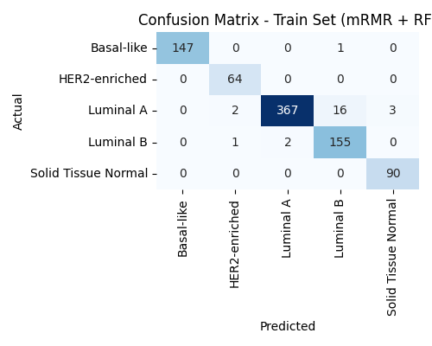
Confusion matrix figure-

Slide 9
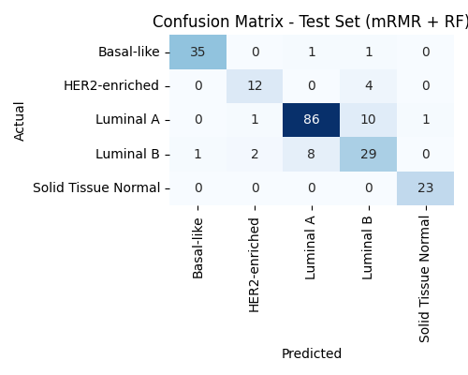
Confusion matrix figure

