Slide 1
Breast Cancer Subtype Classification Based On Gene Expression – Week6
Student: Nianqi Di
Jiayi Zhang
Yiwen Zhang
Junheng Cui
Xuayng Gou
Supervisor: Liu Bo
Date: 2025-08-25

Slide 2
Weekly Overview
automatically selected 20 key genes with mRMR;
tuned a XGBoost via RandomizedSearchCV;
used 3-fold stratified CV for robustness;
evaluated and visualized results on a fully independent test set of 214 samples.

Slide 3
Data Overview
Training set: 848 samples × 4224 genes
Test set: 214 samples (independent)
Class distribution
Basal-like 37 HER2-enriched 16 Luminal A 98 Luminal B 40 Normal 23

Slide 4
MRMR
Pipeline:
mRMR first filters 4,224 genes down to 60-140 key features → XGBoost tunes 7 core hyper-parameters via 3-fold × 40-iteration randomized search → final 1,000-tree refit on full training data
delivers 92 % independent-test accuracy in 3 minutes, plus a Top-20 gene list and a one-click reproducible model bundle.

Slide 5
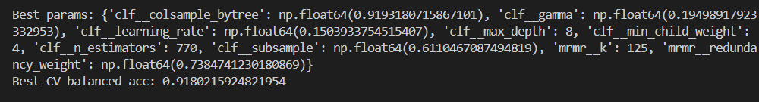
Hyper-parameter Tuning
3-fold stratified CV
Best params:
CV balanced_acc: [0.9405838 0.90409846 0.90938252]

Slide 6
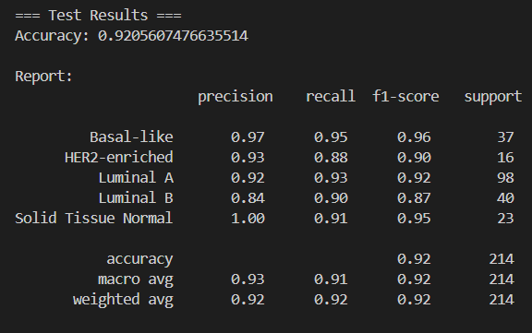
Result
Test accuracy: 92 %

Slide 7
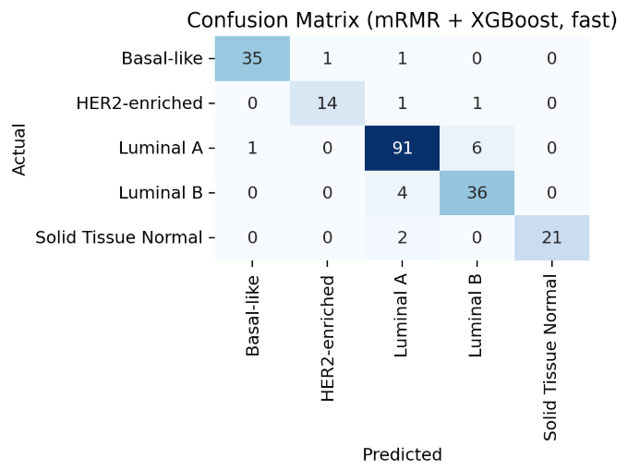
Confusion matrix figure

