Slide 1
T2LP Experience
Li Jia

Slide 2
DataSet
WIKI
YAGO
 | WIKI | YAGO
entity | 12554 | 10623
relation | 24 | 10
test | 15115 | 5791
train | 201100 | 82550
valid | 18208 | 8046
Head | Relation | Tail | Time
<Frances_Howard_(actress)> | <isMarriedTo> | <Samuel_Goldwyn> | 1970
<Frances_Howard_(actress)> | <isMarriedTo> | <Samuel_Goldwyn> | 1971
<Frances_Howard_(actress)> | <isMarriedTo> | <Samuel_Goldwyn> | 1972
<Frances_Howard_(actress)> | <isMarriedTo> | <Samuel_Goldwyn> | 1973
<Frances_Howard_(actress)> | <isMarriedTo> | <Samuel_Goldwyn> | 1974
<Fun_Labs> | <created> | <Cabela's_Dangerous_Hunts_2009> | 360
<Zhang_Jindong> | <owns> | <Suning_Holdings_Group> | 100
<Carly_Chaikin> | <created> | <Suburgatory> | 2011
<Florence_Engel_Randall> | <created> | <A_Watcher_in_the_Woods> | 1976

Slide 3
Baseline
TransE: https://papers.nips.cc/paper/5071-translating-embeddings-for-modeling-multi-relational-data.pdf
TransH: https://pdfs.semanticscholar.org/2a3f/862199883ceff5e3c74126f0c80770653e05.pdf
t-TransE: https://www.aclweb.org/anthology/D16-1260.pdf
HyTE: http://talukdar.net/papers/emnlp2018_HyTE.pdf
RE-NET: https://rlgm.github.io/papers/69.pdf

Slide 4
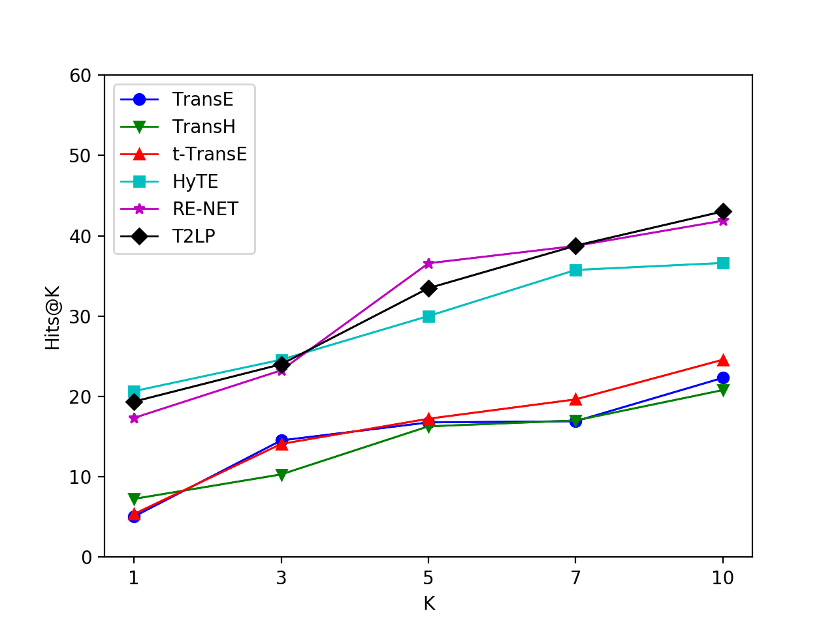
entity_prediction(WIKI)
Method | MRR | Hits@1 | Hit@3 | Hits@5 | Hit@7 | Hits@10
TransE | 10.37 | 5.05 | 14.53 | 16.77 | 16.92 | 22.32
TransH | 9.86 | 7.25 | 10.3 | 16.28 | 17.01 | 20.8
t-TransE | 11.22 | 5.37 | 14.09 | 17.23 | 19.64 | 24.58
HyTE | 28.75 | 20.66 | 24.58 | 30.01 | 35.75 | 36.62
RE-NET | 20.64 | 17.33 | 23.25 | 36.58 | 38.74 | 41.88
T2LP | 30.73 | 19.36 | 24.01 | 33.48 | 38.77 | 43.04

Slide 5
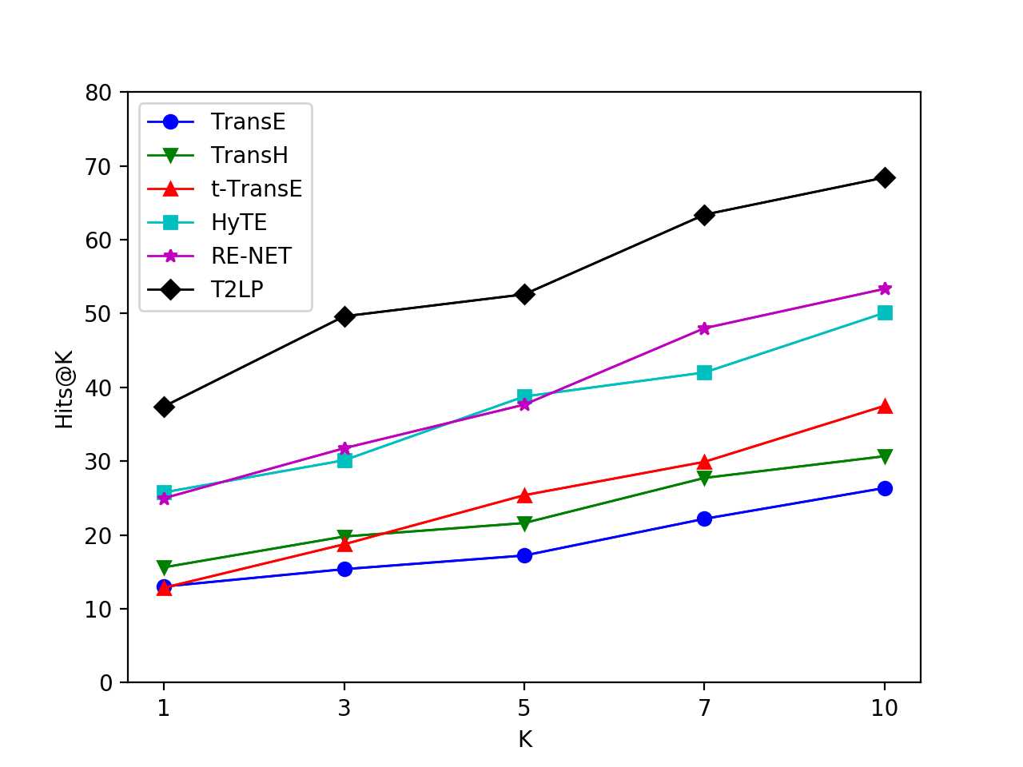
relation_prediction(WIKI)
Method | MRR | Hits@1 | Hit@3 | Hits@5 | Hit@7 | Hits@10
TransE | 15.27 | 13.02 | 15.37 | 17.22 | 22.19 | 26.37
TransH | 18.41 | 15.62 | 19.79 | 21.62 | 27.73 | 30.67
t-TransE | 16.31 | 12.85 | 18.74 | 25.39 | 29.91 | 37.5
HyTE | 30.19 | 25.77 | 30.12 | 38.76 | 42.01 | 50.1
RE-NET | 31.35 | 24.98 | 31.75 | 37.66 | 48.01 | 53.35
T2LP | 50.86 | 37.41 | 49.62 | 52.6 | 63.39 | 68.42

Slide 6
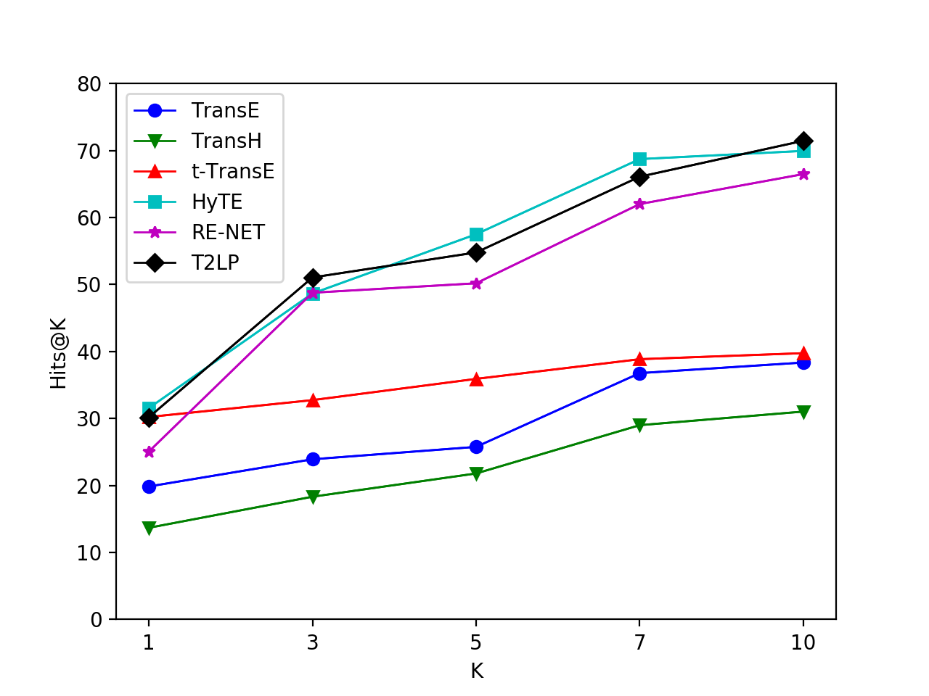
entity_prediction(YAGO)
Method | MRR | Hits@1 | Hit@3 | Hits@5 | Hit@7 | Hits@10
TransE | 33.23 | 19.85 | 23.91 | 25.76 | 36.77 | 38.35
TransH | 30.27 | 13.68 | 18.32 | 21.79 | 29 | 31.03
t-TransE | 38.69 | 30.22 | 32.74 | 35.91 | 38.85 | 39.75
HyTE | 44.35 | 31.55 | 48.66 | 57.5 | 68.72 | 69.94
RE-NET | 48.32 | 25.06 | 48.77 | 50.18 | 62.01 | 66.48
T2LP | 50.75 | 30.18 | 51.05 | 54.78 | 66.09 | 71.45

Slide 7
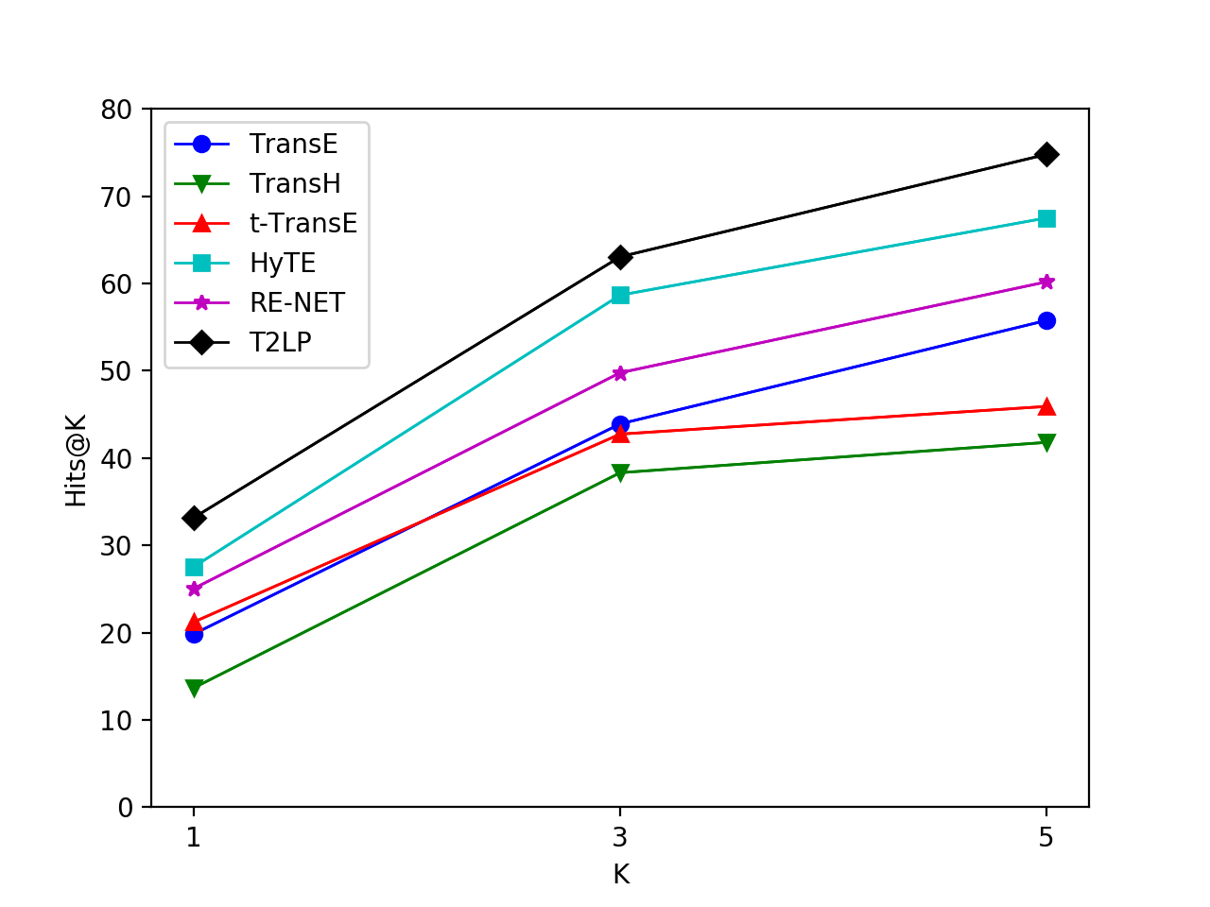
relation_prediction(YAGO)
Method | MRR | Hits@1 | Hit@3 | Hits@5
TransE | 43.23 | 19.85 | 43.91 | 55.76
TransH | 40.27 | 13.68 | 38.32 | 41.79
t-TransE | 41.69 | 21.22 | 42.74 | 45.91
HyTE | 52.35 | 27.55 | 58.66 | 67.5
RE-NET | 48.32 | 25.06 | 49.77 | 60.18
T2LP | 63.75 | 33.18 | 63.05 | 74.78

Slide 8
Thanks

