Slide 1
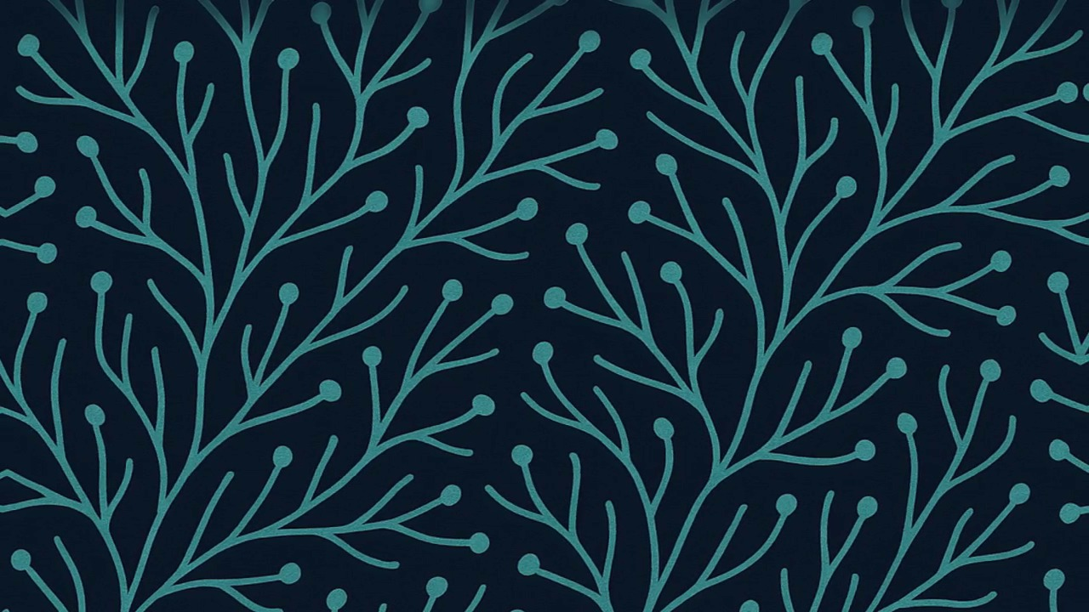
GuardSpine
Cryptographic Proof for Every AI Decision
The governance spine for AI-generated code, documents, spreadsheets, and images.
Angel Investor Brief | February 2026
David Youssef, CEO | david@guardspine.io | github.com/DNYoussef

Slide 2
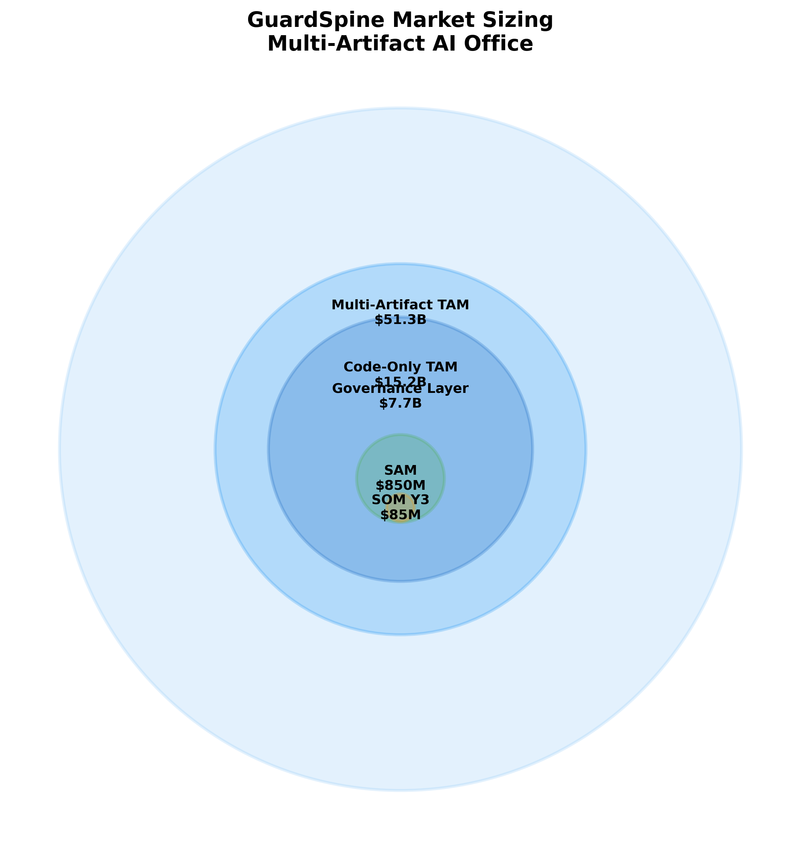
Every AI Decision Is a Liability Without Proof
$51B total addressable market across all AI artifact types
No competitor governs docs, spreadsheets, or images
EU AI Act enforcement: Aug 2, 2026 (7% turnover fines)
SOX, HIPAA, and DORA all require tamper-proof audit trails
Enterprises use AI daily but cannot prove what it did
Sources: EU AI Act Art. 99; Gartner AI governance TAM 2025

Slide 3
The $51B Governance Gap Opens August 2026
EU AI Act enforcement begins Aug 2, 2026
79% of enterprises adopted agentic AI (Capgemini Feb 2026)
AI agents write code, draft contracts, edit spreadsheets
Zero tools provide cross-artifact governance today
First-mover window: 6-12 months before incumbents react
79%
of enterprises now use agentic AI
but none can prove what the AI did, who approved it, or whether it was safe.
Source: Capgemini Research Institute, Feb 2026

Slide 4
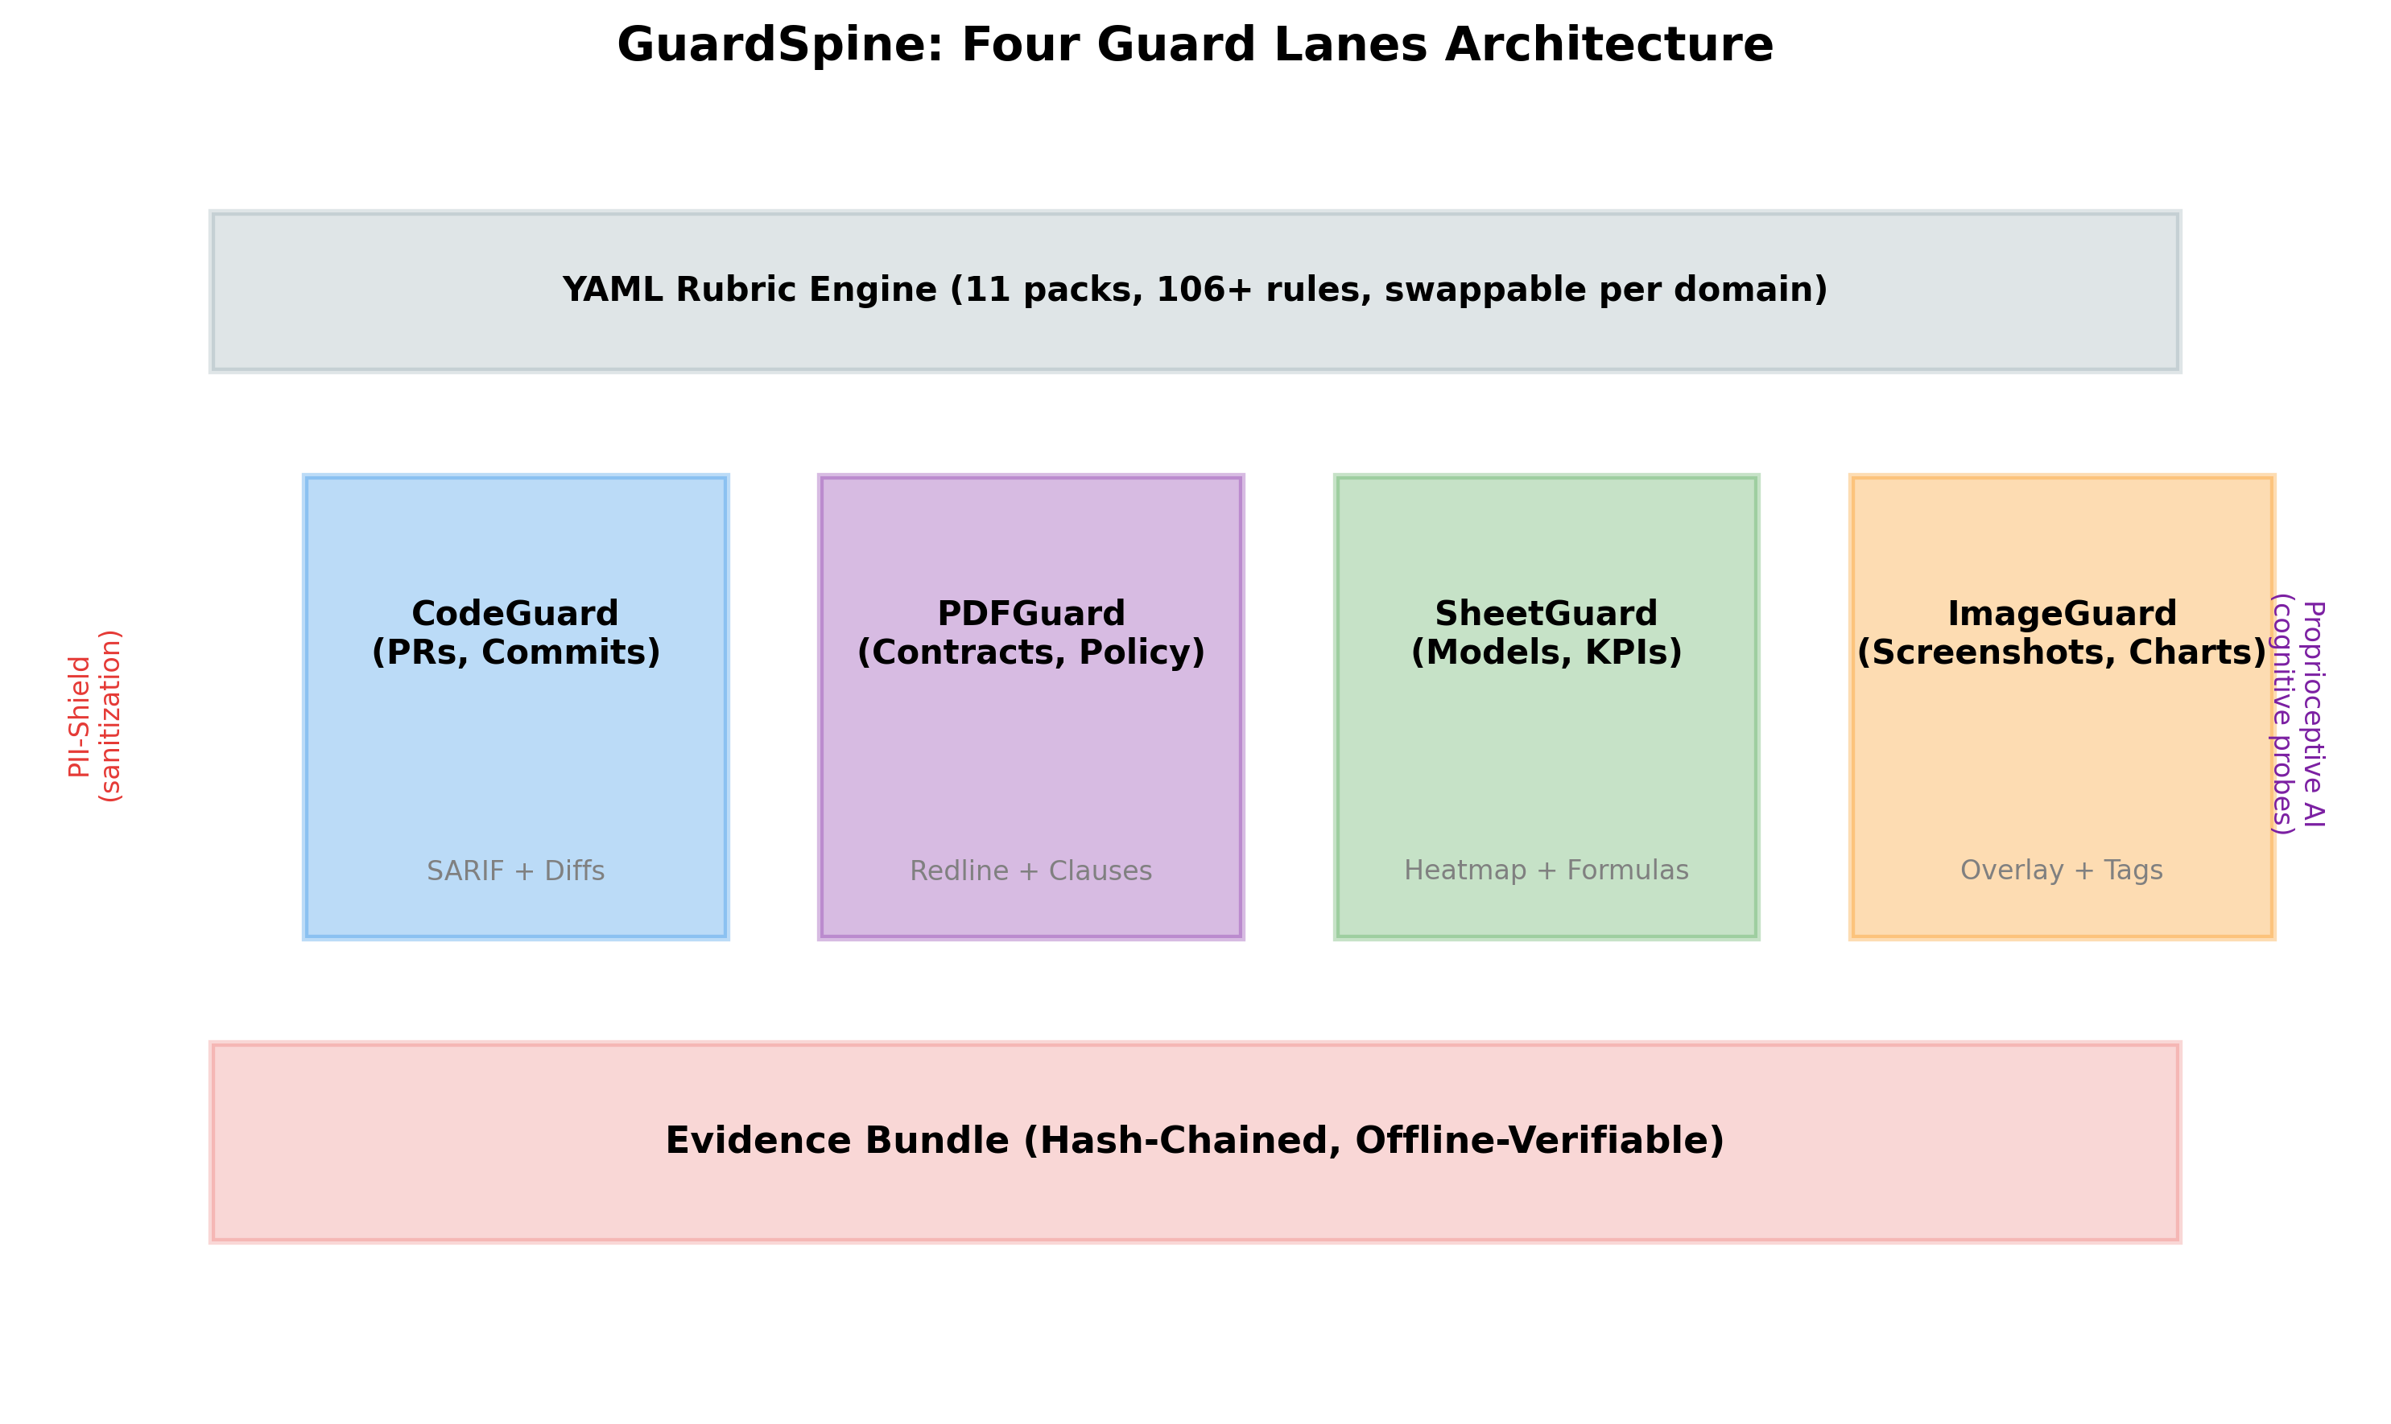
We Answer One Question: Are We in Control?
AI reviews every change (code, PDF, spreadsheet, image)
Risk tier assigned: auto-pass to executive approval
Hash-chained evidence bundle created per decision
Decision card posted: APPROVED / CONDITIONAL / BLOCKED
Escalation policies enforce SLAs by risk tier

Slide 5
We Guard What Nobody Else Touches
Lane | What It Guards | File Types | Status
CodeGuard | Pull requests, commits, CI | Any code | Live (v1.0.1)
PDFGuard | Document revisions, contracts | .pdf | Beta
SheetGuard | Spreadsheet changes, KPIs | .xlsx, .xlsm | Beta
ImageGuard | Visual asset swaps | .png, .jpg, .tiff | Roadmap
Every competitor stops at code. We govern all AI artifacts.

Slide 6
87-91% Margins on Zero Inference Cost
Bring Your Own Key: customers supply their LLM API keys.
Open-Core Model
Tier | Price/mo | Gross Margin
Team | $2,000 | 87.5%
Org (Multi-Lane) | $5,000 | 90.0%
Enterprise | $12,000 | 91.3%
FREE: Spec, kernels, GitHub Action (Apache 2.0)
PAID: Dashboard, multi-lane guards, SSO, workflows
Complements SBOM: we track what HAPPENED to code
Industry average SaaS margin: 70-80%

Slide 7
85% Built. Revenue in Weeks, Not Months.
Platform
AI & Governance
24-page React 19 + FastAPI application
33 backend services, 149+ API routes
SSO (Okta, Entra ID, Google) + role-based access
428 tests passing, full CI pipeline
12 public repos on GitHub (Apache 2.0)
codeguard-action live on GitHub Marketplace
13 compliance rubric packs (SOX, HIPAA, SOC2...)
4 AI providers with multi-model consensus
Entropy-based secret detection (PII-Shield)
Cross-language hash parity (TypeScript + Python)
Team tier ships in 1-2 weeks. Org tier ships in 2-3 weeks.

Slide 8
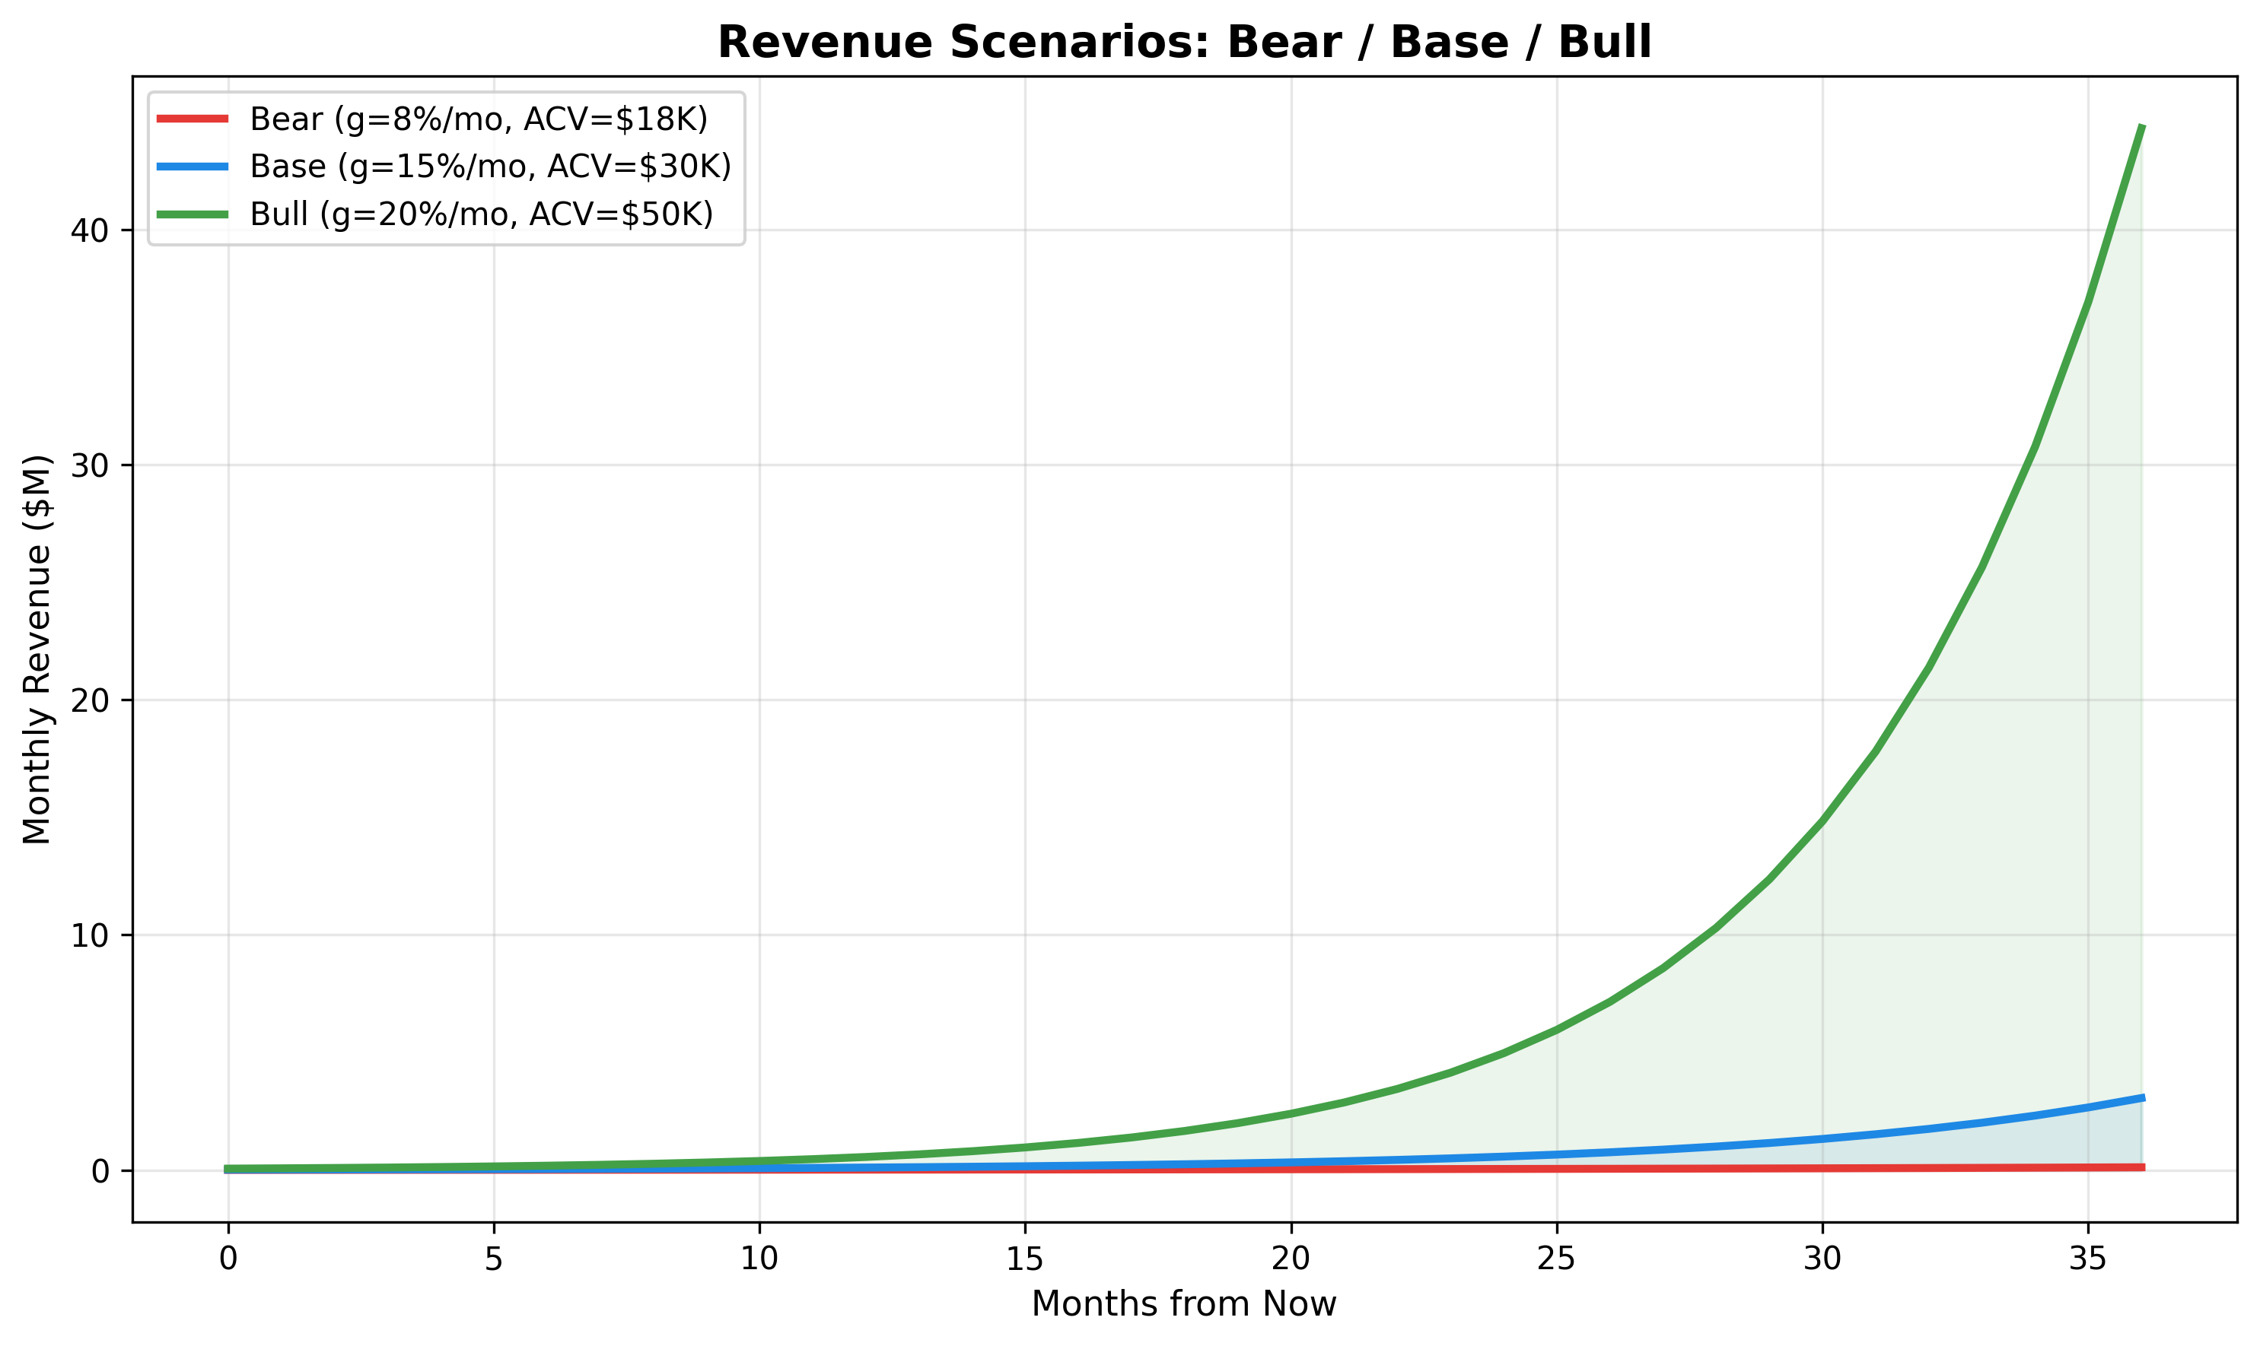
Conservative Path to $36.8M ARR by Year 3
Why These Numbers Are Achievable
Scenario | Year 1 ARR | Year 3 ARR
Bear | $228K | $1.4M
Base | $1.28M | $36.8M
Bull | $6.7M | $535M
EU AI Act creates forced buying event in Aug 2026
Product is 85%+ built -- not a pitch, not a prototype
Multi-lane expansion drives 120-130% net revenue retention
Zero inference cost = no margin compression at scale
Base case is the planning scenario.

Slide 9
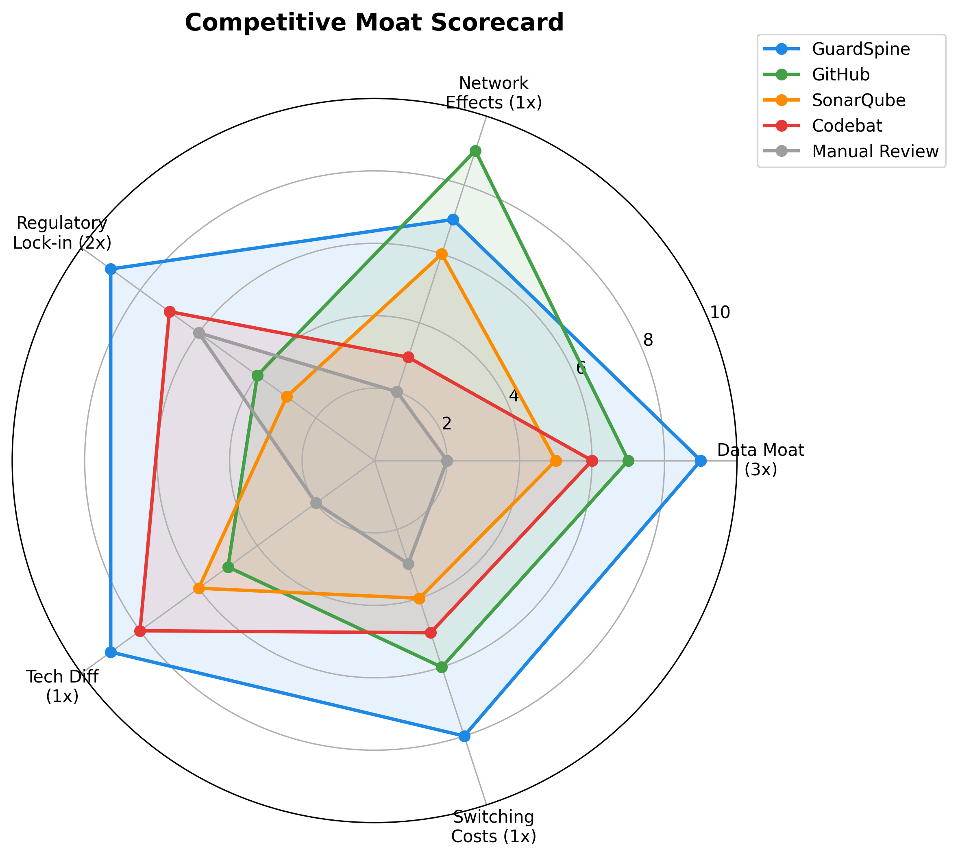
9 of 9 Governance Dimensions. Nearest Rival: 3.
Hash-chained evidence: cryptographic proof, not just logs
Model-neutral: any LLM provider, including airgapped deploys
Complements SBOM: SBOM tracks components, we track decisions
Z-Inspection alignment: third-party trustworthy AI methodology
Four artifact lanes vs. competitors' code-only approach
Source: Internal analysis of 7 named competitors, Feb 2026

Slide 10
Built by Engineers Who Ship, Not Consultants Who Advise
David built GuardSpine after watching AI-generated code ship to production with zero oversight -- and no way to prove what happened.
Strategic Partners
Person | Role | Background
David Youssef | CEO / Architect | AI systems eng, 12-repo platform
Igor Malovitsa | CTO | 13yr commercial eng, Rust, crypto
Kristen Hengst Smith | GTM | Product-to-market, angel network
Partner | Value
Ishwar (IBM / Z-Inspection) | Enterprise validation
Jacob (G7 AI governance) | Standards + gov access
Chris Hood (ex-Google) | Advisor, 7yr Google, USPTO
Triangle Strategy: IBM pilot + G7 standards + cognitive patents. 2 of 4 gates done.

Slide 11
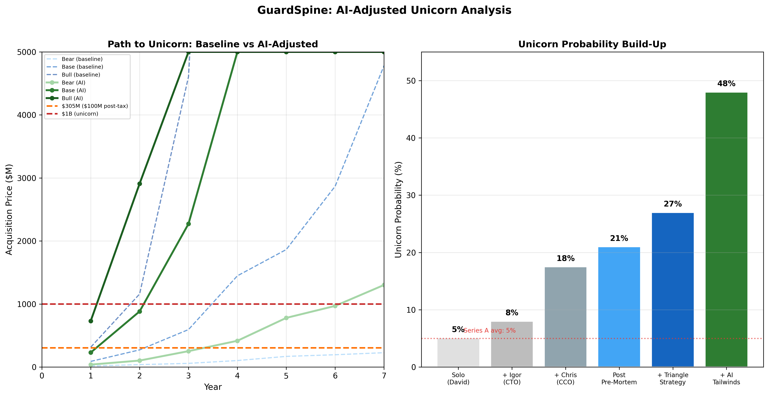
$1M Buys 6.25% of a $15M Pre-Money Company
25 months of runway at $40K/mo burn
Milestones This Round Funds
Category | Amount
Founder compensation (2yr) | $480K
Engineering hire | $200K
Legal & compliance (SOC2, patents) | $120K
Infrastructure + sales | $160K
Contingency | $40K
Ship Team + Org tiers (weeks 1-3)
First 5 enterprise design partners
SOC 2 Type I certification
AWS + Azure Marketplace listings
IBM pilot via Ishwar (Q3 2026)
Investor Return Math
At base-case $316M exit: $62.5K investment becomes $1.2M (20x). 34% base probability, 48-52% with AI tailwinds.

Slide 12
Every AI decision. Governed. Proved. Trusted.
We are building the world where enterprises ship AI with confidence -- not because they trust the model, but because they can prove every decision it made.
David Youssef | david@guardspine.io | github.com/DNYoussef
Confidential -- intended for named recipient only.

