Slide 1
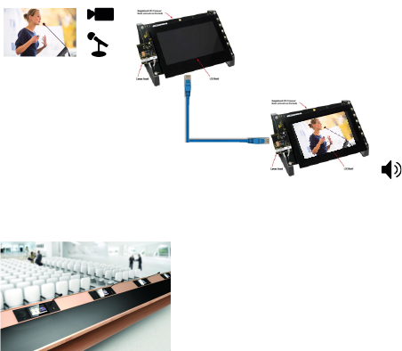

Exploration of the TI AM5728 Audio/Video Subsystem
Dennis Joosens
In this master thesis we investigate if it is feasible to develop a proof of concept videoconferencing system having a maximum end-to-end latency of 25 ms.
The project is executed by using the Texas Instruments AM5728 EVM development board.
The system will be used in big conference halls. In such rooms it is sometimes impossible to hear or see the person speaking in front of the room.

