Slide 1

SRIT Intern Portal Hub
SRIT Intern Portal Hub
by
D. Neha Anjum
Roll No. 224G1A0559
V. Meghana
Roll No. 234G5A0507
S. Mohammad Anees
Roll No. 224G1A0553
Under the guidance of
Dr. D. Rajesh Babu _{M.Tech.,} _{(Ph.D)}
_{Associate Professor}
Department of Computer Science and Engineering
Srinivasa Ramanujan Institute of Technology
Autonomous
Rotarypuram Village, B K Samudram Mandal, Ananthapuramu – 515701.
2025-2026
A-8
DEPT. OF COMPUTER SCIENCE AND ENGINEERING
Srinivasa Ramanujan Institute of Technology
1

Slide 2
Contents
SRIT Intern Portal Hub
Title Justification
Abstract
Problem statement
Objectives of Project
Literature survey for objectives
Proposed Work -(Methods to be followed for proposed system)
References
GitHub Link
Queries
Srinivasa Ramanujan Institute of Technology

Slide 3
Title Justification
SRIT Intern Portal Hub
Project Title:
SRIT Intern Portal Hub
Justification:
The title “SRIT Intern Portal Hub” represents a centralized web-based system designed to manage and streamline internship-related activities for students, faculty, and administrators.
The word “SRIT” signifies that the system is developed specifically for the institution, ensuring an organized and institution-focused internship management solution..
“The term “Intern” reflects the project’s core objective of supporting students in exploring, applying for, and tracking internship opportunities that align with their academic and career goals.
The phrase “Portal Hub” highlights the role of the system as a single unified platform where users can register, browse available internships, submit applications, and monitor application status.
Overall, the title clearly conveys the project’s purpose of simplifying the internship process, reducing manual effort, and providing a structured, user-friendly digital solution that improves efficiency and transparency in real-world academic environments.
Srinivasa Ramanujan Institute of Technology

Slide 4
Abstract
SRIT Intern Portal Hub
Internship management in educational institutions often involves manual processes and scattered communication, which can lead to inefficiency, delays, and lack of transparency for students and faculty. To address this challenge, this project presents the “SRIT Intern Portal Hub,” a centralized web-based platform designed to simplify and organize the process of finding, applying for, and managing campus internship opportunities.The main objective of the system is to provide a unified portal where faculty can post internship and job openings, share updates, and track student applications, while students can securely log in, view available opportunities, and submit applications without manual paperwork. The portal also enables faculty to review submitted profiles, shortlist candidates, and manage the entire selection process efficiently through a structured workflow.
The proposed system improves communication between students and faculty, reduces administrative workload, and saves time by automating internship-related activities. Overall, the SRIT Intern Portal Hub offers a transparent, user-friendly, and efficient solution for internship management, making it highly suitable for real-world academic environments and institutional deployment.
Srinivasa Ramanujan Institute of Technology

Slide 5
Problem Statement
SRIT Intern Portal Hub
Internship and job opportunity management within educational institutions is an important aspect of student career development. However, existing practices are largely unstructured and rely on manual communication, making it difficult for students to access all available opportunities through a single platform. These methods often result in missed opportunities for students and inefficiencies in tracking applications.
Furthermore, there is no unified system that enables faculty to post internship and job openings, monitor student participation, and manage application submissions effectively. Due to the lack of centralization, faculty face challenges in shortlisting candidates, approving applications, and maintaining transparency. Therefore, there is a need for a centralized and systematic online platform that can efficiently organize postings, student applications, and the entire selection workflow to support transparent and effective campus internship management.
Srinivasa Ramanujan Institute of Technology

Slide 6
Objectives of Project
SRIT Intern Portal Hub
1. Research Objective
To develop a centralized and intelligent online internship management portal that enables faculty to post campus internship and job opportunities and allows students to securely view and apply for them through a user-friendly interface.
2. Objectives of the Internship Management System
To design a unified platform that simplifies internship and job opportunity sharing across all departments and provides students with easy access to apply and track their applications.
To build an efficient system that supports faculty in reviewing applications, shortlisting candidates, updating application status, and managing the entire selection workflow in an organized and transparent manner.
To integrate an AI-based resume generation feature that assists students in creating a professional and well-structured resume instantly using the information provided by them.
Srinivasa Ramanujan Institute of Technology

Slide 7
SRIT Intern Portal Hub
Literature survey for objectives
No | Title | Authors & Year | Journal Name | Methodology Adapted | Key Findings | Gaps
1. | Design and Development of Placement Management System for Academic Institutions | S. Patel, K. Desai – 2024 | IRJET | Web-based placement portal, centralized posting system | Reduces missed notifications. | No automation for selection.
2. | Automated Recruitment and Shortlisting System | A. Kumar, R. Mishra – 2024 | IJRTE | Automated filtering and scoring algorithms | Faster, accurate | No student-side modules.
3. | AI-Based Resume Builder Using NLP and Machine Learning | P. Sharma, M. Singh – 2025 | IRJET | NLP-based resume generation using ML templates | Produces clean resumes. | Limited customization.
Srinivasa Ramanujan Institute of Technology

Slide 8
Proposed System
SRIT Intern Portal Hub
The proposed system is a centralized web-based portal designed to manage campus internship and job opportunities in an organized and efficient manner. Faculty members can post internship and job openings through the portal, making them accessible to all eligible students in a single platform.
Students can securely log in to the system, view available opportunities, and submit their applications through a simple and user-friendly interface. The system stores student profiles and application details systematically to support easy tracking and management.
Faculty are provided with a dedicated dashboard where they can review all submitted applications, verify student details, shortlist or reject candidates based on eligibility, and update application statuses to ensure transparent communication.
Additionally, the system integrates an AI-powered resume generation feature that helps students create professional resumes using the information they provide. This feature enhances the quality of applications and improves the overall efficiency of the internship selection process.
Srinivasa Ramanujan Institute of Technology

Slide 9
References
SRIT Intern Portal Hub
[1] C. Lee, “Virtual Internships as Alternative Work-Based Learning,” Education and Information Technologies, 2025.
[2] M. Deepa, S. Naveen, B. Sachin, K. Vasanthan, and L. Rahill Rifaq, “Smart Internship Portal for Students and Companies,” International Journal of Progressive Research in Engineering Management and Science (IJPREMS), vol. 5, no. 10, pp. 1634–1641, Oct. 2025.
[3] C. Lal, P. Chandrakar, and V. Sahu, “InternConnect: A Smart Internship Finder Portal,” International Journal of Innovative Science and Research Technology (IJISRT), vol. 10, no. 5, pp. 3544–3545, May 2025, doi: 10.38124/ijisrt/25may2247.
Srinivasa Ramanujan Institute of Technology

Slide 10
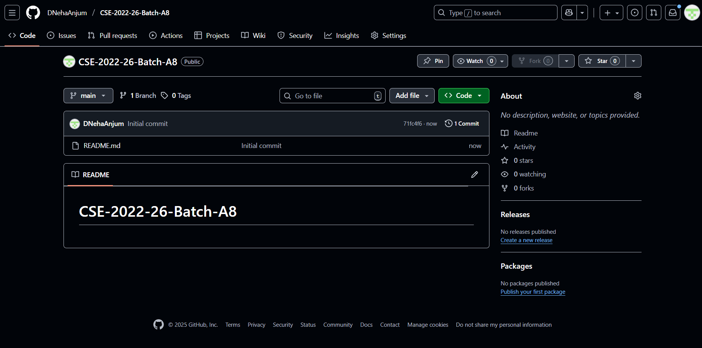
Git Hub Dashboards of each student
SRIT Intern Portal Hub
GitHub Link : https://github.com/DNehaAnjum/CSE-2022-26-Batch-A8
Srinivasa Ramanujan Institute of Technology

Slide 11
Any Queries?
SRIT Intern Portal Hub
Srinivasa Ramanujan Institute of Technology

