Slide 1

Real-Time Fire and Smoke Detection System Using YOLOv9 with Intelligent Alerting
by
D. Neha Anjum
Roll No. 224G1A0559
V. Meghana
Roll No. 234G5A0507
S. Mohammad Anees
Roll No. 224G1A0553
Under the guidance of
Dr. D. Rajesh Babu _{MTech,} _{PhD}
_{Associate Professor}
Department of Computer Science and Engineering
Srinivasa Ramanujan Institute of Technology
Autonomous
Rotarypuram Village, B K Samudram Mandal, Ananthapuramu – 515701.
Accredited by NBA & NAAC with “A” Grade,Affiliated to JNTUA,Ananthapuramu
2025-2026

Slide 2
Contents
Abstract
Introduction
Literature Survey
Existing System
Proposed System
Planning
Design
Implementation
Research Paper
References
GitHub Link

Slide 3
Abstract
This work presents an improved fire detection system based on the YOLOv9 deep learning model for real-time detection of fire and smoke from live surveillance video streams.
The system continuously monitors video feeds and generates confidence scores for detected fire or smoke regions to ensure accurate and reliable detection.
To reduce false alarms caused by environmental disturbances such as dust or lighting variations, temporal validation is performed across consecutive frames before confirming a fire incident.
After validation, the system classifies fire severity into low, medium, and high levels, enabling prioritized emergency response and effective fire management.
Once a fire is confirmed, an automatic emergency alert is triggered and all detection details are logged for future analysis, safety audits, and system performance improvement.

Slide 4
Introduction
Fire accidents pose a serious threat to human life and infrastructure, and existing fire detection systems often suffer from delayed response and high false alarm rates.
With the increasing availability of surveillance cameras, computer vision–based fire detection has emerged as an effective solution for continuous and large-area monitoring.
Recent advances in deep learning, particularly the YOLOv9 model, enable fast and accurate real-time detection of fire and smoke from video streams.
This work focuses on developing an improved YOLOv9-based fire detection system that reduces false alarms, identifies fire severity, and triggers automated emergency alerts to enhance overall safety.

Slide 5
Literature Survey
Literature survey for objectives
Author(s) | Year | Methodology Used | Implementation | Limitations
Remmelzwaal, L. | 2025 | Artificial intelligence-based image analysis for early fire detection using high-definition cameras. | Implemented a real-time fire detection framework that processes HD camera video streams using AI algorithms to identify fire patterns and smoke features in surveillance footage. | Performance may decrease in low visibility conditions and requires high computational resources for processing high-resolution video streams.
Morchid, A., Alblushi, I. G. M., Khalid, H. M., El Alami, R., Said, Z., Qjidaa, H., & Jamil, M. O. | 2025 | IoT-based smart agriculture fire detection using embedded systems and machine-to-machine communication protocols. | Developed an integrated system combining sensors, embedded devices, and IoT communication to detect fire incidents in agricultural environments and transmit alerts through networked devices. | Sensor-based systems may suffer from delayed detection and limited coverage compared to vision-based detection approaches.
Salaria, A., & Singh, A. | 2025 | Analysis and selection of wireless communication technologies for forest fire detection networks. | Proposed a framework evaluating multiple wireless communication technologies to improve reliability and communication efficiency in early forest fire detection systems. | Focuses mainly on communication infrastructure rather than improving fire detection accuracy or real-time visual monitoring.
Wilk-Jakubowski, J. L., Loboichenko, V., Divizinyuk, M., Wilk-Jakubowski, G., Shevchenko, R., Ivanov, S., & Strelets, V. | 2025 | Review of acoustic wave-based fire detection combined with artificial vision systems. | Investigated the use of acoustic signals along with vision-based detection methods to identify fire-related events and environmental changes. | Acoustic-based detection can be sensitive to environmental noise and may produce false detections in noisy environments.
Mia, M. M. | 2025 | Review of artificial intelligence-enabled fire detection and suppression technologies for building safety. | Analyzed various AI-based fire detection systems and their integration with automated fire suppression mechanisms in modern buildings. | Primarily a review study without implementing a specific real-time fire detection system or experimental validation.

Slide 6
Existing System
Traditional fire detection systems mainly rely on sensor-based methods such as smoke detectors, heat sensors, and gas sensors, which often detect fire only after smoke or temperature levels reach a threshold, resulting in delayed detection.
Many existing computer vision-based fire detection approaches use conventional image processing techniques or basic convolutional neural network models, which analyze single frames and are sensitive to environmental variations such as lighting changes, reflections, and background motion.
Several existing detection models perform frame-by-frame fire detection without temporal validation, which can lead to high false alarm rates when visual disturbances such as dust, fog, or sunlight reflections appear similar to fire or smoke.
Most current systems focus only on binary fire detection (fire or no fire) and do not provide additional functionalities such as fire severity classification, automatic alert generation, or detailed event logging, which limits their practical usability in real-world surveillance environments.

Slide 7
Proposed System
The proposed system utilizes an improved YOLOv9 deep learning model to perform real-time detection of fire and smoke from live surveillance video streams, enabling faster and more accurate identification of fire incidents.
A temporal validation mechanism is introduced to analyze detections across multiple consecutive frames, which helps reduce false alarms caused by environmental disturbances such as dust, lighting variations, or reflections.
After confirming a fire incident, the system performs fire severity classification by categorizing the detected fire into low, medium, and high levels based on fire size, smoke density, and detection confidence.
The system includes an automatic emergency alert and event logging mechanism, which sends alerts with location, time, and severity information while storing detection records for future analysis, safety audits, and system performance improvement.

Slide 8
Planning
Fire and Smoke Video Dataset A diverse dataset consisting of fire and smoke images and video frames captured under different environments, lighting conditions, and fire intensities is used to train and validate the YOLOv9 model.
Real-Time Video Input Module Live video streams collected from surveillance cameras serve as real-time input for continuous fire monitoring and detection.
YOLOv9 Detection and Validation Module This module processes the input frames using the YOLOv9 model and performs temporal validation to reduce false alarms and confirm genuine fire incidents.
Severity Classification and Alert Module Confirmed fire detections are classified into severity levels, and automatic emergency alerts and event logs are generated for effective response and analysis.

Slide 9
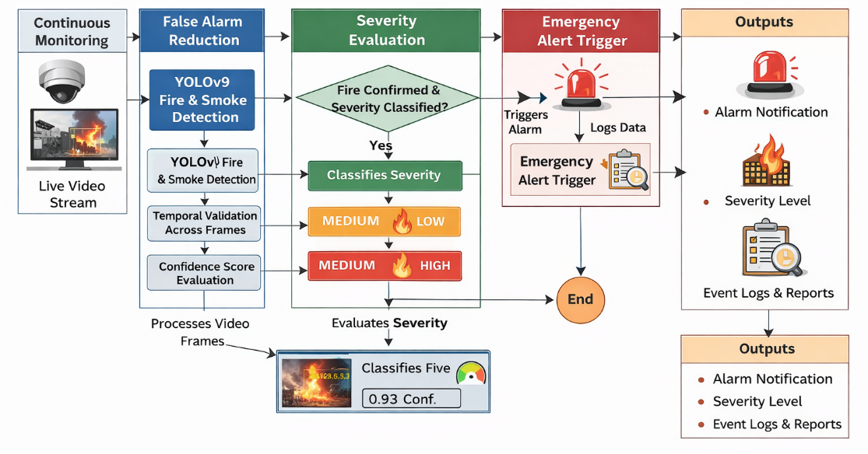
System Architecture

Slide 10
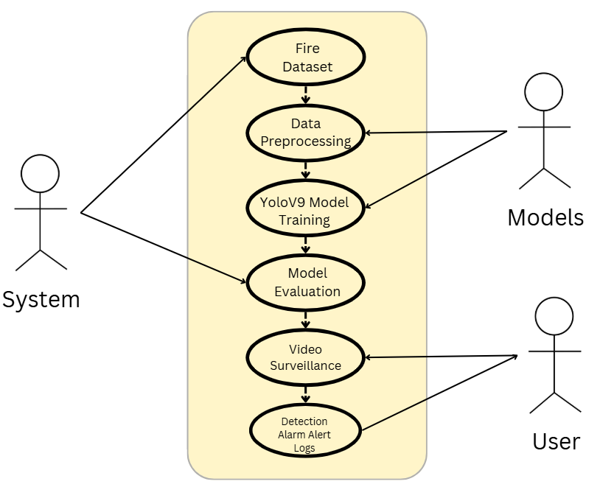
Use Case Diagram
The UML use case diagram for the proposed YOLOv9-based fire detection system represents the interactions between users and system components across all major stages, including dataset handling, preprocessing, model training, testing, and user interface operations. In the dataset stage, the user or administrator uploads fire and smoke image and video datasets, which are then preprocessed by the system through frame extraction, resizing, normalization, and annotation to ensure data consistency. During model training, the system uses the preprocessed dataset to train the YOLOv9 model, learning discriminative fire and smoke features, followed by model testing and validation to evaluate detection accuracy and reliability. In the deployment phase, the trained model is integrated with the user interface, where users can provide live camera input or recorded video for real-time fire detection.

Slide 11
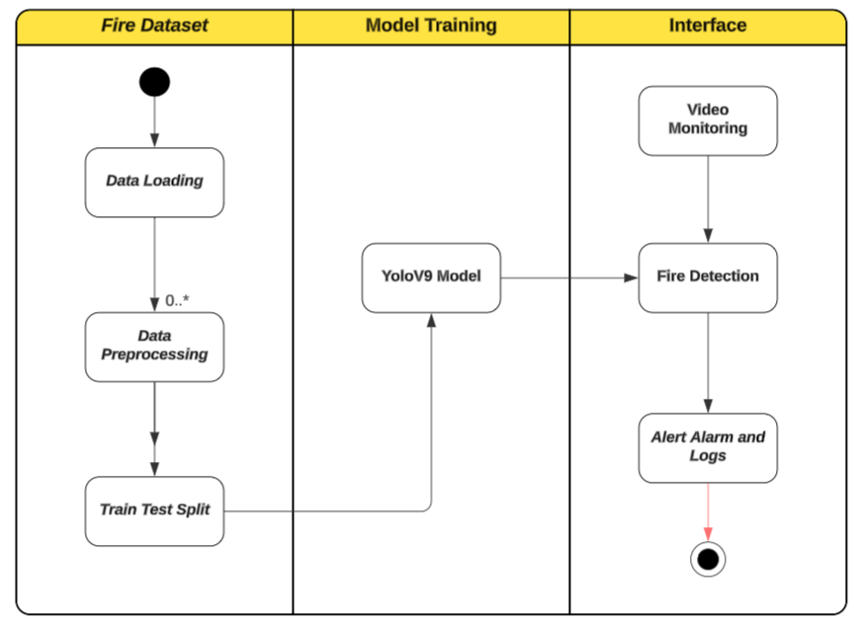
Activity Diagram
The activity diagram of the proposed YOLOv9-based fire detection system illustrates the complete operational workflow from data input to emergency response in a sequential and decision-driven manner. The process begins with capturing live video streams or loading recorded video data, followed by frame extraction and preprocessing to prepare the input for analysis. Each frame is then passed to the trained YOLOv9 model for fire and smoke detection, where a decision node checks whether fire or smoke is detected. If no fire is identified, the system continues monitoring the video stream; if fire or smoke is detected, the workflow proceeds to temporal validation, where detections are verified across consecutive frames to eliminate false alarms.

Slide 12
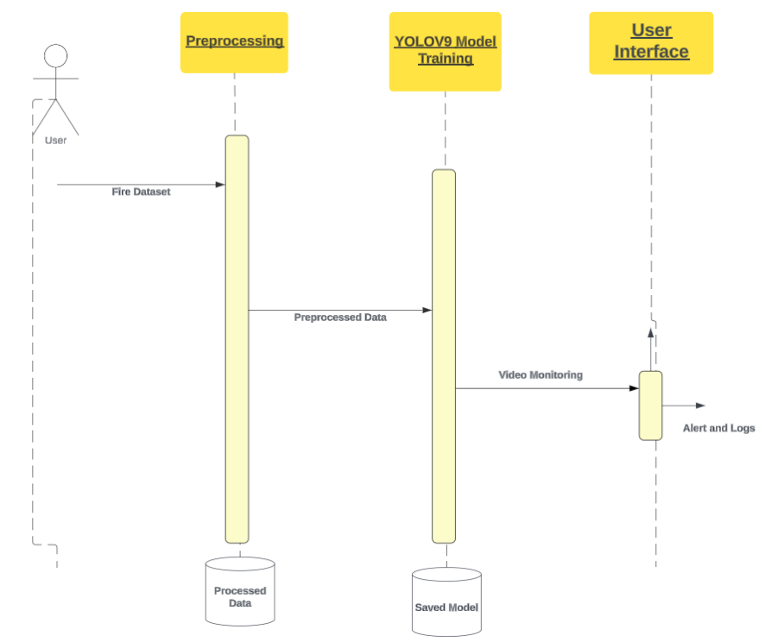
Sequence Diagram
The sequence diagram of the proposed YOLOv9-based fire detection system depicts the step-by-step interactions between the system components and the user for real-time fire monitoring and response. The sequence begins with the user or surveillance system providing live video input, which is sent to the preprocessing module for frame extraction, resizing, and normalization. The preprocessed frames are then passed sequentially to the YOLOv9 detection module, which analyzes each frame for fire or smoke and returns detection results along with confidence scores. These results are forwarded to the temporal validation module, where consecutive-frame consistency is checked to confirm genuine fire incidents and reduce false alarms. Once validated, the severity classification module determines the intensity of the fire as low, medium, or high. Based on the classification, the alert generation module automatically triggers emergency notifications, while the logging module records event details such as time, severity, and confidence scores for future analysis.

Slide 13
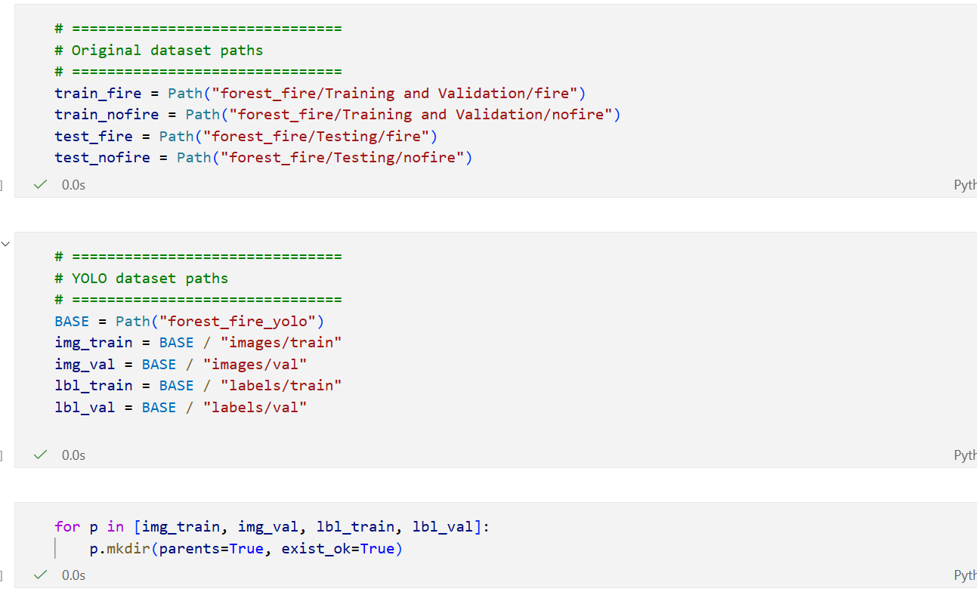
Implementation
Loading Datasets

Slide 14
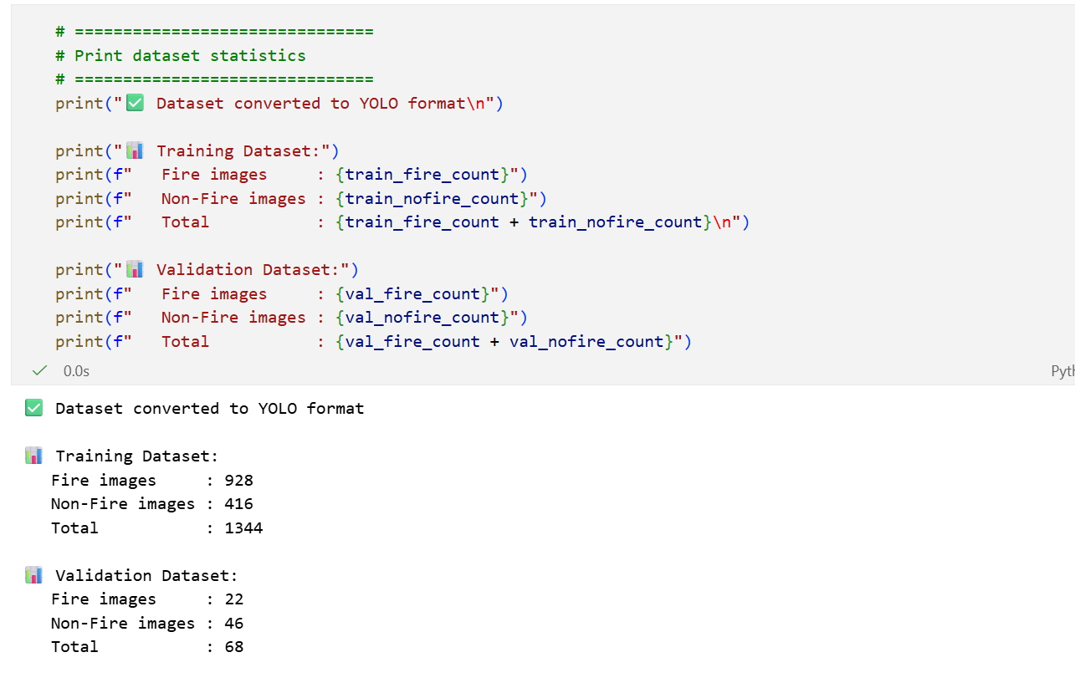
Implementation
Dataset Statistics

Slide 15
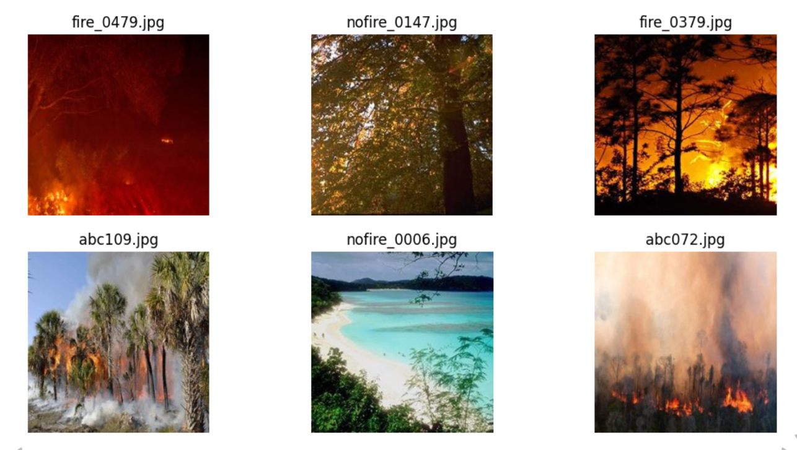
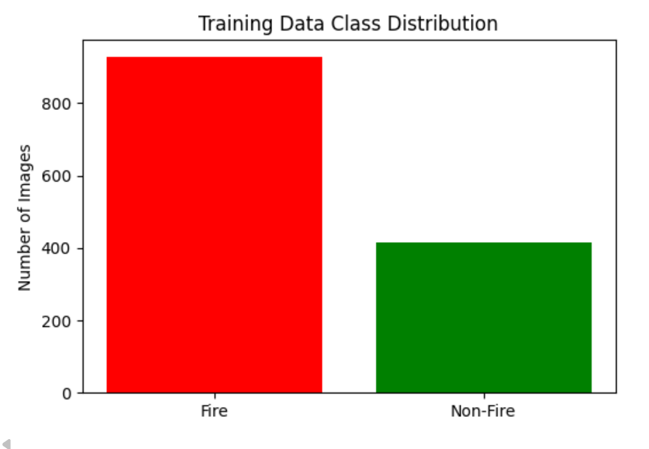
Implementation
Sample Images of Data

Slide 16

Research Paper

Slide 17
References
Remmelzwaal, L. (2025). An AI-based early fire detection system utilizing HD cameras and real-time image analysis. In Artificial Intelligence and Applications.
Morchid, A., Alblushi, I. G. M., Khalid, H. M., El Alami, R., Said, Z., Qjidaa, H., ... & Jamil, M. O. (2025). Fire detection and anti-fire system to enhance food security: A concept of smart agriculture systems-based IoT and embedded systems with machine-to-machine protocol. Scientific African, 27, e02559.
Salaria, A., & Singh, A. (2025). A guide for selection of wireless communication technology for effective and robust early forest fire detection system. Bulletin of Electrical Engineering and Informatics, 14(2), 1026-1035.
Wilk-Jakubowski, J. L., Loboichenko, V., Divizinyuk, M., Wilk-Jakubowski, G., Shevchenko, R., Ivanov, S., & Strelets, V. (2025). Acoustic Waves and Their Application in Modern Fire Detection Using Artificial Vision Systems: A Review. Sensors (Basel, Switzerland), 25(3), 935.
Mia, M. M. (2025). A REVIEW ON THE INFLUENCE OF AI-ENABLED FIRE DETECTION AND SUPPRESSION SYSTEMS IN ENHANCING BUILDING SAFETY. Review of Applied Science and Technology, 4(04), 36-73.

Slide 18
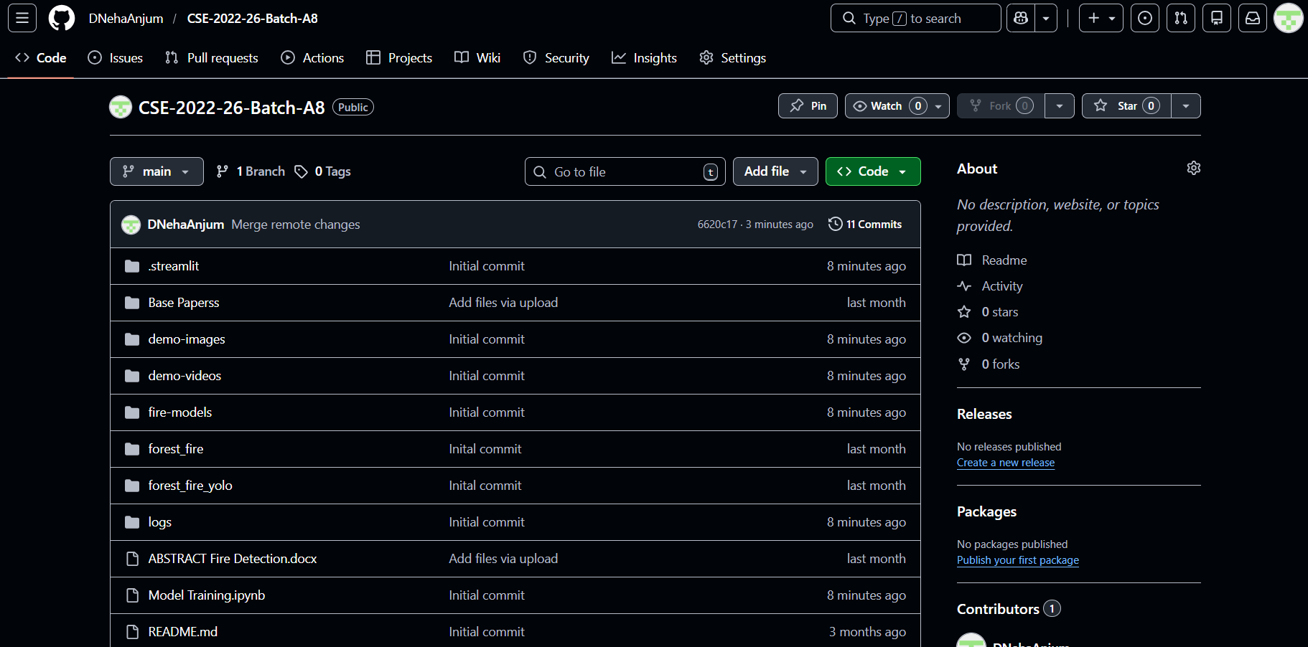
Github Link
Link: DNehaAnjum/CSE-2022-26-Batch-A8

Slide 19
Thank You!!!

Slide 20
Any Query?

Slide 21
Comments

