Slide 1

CSI-535/435 ECE-660 Introduction to Artificial Intelligence
Prof. Ming-Ching Chang University at Albany – SUNY mchang2@albany.edu
TA: Yuwei Chen ychen69@albayn.edu
TuTh 10:30 – 11:50am Aug. 26 – Dec. 9 Fall 2019
Room: ES-241
Office Hour: Th 8:30pm – 10:30pm (On Zoom, by appointment)
TA Office Hour: Th 1:30-3pm

Slide 2
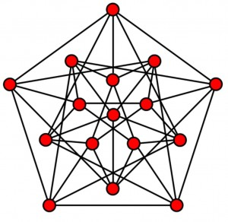

Today
Intro to Python Programming
Review on Graph Theory
Graph Search Lab

Slide 3
Intro to Python Programming
Python course tutorial at www.python-course.eu/course.php
Why Python?
Interactive Mode
Execute a Script
Structuring with Indentation
Data Types and Variables
Operators
input and raw_input via the keyboard
Conditional Statements
While Loops
For Loops
Formatted output
Output with Print
Sequential Data Types
List Manipulation
Dictionaries
Sets and Frozen Sets
Shallow and Deep Copy

Slide 4
Intro to Python Programming
Python course tutorial at www.python-course.eu/course.php
Functions
Recursion and Recursive Functions
Tests, DocTests, UnitTests
Decorators
Memoization with Decorators
Passing Arguments
Namespaces
Global vs. Local Variables
File Management
Modular Programming and Modules
Regular Expressions
Regular Expressions, Advanced
Lambda Operator, Filter, Reduce and Map
List Comprehension
Generators
Exception Handling
Object Oriented Programming
Slots
Classes and Class Creation
Metaclasses
Abstract Classes

Slide 5
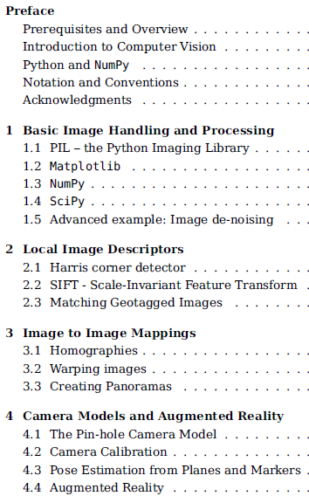
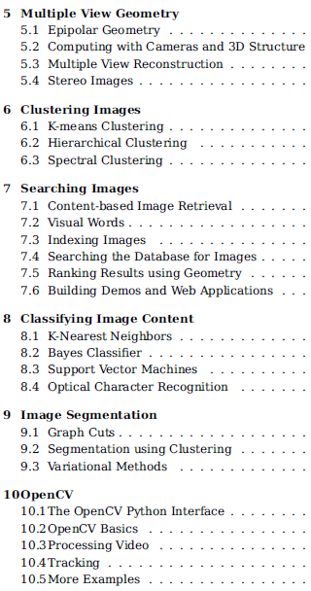
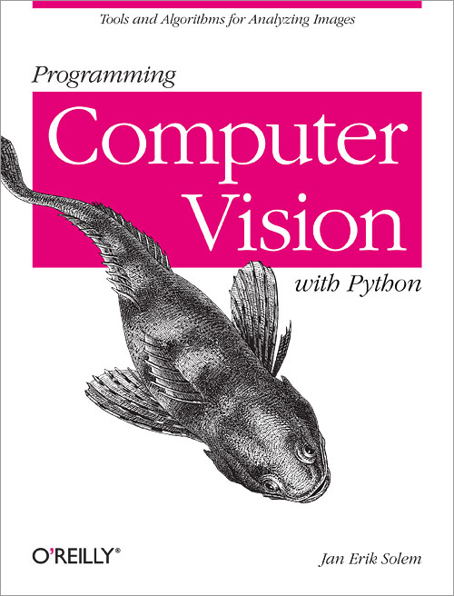
Programming Computer Vision with Python
http://programmingcomputervision.com/ 2013

Slide 6
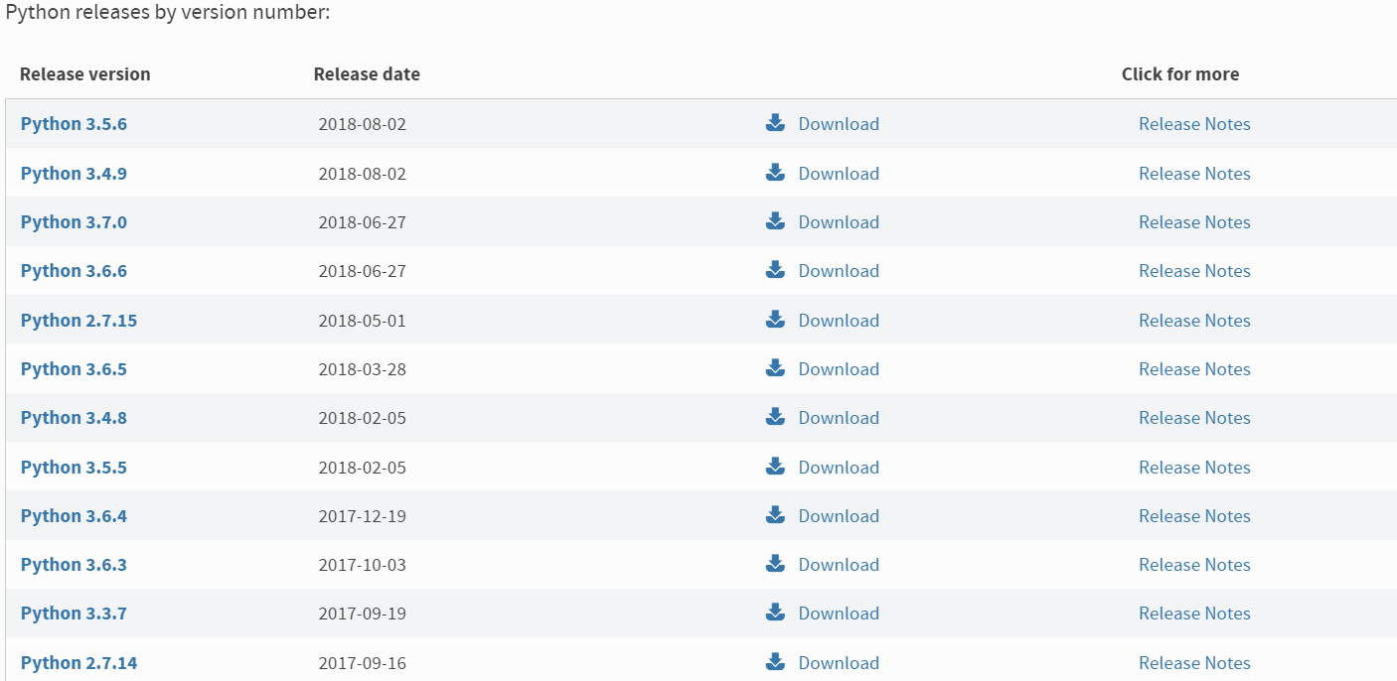
Python Installation
Python2or3? (Python3.x is recommended)
Download & installation
https://www.python.org/downloads/
https://realpython.com/installing-python/

Slide 7
Python Introduction
Interactive mode & Script mode programming
Basic syntax
Lines and indentation, if-else, for while loop, import
Basic data types
Numbers, Booleans, Strings
Containers
List, Set, Dictionary, Tuple
Functions
References:
https://www.tutorialspoint.com/python/python_basic_syntax.htm
https://github.com/kuleshov/cs228-material/blob/master/tutorials/python/cs228-python-tutorial.ipynb
http://cs231n.github.io/python-numpy-tutorial/

Slide 8
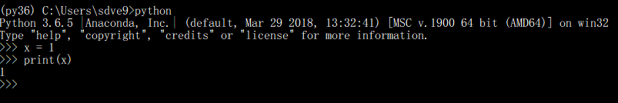

Interactive Mode & Script Mode
Interactive mode
Ipython is another powerful interactive Python shell
Script mode
Invoking the interpreter with a script parameter begins execution of the script and continues until the script is finished. When the script is finished, the interpreter is no longer active.

Slide 9
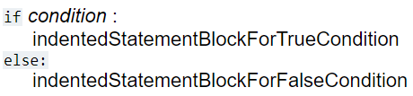
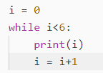

Basic Syntax
Indentation
Blocks of code are denoted by line indentation, which is rigidly enforced. The number of spaces in the indentation is variable, but all statements within the block must be indented the same amount.
Import
The import statement combines two operations; it searches for the named module, then it binds the results of that search to a name in the local scope.
If-else
For & while loop
A for loop is used for iterating over a sequence (that is either a list, a tuple, a dictionary, a set, or a string).
With the while loop we can execute a set of statements as long as a condition is true.

Slide 10
Python in Practice
Basic data types
Numbers, Booleans, Strings
Containers
List, Set, Dictionary, Tuple
Functions

Slide 11
Review – Graph Theory
Graph – Definition
Types of Graphs
Graph Data Representation

Slide 12
Graph Theory
https://en.wikipedia.org/wiki/Graph_(discrete_mathematics)
A graph is an ordered pair G = (V, E) comprising a set V of vertices (nodes or points) together with a set E of edges (arcs or lines), which are 2-element subsets of V (i.e., an edge is associated with two vertices, and the association takes the form of the unordered pair of the vertices). To avoid ambiguity, this type of graph may be described precisely as undirected and simple.
Graph Definition:
Nodes (nodes of degree k)
Links (or edges)
Notes:
https://pabii.co/instagram-algorithm-decomposition/network-to-matrix/

Slide 13
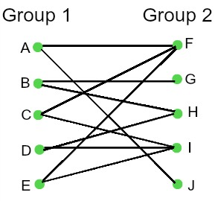
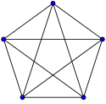
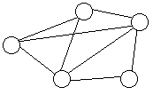
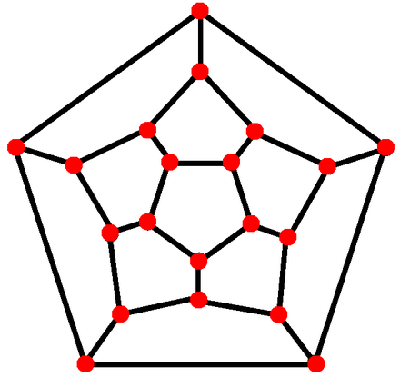
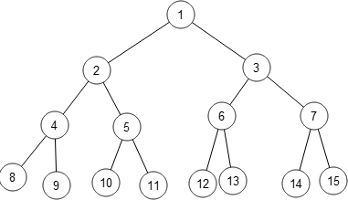
Classes of Graphs
Complete Graph
Connected Graph
Bipartite Graph
Planar Graph
Tree
Notes:
In the mathematical field of graph theory, a bipartite graph (or bigraph) is a graph whose vertices can be divided into two disjoint and independent sets U and V such that every edge connects a vertex in U to one in V. Vertex sets U and V are usually called the parts of the graph. Equivalently, a bipartite graph is a graph that does not contain any odd-length cycles.

Slide 14
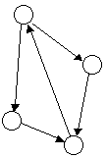
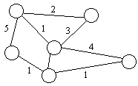
Types of Graphs
Undirected / directed graphs
Weighted/ unweighted graphs
Directed Graph
Weighted Graph

Slide 15
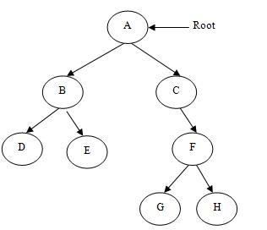
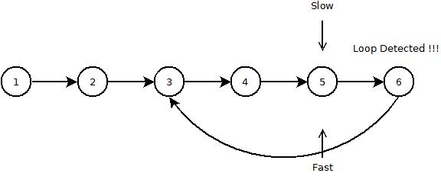
Special Cases of Graphs
Tree is an acyclic simple graph
directed / undirected tree
weighted / unweighted tree
rooted / unrooted tree
List is a special case of graph (no branching)
uni-directional list
bi-directional link list

Slide 16
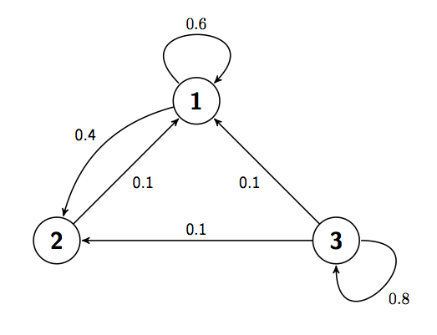
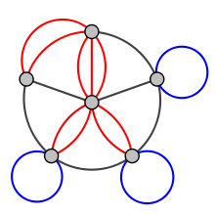
Degenerate Graphs
Node with self-loop
Multigraph - two nodes sharing > 1 (or 2) links

Slide 17
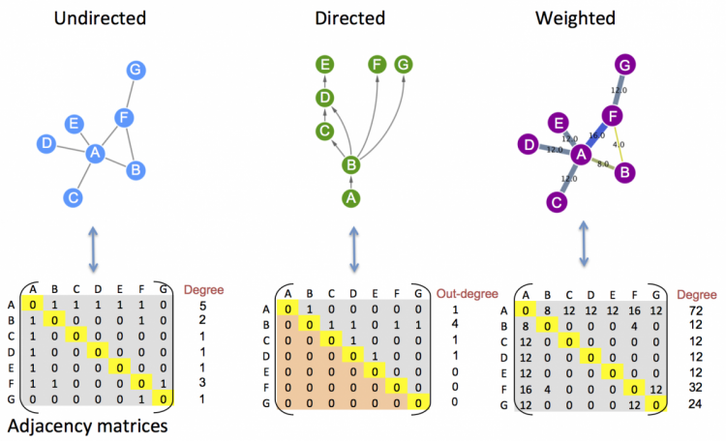
Graph Data Representation
Vertex-list
Adjacency matrix

Slide 18
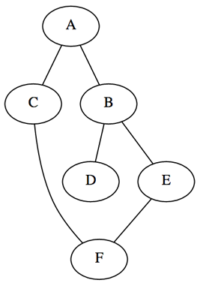
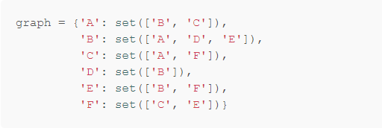
Graph Data Representation
Vertex-list
Adjacency matrix

Slide 19
Graph Data Representation
Vertex-list
Adjacency matrix

Slide 20
Adjacency Matrix
Adjacency matrix A is a square matrix used to represent a finite graph, where the elements of the matrix indicate the edge weight (or whether pairs of vertices are adjacent or not) in the graph.
Diagonal: 0, or graph node weight
Non-diagonal: graph link weight
For undirected graph, A is symmetric.
Eigenvalues/eigenvectors of A is studied in spectral graph theory.

Slide 21
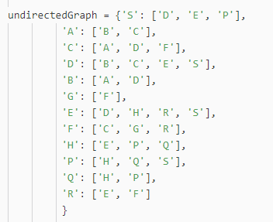
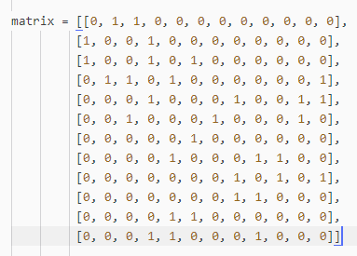
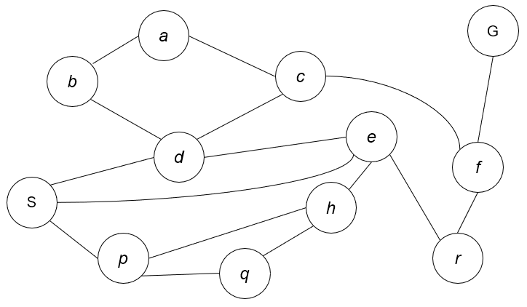
Graph Representation- Undirected Graph
Adjacency matrix in Python

Slide 22
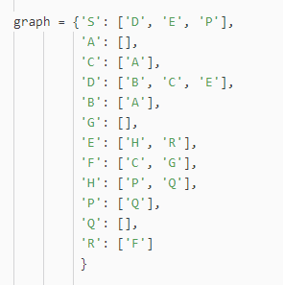
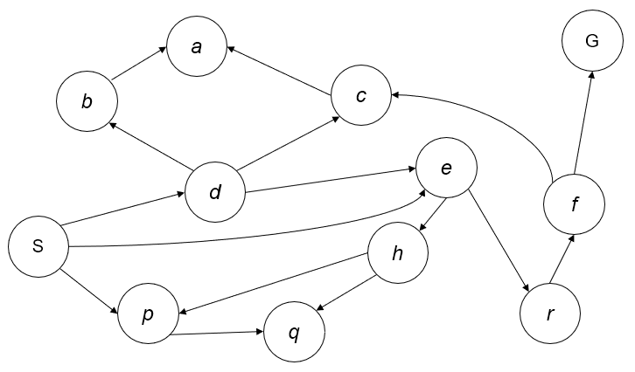
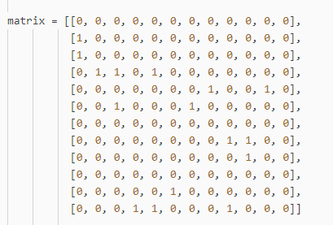
Graph Representation – Directed Graph
Different from the undirected graph

Slide 23
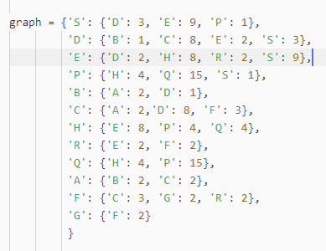
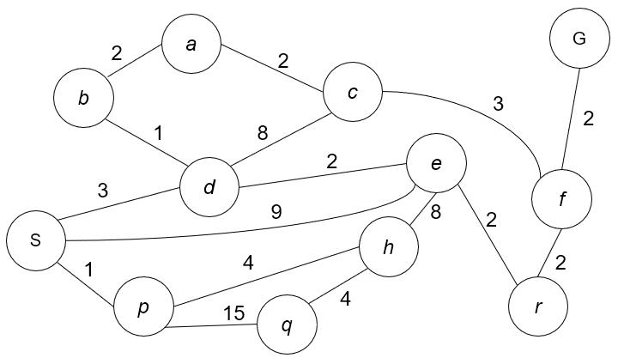
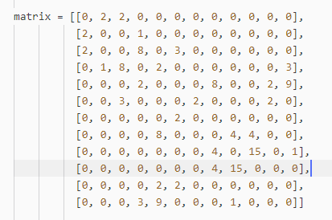
Graph Representation – Weighted Graph

Slide 24
Graph Search Lab
Basic Data Structure / Algorithms
Recursion
Stack, Queue,
Priority Queue and Heap
Complexity – the “Big O” notation
Graph/Tree Traversal: DFS, BFS, UCS

Slide 25
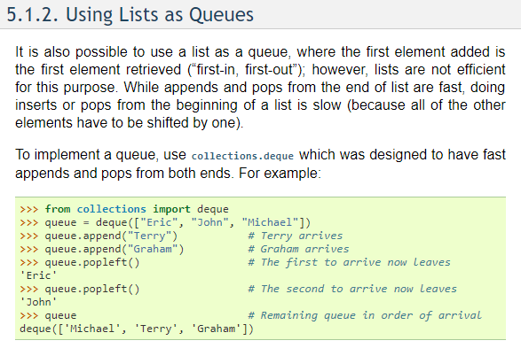
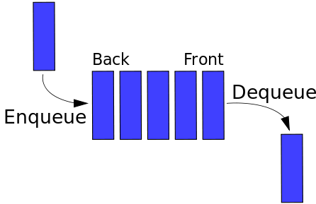
Queue
https://docs.python.org/2/tutorial/datastructures.html
https://docs.python.org/3.6/library/queue.html

Slide 26
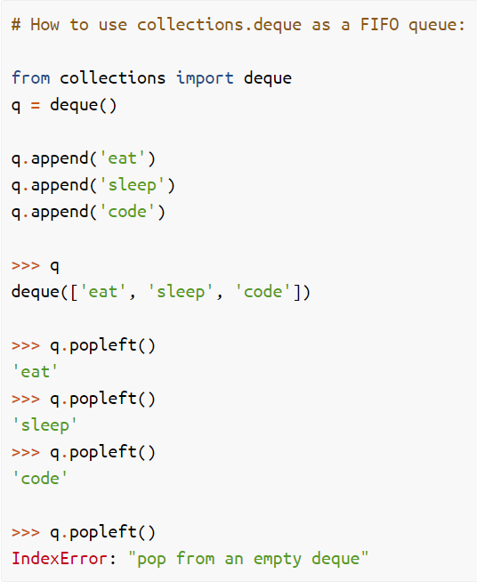
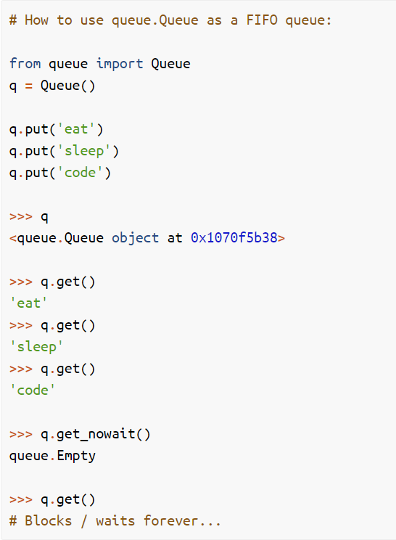
Queues in Python
https://dbader.org/blog/queues-in-python

Slide 27
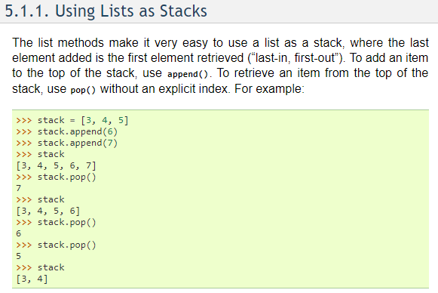
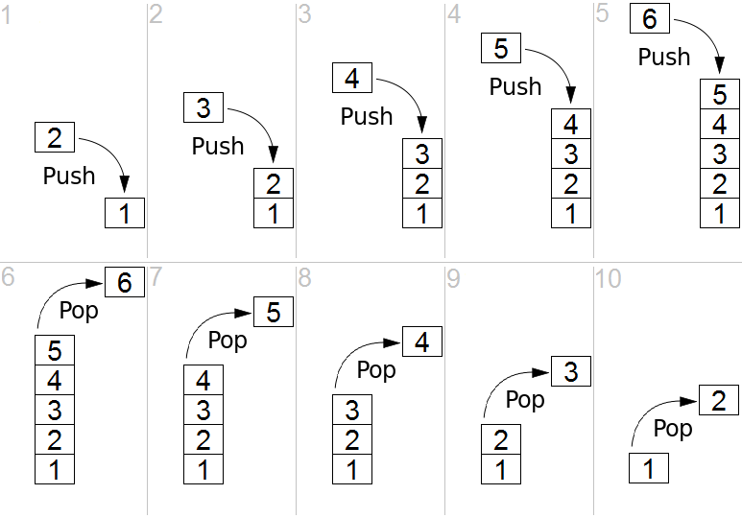
Stack
https://docs.python.org/2/tutorial/datastructures.html

Slide 28
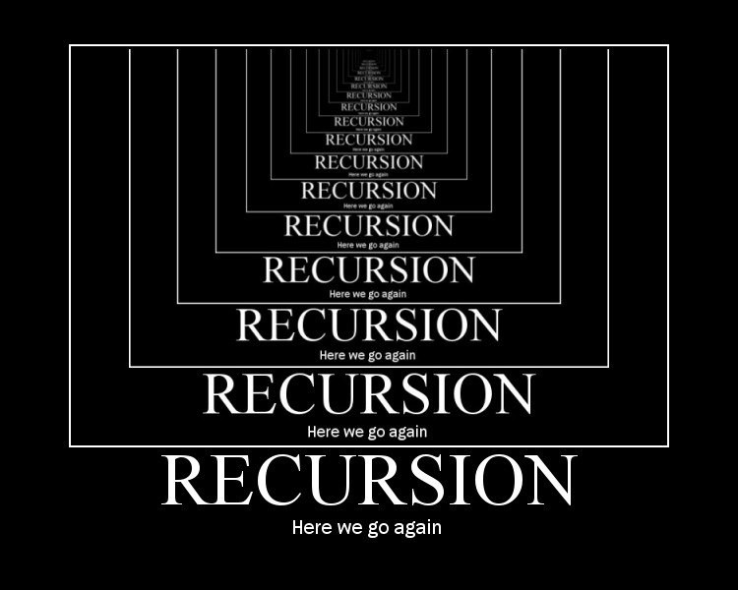
Recursion
https://en.wikipedia.org/wiki/Recursion_(computer_science)
n!=n*(n-1)*...*1
function factorial is:
input: integer n such that n >= 0
output: [n × (n-1) × (n-2) × … × 1]
1. if n is 0, return 1
2. otherwise, return [ n × factorial(n-1) ]
end factorial
Recursion function implementation needs to consume function calling stacks. And you can avoid recursion using an explicit stack implementation.
See how to remove recursion using a stack
Notes:
https://en.wikipedia.org/wiki/Recursion_(computer_science)

Slide 29
Stack to Remove Recursion
def factorial(n):
v = 1 s = Stack()
s.push (n)
while not s.empty():
a = s.pop()
v = v*a
if a>1:
s.push (a-1)
def factorial(n): if n == 0:
return 1
else:
return n * factorial(n - 1)
algorithm search(NODE):
createStack()
addNodeToStack(NODE)
while(stackHasElements)
NODE = popNodeFromStack()
doSomethingWith(NODE)
for each node CHILD connected to NODE:
addNodeToStack(CHILD)

Slide 30
Priority Queue
https://en.wikipedia.org/wiki/Priority_queue
A Priority Queue (PQ) is an abstract data type that supports:
is_empty
insert_with_priority
pull_highest_priority_element
peek
PQ is usually implemented using a heap (a complete binary tree)
Example usage: heap sort, UCS

Slide 31
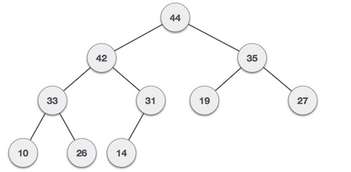
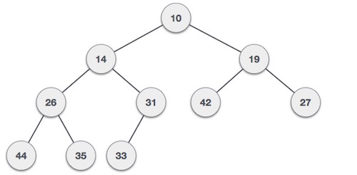
Heap
https://en.wikipedia.org/wiki/Heap_(data_structure)
https://www.tutorialspoint.com/data_structures_algorithms/heap_data_structure.htm
See:
Max Heap Construction Algorithm
Max Heap Deletion Algorithm
max heap
min heap
Notes:
https://www.tutorialspoint.com/data_structures_algorithms/heap_data_structure.htm

Slide 32
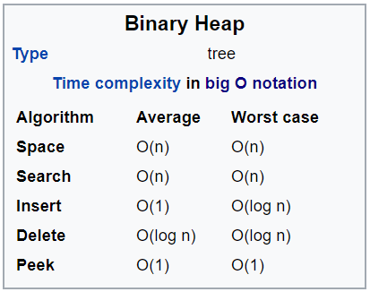
Complexity
Big O notation
Time vs space complexity
Quick sort: O (n log n)
Heap:
Notes:
https://stackoverflow.com/questions/39514469/argument-for-o1-average-case-complexity-of-heap-insertion

Slide 33
Depth-First Search
a
G
a
c
Strategy: expand a deepest node first
Implementation: Fringe is a LIFO stack
b
c
b
e
d
e
d
f
f
S
h
h
p
p
r
q
r
q
S
d
e
p
b
c
e
h
r
q
a
a
h
r
p
q
f
p
q
f
q
c
G
q
c
G
a
a

Slide 34
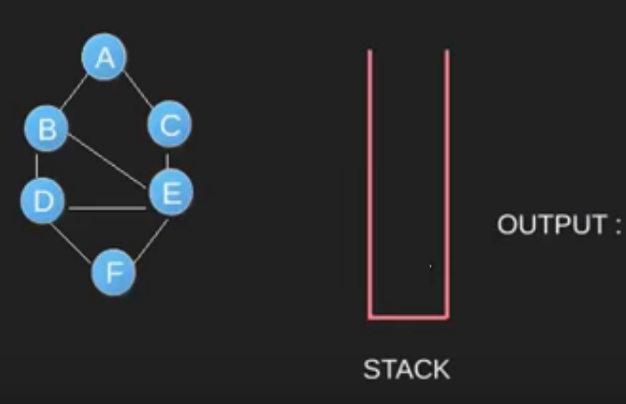
Depth-First Search
https://www.geeksforgeeks.org/depth-first-search-or-dfs-for-a-graph/

Slide 35
Breadth-First Search
Strategy: expand a shallowest node first
Implementation: Fringe is a FIFO queue
a
G
b
c
d
e
f
S
h
p
q
r
S
d
e
p
Search
Tiers
b
c
e
h
r
q
a
a
h
r
p
q
f
p
q
f
q
c
G
q
c
G
a
a

Slide 36
a
G
b
c
d
e
f
queue | visited
S | S
D | D
E | E
p | P
B | B
C | C
h | h
r | r
q | q
a | a
f | f
g | g
S
h
p
q
r

Slide 37
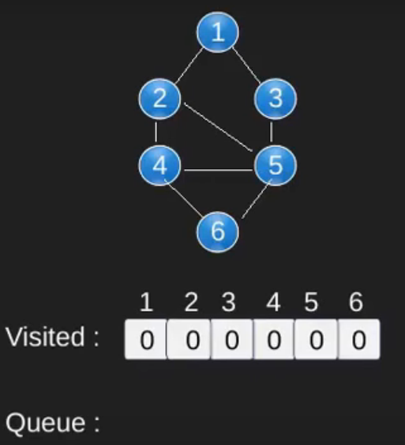
Example
https://www.geeksforgeeks.org/breadth-first-search-or-bfs-for-a-graph/

Slide 38
Uniform Cost Search
queue
S, 0
S->p,1
S->d,3
S_e,9
s->q,16
S->b, 4
S->c,11
S->e,5
q
a
f
g
2
G
a
Strategy: expand a cheapest node first:
Fringe is a priority queue (priority: cumulative cost)
b
c
1
8
2
2
e
3
d
f
9
8
2
S
h
1
1
p
q
r
15
0
S
d
3
e
9
p
1
b
4
e
5
h
17
r
11
q
16
c
11
Cost contours
a
6
a
h
13
r
7
p
q
f
p
q
f
8
q
c
G
q
c
a
11
G
10
a

Slide 39
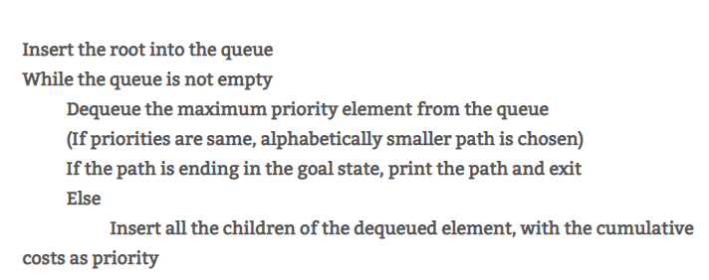
Uniform Cost Search
https://algorithmicthoughts.wordpress.com/2012/12/15/artificial-intelligence-uniform-cost-searchucs/

Slide 40
Priority Queue
https://en.wikipedia.org/wiki/Priority_queue
https://www.bogotobogo.com/python/python_PriorityQueue_heapq_Data_Structure.php
A Priority Queue (PQ) is an abstract data type that supports:
is_empty
insert_with_priority
pull_highest_priority_element
peek
PQ is usually implemented using a heap (a complete binary tree)
Example usage: heap sort, UCS
Notes:
a priority queue is an abstract data type which is like a regular queue or stack data structure, but where additionally each element has a "priority" associated with it. In a priority queue, an element with high priority is served before an element with low priority. In some implementations, if two elements have the same priority, they are served according to the order in which they were enqueued, while in other implementations, ordering of elements with the same priority is undefined.

Slide 41
Heap
https://en.wikipedia.org/wiki/Heap_(data_structure)
https://www.tutorialspoint.com/data_structures_algorithms/heap_data_structure.htm
See:
Max Heap Construction Algorithm
Max Heap Deletion Algorithm
max heap
min heap
Notes:
https://www.tutorialspoint.com/data_structures_algorithms/heap_data_structure.htm

Slide 42
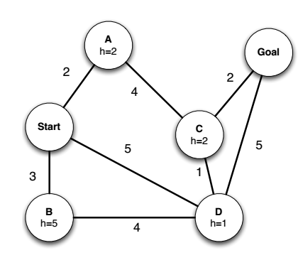
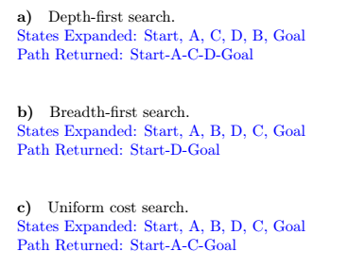
States Expanded:
The order of enqueued states during the path searching procedure. When goal is found, the procedure will stop and return.
Returned Path:
The shortest path from start to goal found by BFS/DFS/UCS.

Slide 43
Thank You

