Slide 1
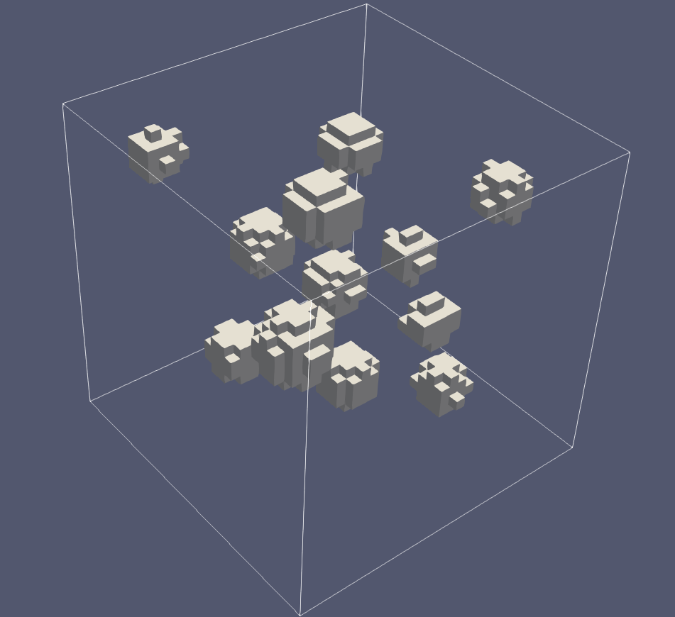
PRECONDITIONING
Heterogeneous Diffusion Problems
Finite elements · Krylov solvers · Parallel performance
12 inclusions contrast up to 10⁵
Nada Elsayed · 10998973 Wu Cao · 11036000
Fude Zhou · 10679500 Elena Nuttini · 10683877
Numerical Methods for Partial Differential Equations · A.Y. 2025/2026

Slide 2
MODEL
02
Problem and coefficient field
−∇ · (μ ∇u) = f in Ω = (0,1)³
u = 0 on ∂Ω, f = 1
μₚ(x) = { 10ᵖ if x ∈ B; 1 otherwise }
• p = 1, …, 5
• μmax / μmin = 10ᵖ
• Fixed geometry isolates contrast
Coefficient visualization, p = 5
KEY POINT
Increasing p preserves the geometry but separates the energy scales by up to five orders of magnitude.
NMPDE · Heterogeneous diffusion

Slide 3
COEFFICIENT CONSTRUCTION
03
How the 12 inclusions are generated
B = ⋃ᵢ₌₁¹² Bᵢ, Bᵢ = { x ∈ Ω : ‖x − cᵢ‖₂ ≤ rᵢ }
HeterogeneousDiffusion::make_balls()
return {{{0.18, 0.20, 0.23}, 0.090}, {{0.34, 0.28, 0.72}, 0.075}, {{0.52, 0.18, 0.46}, 0.080}, {{0.76, 0.24, 0.32}, 0.070}, {{0.24, 0.52, 0.55}, 0.085}, {{0.48, 0.48, 0.22}, 0.070}, {{0.68, 0.56, 0.78}, 0.095}, {{0.86, 0.62, 0.50}, 0.060}, {{0.30, 0.78, 0.30}, 0.075}, {{0.55, 0.82, 0.60}, 0.090}, {{0.78, 0.84, 0.20}, 0.070}, {{0.14, 0.86, 0.82}, 0.065}};
Rendered coefficient field at p = 5
KEY POINT
The centers and radii remain fixed; only the coefficient value inside the spheres changes with p.
NMPDE · Heterogeneous diffusion

Slide 4
NUMERICAL METHOD
04
From the weak form to measured performance
Find uₕ ∈ Vₕ : ∫Ω μ∇uₕ · ∇vₕ dx = ∫Ω f vₕ dx ⟹ A U = b
01
02
03
04
05
Mesh
Discretize
Assemble
Solve
Measure
Uniform hexahedra r = 3, 4, 5
Q₁ finite elements 729–35,937 DoFs
Distributed matrix and right-hand side
CG + one of five preconditioners
Iterations, κ̂, setup and solve time
Q₁
CG
MPI
CONTINUOUS TRILINEAR ELEMENTS
‖rₖ‖₂ ≤ 10⁻¹⁰ ‖b‖₂
DISTRIBUTED DEAL.II + TRILINOS
KEY POINT
Every preconditioner solves the same assembled system with the same initial guess and stopping rule.
NMPDE · Heterogeneous diffusion

Slide 5
EXPERIMENT
05
How the comparison is designed
CONTRAST
MESH
PARALLELISM
SOLVER
p = 1, 2, 3, 4, 5
r = 3, 4, 5
np = 1, 2, 3, 4
5 preconditioners
Tests robustness to μmax/μmin
Tests dependence on h and DoFs
Tests strong scaling
Tests algebraic strategies
Controlled for fairness
What we measure
• Same matrix and right-hand side
• Zero initial guess for every solve
• Relative residual tolerance: 10⁻¹⁰
• Wall time reduced with MPI maximum
Effectiveness
iterations + κ̂
Efficiency
setup + solve time
Optimality
growth with r
Scalability
speedup with np
5 × 3 × 4 × 5 = 300 measured solves
S(np) = T(1)/T(np), E(np) = S(np)/np
KEY POINT
The design separates solver quality, mesh robustness, and parallel behavior instead of relying on one timing.
NMPDE · Heterogeneous diffusion

Slide 6
SOLVER CHOICES
06
Five levels of algebraic information
None
Jacobi
SSOR
ILU
AMG
M = I
M = D = diag(A)
M ≈ (D+ωL)D⁻¹(D+ωU)
A ≈ L̃Ũ
M⁻¹ ≈ S + PAₕ⁻¹R
Zero overhead No spectral correction
Pointwise and parallel Ignores coupling
Richer local structure Ordering dependencies
Local factorization Triangular solves
Smooth + coarse error Global scale coverage
information complexity
information complexity
information complexity
information complexity
information complexity
Increasing setup and communication complexity →
KEY POINT
The central tradeoff is richer spectral correction versus setup, memory, and communication cost.
NMPDE · Heterogeneous diffusion

Slide 7
CORRECTNESS
07
Verification before performance comparison
uₑₓ = sin(πx) sin(πy) sin(πz)
μ = 1, f = 3π²uₑₓ
2.00
1.00
OBSERVED L² RATE
OBSERVED H¹ RATE
• Matches Q₁ finite-element theory
• Checks assembly and constraints
• Checks distributed solve and norms
KEY POINT
The expected L² and H¹ rates confirm the discretization before solver timings are interpreted.
NMPDE · Heterogeneous diffusion

Slide 8
MAIN RESULT
08
Contrast robustness and its spectral explanation
Iteration count k
κ̂(M⁻¹A)
KEY POINT
At p = 5, AMG needs 31 iterations and reduces the condition estimate from 1.05 × 10⁷ to 18.5.
NMPDE · Heterogeneous diffusion

Slide 9
HARDEST SERIAL CASE
09
AMG repays its setup cost
tₜₒₜₐₗ = tₛₑₜᵤₚ + tₛₒₗᵥₑ
Total time · logarithmic
AMG: 0.262 s total · 33% setup
KEY POINT
AMG has the largest setup cost, but its shorter solve phase makes it the fastest method overall.
NMPDE · Heterogeneous diffusion

Slide 10
TWO DIFFERENT QUESTIONS
10
Mesh robustness and parallel scaling
k(r) at p = 5
S(np) = T(1)/T(np)
KEY POINT
AMG is the fastest four-rank method even though simpler methods show better speedup ratios.
NMPDE · Heterogeneous diffusion

Slide 11
DECISION
11
Hardest-case scorecard
Method | Iterations | κ̂ | T₁ [s] | T₄ [s] | S₄
None | 16,067 | 1.05e+07 | 16.941 | 6.922 | 2.45
Jacobi | 611 | 1.5e+06 | 0.362 | 0.175 | 2.06
SSOR | 211 | 1.7e+05 | 0.494 | 0.683 | 0.72
ILU | 172 | 1.13e+05 | 0.399 | 0.175 | 2.28
AMG | 31 | 18.5 | 0.262 | 0.168 | 1.57
BEST ROBUSTNESS
BEST TOTAL TIME
BEST S₄
BEST COMPROMISE
AMG
AMG
None
AMG
KEY POINT
AMG is the only tested method that wins both the robustness and absolute-time comparisons.
NMPDE · Heterogeneous diffusion

Slide 12
CONCLUSION
12
AMG is the recommended default
for this heterogeneous elliptic problem
31
18.5
0.262 s
ITERATIONS
ESTIMATED Κ
SERIAL TOTAL
vs. 16,067 without PC
vs. 1.05 × 10⁷
fastest tested method
Verified discretization · 300 measured solves · editable data-driven charts
Next: repeat timing trials on larger meshes and tune the AMG hierarchy.
Source data: result/benchmark_results.csv

