Slide 1

Contention-Aware Expert
Parallel Load Balancing in
Mixture-of-Experts Serving in vLLM
Unbatched
Rank-disjoint batches
R0
R1
R0→R1 R2→R3
Batch 0
→
R2
R3
Batch 1
R1→R2 R0→R3
Main idea:
Seperate conflicting transfers.
WU CAO · 11036000
Advisor
Prof. Qiaolun Zhang
MSc High Performance Computing Engineering
A.Y. 2026–2027
Co-advisor
Prof. Massimo Tornatore
Merged into vLLM · PR #52641

Slide 2
OVERVIEW
Outline
01
Background
02
Model
MoE, EP, and asynchronous EPLB
Contention model and offline ILP
03
Design
04
Evaluation
online greedy scheduler
E2E serving, NIC traffic, and profiling

Slide 3
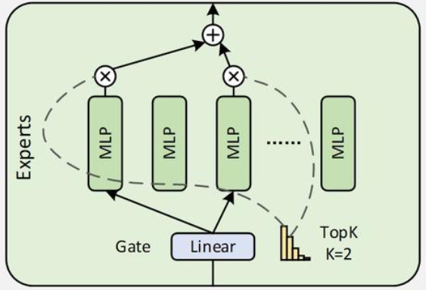
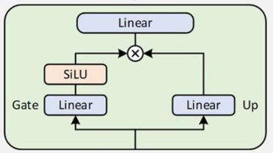
BACKGROUND
MoE(Mixture-of-Experts)
MoE
MLP((Multi-Layer Perceptron))
Why MoE?
Larger model capacity with lower active computation.
Better parameter scaling without proportional FLOPs growth.
Multiple expert MLPs
A router activates only a subset per token.
Feed-forward network for nonlinear feature transformation.

Slide 4
BACKGROUND
EPLB(Expert Parallel Load Balance)
What is EPLB?
Dynamically balances expert workloads across GPUs.
Example
Rank 0
Rank 1
Rank 2
Rank 3
E0
E3
E6
E1
E1
E4
E7
E2
E2
E5
E0
E3
→ expert load balance(Copy overloaded experts)
→ rank load balance(Migrate overloaded experts)
EPLB’s jobs

Slide 5
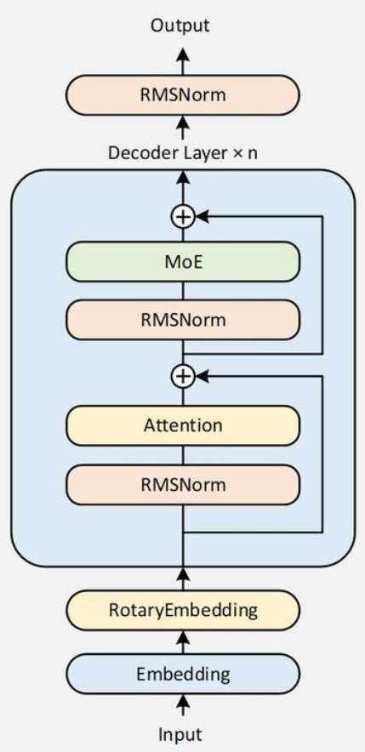
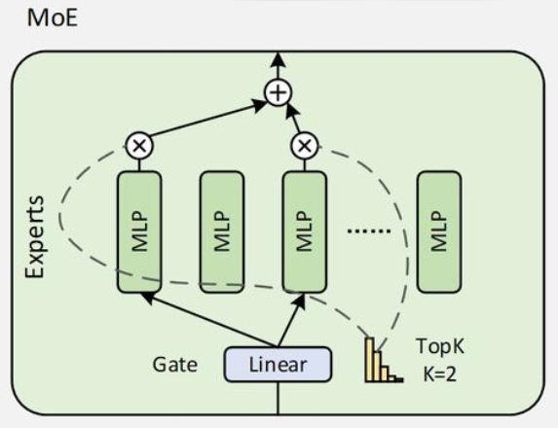
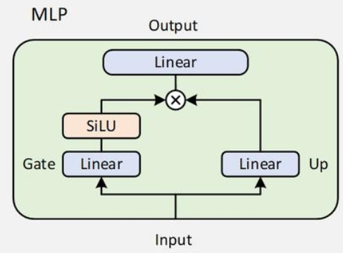
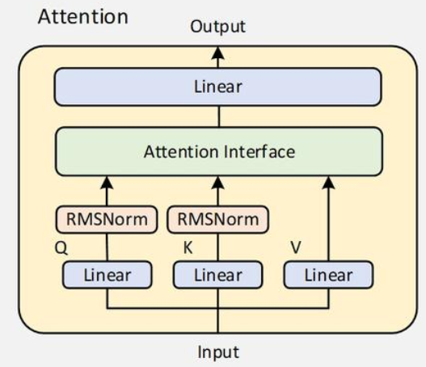
BACKGROUND
Qwen3 MoE Architecture
Qwen3-30B-A3B (MoE Model)
An opensource LLM by Alibaba.
Total Parameters: 30.5B
Active Parameters: 3.3B per token
Transformer Layers: 48
Experts: 128 per MoE layer
Activated Experts: Top-8 per token

Slide 6
BACKGROUND
Sync and Async EPLB
SYNCHRONOUS EPLB
ASYNCHRONOUS EPLB
Inference
paused
Inference
continues
Migration
Migration
Common approach/
Online serving
Research/Debug

Slide 7
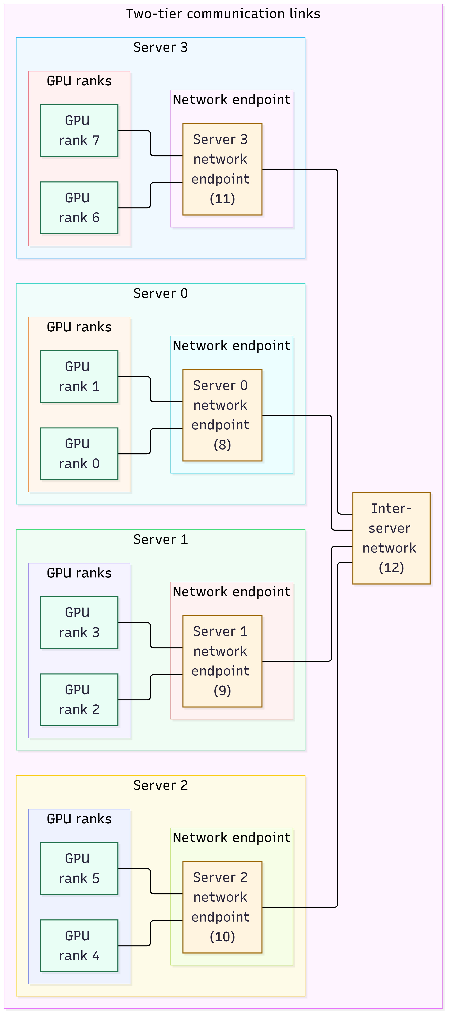
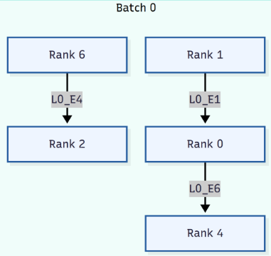
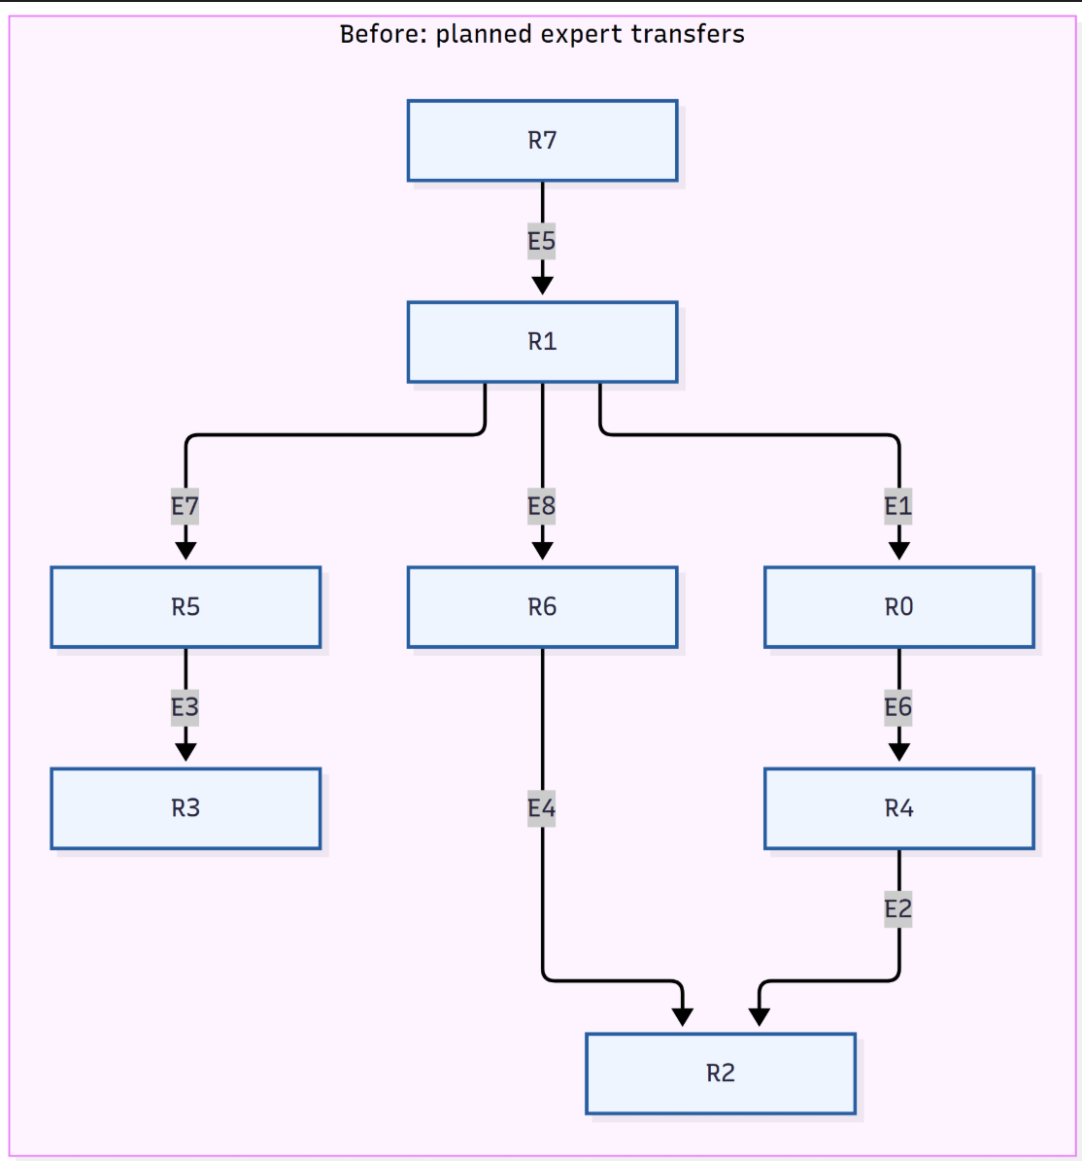
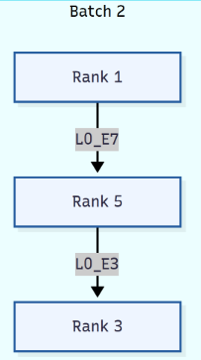
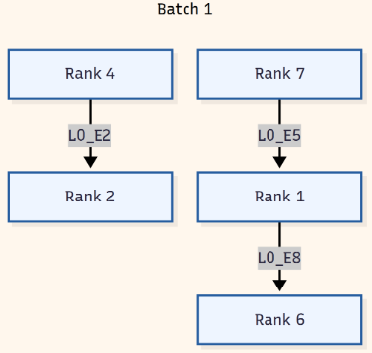
OFFLINE MODEL
ILP Hotspot Example
After batching
Before batching
Inference time 4.75
Inference time 2.25

Slide 8










OFFLINE MODEL
ILP Formulation
VARIABLES & INPUTS
LEXICOGRAPHIC OBJECTIVES
1 inference
2 batches
$$minT_{infer}$$
DECISION VARIABLES
$$min\sum_{b∈B}{y_{b}} s.t. T_{infer}≤T_{infer}^{∗}+ε$$
$$x_{p,b}∈\{0,1\}$$
flow assignment
$$y_{b}∈\{0,1\}$$
active-batch flag
1 Every flow runs exactly once
$$\sum_{b∈B}{x_{p,b}}=1, ∀p∈P$$
$$T_{infer}≥0$$
worst inference time
2 Activate used batches; no gaps
$$x_{p,b}≤y_{b}, y_{b}≥y_{b+1}$$
KNOWN INPUTS
$$w_{p}$$
experts in flow p
3 Migration load on each link
$$L_{e,b}=\sum_{p∈P}{w_{p}}f_{p,e}x_{p,b}$$
$$f_{p,e}$$
fraction routed on link e
$$C_{e}$$
capacity of link e
$$T_{0}, ρ$$
baseline time; inference share
4 Inference-time lower bound
$$T_{infer}≥T_{0}\left(1+\frac{L_{e,b}}{C_{e}\left(1−ρ\right)}\right), ∀e,b$$

Slide 9
ONLINE DESIGN
Online Design
OFFLINE ILP
ONLINE SCHEDULER
Exact reference
Greedy Algorithm
Explains the model
Prove this problem can be optimized
Expensive
Achieve similar returns
But much cheaper
Not used in serving
Used in serving
We can not use ILP in vllm because ILP is expensive

Slide 10
ALGORITHM
Greedy Algorithm
INPUT ORDER(DAG)
0
F₀ {E₁,E₇}
1
F₃ {E₉}
F₂ {E₄}
3
2
F₁ {E₃}
FIRST-FIT DECISIONS
F₀
Batch 0
uses ranks {0,1}
INPUT ORDER(for loop flows)
F₀
0 → 1
{E₁,E₇}
F₁
Batch 0
uses ranks {0,1,2,3}
F₂
Batch 1
uses ranks {1,2}
F₁
2 → 3
{E₃}
F₃
Batch 1
uses ranks {0,1,2,3}
F₂
1 → 2
{E₄}
F₃
0 → 3
{E₉}

Slide 11
EVALUATION METHODOLOGY
Experimental Setup
WORKLOAD
Node 0
Node 1
Node 2
Node 3
Dataset
random · seed 0
RTX 6000
24 GB
RTX 6000
24 GB
RTX 6000
24 GB
RTX 6000
24 GB
Prompts
500
Concurrency
32
10 GbE · no RDMA
Prefix / input
300 / 200 tokens
Qwen3-30B-A3B-Instruct-2507 · FP16 · TP=EP=4
Output
300 tokens · ignore EOS
Async EPLB · window 50 · step interval 50 · 16 redundant experts
Reported
P50 and P99
Prefix cache enabled · eager execution · 500/500 requests completed
OFF vs ON · same request stream
Background
Model
Algorithm
Evaluation

Slide 12
EVALUATION RESULTS
E2E Results
Metric
Batching off
Batching on
Improvement
MAIN RESULT
Output throughput
31.54 tok/s
32.26 tok/s
+2.28%
+2.28%
TTFT P50
49,180.71 ms
48,599.04 ms
+1.18%
output throughput
TTFT P99
75,740.25 ms
74,756.17 ms
+1.30%
−3.18%
TPOT P50
828.53 ms
812.44 ms
+1.94%
E2EL P50
TPOT P99
1,007.82 ms
999.01 ms
+0.87%
E2EL P50
303,462.69 ms
293,821.76 ms
+3.18%
No regression
E2EL P99
322,184.88 ms
317,351.61 ms
+1.50%
in the reported async metrics
All metrics improved

Slide 13
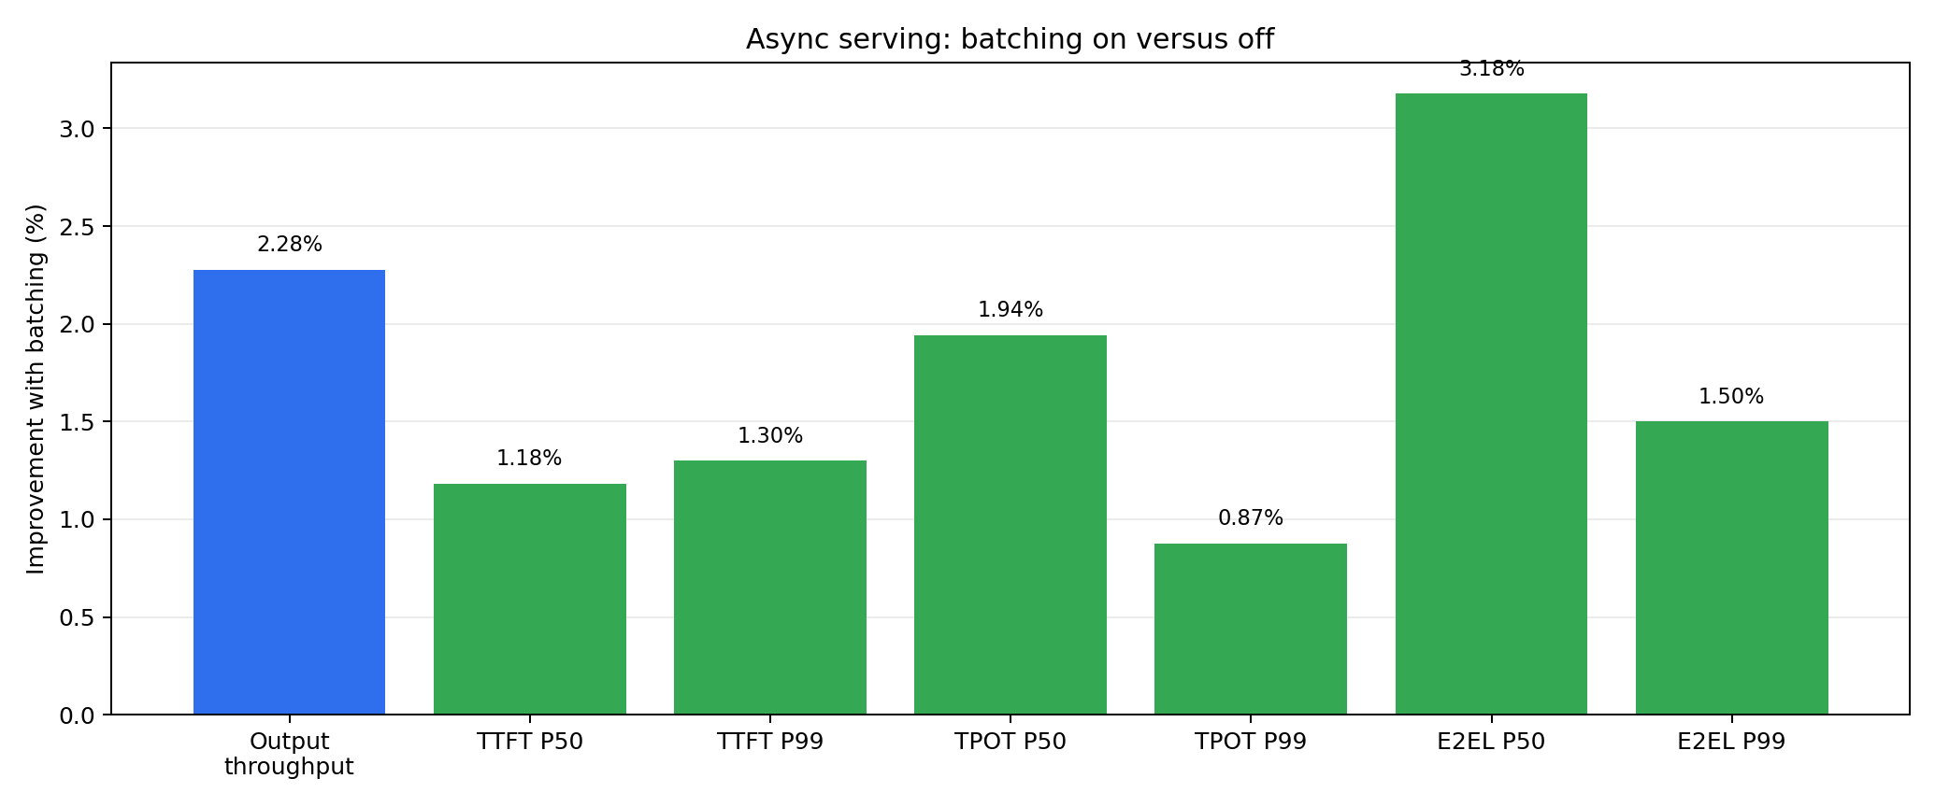
EVALUATION RESULTS
Serving Improvements
+2.28%
throughput
+1.18 / +1.30%
TTFT P50 / P99
+1.94 / +0.87%
TPOT P50 / P99
+3.18 / +1.50%
E2EL P50 / P99

Slide 14
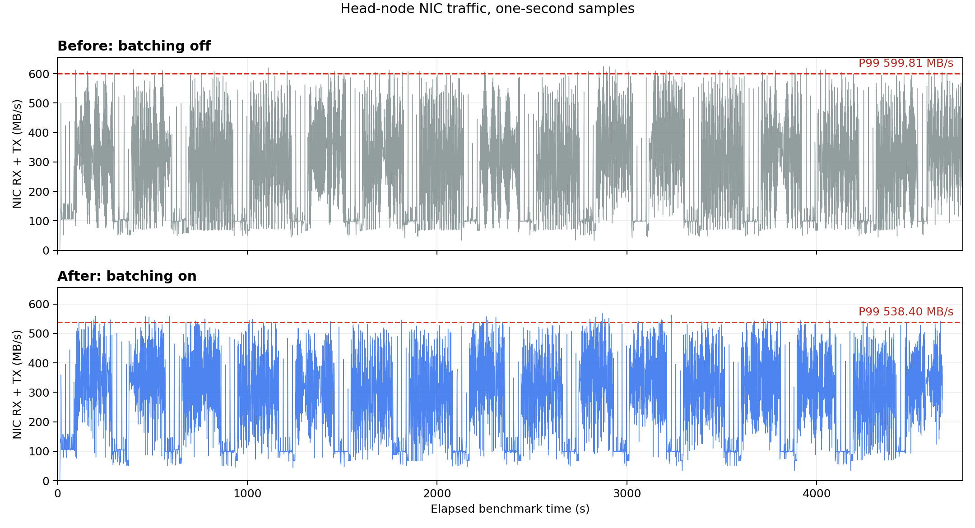
NETWORK EVIDENCE
NIC Traffic
599.81
MB/s P99 · off
538.40
MB/s P99 · on
−10.24%
NIC P99
My feature can smooth the large traffic bursts.

Slide 15
SCHEDULER PROFILING
Profiling Method
PURPOSE Is the added scheduler cost < the serving time saved?
Saved serving time
VS
Extra schedule time

Slide 16
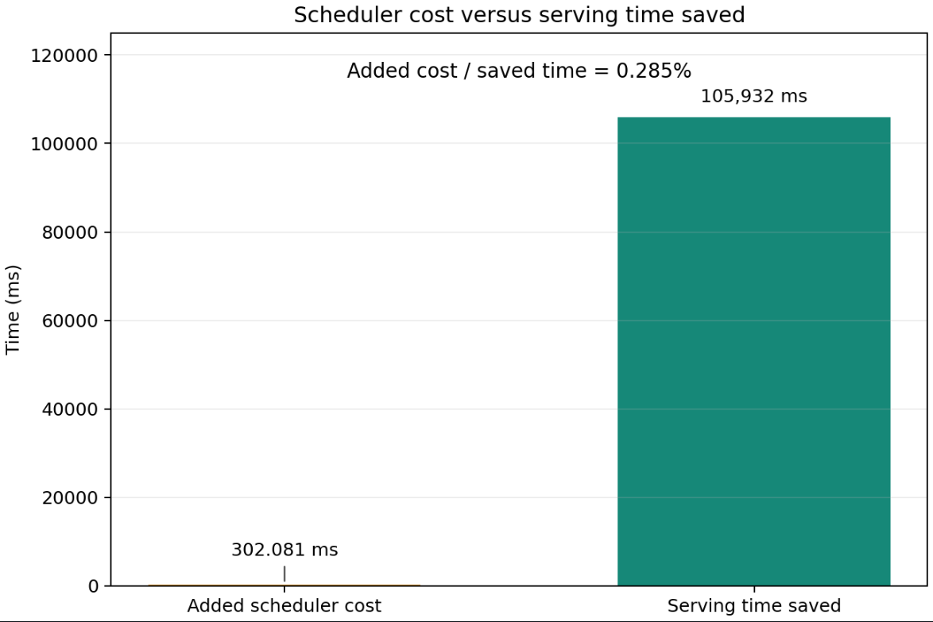

SCHEDULER PROFILING
Profiling Results
Cumulative: Total extra schedule time of each rank
Rank
Calls
P50/call
P99/call
Cumulative
0
34
7.819 ms
17.536 ms
302.081 ms
1
34
7.090 ms
12.357 ms
253.152 ms
2
34
7.035 ms
16.104 ms
255.239 ms
3
34
7.005 ms
8.103 ms
241.190 ms
One call builds schedules for all 48 MoE layers
$$R=\frac{C_{max}}{T_{off}−T_{on}}×100\%=0.285\%$$
302.081 ms
105.932 s
largest cumulative scheduler cost
clean E2E serving time saved
This is a positive optimization!

Slide 17
THANKS
Q&A
Questions?
Result: a positive optimization merged into vLLM
vLLM PR #52641

