Slide 1



Link Configuration for Fidelity-Constrained
Entanglement Routing in Quantum Networks
Qiaolun Zhang¹, Nicola Di Cicco¹, Memedhe Ibrahimi¹, Raul Almeida Júnior²,
Alberto Gatto¹, Raouf Boutaba³, Massimo Tornatore¹
¹Politecnico di Milano, ²Federal University of Pernambuco, ³University of Waterloo
May 22nd, 2025
Notes:
Increase

Slide 2
Outline
Introduction and Motivation
System Model and Problem Statement
  Technical Preliminaries on Quantum Networks
  Problem Statement of Link Configuration for Entanglement Routing
Integer Linear Programming Model and Link Configuration Algorithm
Numerical Results
Conclusion

Slide 3
Outline
Introduction and Motivation
System Model and Problem Statement
  Technical Preliminaries on Quantum Networks
  Problem Statement of Link Configuration for Entanglement Routing
Integer Linear Programming Model and Link Configuration Algorithm
Numerical Results
Conclusion

Slide 4
Quantum Entanglement
Quantum entanglement: strong state correlation of two qubits
  Measuring one qubit can reveal the value of the other
0
0
1
1
Notes:
Where does this communication overhead come from?
routing and scheduling without fixing a logical topology
Distributed TensorFlow is an extension of the TensorFlow framework, designed to scale up the training of deep neural networks by distributing computations across multiple GPUs or machines. This allows for handling larger models and datasets that would otherwise be too large or slow to process on a single GPU or machine.

Slide 5
Quantum Entanglement
Quantum entanglement: strong state correlation of two qubits
  Measuring one qubit can reveal the value of the other
  Fidelity: measures entanglement quality, ranges from 0 to 1
  Entangled states: known as Einstein-Podolsky-Rosen pairs, or EPR pairs
0
0
1
Applications: quantum key distribution, quantum computing, etc.
How to establish high-fidelity entanglements between distant nodes?
Notes:
Where does this communication overhead come from?
routing and scheduling without fixing a logical topology
Distributed TensorFlow is an extension of the TensorFlow framework, designed to scale up the training of deep neural networks by distributing computations across multiple GPUs or machines. This allows for handling larger models and datasets that would otherwise be too large or slow to process on a single GPU or machine.

Slide 6
Quantum Networks and Entanglement Routing
Quantum network elements
  Quantum node: limited memory size
    One entanglement requires one memory per end node
  Quantum link (e.g., fiber): establish entanglements between adjacent nodes
Entanglement routing (ER) to distribute entanglements
swapping
Quantum
node
Link
Entanglement
Occupied quantum memory
Free quantum memory
Notes:
1. Entanglement generation and also link configuration

Slide 7
Link Configuration for Quantum Networks
Existing quantum networking works typically assume quantum links with fixed fidelity
Quantum link configuration: assign different combinations of (rate, fidelity) [1,2]
  Achievable by simply tuning microwave pulses
This study aims to investigate the following two research questions:
  How to decide the link configuration at network-scale?
  What is the improvement in terms of acceptance ratio of EPR pair requests enabled by link configuration on existing ER algorithms?
Rate (EPR pair /s) | 40 | 60 | 80 | 100 | 120
Fidelity | 0.9 | 0.85 | 0.8 | 0.75 | 0.7
[1]. P. C. Humphreys, etc, “Deterministic delivery of remote entanglement on a quantum network,” Nature, 2018.
[2]. G. Vardoyan and S. Wehner, “Quantum network utility maximization,” in IEEE International Conference on Quantum Computing and Engineering (QCE), 2023.
Notes:
40 * 15/10
Show a table
For each link, we can introduce a table for each link and fidelity
Fidelity: F = $\frac{3ω+1}{4}\text{=}\text{1} \text{− }\text{α}$
Entanglement generation rate: $R=\frac{4}{3}ⅆα,$where d is a constant related to

Slide 8
Outline
Introduction and Motivation
System Model and Problem Statement
  Technical Preliminaries on Quantum Networks
  Problem Statement of Link Configuration for Entanglement Routing
Integer Linear Programming Model and Link Configuration Algorithm
Numerical Results
Conclusion

Slide 9
Fidelity Improvement with Purification
Purification: distill high-fidelity entanglements from low-fidelity entanglements
  Average number of entanglements used to distill one desired-fidelity entanglement [1,2]
Quantum
node
Round 0
Initial fidelity | 0.8 | 0.8
 | Average required EPR pair to get 1 EPR pair | Fidelity
Round 0 | 2.6 | 0.83
Round 1 | 6.4 | 0.87
Round 2 | 15.2 | 0.90
Round 3 | 34.6 | 0.93
f₀
Link
f₁
Round 1
Entanglement
Occupied memory
f₂
Free memory
f₂>f₁>f₀
Table 1. Purification for one link configuration.
[1]. C. H. Bennett, etc, “Purification of noisy entanglement and faithful teleportation via noisy channels,” Physical review letters, 1996.
[2] W. Dür, “Quantum repeaters based on entanglement purification,” Physical Review A, 1999.
Notes:
Fidelity: quality of entanglements
Value between 0 and 1, higher value ➔ better quality

Slide 10

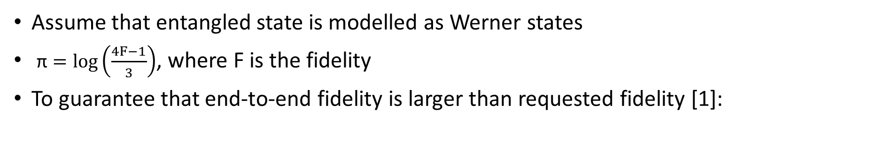
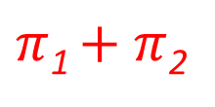
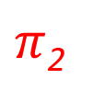

Swapping to Establish End-to-End Entanglement
swapping
$$π\text{1}$$
$π$₂
$π$₁ $+ π$₂
Quantum
node
Link
Entanglement
Occupied quantum memory
Free quantum memory
Assume that entangled state is modelled as Werner states
$\text{π}=log⁡\left(\frac{4F−1}{3}\right)$, where F is the fidelity
To guarantee that end-to-end fidelity is larger than requested fidelity [1]:
$$\sum_{lεr}{π_{l}≥ }π^{req}$$
[1]. Á. G. Iñesta, etc, “Optimal entanglement distribution policies in homogeneous repeater chains with cutoffs,” npj Quantum Information, 2023.

Slide 11
Outline
Introduction and Motivation
System Model and Problem Statement
  Technical Preliminaries on Quantum Networks
  Problem Statement of Link Configuration for Entanglement Routing
Integer Linear Programming Model and Link Configuration Algorithm
Numerical Results
Conclusion

Slide 12
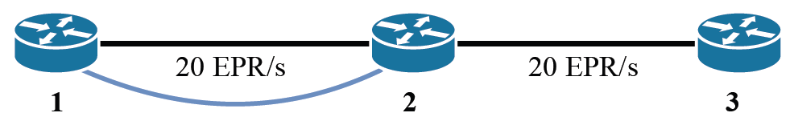
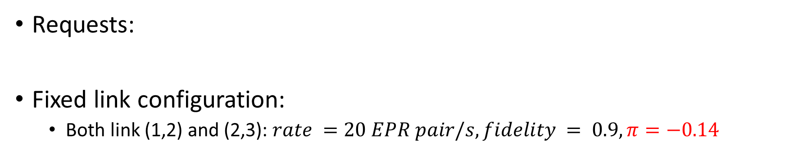
Illustrative Example (Fixed Link Configuration)
Requests:
Fixed link configuration:
  Both link (1,2) and (2,3): $rate =20 EPR pair/s,fidelity = 0.9, π=−0.14$
$$(1,2)=20 EPR pair/s,fidelity = 0.6, π=−0.76$$
$$(1,3)=5 EPR pair/s,fidelity = 0.75, π=−0.4$$
Path for request 1
: all entanglements in link (1,2) are exhausted
Notes:
w, and log(w)

Slide 13
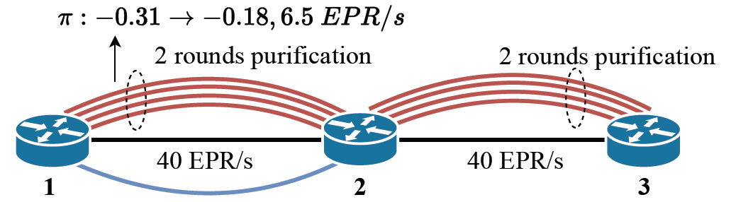
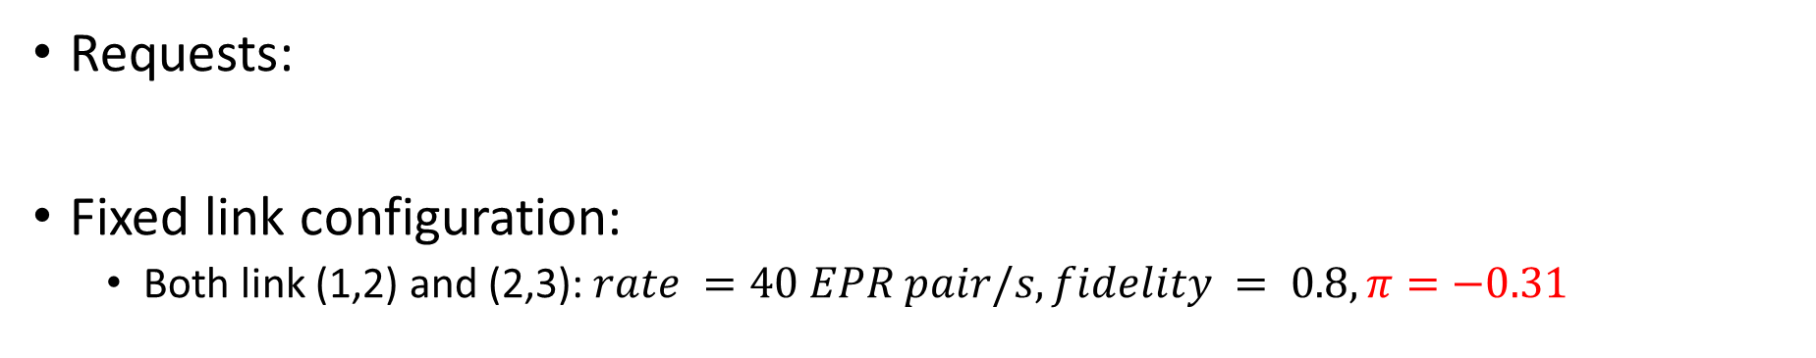
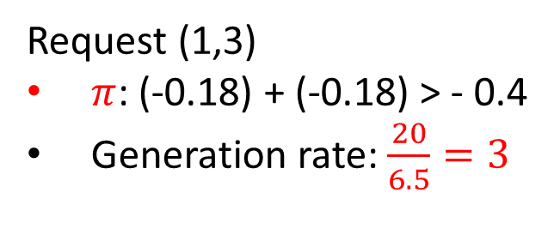
Illustrative Example (Fixed Link Configuration)
Requests:
Fixed link configuration:
  Both link (1,2) and (2,3):$rate =40 EPR pair/s,fidelity = 0.8, π=−0.31$
$$(1,2)=20 EPR pair/s,fidelity = 0.6, π=−0.76$$
$$(1,3)=5 EPR pair/s,fidelity = 0.75, π=−0.4$$
Request (1,3)
$π$: (-0.18) + (-0.18) > - 0.4
Generation rate: $\frac{20}{6.5}=3$

Slide 14
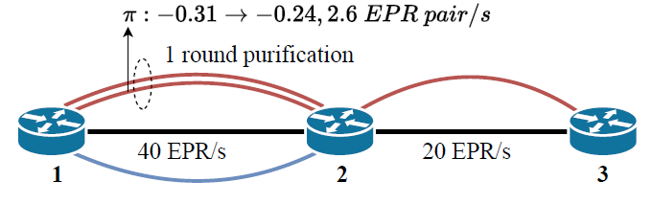
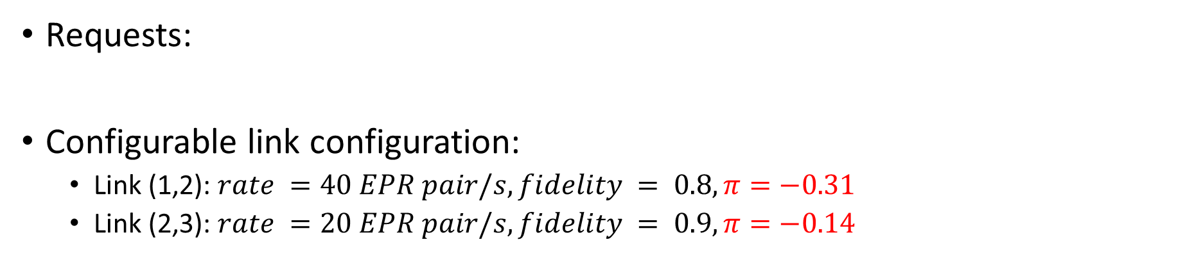
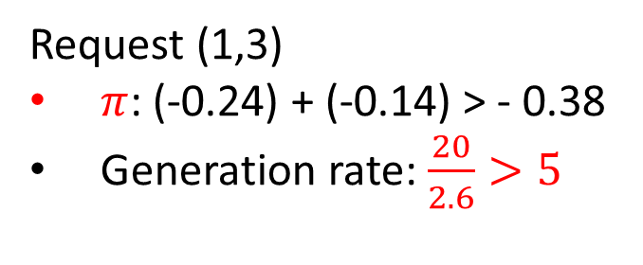
Illustrative Example (Configurable Link Configuration)
Requests:
Configurable link configuration:
  Link (1,2): $rate =40 EPR pair/s,fidelity = 0.8, π=−0.31$
  Link (2,3): $rate =20 EPR pair/s,fidelity = 0.9, π=−0.14$
$$(1,2)=20 EPR pair/s,fidelity = 0.6, π=−0.76$$
$$(1,3)=5 EPR pair/s,fidelity = 0.75, π=−0.4$$
Request (1,3)
$π$: (-0.24) + (-0.14) > - 0.38
Generation rate: $\frac{20}{2.6}>5$
Higher fidelity
All requests served
Fewer purification
Notes:
rate = 20 EPR pair/s, fidelity = 0.9, π=-0.14

Slide 15
Problem Statement
Given
Topology and node memory
ER requests with required fidelity
Different link configurations (fidelity/rate combinations)
Purification table of fidelity and the number of required EPR pair per purification round
Problem statement
Decide
Link configuration (fidelity, rate) for each link
Routing and purification in each edge for each request
Objective
Maximize served generation rate
Constraints
Fidelity constraint
Capacity constraints of nodes and links
Notes:
Show an example of doing entanglement routing, how to select the route, how many entanglements are needed

Slide 16
Outline
Introduction and Motivation
System Model and Problem Statement
  Technical Preliminaries on Quantum Networks
  Problem Statement of Link Configuration for Entanglement Routing
Integer Linear Programming Model and Link Configuration Algorithm
Numerical Results
Conclusion

Slide 17
Mixed Integer Linear Programming (ILP) Model
Objective function of ILP:
  Maximize served generation rate
Constraints:
  Link configuration ➔ choose among a set of configurations
  Route formulation for swapping to generate entanglements
  Fidelity constraints ➔ purification decision
  Link capacity constraints
  Quantum memory constraints
Find path
Capacity
constraints

Slide 18
Generalized Procedure of Link Configuration
Requests
SPFD
Initial Fidelity configuration
Bayesian Optimizer
Fidelity
configuration
Entanglement
routing
Selected
link configuration
Served generation rate
Link configuration
Shortest-path-based fidelity determination (SPFD) algorithm
  All requests are served along shortest path
  For each link, greedily decide link configuration
Bayesian optimization (BO): to further improve link configuration decision

Slide 19
Outline
Introduction and Motivation
System Model and Problem Statement
  Technical Preliminaries on Quantum Networks
  Problem Statement of Link Configuration for Entanglement Routing
Integer Linear Programming Model and Link Configuration Algorithm
Numerical Results
Conclusion

Slide 20
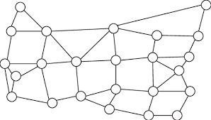
Simulation Settings
Two topologies
  German topology with 7 nodes and 11 links
  UsNet topology with 24 nodes and 43 links
(a) German topology
(b) UsNet topology

Slide 21
Simulation Settings
Link capacity:
  Fidelity = 0.8
  Generation rate uniformly distributed in [250, 500] EPR pair/s [1]
  Capacity of different link configuration can be derived with [2,3]
Memory: 12,000 memory slots [1]
Time duration of the entanglement routing period is shorter than the decoherence time
Average requested fidelity: 0.9
Rate (EPR pair /s) | 250 | 500 | 750 | 1000
Fidelity | 0.9 | 0.8 | 0.7 | 0.6
[1] S. Pouryousef, N. K. Panigrahy, and D. Towsley, “A quantum overlay network for efficient entanglement distribution,” in INFOCOM, 2023.
[2]. P. C. Humphreys, etc, “Deterministic delivery of remote entanglement on a quantum network,” Nature, 2018.
[3]. G. Vardoyan and S. Wehner, “Quantum network utility maximization,” in IEEE International Conference on Quantum Computing and Engineering (QCE), 2023.
Notes:
500 / 0.2 = x / 0.3

Slide 22
Compared Scenarios
Starting point: 3 baseline Entanglement Routing (ER) algorithms
  Progressive Filling (PF) [1]: same fidelity on each link
  Low-complexity Routing (Qleap) [2]: purification on links to achieve a fidelity threshold based on each request
  Purification-enabled Iterative Routing (Qpath) [2]: purification on critical links that have the highest improvement in fidelity with the least entanglements
Starting
baseline
 | PF | Qleap | Qpath
SPFD | SPFD-PF | SPFD-Qleap | SPFD-Qpath
BO | BO-PF | BO-Qleap | BO-Qpath
Added
functionality
[1]. C. Li, T. Li, Y.-X. Liu, and P. Cappellaro, “Effective routing design for remote entanglement generation on quantum networks,” npj Quantum Information, 2021.
[2]. J. Li, M. Wang, K. Xue, R. Li, N. Yu, Q. Sun, and J. Lu, “Fidelity-guaranteed entanglement routing in quantum networks,” IEEE Transactions on Communications,, 2022

Slide 23
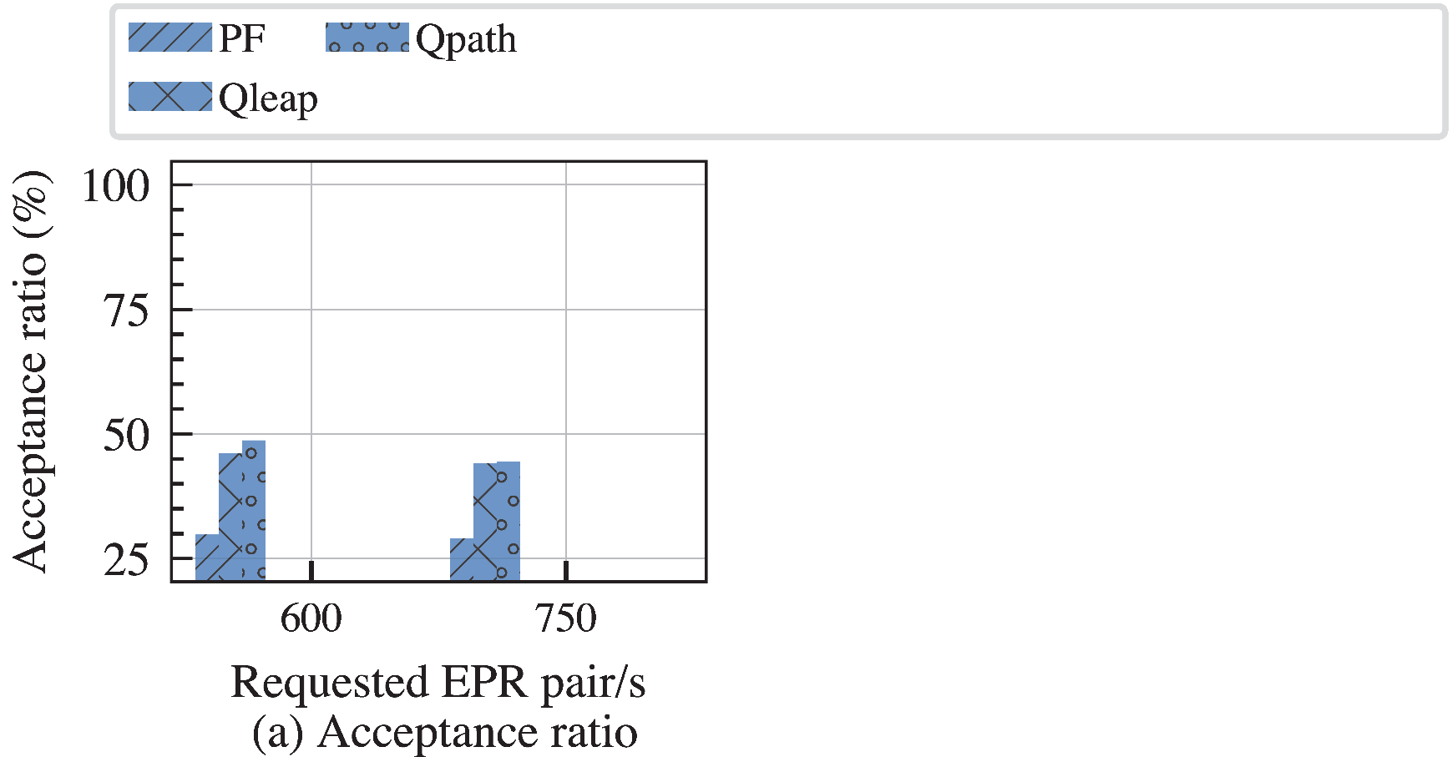
Comparison between ILP and Proposed Heuristics

Slide 24
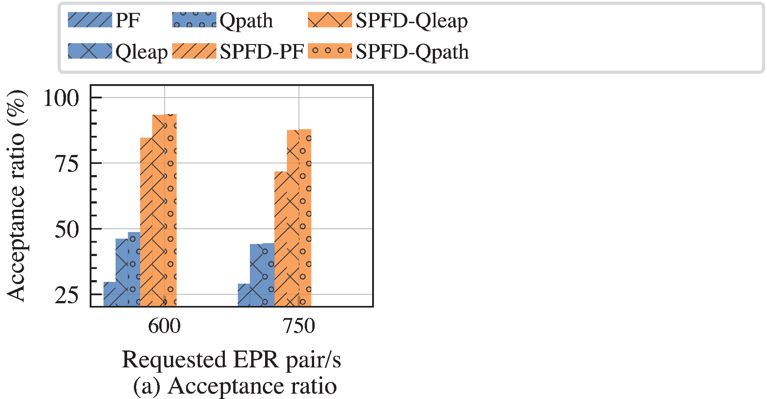
Comparison between ILP and Proposed Heuristics
Improvement of acceptance ratio
  SPFD: up to 55%

Slide 25
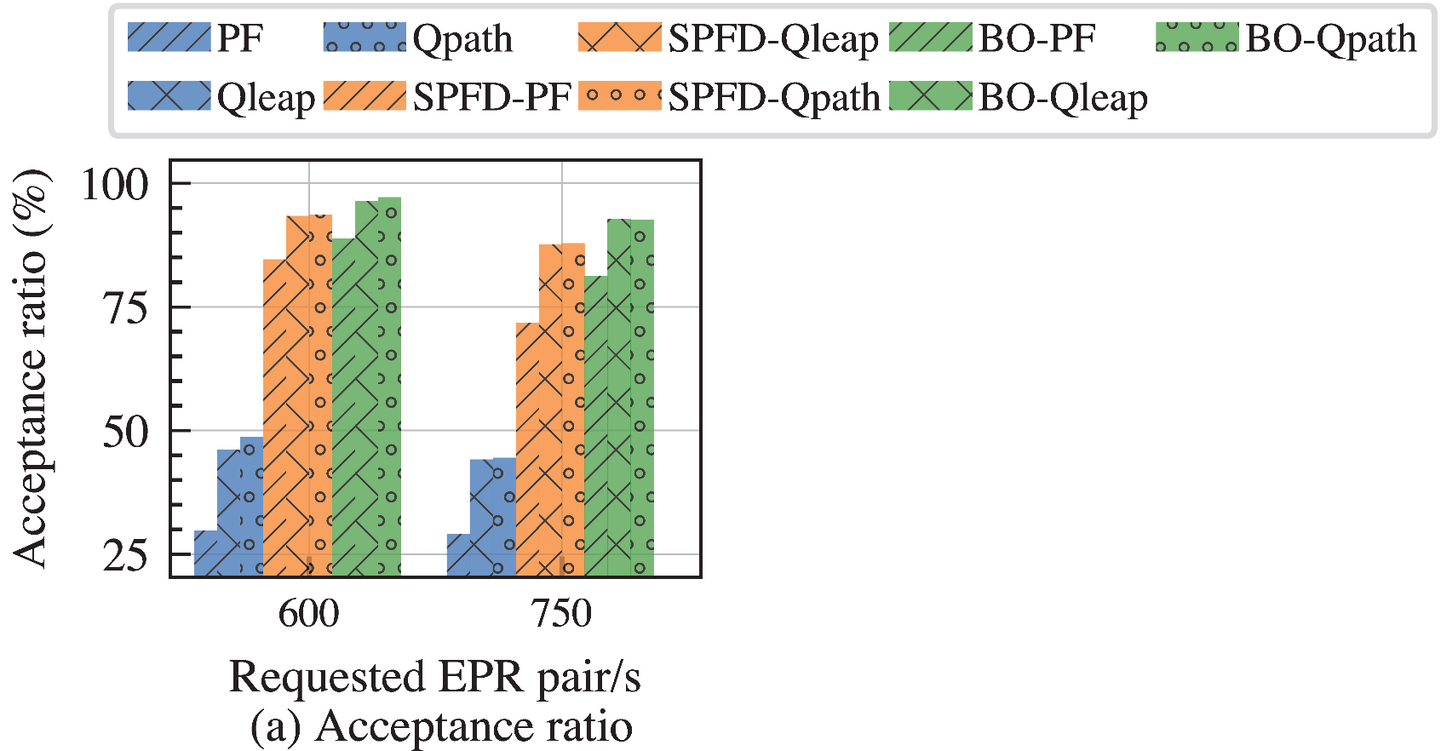
Comparison between ILP and Proposed Heuristics
Improvement of acceptance ratio
  SPFD: up to 55%
  BO: further 9% vs SPFD

Slide 26
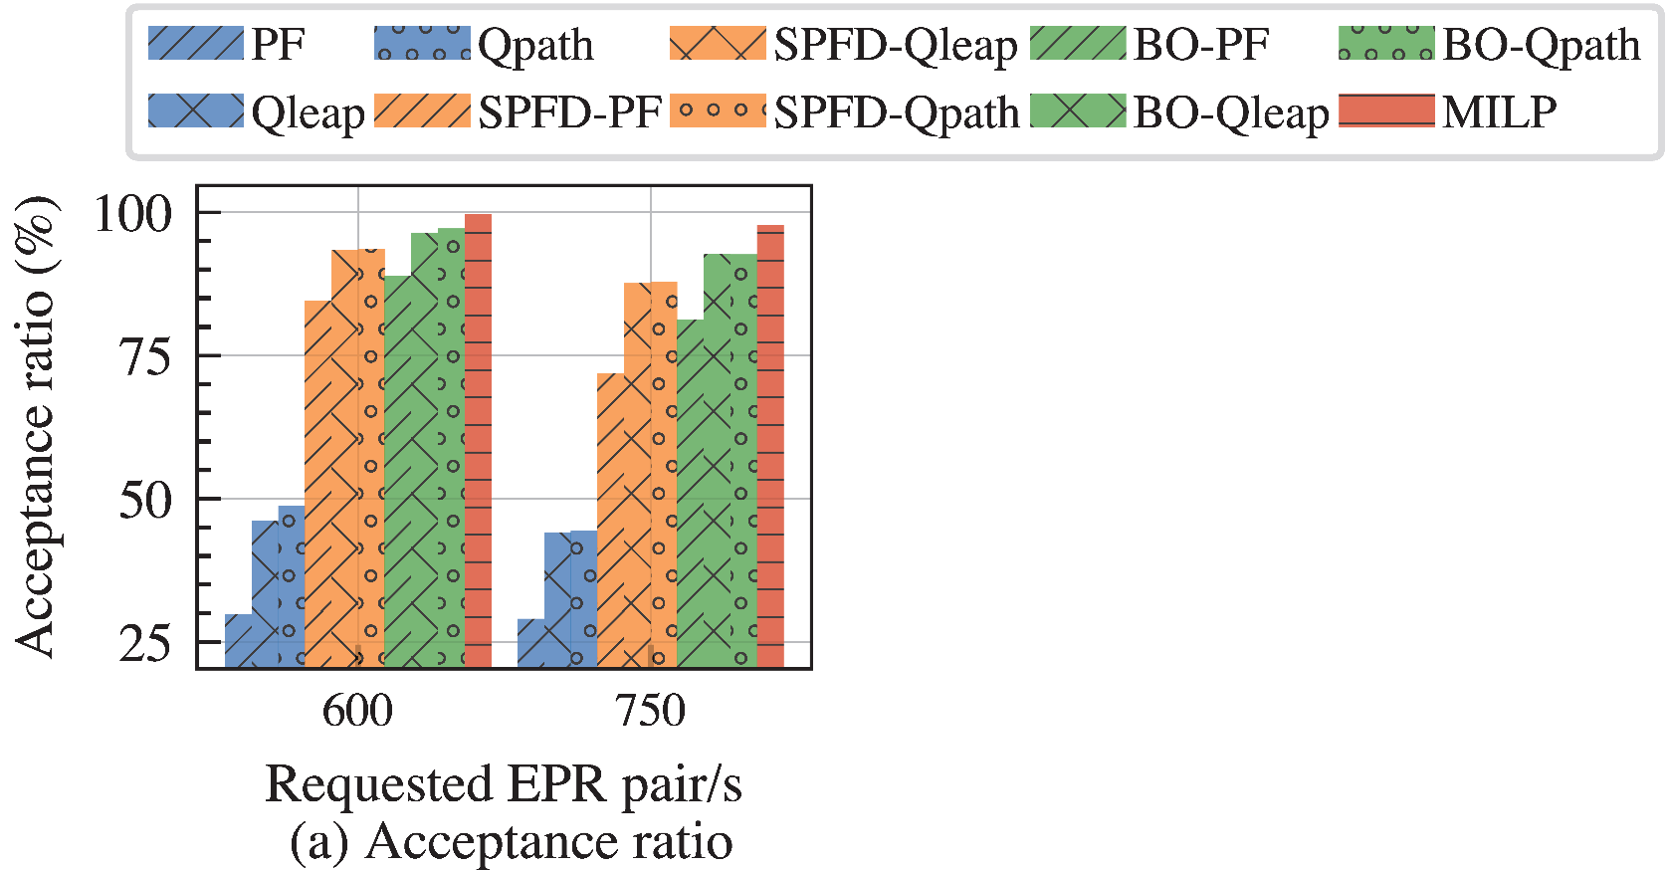
Comparison between ILP and Proposed Heuristics
Improvement of acceptance ratio
  SPFD: up to 55%
  BO: further 9% vs SPFD
Optimality gap < 6%

Slide 27
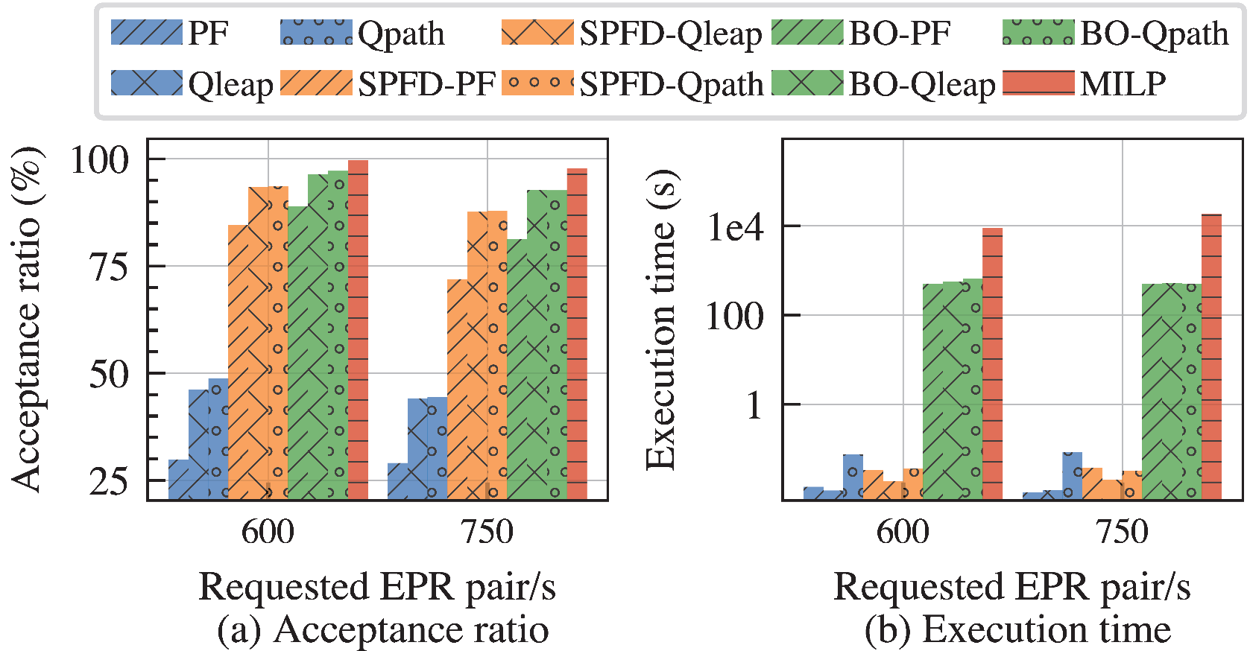
Comparison between ILP and Proposed Heuristics
Improvement of acceptance ratio
  SPFD: up to 55%
  BO: further 9% vs SPFD
Optimality gap < 6%
Execution time:
  SPFD: < 1 second
  BO: < 500 second

Slide 28
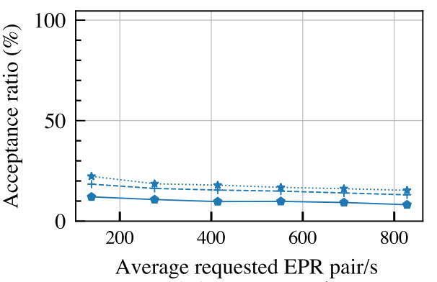
Performance under different requested generation rate

Slide 29
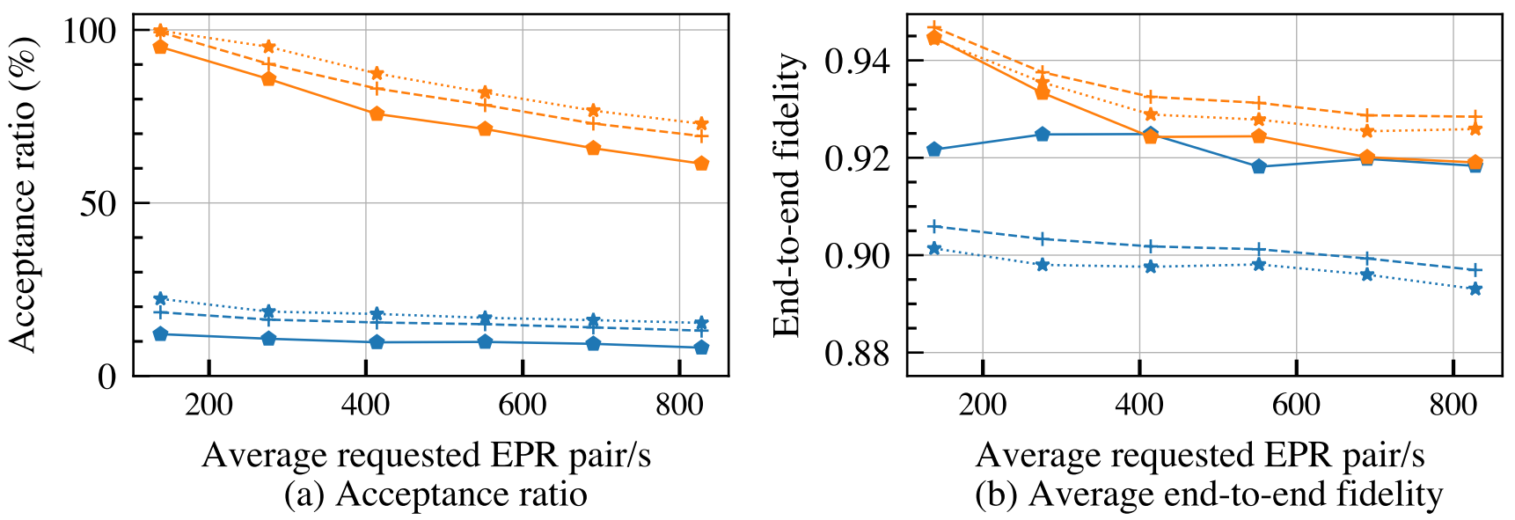
Performance under different requested generation rate
Advantages of link configuration in acceptance ratio
  SPFD: improves by up to 83%

Slide 30
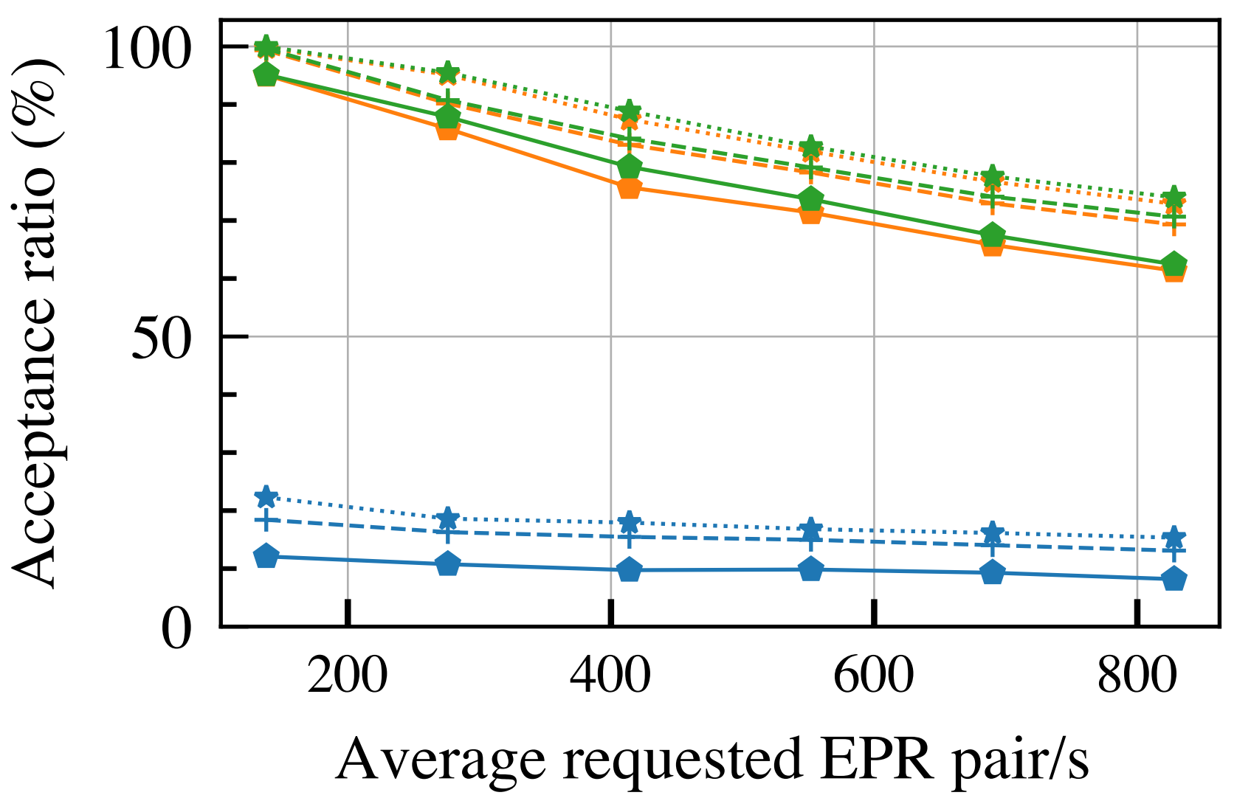
Performance under different requested generation rate
Advantages of link configuration in acceptance ratio
  SPFD: improves by up to 83%
  BO further improves by up to 3.5%
    Up to 6% lower fidelity
    5% additional resource utilization

Slide 31
Outline
Introduction and Motivation
System Model and Problem Statement
  Technical Preliminaries on Quantum Networks
  Problem Statement of Link Configuration for Entanglement Routing
Integer Linear Programming Model and Link Configuration Algorithm
Numerical Results
Conclusion

Slide 32
Conclusion
For the first time, we introduced the concept of link configuration (rate, fidelity) for the entanglement routing (and purification) problem
We formulated entanglement routing with link configuration as an MILP model
We proposed a scalable entanglement routing with link configuration algorithm with a low optimality gap
Numerical results show that:
  SPFD: improvement of acceptance ratio of up to 83% with similar execution time
  BO: improvement of acceptance ratio of up to 87% with 500X execution time

Slide 33
Thank you! qiaolun.zhang@polimi.it
Notes:
How to re-deploy a new implementation
Offline: do it never touch it
Online: update peiodically, we adjust when the network condition changes, update routing and scheduling to adapt to the new network condition
Define the use cases considering use cases

Slide 34
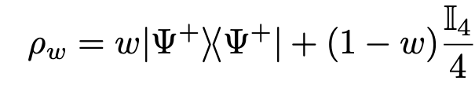
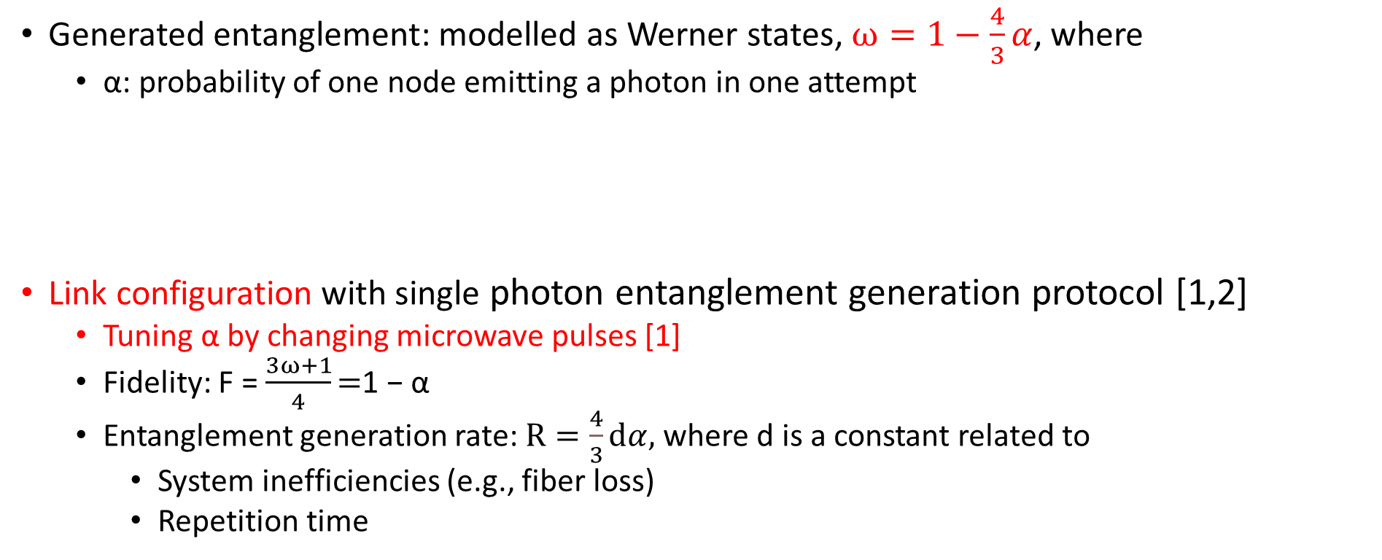
Link Configuration: Modeling Fidelity and Rate
Generated entanglement: modelled as Werner states, $ω=1−\frac{4}{3}α$, where
  α: probability of one node emitting a photon in one attempt
Link configuration with single photon entanglement generation protocol [1,2]
  Tuning α by changing microwave pulses [1]
  Fidelity: F = $\frac{3ω+1}{4}\text{=}\text{1} \text{− }\text{α}$
  Entanglement generation rate: $R=\frac{4}{3}ⅆα,$where d is a constant related to
    System inefficiencies (e.g., fiber loss)
    Repetition time
Bell state
Identity matrix
[1]. P. C. Humphreys, etc, “Deterministic delivery of remote entanglement on a quantum network,” Nature, 2018.
[2]. G. Vardoyan and S. Wehner, “Quantum network utility maximization,” IEEE International Conference on Quantum Computing and Engineering (QCE), 2023.
Notes:
Repetition time (defined as the time between entanglement generation attempts)

Slide 35

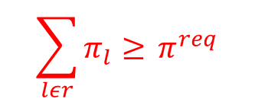
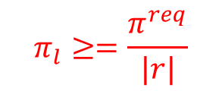
Generalized Procedure of Link Configuration
Requests
SPFD
Initial Fidelity setting
Bayesian Optimizer
Fidelity
setting
Entanglement
routing
Selected
link configuration
Served generation rate
$$π_{l}=$$
Link configuration
Shortest-path based fidelity determination (SPFD) algorithm
  All requests are served along shortest path
  For each link, greedily decide link configuration
Bayesian optimization: further improve link configuration decision
$$\sum_{lεr}{π_{l}≥ }π^{req}$$
$$π_{l}≥=\frac{π^{req}}{|r|}$$

Slide 36
Performance under different requested generation rate
Advantages of link configuration
  SPFD improves acceptance ratio of all ER algorithms by up to 83%
  BO further improves the acceptance ratio of SPFD by up to 3.5%
    Achieved with up 0.005 lower end-to-end fidelity
    Up to 5% additional resource utilization

