Slide 1
vLLM · EPLB
vllm EPLB:
Contention-Aware
Expert Migration
Batching

Slide 2
Roadmap
Two questions: can contention be optimized, and does it help real serving?
01
Upstream impact
02
ILP model
The merged vLLM contribution
Theoretical optimum and trade-off
03
E2E experiment
04
Profiling
Serving quality and NIC traffic
Scheduler cost versus time saved

Slide 3
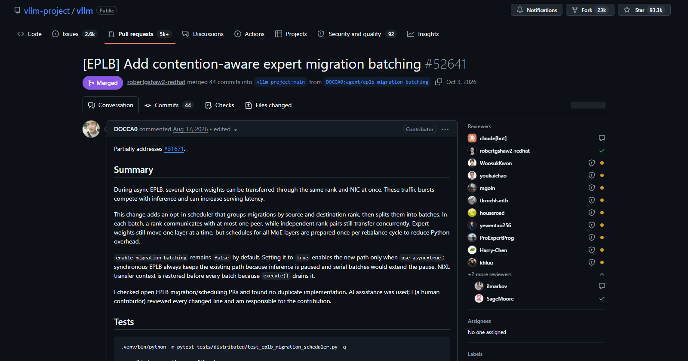
The work is now part of vLLM
MERGED
into vllm-project/vllm:main
github.com/vllm-project/vllm/pull/52641

Slide 4
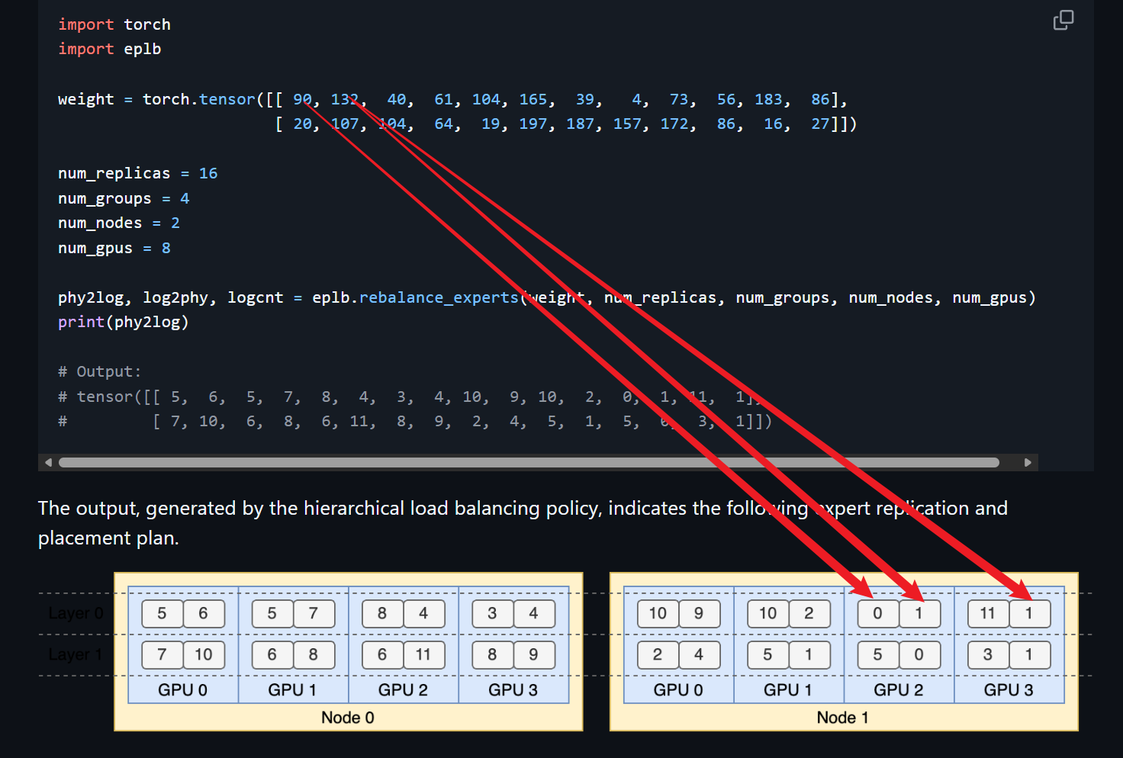
Background-EPLB(Expert Parallelism Load Balancer)
Group | Physical placement | Traffic sum
Group 0 | Node0 GPU0-1 = [5,6,5,7] | 165 + 39 + 165 + 4 = 373
Group 1 | Node0 GPU2-3 = [8,4,3,4] | 73 + 104 + 61 + 104 = 342
Group 2 | Node1 GPU0-1 = [10,9,10,2] | 183 + 56 + 183 + 40 = 462
Group 3 | Node1 GPU2-3 = [0,1,11,1] | 90 + 132 + 86 + 132 = 440

Slide 5
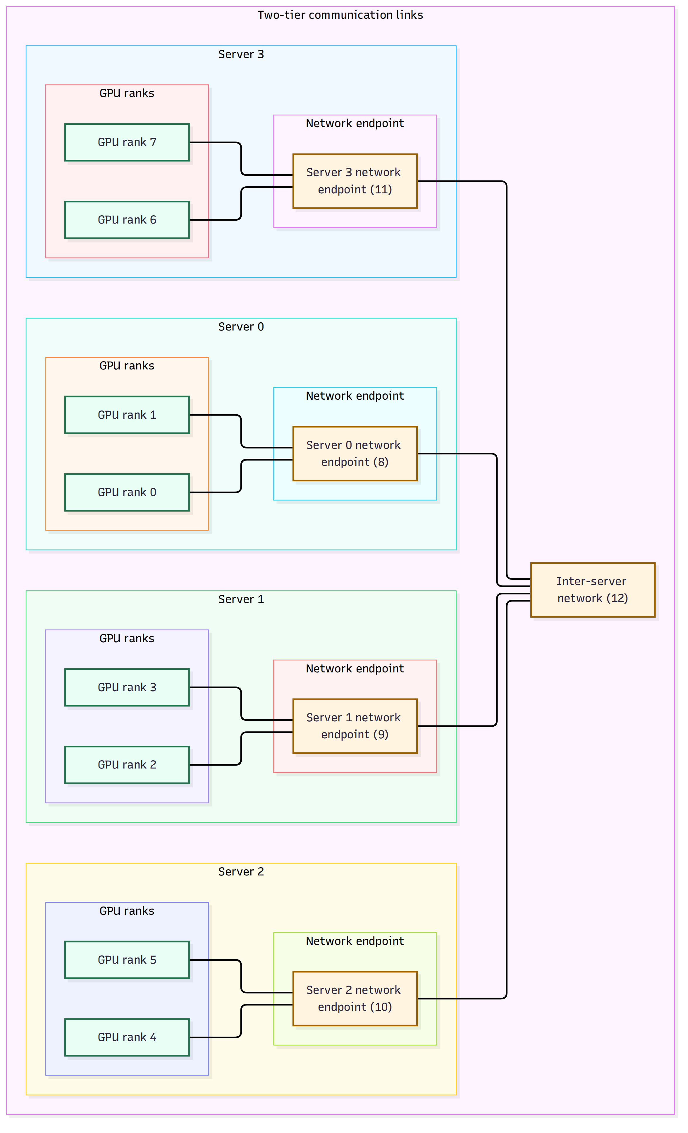
PART I · ILP
ILP-Network Modeling

Slide 6
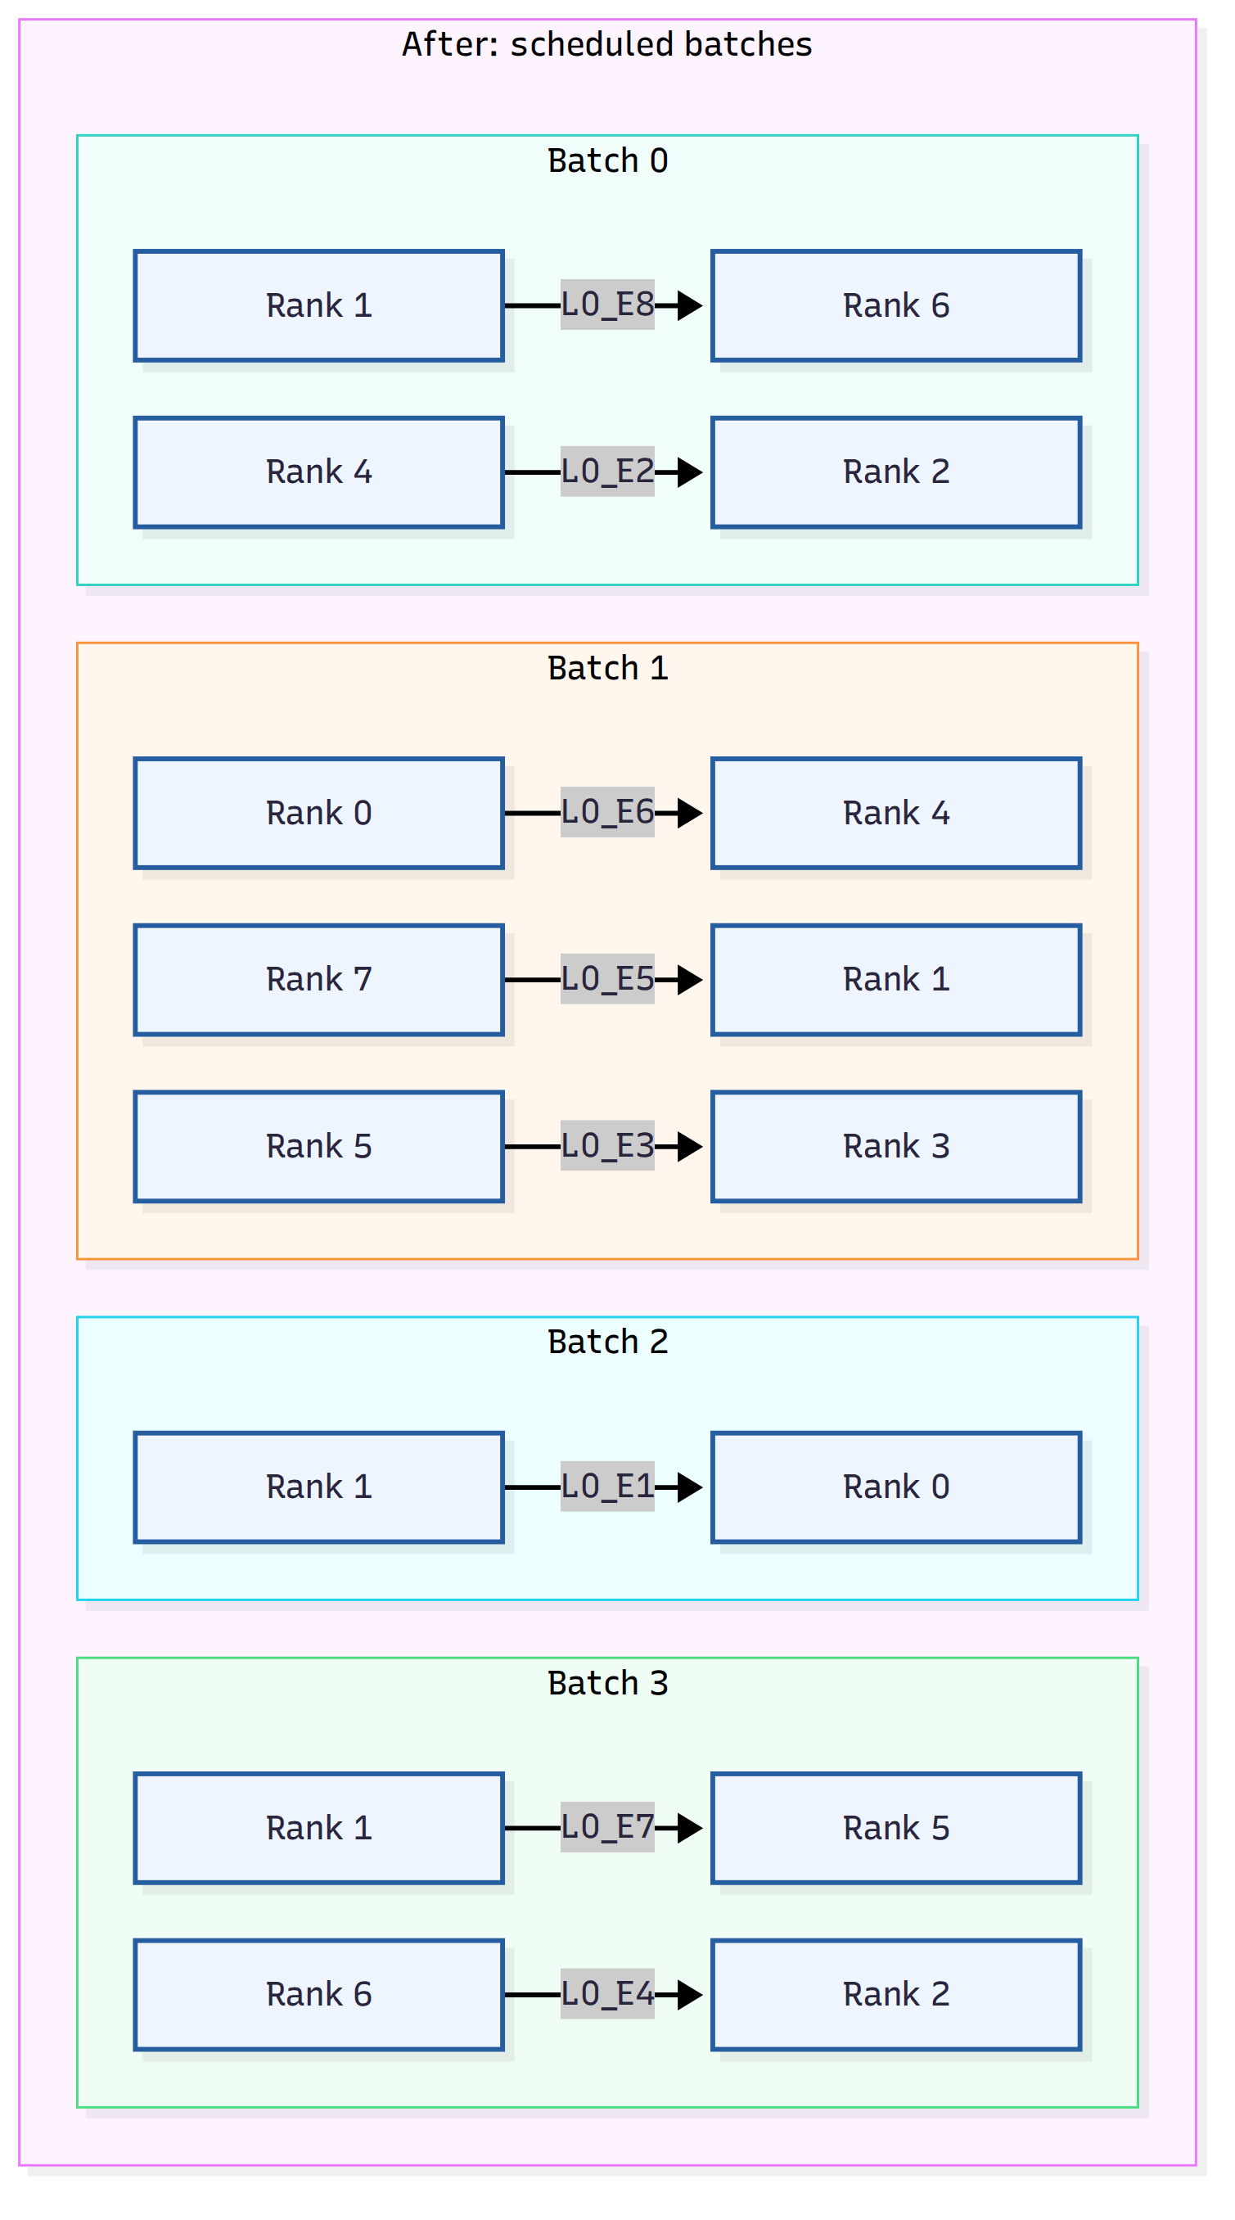
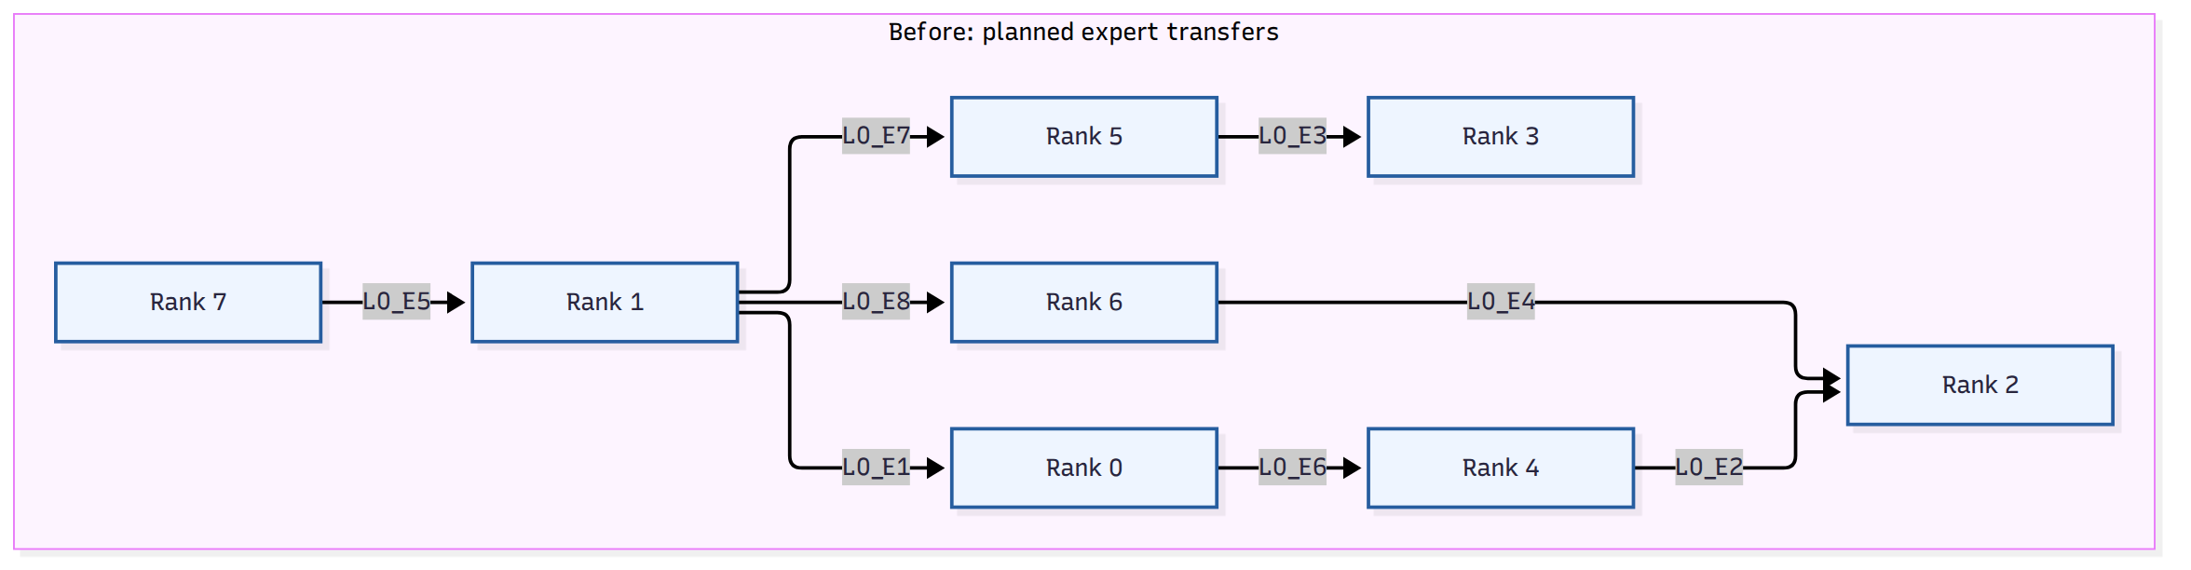
PART I · ILP
ILP-Before and After optimization

Slide 7
PART II
Real-system experiments
E2E serving validates the benefit; Nsight profiling measures the cost.

Slide 8
PART II · E2E
Algorithm
Group expert moves by rank pair, then separate flows that share a rank.
1 Expert moves
2 Coalesce by rank pair
3 Build batches
E1
0 → 1
Flow A
0 → 1
{E1, E7}
Batch 0
A: 0→1
+
B: 2→3
E7
0 → 1
Runs concurrently — endpoints {0,1} and {2,3} do not overlap.
Flow B
2 → 3
{E3}
E3
2 → 3
Flow C
1 → 2
{E4}
Batch 1
C: 1→2
+
D: 0→3
E4
1 → 2
Flow D
0 → 3
{E9}
C conflicts with Batch 0; C and D are disjoint, so they share Batch 1.
E9
0 → 3
One flow = one directed (source, destination) pair.
Rule
A rank can communicate with at most one peer in each batch.

Slide 9
PART II · E2E
Experiments setup
NODE 0
NODE 1
NODE 2
NODE 3
RTX 6000
24 GB
RTX 6000
24 GB
RTX 6000
24 GB
RTX 6000
24 GB
Qwen3-30B-A3B-Instruct-2507
TP = EP = 4
async EPLB

Slide 10
PART II · E2E
Benchmark Command
The off/on runs use the same request stream and a fresh server.
vllm bench serve --backend vllm --model "$MODEL" --port 8000 \
--dataset-name random --random-prefix-len 300 \
--random-input-len 200 --random-output-len 300 \
--num-prompts 500 --max-concurrency 32 --seed 0 --temperature 0 \
--percentile-metrics ttft,tpot,e2el --metric-percentiles 50,99 \
--ignore-eos --disable-tqdm --save-result \
--result-dir "$RESULTS" --result-filename bench.json
500 prompts · concurrency 32 · deterministic decoding · TTFT / TPOT / E2EL P50 and P99

Slide 11
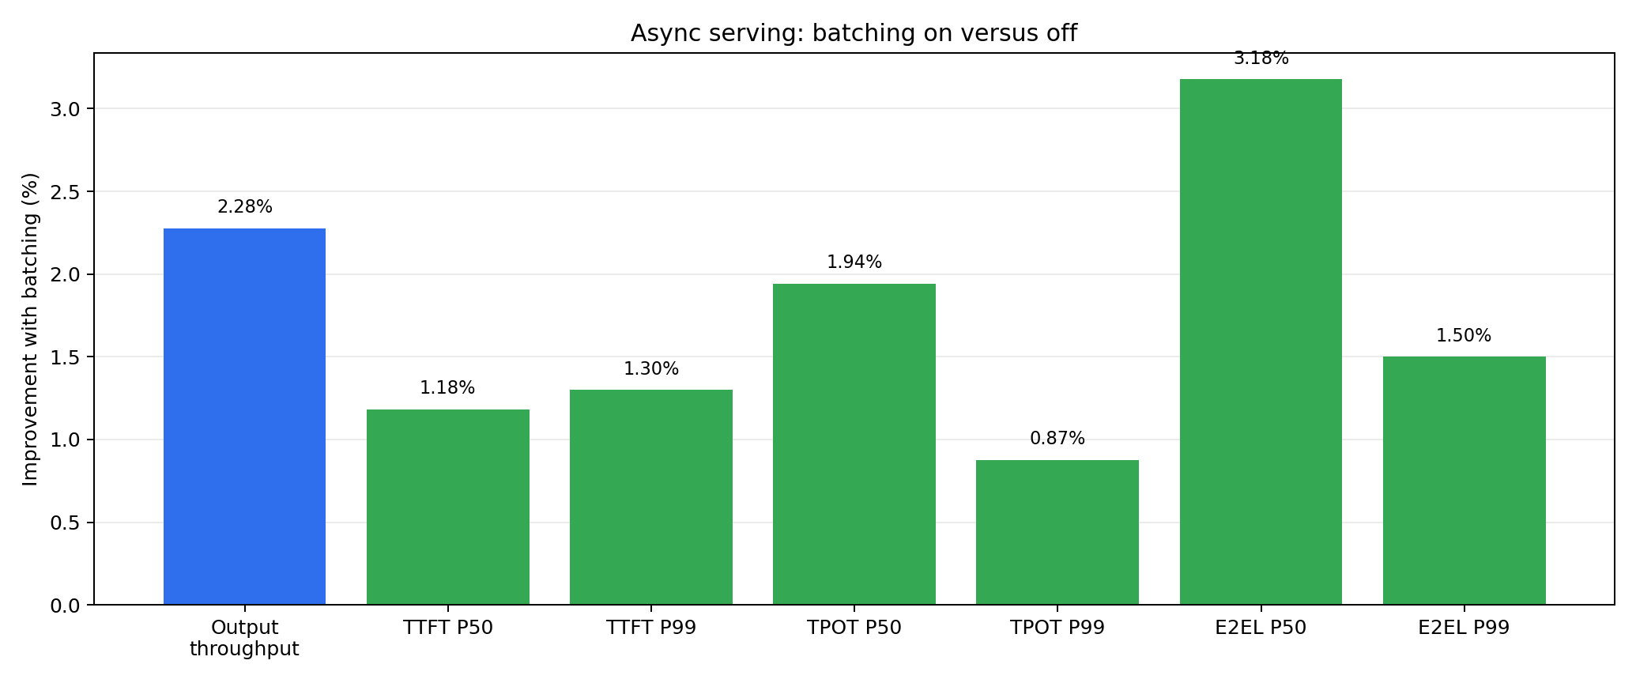
PART II · E2E
Metric Results
Batching | Duration (s) | Request/s | Output tok/s | TTFT P50 / P99 (ms) | TPOT P50 / P99 (ms) | E2EL P50 / P99 (ms)
off | 4,756.10 | 0.1051 | 31.54 | 49,180.71 / 75,740.25 | 828.53 / 1,007.82 | 303,462.69 / 322,184.88
on | 4,650.17 | 0.1075 | 32.26 | 48,599.04 / 74,756.17 | 812.44 / 999.01 | 293,821.76 / 317,351.61

Slide 12
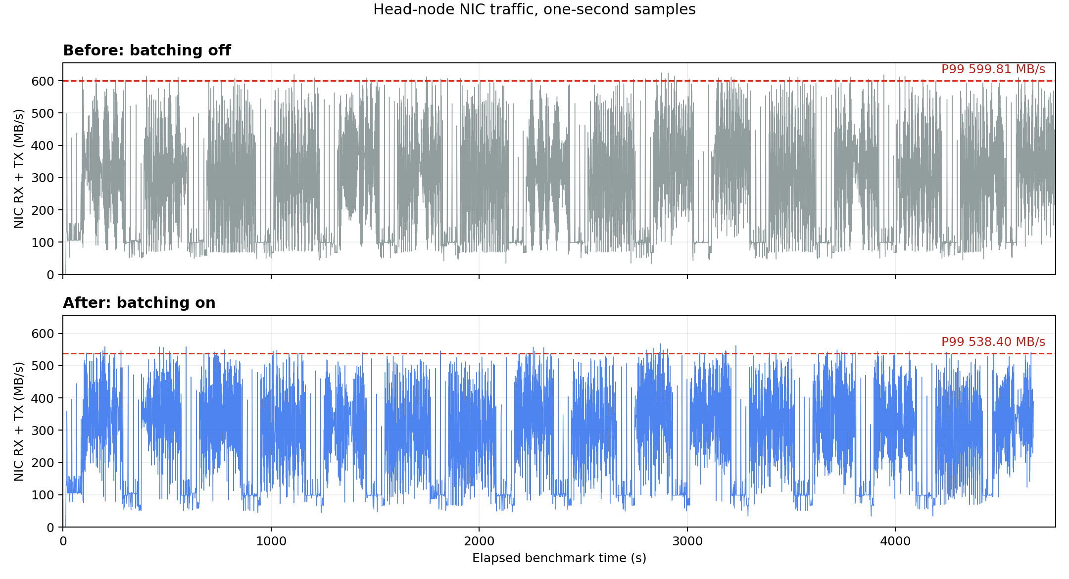
PART II · E2E
NIC Observation
One-second Linux RX+TX samples on the head node
599.81
MB/s P99 · batching off
538.40
MB/s P99 · batching on
−10.24%
head-node NIC P99
Less bursty migration traffic leaves more headroom for inference.

Slide 13
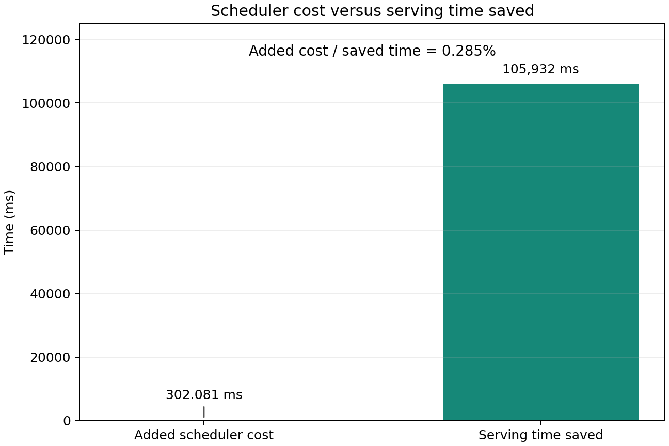
PART II · PROFILING
The optimization pays for itself by a wide margin
Profiling cost is compared with the independent clean E2E A/B run
302.081 ms
worst-rank total scheduler cost
105.932 s
serving time saved
0.285%
cost / saved time

Slide 14
vLLM · EPLB
Thank you
Questions & Discussion
github.com/vllm-project/vllm/pull/52641

