Slide 1


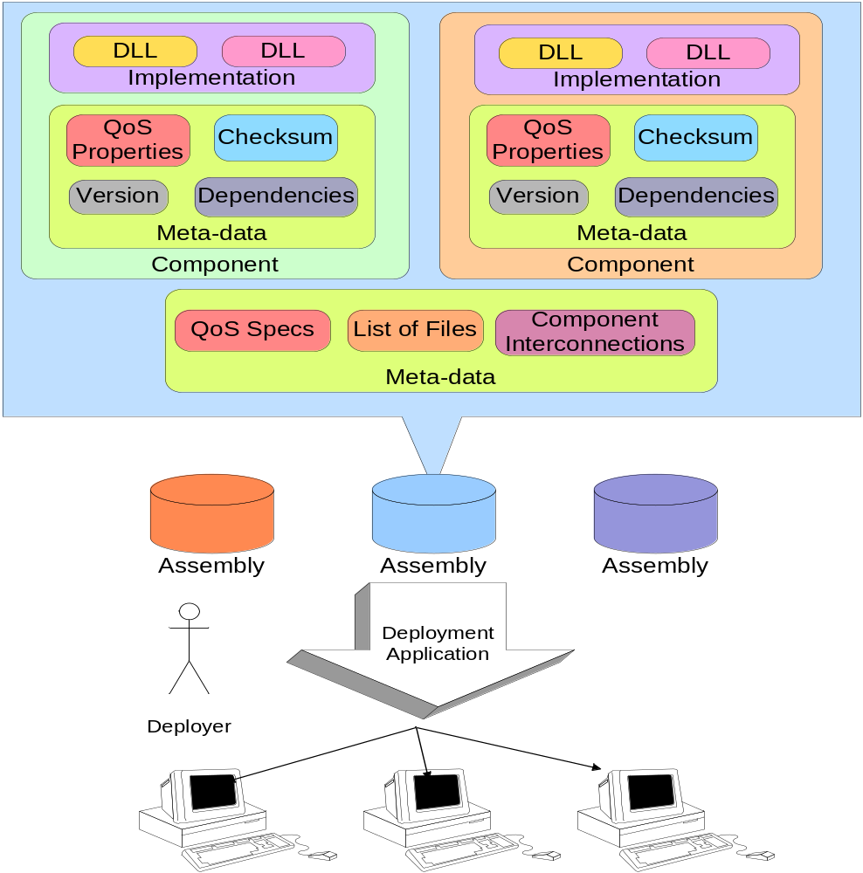
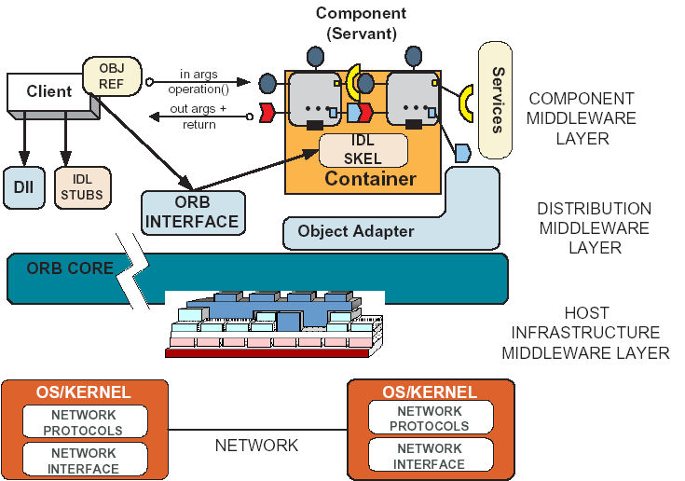
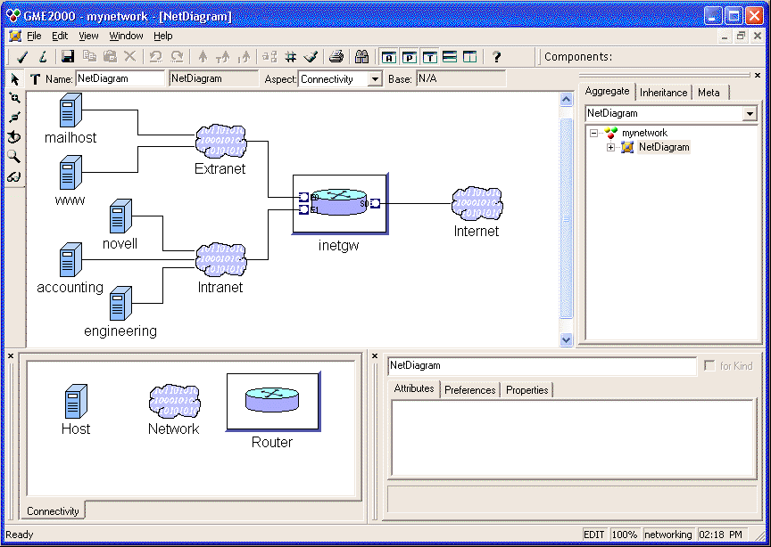
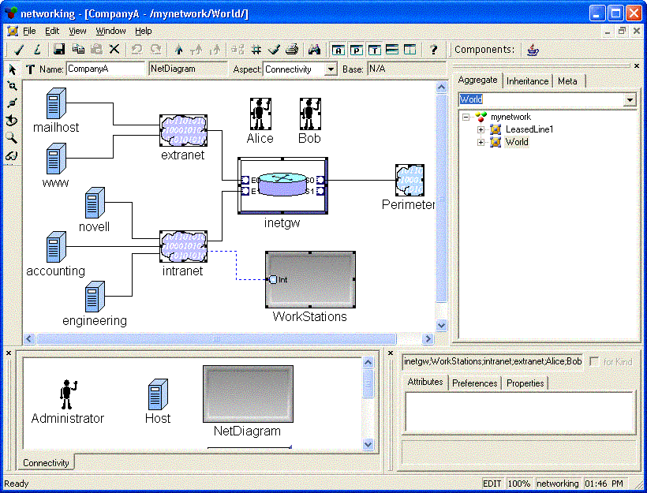

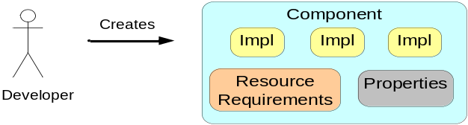
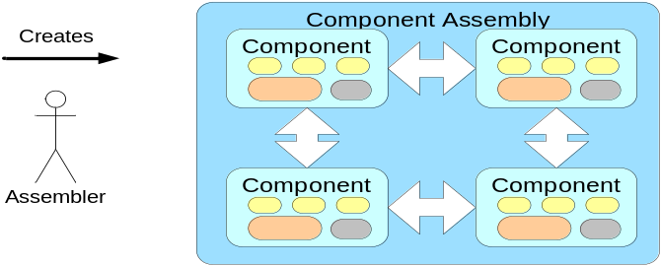
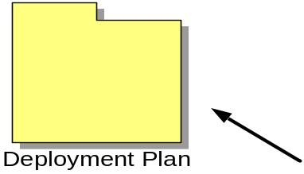
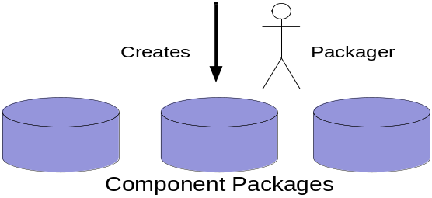


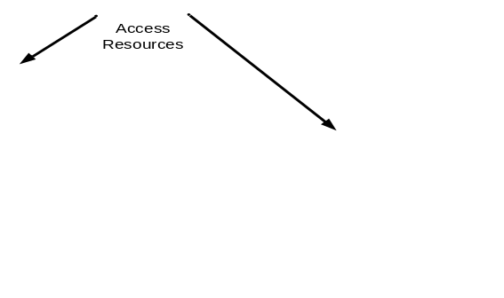
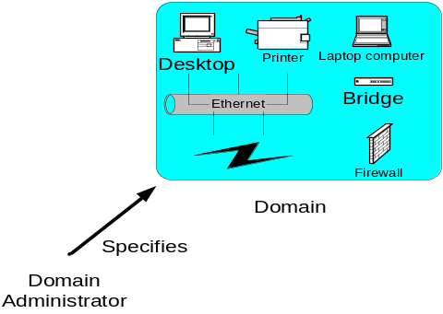

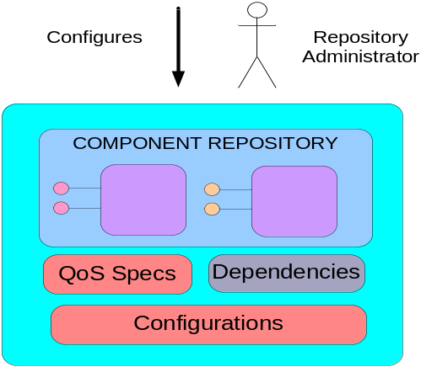
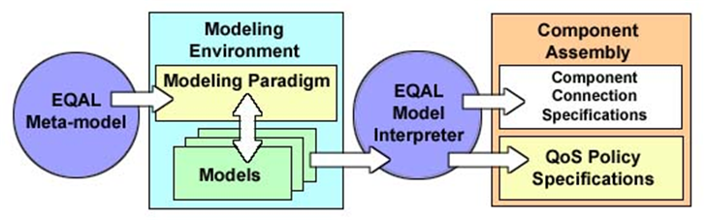
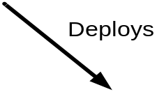
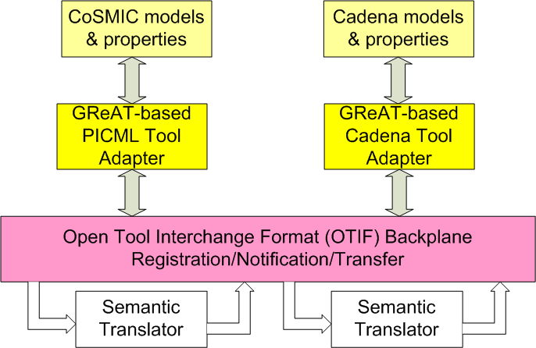
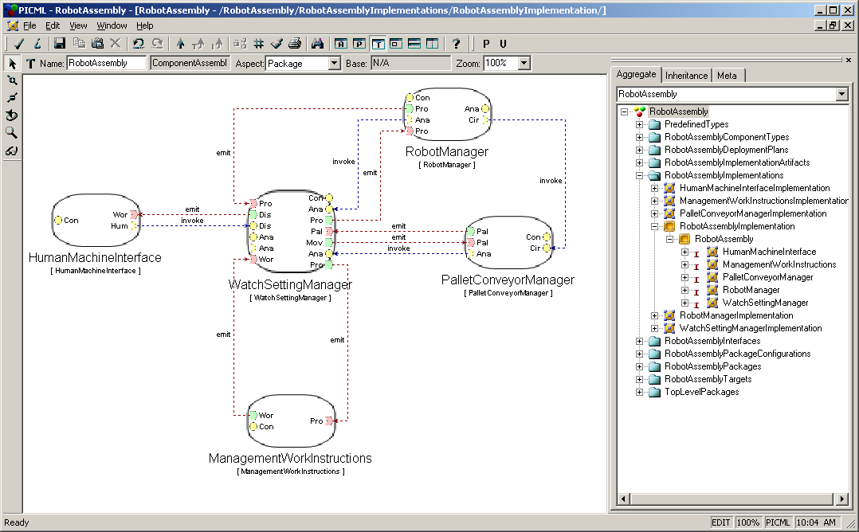
CoSMIC: Tool-suite for Weaving Deployment & Configuration Crosscutting Concerns of CCM-based DRE Systems
Dr. Aniruddha Gokhale (PI)
Institute for Software Integrated Systems, Vanderbilt University, Nashville, TN 37235
(1) Deployment & Configuration (D&C) Overview
(4) Interface Definition Modeling Language (IDML)
(7) Publisher/Subscriber Service Configuration Challenges
Specifies interfaces for deployment of component-based applications
Will replace Packaging & Deployment chapter of CCM specification
Platform Independent Model (PIM)
Defined in two dimensions
  Data models vs. management (run-time) models
  Component software vs. target vs. execution
Meta-information is captured using XML descriptors
Create Model
Graphical modeling language.
Component middleware building blocks.
Integrated with PICML.
Export model to equivalent XML format.
Generate middleware-specific application code.
  IDL generator finished
  Planned generators for EJB and SLICE
Context
  Publisher/subscriber services are highly configurable
  XML-based specification of QoS properties
Problems
  Multiple dissimilar services
  Semantically invalid operating policies
  Error-prone handwritten XML
Solution
  Use models to enforce policy constraints & synthesize configuration files
Modify Model
Export
XML
IDL Generator
Generate
IDL
EJB
SLICE
(5) Importing CCM Applications Into IDML
(2) D&C Activities & Stages
IDL
IDL Importer translates IDL into IDML’s XML format.
Import XML into graphical modeling tool.
  Translate to other middleware platform.
Develop model further
  Regenerate IDL.
  Generate application code for a different middleware platform.
(8) Event QoS Aspect Language (EQAL)
Descriptors are passive entities
Manipulated by Actors
Different Stages
  Development
    Developer
    Assembler
    Packager
  Target
    Domain Administrator
  Deployment
    Repository Administrator
    Planner
    Executor
Actors are abstract
IDL Importer
EQAL is part of CoSMIC tool suite and is part of PICML
  Built in the Generic Modeling Environment (GME)
  Addresses publisher/subscriber service configuration and deployment challenges
    Models specify service configurations and deployments
    Aspects decouple D&C concerns
    Constraints ensure semantic validity
    Interpreters generate descriptor files
XML
Import
Modify Model
IDL
EJB
SLICE
(6) Model Checking & Analysis in CoSMIC
Context
DRE system CoSMIC models must be analyzed for functional correctness & QoS properties
CoSMIC provides limited constraint-checking but no model checking & analysis
Problem
Selecting the right analysis tool
Choosing the right tool data interchange & interoperability communication model
Preserving semantics of data during transforms
Lossless communication of data & its semantics
(3) Resolving D&C Challenges via Platform-Independent Component Modeling Language (PICML)
(9) Towards Platform Independence via MOF-Compliant Modeling
Context
  Configuring & Deploying component-based applications using XML meta-data
Problem
  Meta-data split across multiple XML descriptors
  Inter-dependencies between descriptors
  XML is error-prone to read/write manually
  No guarantees about semantic validity (only syntactic validation possible)
  If meta-data is wrong, what about my application?
Generate
MOF Abstract Mapping (IDL)
Use MOF to IDL mapping to generate IDL interfaces.
  Inheriting from the MOF abstract IDL interfaces.
  Used to implement a repository for models.
Through repository, models are accessible to other MOF-compliant tools.
  For generation
  For further development
  For reuse in other projects
  For analysis &simulation
inherits
MOF2IDL
Repository IDL
implement
MOF Modeling Environment
Model Repository
Solution
KSU’s Cadena model checker for analysis & model refinement
Leverage DARPA MoBIES technology, e.g., Unified Data Model (UDM), Open Tool Interchange Format (OTIF), & Graph Transformation Tool (GReAT)
Two way export & import of models and properties between CoSMIC & Cadena
Lossless data communication via exporting only common information and/or decorating models with extra information. Merging of variations on import.
MOF-Compliant Tool
MOF-Compliant Tool
Solution
  Platform Independent Component Modeling Language (PICML)
    Modeling paradigm developed using Generic Modeling Environment (GME)
  Capture dependencies visually
  Define semantic constraints using Object Constraint Language (OCL)
  Generate domain specific meta-data from models
  Correct-by-construction
Team: Bala Natarajan, Krishnakumar Balasubramanian, Tao Lu, Arvind Krishna, Jaiganesh Balasubramanian, Jeff Parsons, Gan Deng, Emre Turkay, Boris Kolpackov, Gabriele Trombetti, George Edwards.
Acknowledgments: Dr. Douglas C. Schmidt
Collaborators: LMCO (Eagan, Dallas), KSU and UAB
CoSMIC is available as open-source from http://www.dre.vanderbilt.edu/cosmic

